Slide 1
COS 316 Precept:
Unix file system & Git’s content addressable storage

Slide 2
Outline
Unix File System
Git’s content addressable storage

Slide 3
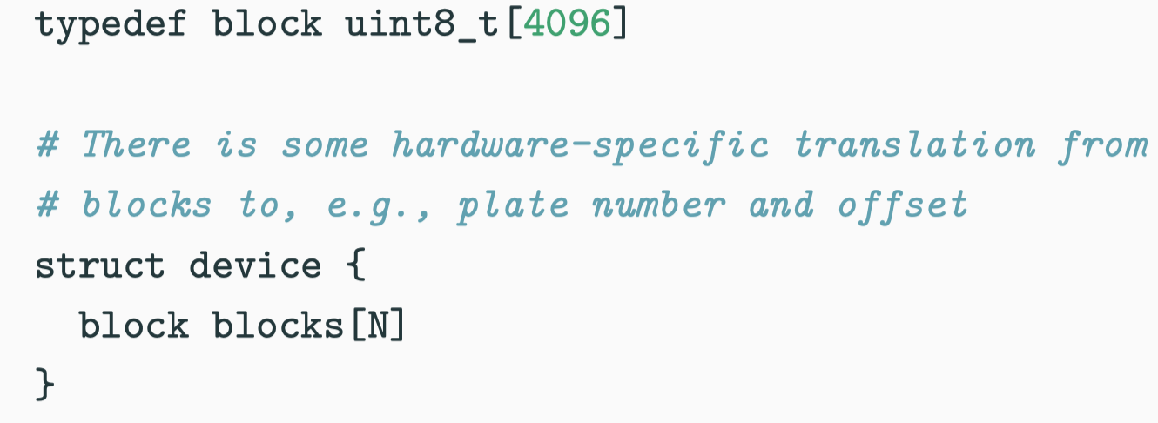
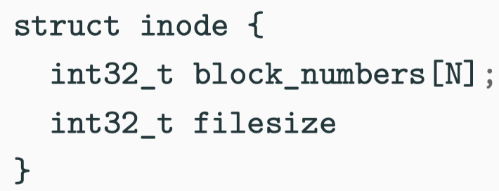
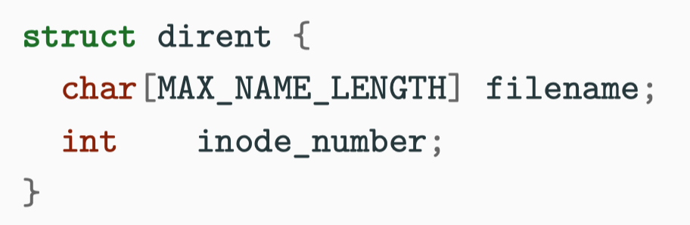
Recap of UNIX File System Layers
Block layer
  Names: integer block numbers
  Values: fix-sized “blocks” of contiguous persistent memory
  Purpose: Organize persistent storage into fix-sized blocks
File layer
  Names: Inode struct
  Values: Arrays of bytes up to size N
  Purpose: Organizes blocks into arbitrary-length files
Inode number layer
  Names: Inode numbers
  Values: Inode struct
  Purpose: Name files as uniquely numbered inodes
Directory layer
  Names: Human readable names with “directory”
  Values: Inode numbers
  Purpose: Human-readable names for files in a directory
Absolute path name
  Purpose: a global root directory
  Usually assigned with a hardcoded inode number
Notes:
Recap from lecture:
Block layer: we can reach the physical block by the block number. All the contents are stored as byte arrays in blocks.
File layer: we can get the list of allocated physical blocks number from the inode struct
Inode number layer: we can get the inode struct by the provided inode number
Directory layer: we can get the corresponding inode number given the directory name

Slide 4
Example:
Root directory
/
home
usr
tmp
Task 1: Check if “a.txt” is in “/home/x/” (lookup)
Suppose we’ve already known that the inode number of “x” is #1000. (Directory layer)
Investigate the inode struct whose inode number is #1000
  #1000 → Inode struct I#1000
  Inode number layer
Get list of physical block numbers in I#1000
  File layer
Read the byte array stored in those blocks based on the given block numbers
  …| a.txt #1101 | b.txt #1102 |...
  Block layer
x
y
a.txt
b.txt
Notes:
Task 1: lookup task. Find if there is a file called “a.txt” in “/home/x/”. The directory tree is on the upper right corner.
Given an inode number, we can get an ordered byte array (stored in the physical blocks) as follows:
Assumption: We already know the inode number of “/home/x”
First: Inode number layer – Get inode struct for the given inode number
Second: File layer – Get the list of physical block numbers in this inode struct
Finally: Block layer – Read the blocks by the provided block numbers.
For each file/subdir in this directory, the filename and inode number is one entry of the block(s).

Slide 5
Example:
Root directory
/
home
usr
tmp
Task 2: Read /home/x/a.txt (read)
Assume inode number of “/” is #1. (Absolute path name)
Start from “/”, get the byte array from the blocks following the previous procedure shown in task 1
  #1 -> …| home #2 | usr #4 | tmp #6 |...
The sub-dir “home” is in “/”. Its inode number is 2. Repeat the previous procedure
  #2 -> …| x #20 | y #24 |...
The sub-dir “x” is in “/home/. It is #20. Repeat..
  #20 -> …| a.txt #35 | b.txt #2484 |...
Finally, we find “a.txt”
  #35 -> …| b”welcome to” | b”the precept” |...
x
y
a.txt
b.txt

Slide 6
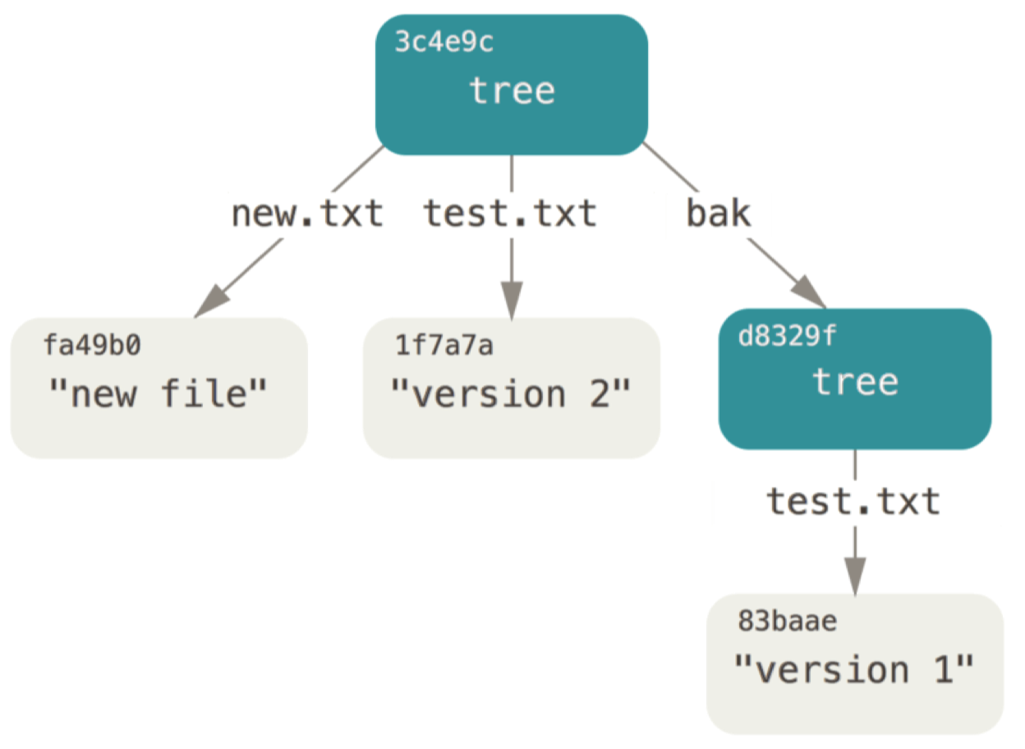
Recap of Git
Object
  Name: SHA-1 hash value of the given contents
  Values: Blobs (Binary large objects), Trees, Commits
  Purpose: All data is stored as objects
  Similar to Blocks
Tree
  Name: Human-readable strings, like UNIX dirs
  Values: Object name, type, permission
  Similar to Directories
Commit
  Name: SHA-1 hash of the value
  Values: Object name of the tree, object name of parent commits, committer info, message…
  Purpose: A way to express a version history of source code tree. Each commit is like a “snapshot”.
Reference
  Name: human readable names
  Values: a commit name
  Purpose: Provide global, human readable names for objects
Notes:
Recap from lecture:
Blobs, trees and commits are all objects. Objects is named with its hash value of the given contents.
Trees organizes blobs into a directory-like hierarchy
Commit versions the tree layer like a “snapshot”. It also record the parent commit.
References; not shown in this figure.

Slide 7
Example
Task: Create a file “hello.txt” with some contents. Then update to the remote repo.
“git add hello.txt”
  Git creates an object (blob) where name is the hash of the contents and value is the contents. (Object layer)
“git commit -m ‘add a new file’”
  Git constructs a new tree object to represent the structure of the repo. (Tree layer)
  Git creates a commit object which includes reference to the tree, metadata of tree( message and committer info) and reference of the previous commit.
“git push”
(Optional) You can also give reference to a commit by
“git tag <ref_name> <commit_hash>”

