Slide 1
COS 316 Precept:
Lecture Review
+
Socket Programming

Slide 2
Outline
Memory Addressing
Socket programming

Slide 3
Terminology
A page
  Traditionally 4KB
  Unit of memory that’s managed by the operating system
Notes:
A page is the normal unit of memory that’s managed by an operating system
They’re traditionally 4 kilobytes in size
While DRAM is able to have much smaller units read from and written to it, for practical reasons, the operating system will manage things in units of 4KB
For the sake of simplicity, let’s think of a page as a single unit of memory

Slide 4
Memory Addressing
Geometric
“I want the page stored in row 14, column 5”
Physical
“I want page 5”
Virtual
“I want (virtual) page 5”
Notes:
So, there are a few ways to address memory
In Tuesday’s lecture, Wyatt covered geometric, physical, and virtual addressing
For geometric addressing, reading from a page may look like the following: “I want the page stored in row 14, column 5”
For physical addressing, reading from a page is simpler: “I want page 5”
And finally, virtual addressing looks like the following to applications: “I want page 5”
Importantly, each of the addressing methods builds an abstraction on top of the previous one
That is, physical builds an abstraction on top of geometric, and virtual builds an abstraction on top of physical
Note that while physical and virtual addressing LOOK identical, there’s a large and important difference that will be explained later

Slide 5
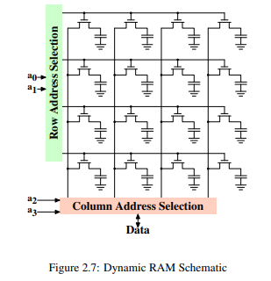
Why do we need abstractions?
They make things simpler!
  Applications are simpler to write
They allow for more capabilities (more on this later)
Notes:
So why do we need these abstractions?
The first reason is that they simplify things!
The second reason is that they allow for more capabilities, which we’ll discuss later
For now, let’s focus on the first reason
Let’s look at geometric addressing. An application that wants to access a memory location would need to know the geometry of the memory itself.
For instance, an access may look something like the following:
“There are 128 rows and 256 columns on this DIMM, which means that the page I want to access is on row 5 and column 50”
This is complex and also tied to the geometry of a particular DIMM
If I switch out one DIMM for another, the number of rows and columns may change

Slide 6
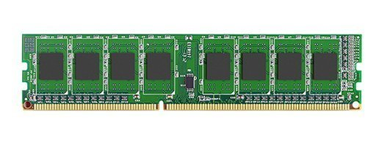
Physical Addressing
Application A
Write to page 0
Notes:
So we introduce physical addressing
Instead of specifying some memory location based on the DIMM’s geometry, applications can use a linear address to refer to a memory location
Hardware attached to the memory will then translate that linear address into a geometric address
That’s much simpler and doesn’t require the application to know anything about the DIMM’s geometry
This is great so far!

Slide 7
Physical Addressing
Application A
Application B
Write to page 0
Read from page 0
Notes:
But what if you want to run TWO applications?
We generally don’t want applications to be able to access each other’s data
You don’t want some sketchy game that you pirated to have access to the memory that your banking app is using

Slide 8
Application A
Application B
Write to page 0
Read from page 0
Notes:
So physical memory addressing can be a problem
If application A wants to write to page 0, and application B wants to read from page 0, then they’ll be referring to the SAME location!
This can result in all kinds of weirdness
In addition, it can make writing applications more difficult
Things become much more complex when an application not only has to keep track of its own memory usage, but also the memory usage of the other applications on the system!
If applications are going to share a single resource, aka multiplex, there needs to be some way for that sharing to be made easy

Slide 9
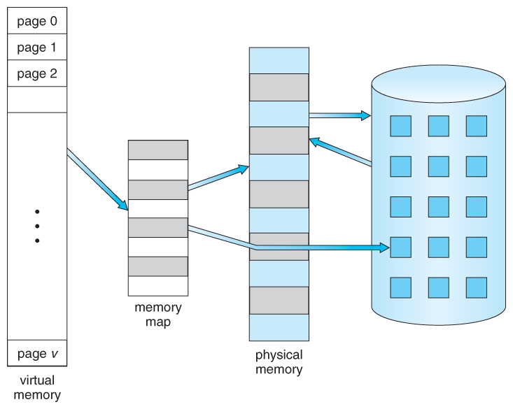
Virtual Addressing
Notes:
So we introduce virtual addressing
Virtual addressing allows multiple applications to use physical memory without interfering with each other
This scheme accomplishes this by adding an additional level of abstraction
Now, instead of each application having direct access to physical memory, the operating system keeps a mapping of virtual pages to physical pages for each application!
Importantly, it will not map virtual pages for two applications to the same physical page!
When an application attempts to access a memory location, the system will step in and perform the translation from virtual page to physical page on the fly
The application never knows a thing!
This provides several benefits:
Since the system sits between the application and the memory it’s accessing, it can do things like make sure application A doesn’t access application B’s memory
In addition, it can provide a simpler and easier to work with view of a machine’s memory to an application
A system that provides virtual addressing essentially lies to each application and tells it that it has a large section of contiguous memory all to itself
It then works to maintain this lie by keeping a mapping of virtual pages to physical pages and performing the translation between them on the fly whenever an application accesses memory
So even if there are a ton of running applications using physical memory, your application won’t have to worry about it

Slide 10
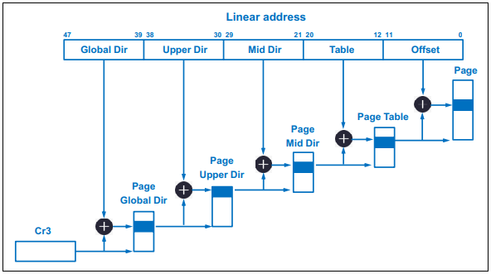
Virtual Addressing
Notes:
The data structure used to hold these virtual to physical address translations is aptly called a page table
When an application is running, its page table is loaded into memory and used by the operating system to perform virtual to physical page translations
This leads us to a bit of a problem
While page tables provide a convenient way to write simpler and safer applications, they affect performance
Memory accesses take time, they are not instantaneous
Formerly, when an application wanted to access memory, it would have to wait for a single memory access to complete
But now, the operating system needs to perform the virtual to physical page translation whenever an application wants to access memory.
For a small page table, this doubles the time spent waiting for the access to complete
For a large page table, the operating system may need to perform multiple accesses to get the full translation
This can drastically raise the cost of an application’s memory accesses
There are things that can be done to mitigate this, like using a TLB
But in general, a price is paid for virtual memory’s benefits

Slide 11
Virtual Memory
What is used to record the translation from virtual address to physical address?
  Page table.
How many processes share one page table?
  Only one!
Would the use of virtual memory hurt the r/w performance?
  Yes!
Any way to mitigate performance degradation?
  TLB!
  TLB: small, fast, hardware implemented cache.
  TLB misses goes to page table

Slide 12
What type of memory naming to use?
On your laptop
  Virtual naming
For a tiny power constrained microcontroller
  Physical naming
For a supercomputer that runs one massive simulation at a time
  Physical naming
On your phone
  Virtual naming
Notes:
Let’s take a look at these questions from lecture and try to answer it, given what we know about physical and virtual addressing
For a laptop, what kind of of addressing should we use? Virtual or physical?
Virtual: Many applications need to run concurrently and share the physical memory on the machine
Tiny power constrained microcontroller
Physical: Only a single application may need to run at once. Also, translating virtual addresses to physical addresses requires computation and energy, something a tiny microcontroller may not have enough of to spare
A super computer that runs one massive simulation
Physical is more performant since it doesn’t need to waste CPU cycles on translating, and it’s running one application so there’s no multiplexing of the physical memory
Phone:
Virtual: Same as laptop

Slide 13


Abstractions
How can two different computers exchange data?
  Complex process, involves many different components, links, etc.
  Computers may have different hardware, operating systems, …
Abstractions avoid us having to worry about this
  A way of reducing implementation complexity into simpler concepts
  Focus on their abstraction paradigm
Many examples for abstractions in modern systems
  Files, Terminals (TTYs), …
Today: sockets!
Notes:
First, let’s talk about abstractions
Computers are composed of components with varying degrees of complexity.
Abstractions provide a more friendly way to interact with that complexity
For a computer-centric example, when you want to perform some calculations, say adding numbers together, you don’t have to think about which transistors need to be turned on and off; you just pop open your calculator and press some keys
Similarly, when developers (in this case you) write applications that need to communicate over the network, they don’t want to think about how communication protocols work or how their application will share a single physical interface with other processes that are running on the machine. They want some abstraction that makes all of that easier so that they can focus on their application logic.
Today, we’ll talk about the most commonly used networking abstraction, sockets!

Slide 14
What are sockets? And connections?
Connection
  Many different definitions!
  In this context: an established method to communicate between
  a process on one host (A) and a process on another host (B)
  A communication channel
  An abstraction; in this case spanning multiple (physical) systems
Socket
  An endpoint of a given connection
    Connections are established between two sockets
  Just another abstraction! The system-local abstraction of a connection
Notes:
In this context, a connection refers to a communication between two processes.
Those two processes can be on the same machine or on different machines that are connected via a network.
A socket is the local abstraction that’s used to interact with that connection.
So imagine a communication channel with a host/process on each end. Each host’s view of the channel is that of a socket.

Slide 15
Client – Server Communication
A paradigm describing how a connection is initiated between two sockets
Client
Actively initiates the connection
Typically “sometimes on” (e.g., web browser on your phone / laptop)
Needs to dial the server
→ thus requires its address!
Server
Passively listens for and accepts connections
Typically “always on” (e.g., web server for google.com in some data center)
Must be reachable under some address
Recall: a connection is established between two processes on some hosts
Thus, an address is composed of a host identifier (IP address) and a process identifier (port number)
Notes:
Next, let’s discuss a common communication paradigm.
Oftentimes, the relationship between two hosts is asymmetrical.
The way that we normally interact with other machines follows the client-server paradigm
In this paradigm, there is a server that’s constantly listening for new attempts to connect.
Conversely, there are clients that try to connect for temporary sessions.

Slide 16

Stream Sockets (TCP): Connection-oriented
Server
socket()
Create a socket
Listening socket
Bound to just the local host & port address
Bind the socket
(assign to a given host and port identifier)
bind()
Client
Create a socket
socket()
listen()
Listen for client
(Wait for incoming connections)
Connect to server
connect()
establish connection
accept()
Accept connection
data (request)
Send data
write()
read()
Receive Data
Connected socket
Bound to both local and remote host & port address
write()
Send data
data (reply)
Receive data
read()
Notes:
There are two types sockets/connections that are generally used
The first is a TCP or connection-oriented socket
TCP stands for transmission control protocol, and it’s used for when a client and server want their connection to persist
This means that once established, the connection between the client and server will continue to exist until one of them terminates it
And they can continually exchange data over this connection
Implementations of the TCP protocol on the client and server work with each other to ensure that data arrives intact and in order
Weird things can happen over a network, and sometimes things get rearranged or lost entirely
The TCP protocol acts to mitigate these occurrences
These types of connections are used when its important for all of the data to arrive intact and in order
For example, streaming a movie or downloading a file

Slide 17
Datagram Sockets (UDP): Connectionless
Server
Client
socket()
Create a socket
Create a socket
socket()
bind()
Bind the socket
Bind the socket
bind()
data (request)
Send data
sendto()
recvfrom()
Receive data
data (reply)
sendto()
Send data
Receive data
recvfrom()
Notes:
The next type of socket is a UDP socket, or a connectionless socket
UDP stands for User Datagram Protocol
Unlike a TCP connection, this connection does not persist
The client and server’s implementations of these protocols don’t keep track of order or arrival
When sending the data, the sender essentially thinks: “I hope it gets to its destination, but I’m not going to worry about it”
These types of connections are used when its not important that data arrives intact or in order
For example: Video conferencing. “I really hope that last image of the user’s face arrived. But if it doesn’t, I’m not going to worry about it. I have new images to send!”

Slide 18
Assignment 1
Write a pair of programs implementing the server – client connection-oriented socket paradigm
  Using “stream sockets” (TCP)
Two files you’ll modify: client.go and server.go
Having a client send data to a server
  And let the server print this data
This precept does not address all requirements of the assignment!
Purpose is to give you an idea of how to get started.
Notes:
For assignment 1, you’ll implement a client and server in go
They will communicate with each other using sockets
In this precept, we’ll walk you through a few useful functions that will help you start the assignment when it’s released

Slide 19
Client – Milestone 1: Connect to a Server
We’ll need to retrieve the server address from the command line
… and connect to it
go’s net.Dial function looks promising!
  Read its documentation to figure out the expected server address format
Read the server address from the command line arguments
  You can find those in os.Args in go!
  The first argument (os.Args[0]) is always the executable name
Client
Create a socket
socket()
go’s net.Dial()
Connect to server
connect()
returns a Conn object
Notes:
We know that the client will need to connect to the server
We can use the Dial function in the net package for that
Looking at the examples in the function’s docs, we can see that the address and port are passed as a single string, being separated by a colon
A server will listen on an address and a port, and a client will try to contact a server on an address and a port
We should take in the address and port of the server from the command line
To accept input, we can use the Args variable in the os package
Like C, Args is an array whose first element is the name of the executable
All other elements are arguments that were passed to the executable when it was launched
From the documentation, you can see that net.Dial returns a Conn object and an Error object
The conn object is what the client will use to communicate with the server
The value of the error object should be checked and handled if necessary

Slide 20
Client – Milestone 2: Write Data & Close Connection
The client will need to read a message from standard input
  Place the message in a buffer
  Write the contents of that buffer to the socket
Use conn.Write to write some bytes to an established connection
Use conn.Close to close a connection
  This informs the opposite end socket that the connection is no longer established
  Both sides can close a connection!
conn
(established socket)
data
Send data
Write()
close
Close connection
Close()
Notes:
Now that we have a socket that we can use to communicate with the server, we should take in input from the command line that we will then send to the server
There are any number of methods. If you’re unsure of how to do that, some googling should suffice.
Once you have input saved in a buffer, you can call the Write method of the conn object to send it to the server
Once the client sends the message to the server, it should exit. Before doing this, the client should invoke conn’s Close method to close the connection

Slide 21
Server – Milestone 1: Create a Listening Socket
To accept connections, our server must create a listening socket
  The net.Listen function does that!
  Returns a Listener, which owns a socket
net.Listen takes a listen address
  Host- and process-address of server (IP & port)
  A server can have multiple host addresses!
  Listening on “localhost” or “127.0.0.1” only allows local connections.
Use fmt.Sprintf to combine the host-address and port number
Server
socket()
Create a socket
go’s net.Listen()
Bind the socket
(assign to a given host and port identifier)
bind()
listen()
Listen for client
(Wait for incoming connections)
Returns a net.Listener
Notes:
Next, we’ll go over some things that will be useful for implementing a server
Remember that the relationship between a client and server is asymmetrical, a client proactively establishes connections while a server listens for incoming connection requests
For the server, we need to create a listening socket that waits for incoming connection requests
Let’s take a look at the documentation to see what we need to pass to net.Listen
Similar to net.Dial, listen takes a network, in our case tcp, and an address string, which is a concatenation of an ip address and port number
It then returns a listener object, which the server can use

Slide 22
Server – Milestone 2: Accept a Connection & Read Data
A Listener can accept an incoming client connection with the Accept method
  returns a net.Conn, same as on Client!
net.Conn can receive data through the Read() method
  Takes a buffer as argument
Accept a client connection
net.Listener
Client establishing connection
Accept()
blocks until a client connects!
Accept a connection
go’s net.Conn
(owns a connected socket underneath)
message
Read()
Receive Data
Notes:
Now that we’ve created a listening socket, we can invoke its accept method. This method blocks until a new connection attempt is received
When it returns and execution of the program is allowed to proceed, it returns both a connection object and an error object
We can check the value of this error object to see if anything went wrong
And we can use the returned connection object to communicate with the client that requested the connection
Note that there are now two sockets on the server side
There’s the listening socket that is always on the lookout for incoming connection requests
And there’s the socket for the established connection, which is used to send and receive data to a client that has already connected
We can then use the conn object’s read method to take in data that has been sent by the client
From the documentation, we can see that the read method takes in a buffer and returns the number of bytes that were read from the connection and saved to that buffer, in addition to an error object
We should then create a buffer to pass into the read function

Slide 23

Server – Milestone 3: Handling a Client Close()
Both sides can close a connection
  What if that happens during a Conn.Read()?
Conn.Read() returns an EOF error!
  “End of file”
Check for this error.
If it occurs, close the connection.
  err may be set to nil – check for this first!
  err provides the Error() method, which returns error codes as strings
go’s net.Conn
(owns a connected socket underneath)
close
Read()
Receive Data
EOF
Notes:
Both the client and server are able to close a connection
What should the server do if the client closes a connection?
Remember that the read method returns an error object
We can check the value of this error object to determine if the client has closed the connection from the other side

Slide 24
Tips and Common gotcha
fmt.Sprintf could be handy
Don’t print the entire buffer
Convert bytes to string when printing
Client needs to close() at end of connection
EOF is not a character, it’s a type of error
Notes:
fmt.Sprintf can help you concatenate strings!
Don’t print the entire buffer. You will make buffers with a fixed size and if a message doesn’t fill the buffer completely, then printing it out in its entirety may result in weird things happening
The buffers that you’ll make are basically byte arrays. Convert them to strings before printing!

