Slide 1
Learning Relaxed Belady
for CDN Caching
COS 316: Principles of Computer System Design
Lecture 16
Wyatt Lloyd & Rob Fish

Slide 2
Edge Cache with Different Algos
Infinite Cache
Clairvoyant (Bélády) shows we can do much better!

Slide 3

Research From Princeton!
Learning Relaxed Belady for
Content Distribution Network Caching.
Zhenyu Song, Daniel S. Berger,
Kai Li, and Wyatt Lloyd.
In 17th USENIX Symposium on Networked Systems Design and Implementation (NSDI 20), February 2020.

Slide 4



CDN Caching Goal: Minimize WAN Traffic
Requests
Requests
User
Edge cache
Miss
Hit
Wide Area Network (WAN)
traffic is expensive
Key metric hit ratio

Slide 5
Caching Remains Challenging
Heuristic-based algorithms (1965–): LRU, LFU, GDSF, ARC, ...
Work well for some workloads, but work poorly for other
ML-based adaptation of heuristics (2017–): UCB, LeCAR, ...
Also work well for some workloads, but poorly for others
The Belady algorithm (1966)
Offline optimal: requires future knowledge
Large gap in miss ratio between state-of-the-art and Belady:
20–40% on production traces

Slide 6
Introducing Learning Relaxed Belady (LRB)
New approach: mimic Belady using machine learning
Machine-Learning-for-Systems (ML-for-Systems)
  Enabling technologies
  When does it make sense?

Slide 7
General Overview of our Approach
Past information
Now
···
R
R
R
······
R
R
R
R
Training data
Cache
ML architecture
Eviction candidates

Slide 8
Challenge 1: Past Information
Past information
Now
What past information to use?
···
R
R
R
······
R
R
R
R
More data improves training but increases memory overhead
Training data
Cache
ML architecture
Eviction candidates

Slide 9
Challenge 2: Generate Online Training Data
Past information
Now
What past information to use?
···
R
R
R
······
R
R
R
R
Generate online training data?
Training data
Cache
ML architecture
Eviction candidates

Slide 10
Challenge 3: ML Architecture
Past information
Now
What past information to use?
···
R
R
R
······
R
R
R
R
Generate online training data?
Training data
Cache
What ML architecture to select?
Large design space:
features, model, prediction target, loss function
ML architecture
Eviction candidates

Slide 11
Challenge 4: Eviction Candidates
Past information
Now
What past information to use?
···
R
R
R
······
R
R
R
R
Generate online training data?
Training data
Cache
What ML architecture to select?
How to select evict candidates?
ML architecture
Eviction candidates

Slide 12
Challenge 5: Quickly Evaluate Design Decisions
Past information
Now
What past information to use?
···
R
R
R
······
R
R
R
R
Generate online training data?
Training data
Cache
What ML architecture to select?
How to select evict candidates?
ML architecture
Eviction candidates
End-to-end evaluation: days

Slide 13
Solutions: Relaxed Belady Algorithm & Good Decision Ratio
What past information to use?
Generate online training data?
Relaxed Belady algorithm
What ML architecture to select?
How to select evict candidates?
End-to-end evaluation: days
Good decision ratio

Slide 14
Solutions: Relaxed Belady Algorithm & Good Decision Ratio
What past information to use?
Generate online training data?
Relaxed Belady algorithm
What ML architecture to select?
How to select evict candidates?
End-to-end evaluation: days
Good decision ratio: mins

Slide 15
Solutions: Relaxed Belady Algorithm & Good Decision Ratio
What past information to use?
Generate online training data?
Relaxed Belady algorithm
What ML architecture to select?
How to select evict candidates?
End-to-end evaluation: days
Good decision ratio: mins

Slide 16
Solution: Relaxed Belady Algorithm
What past information to use?
Generate online training data?
Relaxed Belady algorithm
What ML architecture to select?
How to select evict candidates?

Slide 17
Challenge: Hard to Mimic Belady Algorithm
Belady: evict object with next access farthest in the future
Evict
Cache
(now)
A
B
······
D
B
A
C
C
D
······
······
Time to next request
Mimicking exact Belady is impractical
Need predictions for all objects → prohibitive computational cost
Need exact prediction of next access → further prediction are harder

Slide 18
Introducing the Relaxed Belady Algorithm
Belady boundary
Evict
Cache
(now)
A
B
······
D
B
A
C
C
D
······
······
Time to next request
Observation: many objects are good candidates for eviction
Relaxed Belady evicts a random object beyond boundary
Do not need predictions for all objects → reasonable computation
No need to differentiate beyond boundary → simplifies the prediction

Slide 19
Good Decision Ratio: Directly Measures Eviction Decisions
Belady boundary
Bad eviction decision
evicted obj’s next access < boundary
Good eviction decision
evicted obj’s next access > boundary
Time to next request
Insight: relaxed Belady enables evaluating eviction decisions
Good decision ratio:
# good eviction decisions
# total eviction decisions

Slide 20
Challenge 5: Quickly Evaluate Design Decisions
What past information to use?
Past information
Now
···
R
R
R
······
R
R
R
R
Generate online training data?
What ML architecture to select?
Training data
Cache
How to select evict candidates?
End-to-end evaluation: days
ML architecture
Eviction candidates

Slide 21
Evaluate Design Decisions w/o Simulation
Training data
ML architecture
Eviction candidates
Simulate once,
reuse for many designs
Log
Evaluate designs on log using good decision ratio in minutes

Slide 22
Challenge 1: Past Information
Past information
Now
What past information to use?
···
R
R
R
······
R
R
R
R
More data improves training but increases memory overhead
Training data
Cache
ML architecture
Eviction candidates

Slide 23
Track Objects within a Sliding Memory Window
Sliding memory window mimics Belady boundary
Now
···
R
R
R
······
R
R
R
R
Only track objects within memory window
Window size is LRB’s main hyperparameter
Per object features

Slide 24
Challenge 2: Training Data
Past information
Now
What past information to use?
···
R
R
R
······
R
R
R
R
Generate online training data?
Training data
Cache
ML architecture
Eviction candidates

Slide 25
Sample Training Data & Label on Access or Boundary
Sliding memory window
Now
···
R
R
R
······
R
R
R
R
Per object features
Access
Past memory window
Sample
Unlabeled training data
Labeled training data

Slide 26
Challenge 3: ML Architecture
Past information
Now
What past information to use?
···
R
R
R
······
R
R
R
R
Generate online training data?
Training data
Cache
What ML architecture to select?
Large potential design space
ML architecture
Eviction candidates

Slide 27
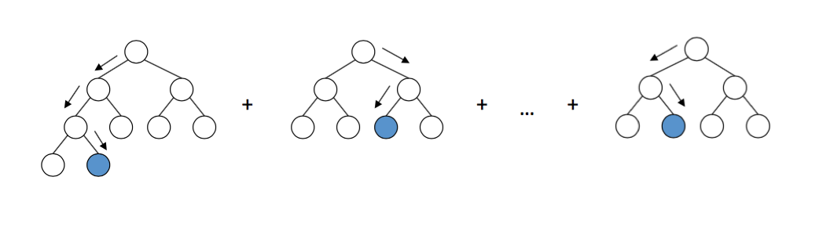
Solution 3: Feature & Model Selection
Use good decision ratio to evaluate new designs
Features
Object size
Object type
Inter-request distances (recency)
Exponential decay counters (long-term frequencies)
Gradient boosting decision trees
Lightweight & high good decision ratio
Training ~300 ms, prediction ~30 us

Slide 28
Challenge 4: Eviction Candidates
Past information
Now
What past information to use?
···
R
R
R
······
R
R
R
R
Generate online training data?
Training data
Cache
What ML architecture to select?
How to select evict candidates?
ML architecture
Eviction candidates

Slide 29
Solution 4: Random Sampling for Eviction
Past information
Now
···
R
R
R
······
R
R
R
R
Cache
Can mimic relaxed Belady if we can
find 1 object beyond the boundary
k=64 candidates; more does not improve
good decision ratio
Random k candidates

Slide 30
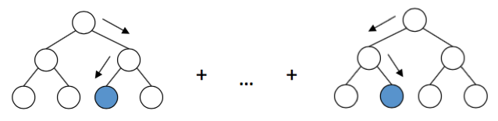
Learning Relaxed Belady
Memory window
Now
···
R
R
R
R
R
···
R
R
R
R
Sample
Label
Cache
Unlabeled dataset
Evict
Train
Sample
Labeled dataset
Eviction Candidates
Model
Predict
···

Slide 31
Implementation
Simulator implementation
  LRB + 14 other algorithms
Prototype implementation
  C++ on top of production system (Apache Traffic Server)
  Many optimizations

Slide 32
Evaluation Setup
Q1: Learning Relaxed Belady (LRB) traffic reduction vs state-of-the-art
Q2: overhead of LRB vs CDN production system
Traces: 6 production traces from 3 CDNs
Hyperparameter (memory window/model/...) tuned on 20% of trace

Slide 33
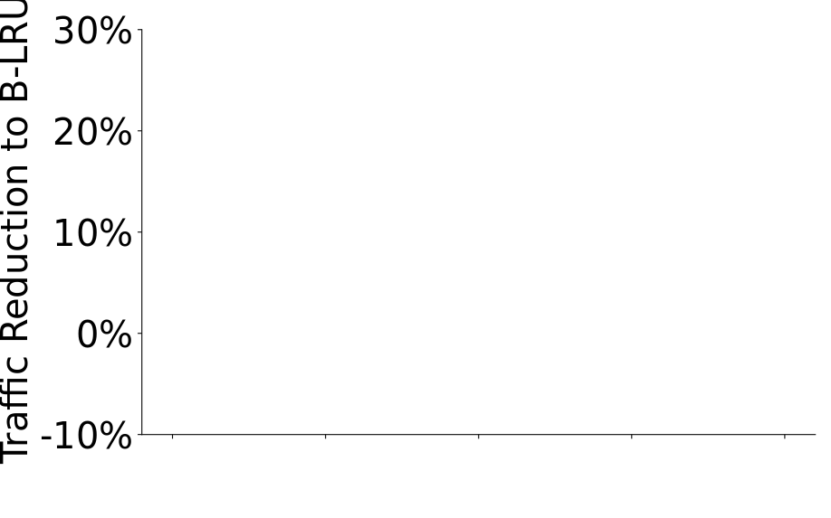
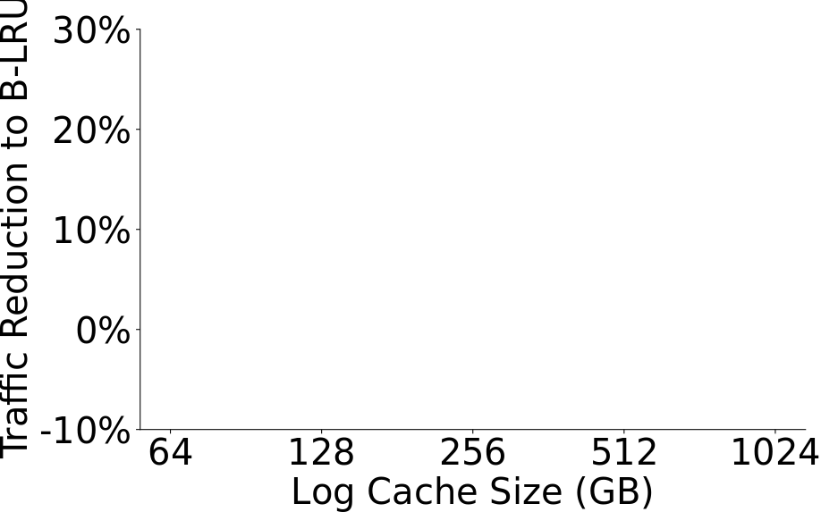
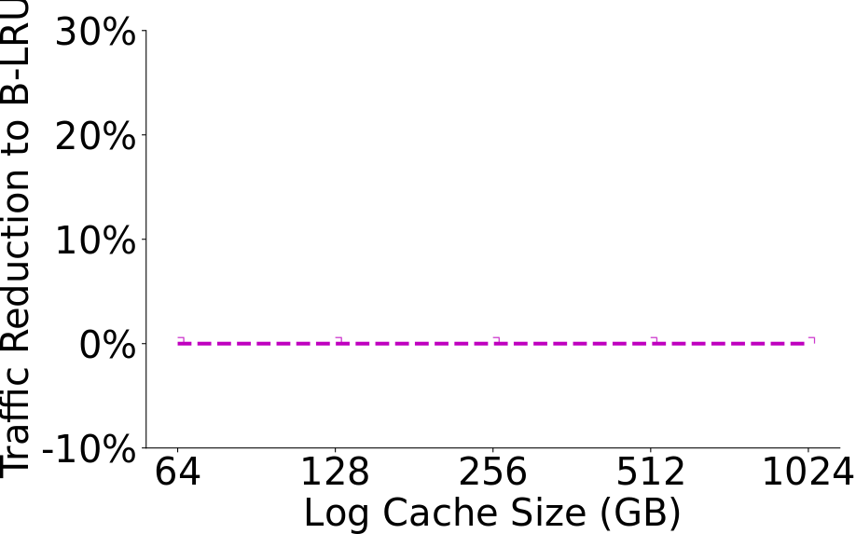
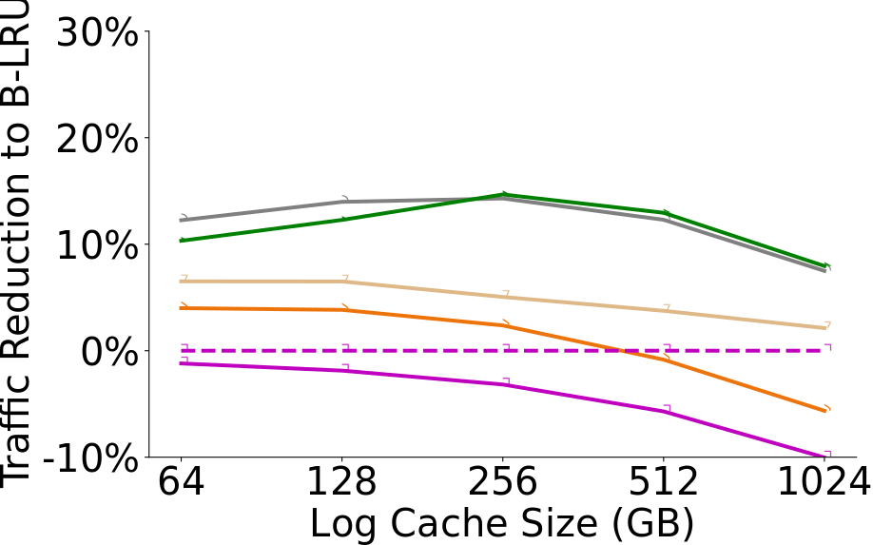
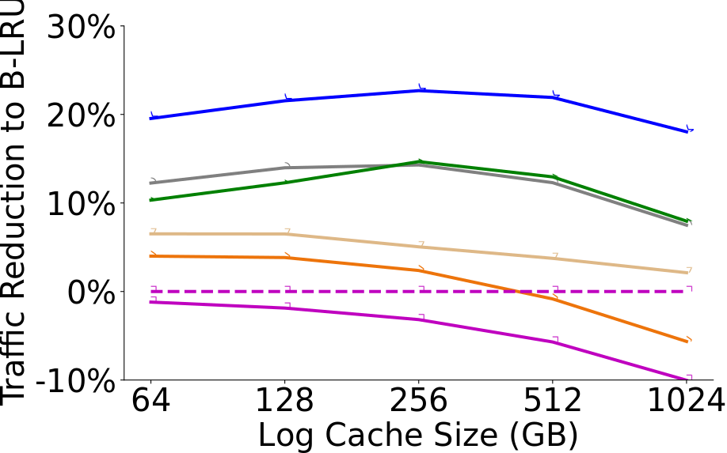
LRB Reduces WAN Traffic
Industry standard
20% traffic reduction over B-LRU
10% reduction over the best SOA
Wikipedia trace

Slide 34
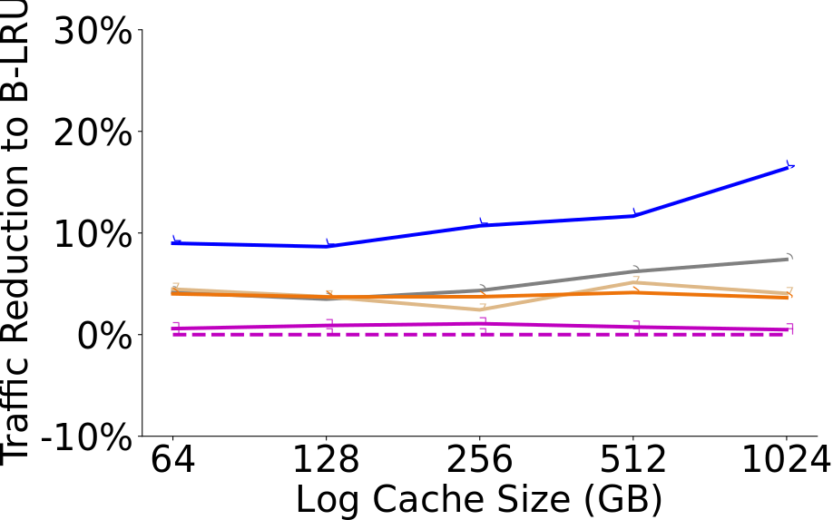
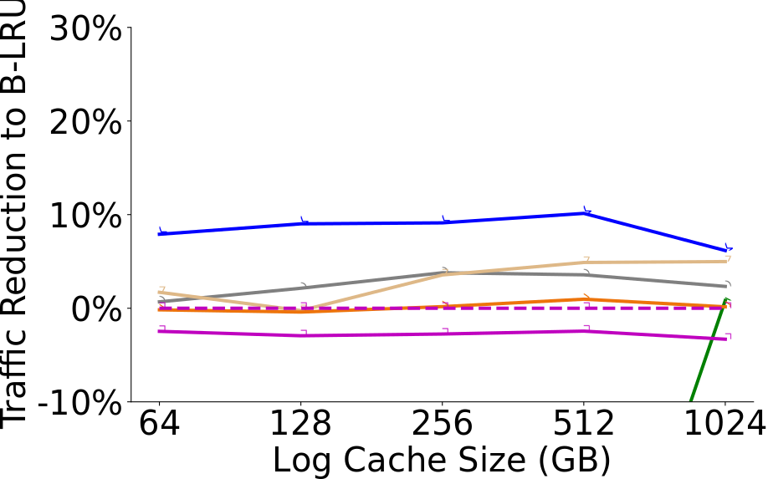
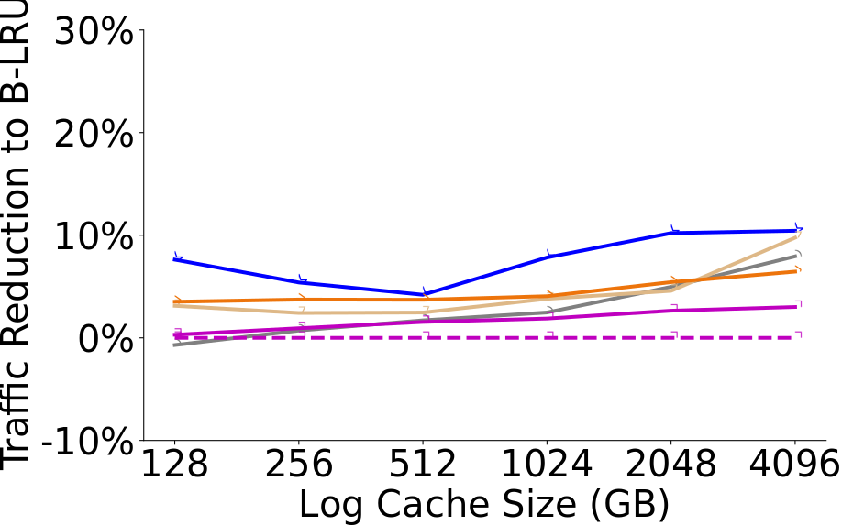
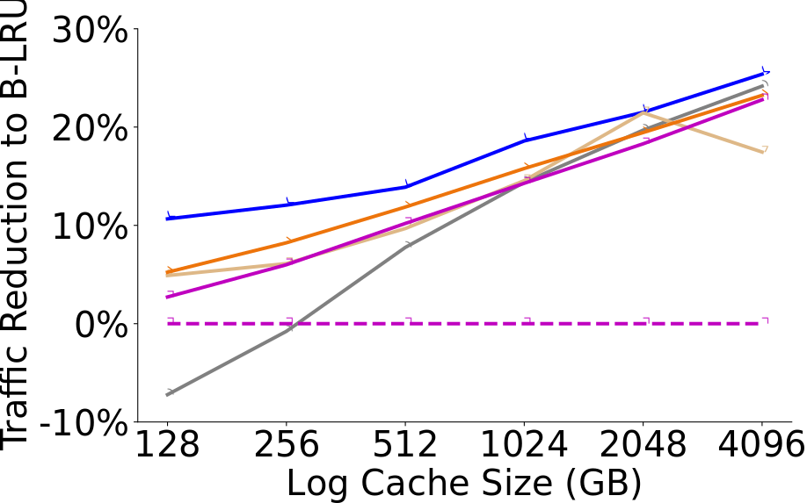
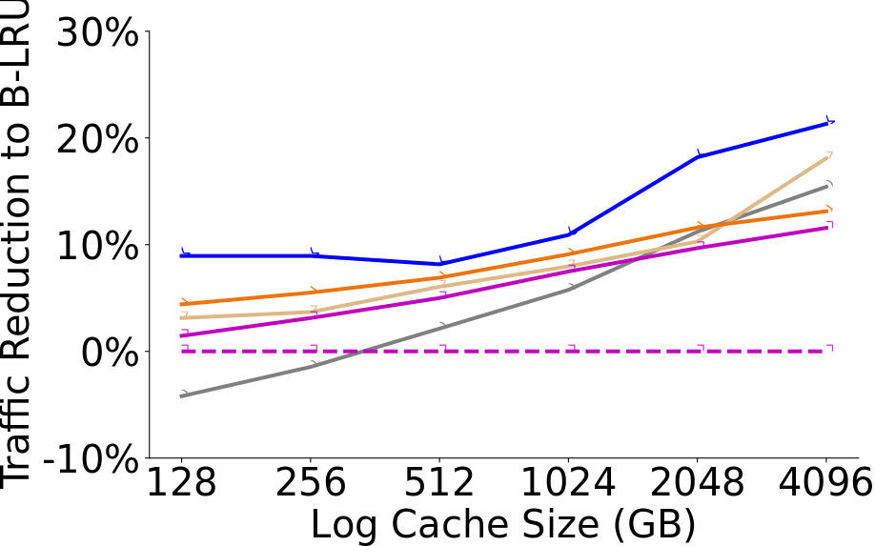
LRB Consistently Improves on the State of the Art
Wikipedia
CDN-A1
CDN-A2
CDN-B1
CDN-B2
CDN-B3

Slide 35
LRB Overhead Is Modest
Requests
User
Edge cache
Memory overhead=1‒3% cache size
Peak CPU: 16% vs 9% (unmodified)
Throughput: 11.7 Gbps vs 11.7 Gbps (unmodified)

Slide 36
Conclusion
LRB reduces WAN traffic with modest overhead
ML-for-systems generally promising to replace heuristics
Key insight: relaxed Belady
→ Simplifies machine learning & reduces system overhead

Slide 37
Systems Classes in the Spring
COS 417 – Operating Systems – T/Th 11-1220
  Mae Milano and Amit Levy
  Previously 318, a revamped OS class!
COS 418 – Distributed Systems – MW 10-1050
  Mike Freedman & Wyatt Lloyd
COS 432 – Information Security – T/Th 11-1220
  Prateek Mittal
  Primarily listed as ECE 432
COS IW 11 – IaaS Systems for Business – M 11-1220
  Corey Sanders ’04 (Recently retired CVP from Microsoft)

