Slide 1
Git’s Content Addressable Storage
COS 316: Principles of Computer System Design
Lecture 5
Wyatt Lloyd & Rob Fish

Slide 2
Naming Module
Naming Overview (today)
  Memory Naming
    OS, Security
Unix File System Naming
  OS
Git Naming
  OS, Distributed Systems
Network Naming
  Networking
Application
Security
Distributed Systems
Network
Security
Network
OS
OS
Hardware
Hardware

Slide 3
Today’s Goals
Compare centralized vs distributed version control
Compare location- vs content-based naming
Learn specifics of git’s content-based naming
Learn some specifics of git internals
See more layering in action

Slide 4
Unix File System
An example of “location-based” naming schemes:
  The block layer names blocks based on the order in which they appear on disk
  The file layer names files based on where to find their blocks
  The inode number layer gives files names that correspond to their block number or location within an inode table
  The absolute path name layer provides the location of the root directory
Location-based naming scheme

Slide 5
Today: When do locations fall short
UNIX File System takes a location-centric view of the data it stores
  Point is: where on disk can I find this data I care about?
When might this view be insuﬀicient?
Today: Git as a lens for:
  How location-based names fall short
  How content-based names can help

Slide 6
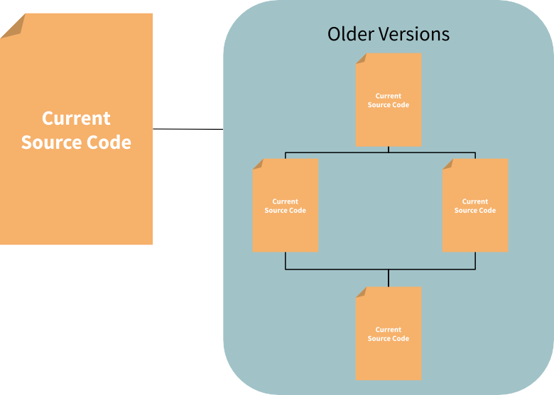
Version Control Overview

Slide 7
A Brief History of Version Control
Local version control
  1972: Source Code Control System (SCCS) developed by early UNIX developers
  1982: Revision Control System (RCS) developed by GNU project
Client/Server Centralized Version Control
  1986: Concurrent Versions System (CVS) developed as front-end to RCS to collaborate on Amsterdam Compiler Kit at Vrije University
  2000: Subversion (SVN) a redesign of CVS widely used by open source projects
Distributed Version Control
  2000: BitKeeper developed to address Linux’s distributed and large community development model
  2005: Git & Mercurial developed concurrently to replace BitKeeper after BitMover starts charging open source projects.

Slide 8
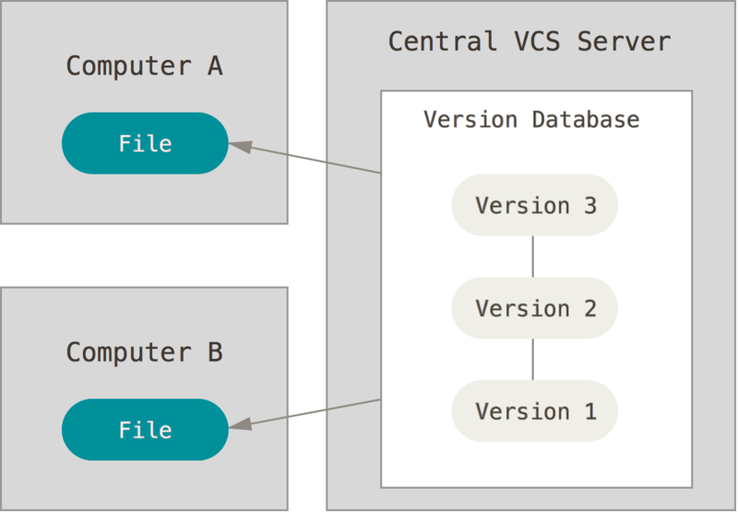
Centralized Version Control

Slide 9
Centralized Version Control
Central server holds “canonical” version of each file
Files committed and versioned independently
Typically only one or a few checkouts of a file
Conflicts between developers expected to be rare
All versioning and conflict resolution mediated by the server
Main role: eﬀiciently store versions of the same file and coordinate updates to individual files.
UNIX file system is a pretty good match!

Slide 10
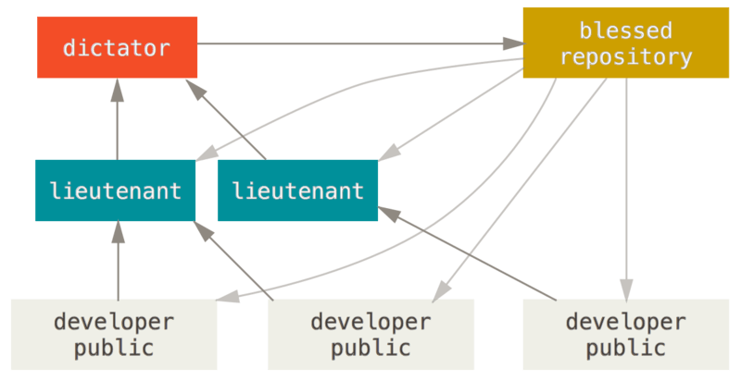
Linux development model

Slide 11
Centralized Version Control Shortcomings…
Are the set of files in the canonical version collectively valid?
Not egalitarian: What if we don’t want just one “central” server?
  P2P collaboration, hierarchical, etc.
What happens if the data on the central server is corrupted?

Slide 12
Distributed Version Control
Two important differences from centralized:
No inherent “canonical” version
Unit of a commit is a complete source code tree
    Each “version” represents a state that some developer intended at some time
    Versioning files is incidental

Slide 13
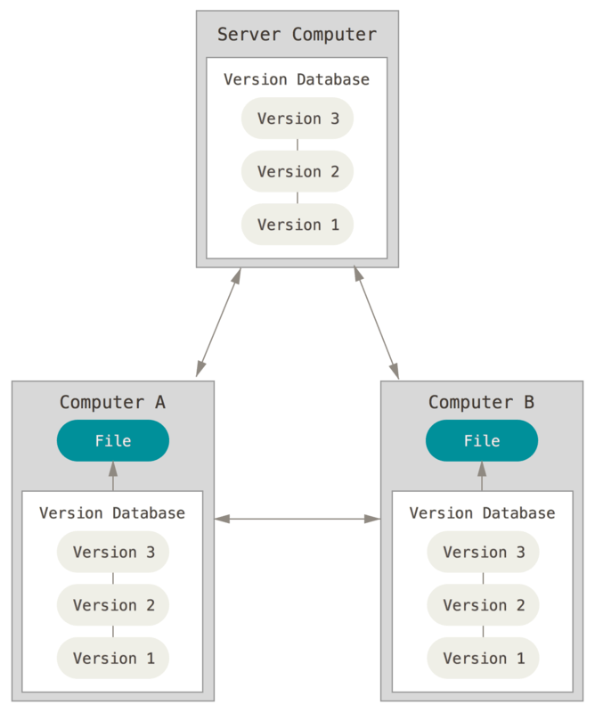
Distributed
Version
Control

Slide 14
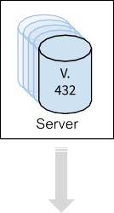
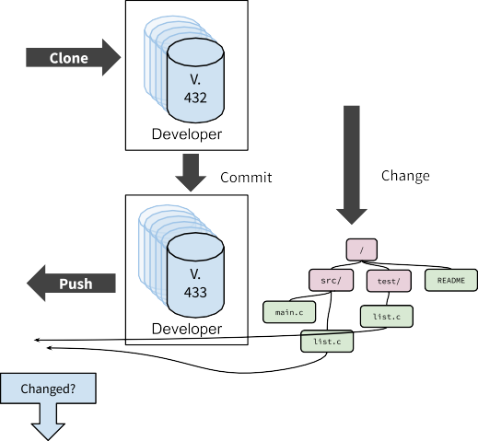

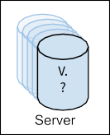

Distributed Version Control Workflow Ex

Slide 15
How would we do this with the UNIX file system?
We need a simple way to succinctly name files, trees, commits, etc. such that we can easily compare them.
We need to eﬀiciently store and transmit many versions of source code tree. Most files in each version will be unchanged.

Slide 16
The Content-based Address
A succinct summary of the content
that’s unique for different content
and the same for the same content
Cryptographic hash functions maps arbitrary size data to a fixed-sized bit-string that is:
  Deterministic
  Computationally “hard” to generate a message that yields a specific hash value
  Computationally “hard” to find two messages with the same hash value
  Similar messages have dissimilar hashes

Slide 17
Git Layers
Layer Purpose a
Object Stores objects in a content-addressable store
Tree Organizes “blobs” into a directory-like hierarchy
Commit Versions the tree layer
Reference Provides human-readable names for trees, commits
Notes:
Similar to UNIX file system layers, but uses content-based names instead of location-based names.
(Can also have references to individual objects, but I think this is too confusing to explain to be worth the little increase in accuracy)

Slide 18
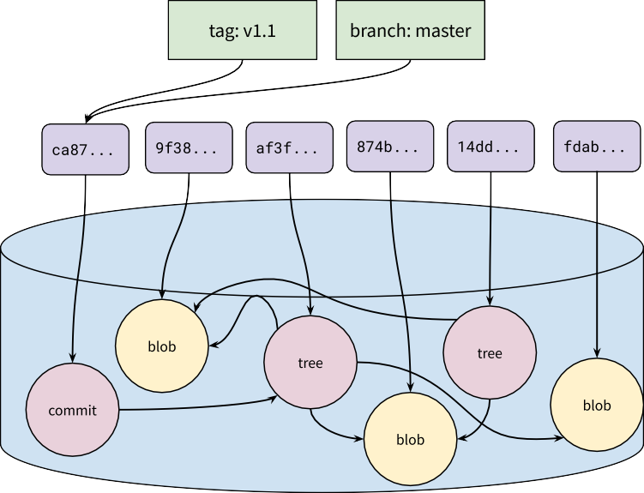
Git Layers

Slide 19
Object Layer
“Objects” are the basic storage unit in Git, like blocks in the UNIX file system
  All data is stored as objects
Names:
  The SHA-1 hash of the object’s content: 40-byte string in hex (160-bits)
    aa8074278ed2c4803a2a545f277d1e0afe5039c3
Values
  Blobs: similar to files
  Trees: similar to directories
  Commits: points to tree and previous commit

Slide 20
Object Layer
Allocation
  Names “allocated” by taking the hash of the object content
Lookup
  Git uses the UNIX file system to store objects on disk
    We need to translate to locations at some point
  Objects stored in a directory .git/objects
  Filename is the 40-byte hex string of the object’s name

Slide 21
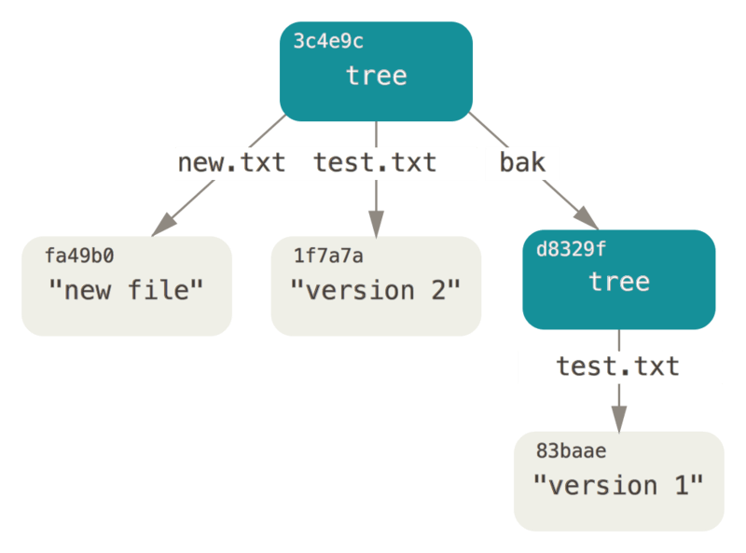
Tree Layer
Similar to, and modeled after, directories in the UNIX file system
Provide hierarchy of trees and blobs that can be traversed using human-meaningful names.

Slide 22
Tree Layer
Names
  Human-readable strings, just like in UNIX directories
Values
  Object name
  Object type
  Permissions (a subset of UNIX permissions)
Allocation
  Names are supplied by the user, just like in UNIX
  Generally, git mirrors an actual directory structure

Slide 23
Tree Layer
Lookup
  Trees stored as a list of entries, similar to directories
$ git cat-file -p 3914fbcc30ea8092034ca5ea4e6ebd0c887495df
100644 blob 96e87117fc618fc54a770bfc938405a29cca1fbb .gitignore
100644 blob 077b93358fba58cacc6acaf098baa317408aa16e Makefile
100644 blob 7addb405782f208c54f6d31182e173304ee117b9 README.md
040000 tree 303c20a830ce296d625fbf0fe4e4cd99fc33f3b1 http_router
040000 tree 85c17ff71ae5cfafcb1affebc4fbc1e8e67bd23c microblog-client
040000 tree a7dc7cfb0850fbfd4fcdf49310fd2e757cb42c08 microblog-server

Slide 24
Commit Layer
The commit layer gives Git a way to express a version history of the source code tree. Commit objects contain
  A reference to the tree
  Metadata about the tree (the author of this version, when it was “committed”, a message describing the changes from the previous version, etc…)
  A reference to the previous commit

Slide 25
Commit Layer
Names
  The SHA-1 hash of the value
Values
  Object name of the tree
  Object name of the parent commit(s)
  Author/committer name and e-mail, and date committed
  Message as a string

Slide 26
Commit Layer
Allocation
  Names “allocated” by taking the hash of the object content
Lookup
  Commit objects have a defined format such that each name has a particular location in the object

Slide 27
Reference Layer
Commits, trees, and blobs names not convenient for humans
  Can’t remember hashes
  Not useful for discovery
  Need some point of synchronization
    e.g., how do we know which is the most recent commit?
References provide global, human readable names for objects

Slide 28
Reference Layer
Names
  Human readable names: e.g., “master”, “wlloyd/wip”, “HEAD”
Values
  A commit name

Slide 29
Reference Layer
Allocation
  Reference names are assigned and managed by users
  Some standard reference names by convention:
    master: refers to the most recent “canonical” version of the source code
    HEAD: refers to the most recently committed tree on the local repository
    origin/*: refers to a reference on the “origin” repository, where this repository was cloned from
Lookup
  Stored as UNIX files in a special subdirectory of the .git directory
  Each reference is a file containing the name of the object they refer to

Slide 30
Contrasting Location-based Names
& Content-based Names

Slide 31
Layers of Names
Both systems we looked at use layers of simple naming schemes
Makes reasoning easier
UNIX File System
  Blocks, files, inode numbers, directories, absolute path
Git
  Objects, blobs, trees, references
Allow extensibility at multiple levels
  Can re-use block layer for other storage systems, e.g., databases
Allows portability at multiple levels
  Can port files & directories to non-block storage

Slide 32
Economy of mechanism
Both systems we looked at reuse mechanisms where possible
UNIX file system
  Stores everything in blocks: inodes, file data, file system metadata
  Reuses inodes for files and directories
Git
  Stores everything in objects: blobs, trees, commits
  Single naming allocation scheme: secure hash function

Slide 33
Naming Design Trade-offs
Location-based Content-based
Necessary? Yes! No
Discovery Easy Hard
Decentralized No Yes
Integrity Hard Easy
Transactions Hard Easy
Notes:
It is straightforward to implemented distributed location-based filesystems, but they will typically be a collection of centralized subdirectories

Slide 34
Summary
Compared centralized vs distributed version control
Compared location- vs content-based naming
Learned specifics of git’s content-based naming
Learned some specifics of git internals
Saw more layering in action

