Slide 1

Intro: What is a System?
COS 316: Principles of Computer System Design
Lecture 1
Wyatt Lloyd & Rob Fish

Slide 2
Today: Systems!
Next time: Course Overview, Syllabus, …

Slide 3
Example Systems
Operating system (OS) kernel
The Internet
Database
Distributed file system
Web framework
Game engine

Slide 4
What is a System?
Provides an interface to underlying resources
Mediates access to shared resources
Isolates applications
Abstracts complexity
Abstracts differences in implementation

Slide 5
Example System: OS Kernel
Interface: system calls
Underlying resources: hardware (CPU, memory, network, disk)
Isolation: Firefox, terminal, zoom, … don’t worry about each other
Abstraction: Collection of system calls
  Instead of specific protocols for using specific devices
  Don’t need to rewrite Firefox to display on new monitors, or save to new disks, or …

Slide 6
Systems Stack (terminal)
Application
Filesystem
OS
TTY
Hardware

Slide 7
Systems Stack (Firefox)
Layout engine
JS VM
Application
Database
Window
manager
Network
Scheduler
OS
Graphics
Filesystem
Hardware

Slide 8
Systems Stack (Firefox to Wikipedia)
Application
Distributed Systems
OS | Network |  | OS | Network
 | FS |  |  | FS
Hardware |  |  | Hardware
Application
 | Network
OS
Hardware
Internet

Slide 9
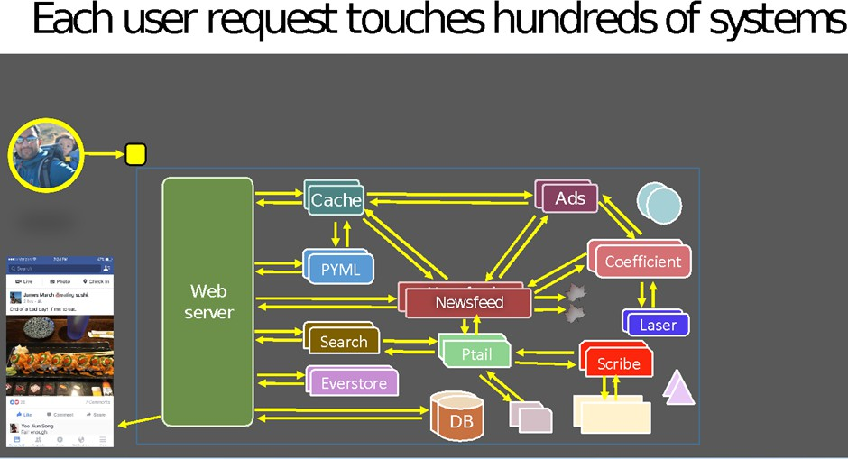
So Many Systems…
[Slide from Kaushik Veeraraghavan Talk’s on Kraken at OSDI ‘16]

Slide 10

Systems Are Everywhere!
People use applications
  Applications are built on systems
    On systems on systems on systems…
If you’re building applications
  Useful to understanding underlying systems
    What could be causing X?
    Why can’t they do Y?
    What can I trust Z to do or not?
Web Server
 | Network
OS
If you’re building systems ☺
  That’s what this is all about!
  Useful to understanding your underlying systems

Slide 11
Why do we build systems?
Sharing: Mediates access to shared resources
Portability: Abstract differences in underlying implementations
Safety: Isolate resources and other applications from faulty apps
Abstraction: Make complex resources easier to use

Slide 12
Why Are Systems Challenging? Part-1a
Correctness
  Incorrect system => incorrect applications
  Correctly implement interface’s guarantees
Performance
  Slow system => slow applications
  Make system fast enough
Security
  Insecure system => insecure applications
  Build security into the system

Slide 13
Why Are Systems Challenging? Part-1b
Distributed storage system that keeps data forever (e.g., videos)
Correctness
  Accurately retain data forever. Really delete data on deletes.
Performance
  Fast and highly concurrent.
Security
  Only allow authorized users to retrieve data

Slide 14
Why Are Systems Challenging? Part-2a
How general should an interface be?
  More general => supports more application-level functionality
  Less general => easier to implement, easier correctness,
better performance, easier security
How portable should an interface be?
  More portable => supports more underlying resources
  Less portable => …
Design tradeoffs!

Slide 15
Why Are Systems Challenging? Part-2b
Distributed cache that provides fast access to popular data
How general should an interface be?
  Read(key)
  Write(key, value)
  Read_transaction(<keys>)
  Write_transaction(<keys>,<values>)
  Read_and_write_transaction(<read_keys>, <write_keys>,<values>)
  …
Design tradeoffs!

Slide 16
Why Are Systems Challenging? Part-2c
Distributed cache that provides fast access to popular data
How portable should an interface be?
  Cache in DRAM
  Cache on SSD
  Cache on NVM
  Cache on HDD
  …
Design tradeoffs!

Slide 17
General vs Portable Interfaces
Cache A:
  Read, Write on DRAM, SSD, NVM, HDD
Cache B:
  Read, Write, Read Transaction, Write Transaction on SSD
Which cache is more general? More portable?
PL Example: Javascript vs Assembly?
Notes:
* Ask class *

Slide 18
Systems We Will Cover In This Class
Application
Security
Distributed Systems
Networking
Operating Systems
Security
Distributed Systems
Network
Security
Network
OS
OS
Hardware
Hardware

Slide 19
Let’s Build a Netflix
Video storage
Video encoding
Video delivery over network
User authentication
Stream authorization
Metadata indexer
Search & recommendations
Comments/reviews
...
Notes:
*What SYSTEMS do we need if we are building a Netflix*

Slide 20
Let’s Build a [mini]-Netflix
How many users? ~5
  Can everyone access everything? Yes
How many movies? ~100
How large are movies? ~20GB/hour x ~2 hours = ~40GB/movie
Max simultaneous streams? ~2
Lots of metadata to search? No! Just 100 movies, a tiny list

Slide 21
Let’s Build a [mini]-Netflix
How much storage?
  100 * 40GB = ~4TB
How much bandwidth?
5 users
100 movies
40GB per movie
<=2 streams
20GB / 3600 * 2 = ~91Mbps
Less with encoding
How much CPU?
  May be best to encode each
stream on-the-fly
  Only 2 streams, so a few cores at
full capacity should work

Slide 22
Let’s Build a [mini]-Netflix
~4TB storage
~91Mbps max bandwidth
~8 cores
Auth.
Database
Application
Encoder |  | Video files
Network
Filesystem
OS
Scheduler
Hardware

Slide 23
Let’s Build a [large]-Netflix
How many users? millions
  Can everyone access everything? No
How many movies? ~1000s
Max simultaneous streams? ~1000s
Lots of metadata to search? Yes! Millions of movies

Slide 24
Why Do I Love Systems?!
Work on the “hard” problems, so applications don’t have to
Correctness as a puzzle: reason through all corner cases
Performance is a different type of puzzle:
  Where are bottlenecks, how to speed them up?
Art of reasoning about tradeoffs: e.g., Interface vs. Performance
Multiplicative impact: improving systems improves all apps built on them

Slide 25
Summary
Application
Security
Distributed Systems
Systems abstract underlying resources
Systems are everywhere
Systems are challenging and interesting and cool
This class is about systems: details next lecture
Network
Security
Network
OS
OS
Hardware
Hardware

