Slide 1
Bayou / Chord
Oct 6, 2022
[Adapted from Andrew Or and Ion Stoica’s original slides]
Notes:
Notes to future preceptors:
There’s a lot of material to cover in this precept—all three of us more or less rushed through the slides. Should you find yourself short on time, we would suggest keeping mind what was already extensively covered in class and opt to focus instead on what wasn’t.
The preceptors got some questions on concepts that we surprisingly found intuitive. For example: the math behind the majorities and quorums, virtual nodes vs. physical nodes, Dynamo handling reconciliation (it passes to the client, but I guess the paper’s diagram doesn’t really make that clear for a beginner).

Slide 2
Context on Bayou: Disconnected Nodes [Stoica]
Early days: nodes always on when not crashed
Network bandwidth always plentiful.
Never needed to work on a disconnected node
Now: nodes detach then reconnect elsewhere
Even when attached, bandwidth is variable
Reconnection elsewhere means often talking to different replica
Work done on detached nodes

Slide 3
Bayou
”[R]eplicated, [eventually] consistent storage system designed for … portable machines with less-than-ideal network connectivity.”
System developed at PARC in the mid-90’s
First coherent attempt to fully address the problem of disconnected operation

Slide 4
Bayou
What is it?
Weakly consistent, replicated storage system
Goals:
Maximize availability, support offline collaboration
Minimize network communication
Agree on all values (eventually)

Slide 5
Bayou Update Protocol: Review from Class
Client sends update to a server
Updates uniquely identified by: <Commit Sequence Number (CSN), Local Timestamp, Node-id
Updates are either committed or tentative CSNs increase monotonically Tentative updates have commit-stamp = ∞
Only Primary server can commit updates Allocates CSN in monotonically increasing order CSN is different from time-stamp

Slide 6
Bayou Writes
Primary
Versions
P: 0
A: 0
B: 0
W(X, 4)
Client 1
Legend
Commit Sequence Number (CSN):Local Timestamp: Node-id
A
Versions
B
Versions
P: 0
A: 0
B: 0
P: 0
A: 0
B: 0

Slide 7
Bayou Writes
Primary
Versions
∞:1:P W(X,4)
P: 1
A: 0
B: 0
Client 1
Legend
Commit Sequence Number (CSN):Local Timestamp: Node-id
A
Versions
B
Versions
P: 0
A: 0
B: 0
P: 0
A: 0
B: 0
Notes:
EXPLAIN THE COLON SYNTAX (Commit timestamp:write timestamp:write server) Commit timestamp is infinity if tentative write.

Slide 8
Bayou Writes
Primary
Versions
∞:1:P W(X,4)
P: 1
A: 0
B: 0
Client 1
Legend
Commit Sequence Number (CSN):Local Timestamp: Node-id
W(Y, 8)
Client 2
A
B
Versions
Versions
W(X, 3)
P: 0
A: 0
B: 0
P: 0
A: 0
B: 0

Slide 9
Bayou Writes
Primary
Versions
∞:1:P W(X,4)
∞:7:P W(Y,8)
P: 7
A: 0
B: 0
Client 1
Legend
Commit Sequence Number (CSN):Local Timestamp: Node-id
W(Z, 8)
Client 2
A
B
W(Y, 4)
Versions
Versions
∞:7:A W(X,3)
P: 0
A: 7
B: 0
P: 0
A: 0
B: 0

Slide 10
Bayou Writes
Primary
Versions
∞:1:P W(X,4)
∞:7:P W(Y,8)
P: 7
A: 0
B: 0
Legend
Commit Sequence Number (CSN):Local Timestamp: Node-id
A
Versions
B
Versions
∞:7:A W(X,3)
∞:12:A W(Y,4)
P: 0
A: 12
B: 0
∞:5:B W(Z,8)
P: 0
A: 0
B: 5

Slide 11
Bayou Anti-Entropy (Sync)
P
Versions
∞:1:P W(X,4)
∞:7:P W(Y,8)
P: 7
A: 0
B: 0
Anti-entropy Session
A & B
A
Versions
B
Versions
P: 0
A: 0
B: 5
∞:5:B W(Z,8)
∞:7:A W(X,3)
∞:12:A W(Y,4)
P: 0
A: 12
B: 0
∞:5:B W(Z,8)
P: 0
A: 0
B: 5
P: 0
A: 12
B: 0
∞:7:A W(X,3)
∞:12:A W(Y,4)

Slide 12
P
Versions
Bayou Anti-Entropy (Sync)
∞:1:P W(X,4)
∞:7:P W(Y,8)
P: 7
A: 0
B: 0
A
Versions
B
Versions
∞:5:B W(Z,8)
∞:7:A W(X,3)
∞:12:A W(Y,4)
P: 0
A: 12
B: 5
∞:5:B W(Z,8)
∞:7:A W(X,3)
∞:12:A W(Y,4)
P: 0
A: 12
B: 5

Slide 13
Bayou Commit
P
Versions
1:1:P W(X,4)
2:7:P W(Y,8)
P: 7
A: 0
B: 0
Primary commits its entries
A
Versions
B
Versions
∞:5:B W(Z,8)
∞:7:A W(X,3)
∞:12:A W(Y,4)
P: 0
A: 12
B: 5
∞:5:B W(Z,8)
∞:7:A W(X,3)
∞:12:A W(Y,4)
P: 0
A: 12
B: 5

Slide 14
Bayou Write
P
Versions
1:1:P W(X,4)
2:7:P W(Y,8)
P: 7
A: 0
B: 0
Write after anti-entropy session
Write timestamp = max(clock, max(TS)+1)
Client 1
D(Y)
A
Versions
B
Versions
∞:5:B W(Z,8)
∞:7:A W(X,3)
∞:12:A W(Y,4)
P: 0
A: 12
B: 5
∞:5:B W(Z,8)
∞:7:A W(X,3)
∞:12:A W(Y,4)
∞:13:B D(Y)
P: 0
A: 12
B: 13
Notes:
D(Y) == delete(Y)

Slide 15
P
Versions
Bayou Anti-Entropy (Sync)
1:1:P W(X,4)
2:7:P W(Y,8)
P: 7
A: 0
B: 0
Anti-entropy Session
P & B
P: 0
A: 12
B: 13
∞:5:B W(Z,8)
∞:7:A W(X,3)
∞:12:A W(Y,4)
∞:13:B D(Y)
A
Versions
B
Versions
1:1:P W(X,4)
2:7:P W(Y,8)
∞:5:B W(Z,8)
∞:7:A W(X,3)
∞:12:A W(Y,4)
P: 0
A: 12
B: 5
∞:5:B W(Z,8)
∞:7:A W(X,3)
∞:12:A W(Y,4)
∞:13:B D(Y)
P: 0
A: 12
B: 13
P: 7
A: 0
B: 0

Slide 16
Bayou Anti-Entropy
P
Versions
1:1:P W(X,4)
2:7:P W(Y,8)
∞:5:B W(Z,8)
∞:7:A W(X,3)
∞:12:A W(Y,4)
∞:13:B D(Y)
P: 7
A: 12
B: 13
Anti-entropy Session
P & B
Primary respects causality
A
Versions
B
Versions
∞:5:B W(Z,8)
∞:7:A W(X,3)
∞:12:A W(Y,4)
P: 0
A: 12
B: 5
1:1:P W(X,4)
2:7:P W(Y,8)
∞:5:B W(Z,8)
∞:7:A W(X,3)
∞:12:A W(Y,4)
∞:13:B D(Y)
P: 7
A: 12
B: 13
Notes:
Since the Primary begins its log at 1 and each commit timestamp is incremented by 1 B knows that it’s tentative write will be committed after those writes with commit timestamps 1 and 2.

Slide 17
Bayou Commit
P
Versions
1:1:P W(X,4)
2:7:P W(Y,8)
3:5:B W(Z,8)
4:7:A W(X,3)
5:12:A W(Y,4)
6:13:B D(Y)
P: 7
A: 12
B: 13
Primary commits Its entries
A
Versions
B
Versions
∞:5:B W(Z,8)
∞:7:A W(X,3)
∞:12:A W(Y,4)
P: 0
A: 12
B: 5
1:1:P W(X,4)
2:7:P W(Y,8)
∞:5:B W(Z,8)
∞:7:A W(X,3)
∞:12:A W(Y,4)
∞:13:B D(Y)
P: 7
A: 12
B: 13

Slide 18
Bayou
P
Versions
1:1:P W(X,4)
2:7:P W(Y,8)
3:5:B W(Z,8)
4:7:A W(X,3)
5:12:A W(Y,4)
6:13:B D(Y)
P: 7
A: 12
B: 13
After a number of commits and anti-entropy sessions (without further writes),
all nodes converge on same state.
A
Versions
B
Versions
1:1:P W(X,4)
2:7:P W(Y,8)
3:5:B W(Z,8)
4:7:A W(X,3)
5:12:A W(Y,4)
6:13:B D(Y)
P: 7
A: 12
B: 13
1:1:P W(X,4)
2:7:P W(Y,8)
3:5:B W(Z,8)
4:7:A W(X,3)
5:12:A W(Y,4)
6:13:B D(Y)
P: 7
A: 12
B: 13

Slide 19
Context for Chord: Key Value Stores
Credit: Ion Stoica’s slide deck

Slide 20
Context for Chord: Key Value Stores
Credit: Ion Stoica’s slide deck

Slide 21
Chord
Chord: “a distributed lookup protocol” for a peer-to-peer distributed hash table [Stoica ‘01]
Consistent hashing for partitioning key space / lookup
Notes:
There are many techniques described in the paper. We will summarize them here.
IMPORTANT: It’s easy to get lost in the implementation details while we go through this list. Try to think about how each technique serves to achieve the high level goal of availability while going through each of them.

Slide 22
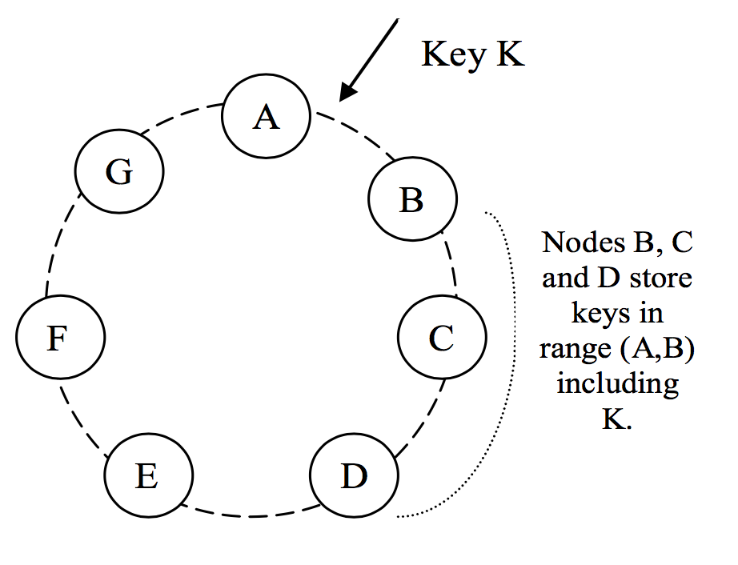
Consistent Hashing
Virtual Nodes
Assign each node a random position on the ring
Node owns the preceding key range
Notes:
Emphasize: “consistent” here has NOTHING to do with the “consistency” we talked about earlier.
The picture on the right: these are virtual nodes, NOT physical nodes.
What’s the purpose of the virtual nodes?
(From the paper)
If a node becomes unavailable (due to failures or routine maintenance), the load handled by this node is evenly dispersed across the remaining available nodes.
When a node becomes available again, or a new node is added to the system, the newly available node accepts a roughly equivalent amount of load from each of the other available nodes.
The number of virtual nodes that a node is responsible can decided based on its capacity, accounting for heterogeneity in the physical infrastructure.
(TL;DR virtual nodes help you achieve more uniform distribution of load across physical nodes)
Note that virtual nodes has NOTHING to do with replication. That is done by walking the circle clockwise from the key and picking the first N unique nodes.

Slide 23
Credit: Ion Stoica’s slide deck
Notes:
Go through at least three examples using this ring
Ask students to arbitrarily choose three numbers (keys) on the ring.
Walk through with them how, if a client’s initial contact is with the node situated at 80, how Chord would help find that key’s location.
They might end up making finger tables for each of the separate nodes.

Slide 24
Techniques for achieving availability
Consistent hashing for partitioning key space
Vector clocks for reconciling conflicts during reads
Sloppy quorums for handling temporary failures
Anti-entropy using Merkle trees for syncing key-value pairs
Gossip-based protocol for membership notifications

Slide 25
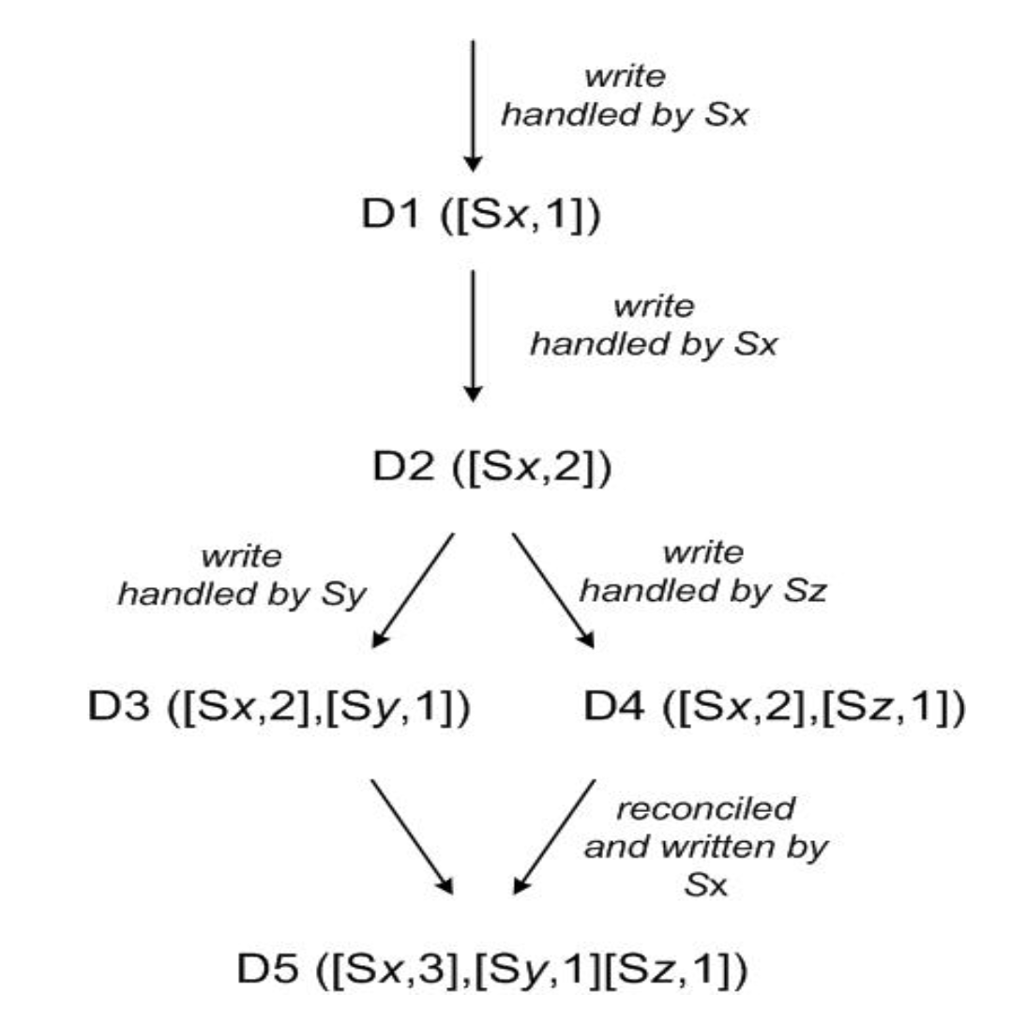
Conflict resolution
Two machines write different values to the same key
Vector clocks: list of (node, count) pairs where count is incremented on write
If one vector clock subsumes another, discard older value
Else, return all conflicting values to client
Notes:
Note that here we're only tracking causal dependencies between updates to a single object item, NOT across all items in key-value store.

Slide 26
Context contains vector clocks
Dynamo client API is simple:
get(key) (value, context)
put(key, value, context)
Common pattern: put after get

Slide 27
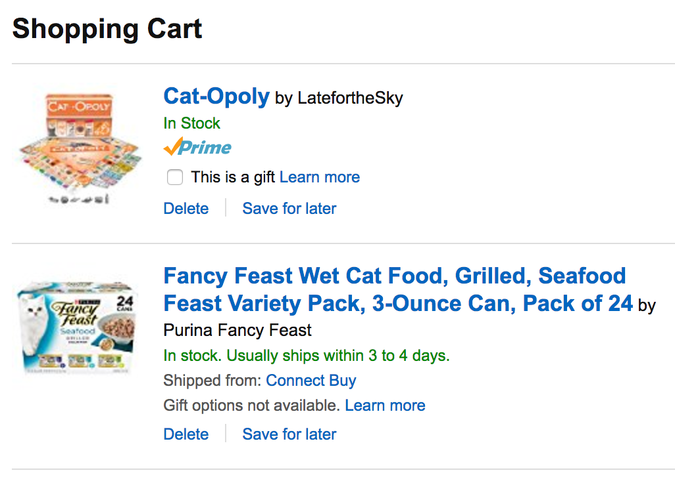
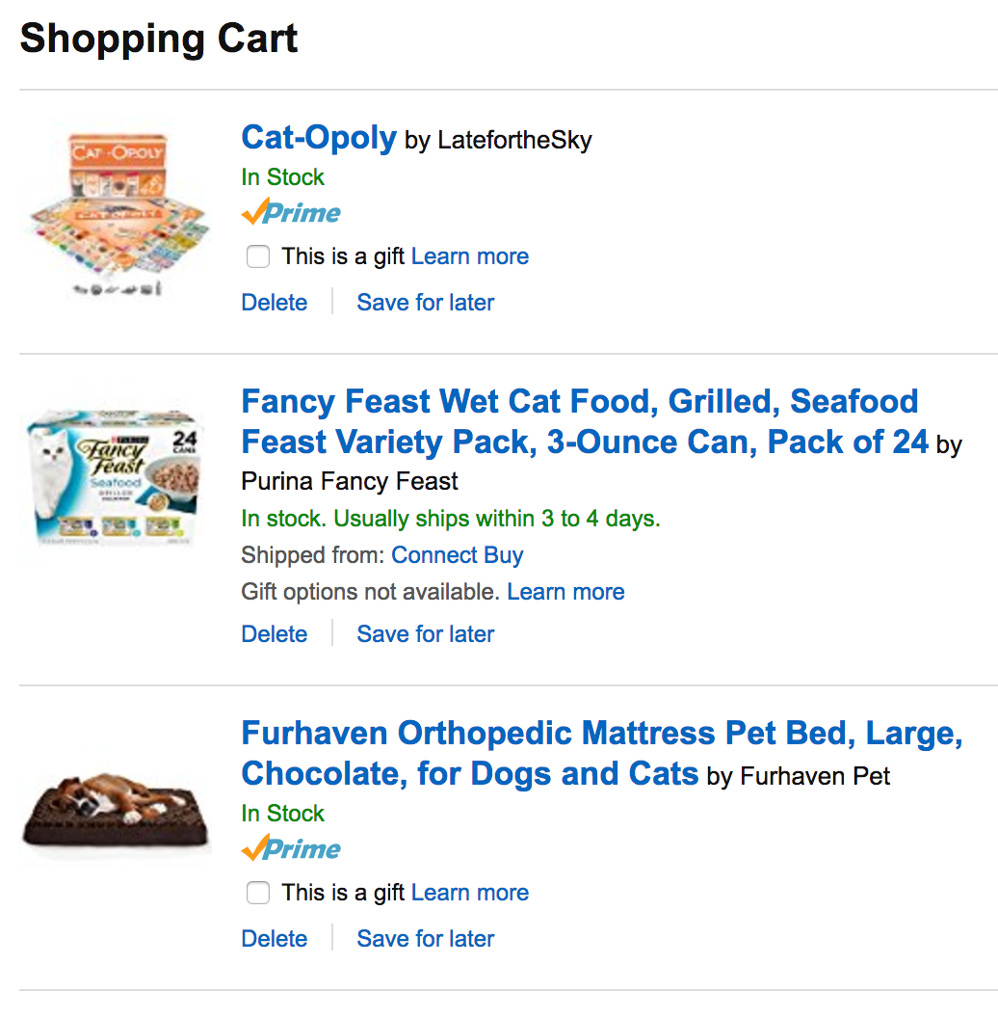
Notes:
Let’s say you and your brother are both trying to buy cat supplies at the same time on the same account. However, servers in the cloud somewhere are failing and your shopping cart is now updated to two different values. How to resolve the conflict?
Well, in the customer’s best interest, Amazon should not lose any items that were added to the cart, so we can just take the union of them. This is also in Amazon’s best interests because now you’re paying them more $$.

Slide 28
DELETE
Notes:
This kind of conflict resolution is highly specific to the application. In fact, this has some potential unexpected results: deleted items can resurface if we’re just taking the union of the shopping carts. This may be acceptable in some applications but not others. In our case, it’s OK because amazon has a ton of confirmation steps before the user actually buys the things. Also he can cancel at any time.

Slide 29
Conflict resolution
Two machines write different values to the same key
Vector clocks: list of (node, count) pairs where count is incremented on write
If one vector clock subsumes another, discard older value
Else, return all conflicting values to client
Notes:
RECAP
So this is how conflict resolution is done in Dynamo. Note: In practice this RARELY happens. 99.9% requests saw exactly 1 version, less than 0.001% saw 2 or more. Though it happens rarely we still need to handle it unfortunately!
(From the paper)
In our next experiment, the number of versions returned to the shopping cart service was profiled for a period of 24 hours. During this period, 99.94% of requests saw exactly one version; 0.00057% of requests saw 2 versions; 0.00047% of requests saw 3 versions and 0.00009% of requests saw 4 versions. This shows that divergent versions are created rarely.
QUESTION: How is this related to availability?
Writes are now always available, because you don’t check for consistency before writing. You just write
Leave conflict resolution to the reads. This happens so little of the time the extra overhead doesn’t really contribute to the latency even in the 99.9th percentile case.

Slide 30
Techniques for achieving availability
Consistent hashing for partitioning key space
Vector clocks for reconciling conflicts during reads
Sloppy quorums for handling temporary failures
Anti-entropy using Merkle trees for syncing key-value pairs
Gossip-based protocol for membership notifications

Slide 31
Sloppy Quorums
Write to N nodes, return success when W < N nodes respond
Read from N nodes, return value(s) from R < N nodes
Typically, W+R > N means at least one writer and one reader overlap, so values are consistent
Sloppy here means skip nodes that have failed, such that even if W+R > N, the readers and writers may not overlap = not consistent!
Notes:
By “skip” here we mean the hinted handoff mechanism. Writes now go to virtual nodes next in the ring which are not the N = 3 nodes that the reads try to read from. This is why readers and writers may not overlap.

Slide 32
Sloppy Quorums
Example:
Typical values are N = 3, W = R = 2
Nodes C and D have failed, so key k is written to E and F instead
Nodes C and D recover, and now client tries to read from C and D = stale value
Notes:
We can’t JUST rely on sloppy quorums because clients get stale value that may never get updated. If we just leave it at that then this system is not even eventually consistent. We need to get the new value for K back to C and D somehow.

Slide 33
Hinted Handoff
“Hint” refers to the node the data originally belongs to
Example:
Nodes E and F remember they are writing on behalf of C and D
As soon as C and D recovers, E and F transfer their values for k to C and D
Notes:
Dynamo does this using “hinted handoff”, where the hint refers to the location information of the original data. So hinted handoff is really part of making sloppy quorums work.

Slide 34
Sloppy Quorums
Write to N nodes, return success when W < N nodes respond
Read from N nodes, return value(s) from R < N nodes
Typically, W+R > N means at least one writer and one reader overlap, so values are consistent
Sloppy here means skip nodes that have failed, such that even if W+R > N, the readers and writers may not overlap = not consistent!
Notes:
RECAP
We saw that sloppy quorums sacrifice consistency when things fail. How does this help with availability?
If we always try to ensure readers and writers overlap, then if enough things fail we might end up waiting for the nodes to come back up. This may take a long time = in the meantime the system is not available.
If we always just pick from N healthy nodes, then we’ll return ASAP without waiting for any failed nodes to come back up

Slide 35
Techniques for achieving availability
Consistent hashing for partitioning key space
Vector clocks for reconciling conflicts during reads
Sloppy quorums for handling temporary failures
Anti-entropy using Merkle trees for syncing key-value pairs
Gossip-based protocol for membership notifications

Slide 36
Anti-entropy using Merkle trees
Goal: minimize durability loss from above techniques
Nodes responsible for the same key spaces exchange Merkle trees
Find differences quickly while exchanging little information
Notes:
Anti-entropy means reducing differences between the state stored across the replica nodes (remember we replicate the same partition to N different nodes in the ring). In an ideal world we’ll have the exact same data on all N nodes, but this doesn’t happen in practice because:
Writes keep coming in and are not immediately propagated to all replicas
Nodes join and leave the ring: partitions are passed around across the nodes in the process
NOTE:* Anti-entropy is necessary for eventual consistency because we want the replicas to all EVENTUALLY return a consistent view of all the values in the key range. This is a pretty weak guarantee (and may in fact never happen if writes keep coming in)!
Anyway, to make anti-entropy faster, Dynamo uses this special data structure called Merkle trees. Each leaf node corresponds to an actual key value pair, and all other nodes are hashes of its children.
When exchanging information in an anti-entropy session, nodes start at the root and exchange only the hash in the root. If the hash matches, great, the two nodes agree and the session terminates. Otherwise, the two nodes keep traversing down the tree until they find the value that doesn’t match. In this case the orange and green values are at odds. So A and B will exchange orange and green to each other such that the root hashes become the same.
NOTE: Only leaf nodes correspond to actual key value pairs. The tree itself stores the hashes of the values. Why not just store the hash of the key? (Because values might get updated for the same key, in which case we want the change to be reflected on both nodes).
How does this provide availability?
It doesn’t, really (at least not directly)
It just helps with eventual consistency, which is a level of consistency that can be achieved in a highly available system

Slide 37
Techniques for achieving availability
Consistent hashing for partitioning key space
Vector clocks for reconciling conflicts during reads
Sloppy quorums for handling temporary failures
Anti-entropy using Merkle trees for syncing key-value pairs
Gossip-based protocol for membership notifications

Slide 38
Membership notification
Gossip-based protocol to propagate membership changes
Each node learns the key spaces handled by all other nodes
Result: zero-hop distributed hash table (DHT)
Clearly not infinitely scalable, but storage requirement not a problem in practice
Notes:
This helps with read and write latency of each request, which helps Dynamo achieve its SLAs.
In practice the storage requirement has been pretty OK because it only scales with the number of nodes and partitions, NOT the number of key value pairs (which would be prohibitive). As long as you keep your dynamo deployment small enough (fewer nodes, like 10s or 100s) then you should be fine.

Slide 39
Bayou (review from class)
Eventual consistency: if updates stop, all replicas eventually the same view.
Update functions for automatic app-driven conflict resolution.
Ordered update log is the real truth, not the DB.
Use Lamport clocks: eventual consistency that respects causality.

Slide 40
Bayou and Dynamo similarities
Anti-entropy to achieve eventual consistency
Exchange vector clocks to determine order of operations
Expose conflict resolution to application
High availability!
Notes:
Also tries to achieve availability, but one big difference between bayou and dynamo is that bayou also additionally makes supporting offline collaboration one of its main goals

Slide 41
A Clash of Cultures
Classic distributed systems: focused on ACID (transaction semantics)
Atomicity: either the operation (e.g., write) is performed on all replicas or is not performed on any of them
Consistency: after each operation all replicas reach the same state
Isolation: no operation (e.g., read) can see the data from another operation (e.g., write) in an intermediate state
Durability: once a write has been successful, that write will persist indefinitely
Modern Internet systems: focused on BASE
Basically Available
Soft-state (or scalable)
Eventually consistent

Slide 42
CAP Theorem [Brewer]
Strong [C]onsistency: all clients see the same view, even in the presence of updates
High [A]vailability: all clients can find some replica of the data, even in the presence of failures
[P]artition-tolerance: the system properties hold even when the system is partitioned
Choose two of three: Consistency, Availability, and Partition-tolerance.

Slide 43
CAP Theorem [Brewer]
You can only have two out of these three properties:
Consistency
Availability
Partition-tolerance
The choice of which feature to discard determines the nature of your system

Slide 44
ACID vs BASE
ACID
Prioritize strong consistency for transactions.
Availability less important.
BASE
Prioritize availability and scalability.
Weak consistency acceptable.

