Slide 1
RPCs in Go
9/22/2022

Slide 2
Outline
RPC overview
Writing an RPC server in Go
MapReduce: fault tolerance and optimizations

Slide 3
Outline
RPC overview
Writing an RPC server in Go
MapReduce: fault tolerance and optimizations

Slide 4
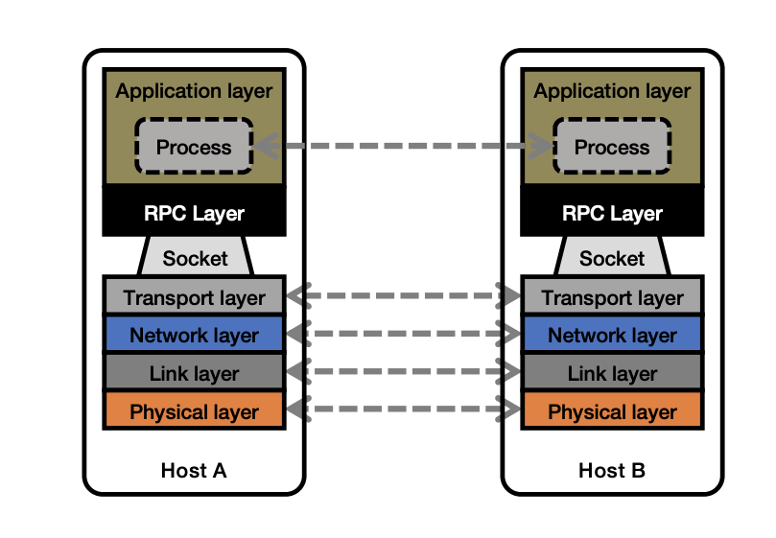
Remote Procedure Call

Slide 5
Remote Procedure Call
Calling a procedure on a remote process as if it were local
Request-response interface
Request: arguments to remote procedure
Response: return values of remote procedure
Examples: client-server, master-worker, peer-peer

Slide 6
Example: Master-Worker
Master {
func LaunchTasks() {
for worker in workers {
// want to call Worker.RunTask(...)
}
}
}
Worker {
func RunTask(index) result {
// ...
}
}

Slide 7
Example: Master-Worker
Master {
func LaunchTasks() {
for worker in workers {
}
}
}
index = worker.Index
address = worker.Address
request = MakeRequest(index)
response = sendRPC("RunTask", address, request)
result = response.Result
handleResult(result)
Worker {
func RunTask(index) result {
// ...
}
}

Slide 8
Asynchronous RPC
Await RPC response in a separate thread
Multiple ways to implement this:
Pass a callback to RPC that will be invoked later

Slide 9
Asynchronous RPC
Await RPC response in a separate goroutine
Multiple ways to implement this:
Pass a callback to RPC that will be invoked later
func handleResponse { ... }
sendRPC("RunTask", address, request, handleResponse)

Slide 10
Asynchronous RPC
Await RPC response in a separate thread
Multiple ways to implement this:
Pass a callback to RPC that will be invoked later
Use channels to communicate RPC reply back to main thread

Slide 11
Asynchronous RPC
Await RPC response in a separate thread
Multiple ways to implement this:
Pass a callback to RPC that will be invoked later
Use channels to communicate RPC reply back to main thread
go func(address, request string) {
channel <- sendRPC("RunTask", address, request)
} (some_address, some_request)
handleResponse(<-channel)

Slide 12
What’s an example application where we would want asynchronous RPCs?

Slide 13
Outline
MapReduce: fault tolerance and optimizations
RPC overview
Writing an RPC server in Go

Slide 14
Go RPCs
Implementation in built-in library net/rpc requires 3 steps:
1. Write stub receiver methods of the form:
func (t *T) MethodName(args T1, reply *T2) error
2. Register receiver methods
3. Create a listener (i.e., server) that accepts requests

Slide 15
Go example: Word count client
func makeRequest(input string, serverAddr string) (map[string]int, error) {
client, err := rpc.Dial("tcp", serverAddr)
checkError(err)
args := WordCountRequest{input}
reply := WordCountReply{make(map[string]int)}
err = client.Call("WordCountServer.Compute", args, &reply)
if err != nil {
return nil, err
}
return reply.Counts, nil
}

Slide 16
Go example: Word count client
func makeRequest(input string, serverAddr string) (map[string]int, error) {
client, err := rpc.Dial("tcp", serverAddr)
checkError(err)
args := WordCountRequest{input}
reply := WordCountReply{make(map[string]int)}
err = client.Call("WordCountServer.Compute", args, &reply)
if err != nil {
return nil, err
}
return reply.Counts, nil
}

Slide 17
Go example: Word count client
func makeRequest(input string, serverAddr string) (map[string]int, error) {
client, err := rpc.Dial("tcp", serverAddr)
checkError(err)
args := WordCountRequest{input}
reply := WordCountReply{make(map[string]int)}
err = client.Call("WordCountServer.Compute", args, &reply)
if err != nil {
return nil, err
}
return reply.Counts, nil
}

Slide 18
Go example: Word count server
type WordCountServer struct {
addr string
}
type WordCountRequest struct {
Input string
}
type WordCountReply struct {
Counts map[string]int
}
func (*WordCountServer) Compute(
request WordCountRequest,
reply *WordCountReply) error {
counts := make(map[string]int)
input := request.Input
tokens := strings.Fields(input)
for _, t := range tokens {
counts[t] += 1
}
reply.Counts = counts
return nil
}

Slide 19
Go example: Word count server
type WordCountServer struct {
addr string
}
type WordCountRequest struct {
Input string
}
type WordCountReply struct {
Counts map[string]int
}
func (*WordCountServer) Compute(
request WordCountRequest,
reply *WordCountReply) error {
counts := make(map[string]int)
input := request.Input
tokens := strings.Fields(input)
for _, t := range tokens {
counts[t] += 1
}
reply.Counts = counts
return nil
}

Slide 20
Go example: Word count server
func (server *WordCountServer) Listen() {
rpc.Register(server)
listener, err := net.Listen("tcp", server.addr)
checkError(err)
go func() {
rpc.Accept(listener)
}()
}

Slide 21
Go example: Word count server
func (server *WordCountServer) Listen() {
rpc.Register(server)
listener, err := net.Listen("tcp", server.addr)
checkError(err)
go func() {
rpc.Accept(listener)
}()
}

Slide 22
Go example: Word count server
func (server *WordCountServer) Listen() {
rpc.Register(server)
listener, err := net.Listen("tcp", server.addr)
checkError(err)
go func() {
rpc.Accept(listener)
}()
}

Slide 23
Go example: Word count client-server
func main() {
serverAddr := "localhost:8888"
server := WordCountServer{serverAddr}
server.Listen()
input1 := "hello I am good hello bye bye bye bye good night hello"
wordcount, err := makeRequest(input1, serverAddr)
checkError(err)
fmt.Printf("Result: %v\n", wordcount)
}
Result: map[hello:3 I:1 am:1 good:2 bye:4 night:1]

Slide 24
Is this synchronous or asynchronous?
func makeRequest(input string, serverAddr string) (map[string]int, error) {
client, err := rpc.Dial("tcp", serverAddr)
checkError(err)
args := WordCountRequest{input}
reply := WordCountReply{make(map[string]int)}
err = client.Call("WordCountServer.Compute", args, &reply)
if err != nil {
return nil, err
}
return reply.Counts, nil
}

Slide 25
Making client asynchronous
func makeRequest(input string, serverAddr string) chan Result {
client, err := rpc.Dial("tcp", serverAddr)
checkError(err)
args := WordCountRequest{input}
reply := WordCountReply{make(map[string]int)}
return ch
}
ch := make(chan Result)
go func() {
err := client.Call("WordCountServer.Compute", args, &reply)
if err != nil {
ch <- Result{nil, err} // something went wrong
} else {
ch <- Result{reply.Counts, nil} // success
}
}()

Slide 26
Making client asynchronous
func makeRequest(input string, serverAddr string) *Call {
client, err := rpc.Dial("tcp", serverAddr)
checkError(err)
args := WordCountRequest{input}
reply := WordCountReply{make(map[string]int)}
return client.Go("WordCountServer.Compute", args, &reply, nil)
}
call := makeRequest(...)
<-call.Done
checkError(call.Error)
handleReply(call.Reply)

Slide 27
Exercise: Cristian’s algorithm
Implement a CristianServer that other machines sync their local time to

Slide 28
MapReduce: Fault Tolerance

Slide 29
MapReduce: Fault Tolerance
Synchronization barrier

Slide 30
MapReduce: Fault Tolerance
Synchronization barrier

Slide 31
MapReduce: Fault Tolerance

Slide 32
Launch same task on a different machine
Assumes tasks are deterministic and idempotent
Map 1*

Slide 33
What if server 1 is just REALLY slow?
Server 1 is a straggler

Slide 34
Use the same idea!
Speculative execution
Map 1*

Slide 35
What should we re-execute?

Slide 36
All mappers might provide inputs to Reduce 2

Slide 37
Can we be smarter?

Slide 38
What should we re-execute?
Write intermediate output to stable storage

Slide 39
What could go wrong?

Slide 40
Mapreduce: What could go wrong?
Key idea: Determine tasks to recompute using data lineage, instead of recomputing all tasks

Slide 41
Lineage is useful for optimizations too

Slide 42
Reusing map outputs
Job 1:
Job 2:

Slide 43
Cristian’s algorithm: Outline
Client sends a request packet, timestamped with its local clock T₁
Server timestamps its receipt of the request T₂ with its local clock
Server sends a response packet with its local clock T₃ and T₂
Client locally timestamps its receipt of the server’s response T₄
Client
Server
T₁
request:
T₁
T₂
T₃
T₄
T₂ ,T₃
response:
Time ↓

Slide 44
Cristian’s algorithm: Offset sample calculation
Goal: Client sets clock ← T₃ + 𝛿_{resp}
Client
Server
Client samples round trip time 𝛿 = 𝛿_{req} + 𝛿_{resp} = (T₄ − T₁) − (T₃ − T₂)
But client knows 𝛿, not 𝛿_{resp}
T₁
request:
T₁
𝛿_{req}
T₂
𝛿_{resp}
T₃
Assume: 𝛿_{req} ≈ 𝛿_{resp}
T₂ ,T₃
T₄
response:
Client sets clock ← T₃ + ½𝛿
Time ↓

Slide 45
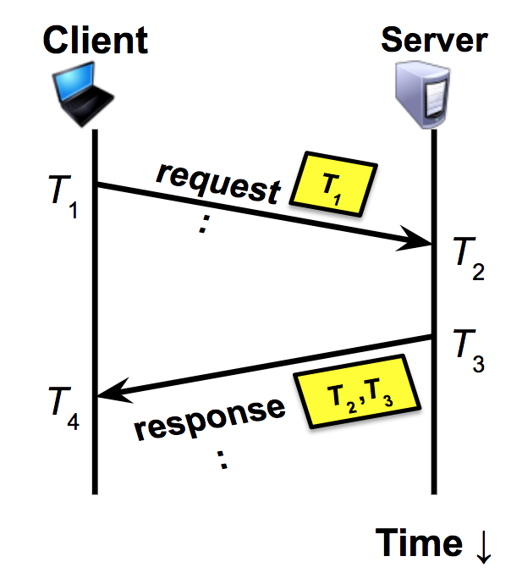
Exercise: Cristian’s algorithm
Implement a CristianServer that other machines sync their local time to
func SyncTime(serverAddr string) (time.Time, error)
Set local time = T₃ + RTT/2, where RTT = (T₄ - T₁) - (T₃ - T₂)
Note: You can just build a simplified version where T₂ = T₃
Hint: use time.Time’s Sub and Add methods, time.Now()

