Slide 1
Making Systems Faster:
Distributed Video Processing
COS 418/518: Distributed Systems
Lecture 20
Wyatt Lloyd
[Grey slides from Qi Huang’s SOSP 2017 Talk]

Slide 2
Distributed Video Processing Outline
Motivation for video processing
  (How streaming video works)
Legacy design
SVE design
Why SVE is faster than legacy
Notes:
Draw on slide!

Slide 3
SVE: Distributed Video Processing at Facebook Scale
Qi Huang
Petchean Ang, Peter Knowles, Tomasz Nykiel, Iaroslav Tverdokhlib,
Amit Yajurvedi, Paul Dapolito IV, Xifan Yan, Maxim Bykov, Chuen Liang, Mohit Talwar, Abhishek Mathur, Sachin Kulkarni, Matthew Burke, Wyatt Lloyd
Facebook, University of Southern California, Cornell, Princeton

Slide 4

Video is growing across Facebook
FB: 500M users watch 100M hours video daily (Mar. 16)
Instagram: 250M daily active users for stories (Jun. 17)
All: many tens of millions of daily uploads, 3X NYE spike
01

Slide 5


Processing is diverse and demanding
Processing
Input video
Re-encoding
Video Classification
Thumbnail
Pt. 1
Legacy System
Scaling Challenges
Pt. 2
SVE
Impact of Design
02

Slide 6

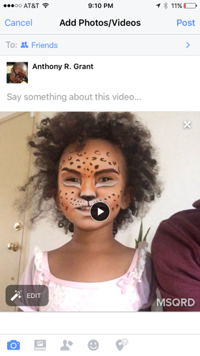
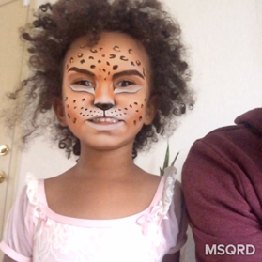
Legacy: upload video file to web server
Client
Web Server
She is having so much fun with #MSQRD
03

Slide 7
Legacy: preserve original for reliability
Client
Web Server
Original
Storage
She is having so much fun with #MSQRD
04

Slide 8
Legacy: process after upload completes
Client
Web Server
Original
Storage
Processing
She is having so much fun with #MSQRD
05

Slide 9
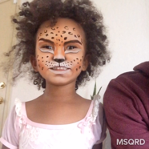

Legacy: encode w/ varying bitrates
Client
Web Server
Original
Storage
Processing
720P
4Mbps
She is having so much fun with #MSQRD
1080P
16Mbps
480P
1.5Mbps
06

Slide 10
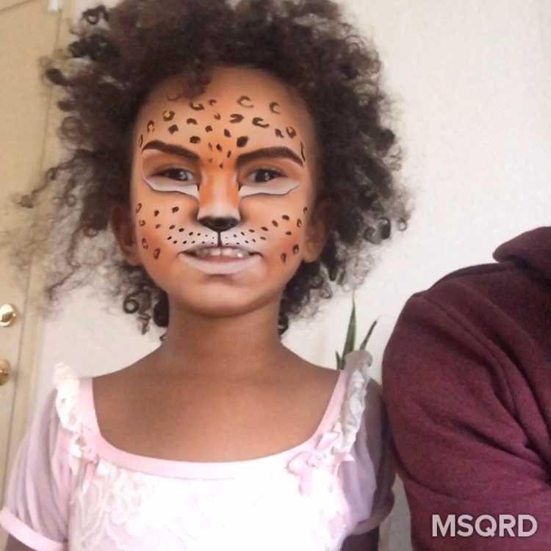
Legacy: store encodings before sharing
Client
Web Server
Original
Storage
Processing
Final
Storage
720P
4Mbps
She is having so much fun with #MSQRD
1080P
16Mbps
480P
1.5Mbps
07

Slide 11
Sharing with adaptive streaming
Client
Web Server
Final
Storage
720p
480p
FBCDN
08

Slide 12
Focus: pre-sharing pipeline
Client
Web Server
Original
Storage
Processing
Final
Storage
All steps from when a user starts an upload until a video is ready to be shared
09

Slide 13
How Long Does This Take? (Latency)
Client
Web Server
Original
Storage
Processing
Final
Storage
Notes:
Draw on slide!

Slide 14
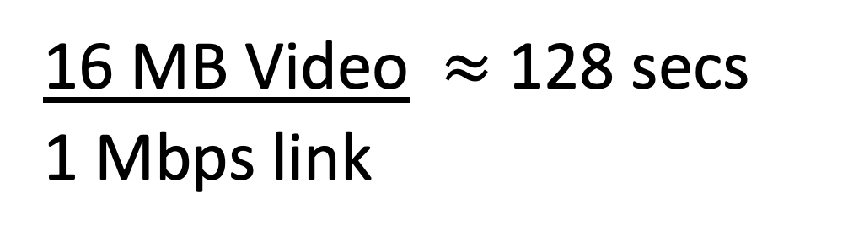
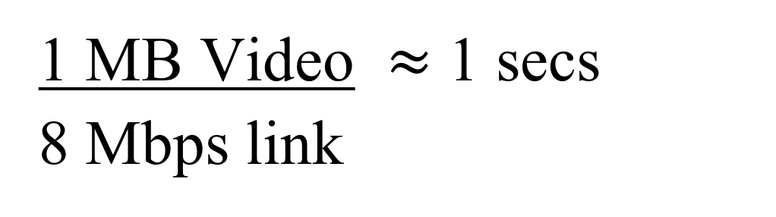
How Long Does This Take? (Latency)
Client
Web Server
1 MB Video $≈$ 1 secs
8 Mbps link
SVE paper stats:
Video Size
≤1MB 10% of uploads over 10 seconds
3-10MB 50% of uploads over 10 seconds
300MB 50% of uploads over 9 minutes
-1GB
16 MB Video $≈$ 128 secs
1 Mbps link
Notes:
For reference:
30sec video on iPhone 7 (1080p) ~= 30 MB

Slide 15
How Long Does This Take? (Latency)
Web Server
Notes:
Draw on slide!

Slide 16
How Long Does This Take? (Latency)
Web Server
Original
Storage
(pipelined with uploading)
SVE paper stats:
median 200 ms
90% 650 ms
99% 900 ms
Notes:
Draw on slide!

Slide 17
How Long Does This Take? (Latency)
Original
Storage
Processing
SVE paper stats:
10% of all video take ≥ 1.3 s
Proportional to video size:
Most videos over 100 MB take over 6 seconds
Notes:
Draw on slide!

Slide 18
How Long Does This Take? (Latency)
Processing
SVE paper stats:
Video Size
1-3MB 20% take over 10 seconds
100- 50% take over 1 minute
300MB
>1GB 23% take over 10 minutes
Notes:
Draw on slide!

Slide 19
Serial pipeline leads to slow processing
Client
Web Server
Original
Storage
Processing
Final
Storage
10

Slide 20
Let’s Make This Faster!
Client
Web Server
Original
Storage
Processing
Final
Storage
Discuss with your neighbors!
Notes:
Draw on slide!

Slide 21
Monolithic script slows development
“Let’s experiment speech recognition, add a logic to extract audio and analysis”
“Change color coding at different time”
Client
Web Server
Original
Storage
Processing
Final Blob Storage
“We need to change the thumbnail generation logic for videos > x minutes to create scene-based scrubber preview”
“Pass-through for small and well-formatted videos”
“We want to experiment AI-based encodings to spend 10x CPU for 30% compression improvement on popular videos”
11

Slide 22
Challenges for video processing @ FB
Speedy
Users can share videos quickly
Flexible
Thousands of engineers can write pipelines for tens of apps
Robust
Handle faults and overload that is inevitable at scale
12

Slide 23
Our Streaming Video Engine (SVE) is speedy, flexible, and robust
13

Slide 24
Speedy: harness parallelism
Users can share videos quickly
Overlap fault tolerance and processing
Overlap upload and processing
Parallel processing
14

Slide 25
Architectural changes for parallelism
Client
Web Server
Original
Storage
Processing
Final
Storage
15

Slide 26
Architectural changes for parallelism
Scheduler
Client
Web Server
Preprocessor
Worker
Final
Storage
Worker
Worker
Original
Storage
16

Slide 27
Overlap fault tolerance and processing
Scheduler
Client
Web Server
Preprocessor
Final
Storage
Write-through
Cache
Worker
Worker
Worker
Original
Storage
17

Slide 28
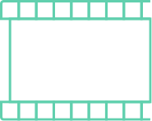
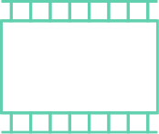
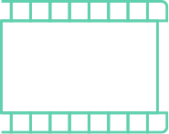



Overlap upload and processing
Scheduler
Client
Web Server
Preprocessor
Worker
Final
Storage
Worker
  Split into segments
Original
Storage
Worker
18

Slide 29
Overlap upload and processing
Scheduler
Client
Web Server
Preprocessor
Worker
Final
Storage
Worker
  ...upload in progress
Original
Storage
Worker
19

Slide 30
Parallel processing w/ many workers
Scheduler
Client
Web Server
Preprocessor
720P Encode
Worker
Final
Storage
480P Encode
Worker
  ...upload in progress
Original
Storage
Worker
Thumbnail
20

Slide 31
Parallel processing w/ many workers
Scheduler
Client
Web Server
Preprocessor
720P Encode
Final
Storage
480P Encode
  ...upload in progress
Original
Storage
Thumbnail
21

Slide 32
Parallel processing w/ many workers
Scheduler
Client
Web Server
Preprocessor
720P Encode
Final
Storage
480P Encode
  ...upload in progress
Original
Storage
Thumbnail
22

Slide 33



Parallel processing w/ many workers
Scheduler
Client
Web Server
Preprocessor
Worker
Final
Storage
Worker
Original
Storage
Worker
23

Slide 34
Three sources of parallelism
Scheduler
Client
Web Server
Preprocessor
Worker
Final
Storage
Worker
Overlap fault tolerance
and processing
Overlap upload and processing
Parallel processing
Original
Storage
Worker
24

Slide 35
Let’s Make This Faster!
Legacy
SVE
Notes:
Draw on slide!

Slide 36
Results: 2.3x ~ 9.3x speedup
Relative speedup
Video size buckets
25
Notes:
Note this is for post-upload latency

Slide 37
Results: 2.3x ~ 9.3x speedup
Overlap upload & processing
Relative speedup
Video size buckets
26

Slide 38
Results: 2.3x ~ 9.3x speedup
Parallel Processing
Relative speedup
Video size buckets
27

Slide 39
Robust: tolerate overload
Handle faults and overload that is inevitable at scale
Rely on priority to degrade non-latency-sensitive tasks
Defer full video processing for some new uploads
Load-shedding across global deployments
38

Slide 40
3X peak load during New Year Eve
NYE
Xmas
Upload volume
3X
Date
39

Slide 41
Prepare for overload
Scheduler
Client
Web Server
Preprocessor
Final Blob Storage
Preprocessor
Worker
Worker
Worker
Worker
Worker
Worker
Original
Storage
40

Slide 42
Use priority for worker overload
Scheduler
Worker
Worker
Worker
Worker
Worker
Worker
Worker
Worker
Worker
Worker
Worker
Hi-priority queue
Worker
Worker
Worker
Worker
Worker
Worker
Worker
Low-priority queue
Worker
Worker
Worker
Worker
Worker
Worker
Only assign hi-pri tasks
under overload
Worker
Worker
Worker
Worker
Worker
Worker
41

Slide 43



Defer full video processing
Preprocessor
Scheduler
Web Server
DAG Generation
Code
Hi-priority queue
Original
Storage
Cache
42

Slide 44
Regional redirection
Scheduler
Web Server
Preprocessor
Worker
Scheduler
Worker
Traffic:
Local distribution → 70%
Remote distribution → 30%
Worker
Traffic:
Local distribution → 100%
Preprocessor
Worker
Worker
Worker
43

Slide 45
Failures from Global Inconsistencies
Lesson Learned
preprocessor = null
if (segment.is_first_segment()) {
preprocessor = get_preprocessor()
storage_write(video_id, “preprocessor”, preprocessor)
} else {
preprocessor = storage_read(video_id, “preprocessor”)
}
forward_segment(preprocessor, segment)
One preprocessor handles all segments of one video
Mapping from video to preprocessor determined when upload starts
Storage system is eventually consistent, what could go wrong?
Notes:
Retry loop is partial solution

Slide 46
Summary
Motivation for video processing
  (How streaming video works)
Legacy design – Serial processing was slow
SVE design – Three sources of parallelism make SVE faster
  Overlap upload and processing
  Overlap fault tolerance and processing
  Parallel processing
Notes:
Draw on slide!

