Slide 1
Distributed Systems Intro
COS 418/518: Distributed Systems
Lecture 1
Wyatt Lloyd

Slide 2
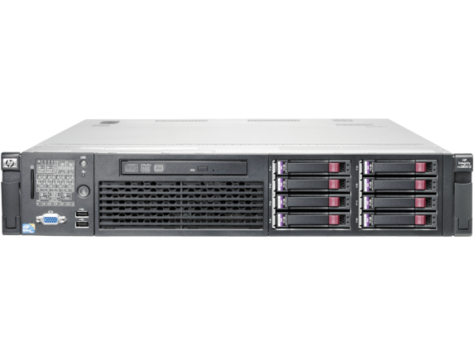
Distributed Systems, What?
Multiple computers
Connected by a network
Doing something together

Slide 3
Distributed Systems, Why?
Or, why not 1 computer to rule them all?
Failure
Limited computation/storage/…
Physical location
Notes:
[Student chat me their answers here]

Slide 4
Distributed Systems, Where?
Web Search (e.g., Google, Bing)
Shopping (e.g., Amazon, Walmart)
File Sync (e.g., Dropbox, iCloud)
Social Networks (e.g., Facebook, Twitter)
Music (e.g., Spotify, Apple Music)
Ride Sharing (e.g., Uber, Lyft)
Video (e.g., Youtube, Netflix)
Online gaming (e.g., Fortnite, DOTA2)
…
Notes:
[Online service-centric, can also add examples of high performance computing for scientific discoveries, …]

Slide 5
“The Cloud” is not amorphous

Slide 6
Microsoft

Slide 7
Google

Slide 8
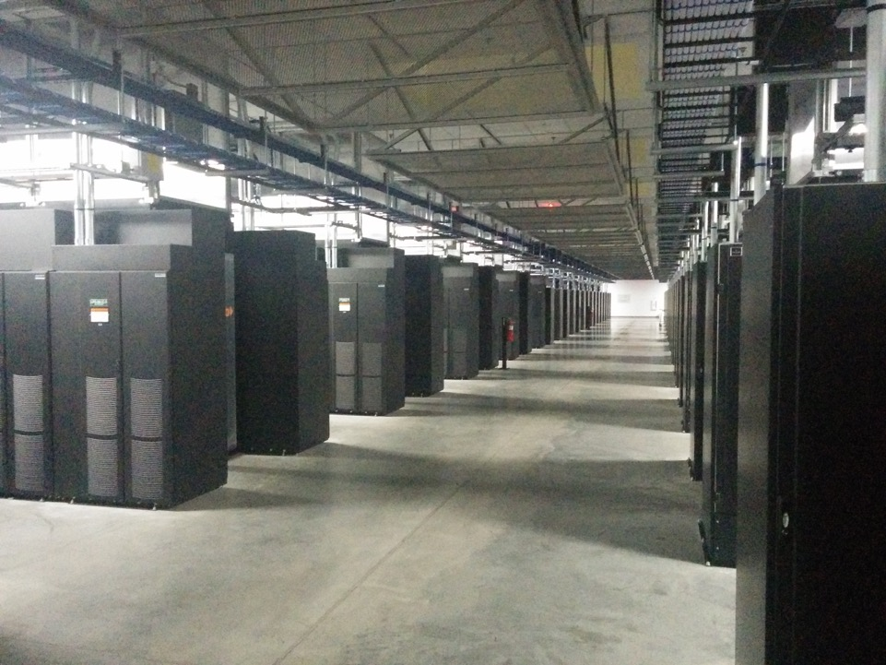
Facebook

Slide 9
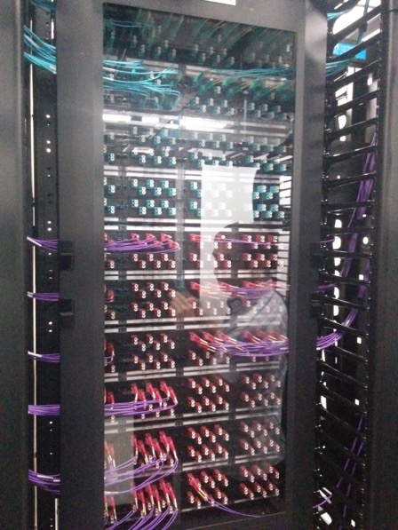
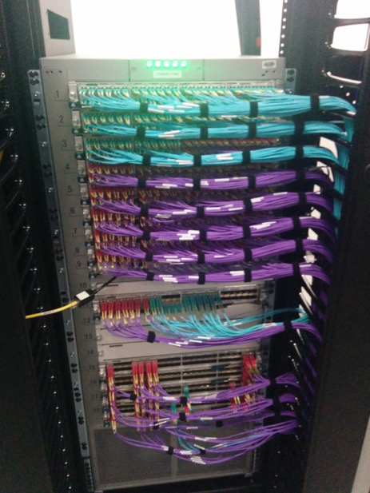
Facebook

Slide 10
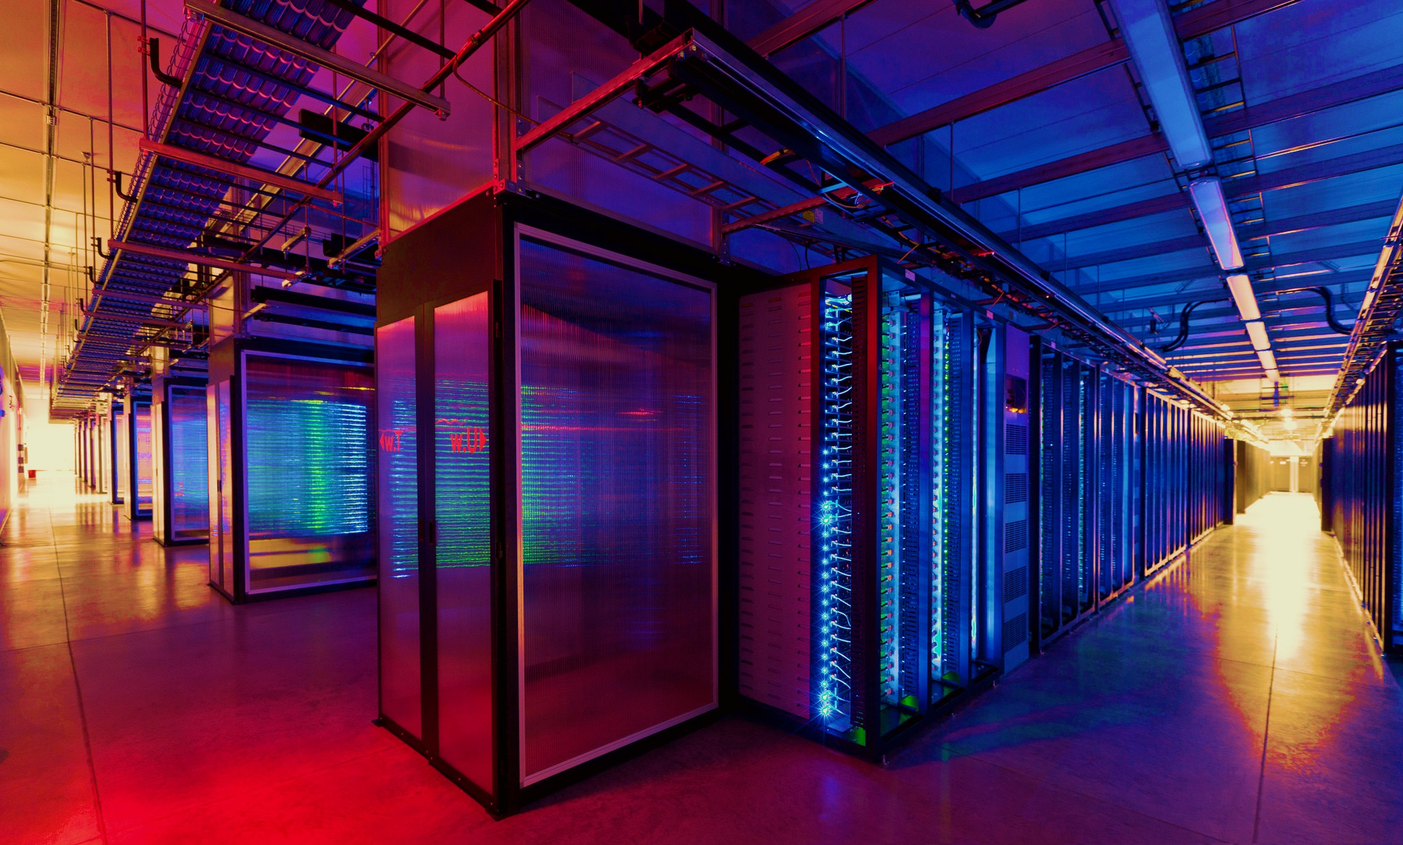
100,000s of physical servers
10s MW energy consumption
Facebook Prineville:
$250M physical infra, $1B IT infra

Slide 11
Distributed Systems Goal
Service with higher-level abstractions/interface
e.g., file system, database, key-value store, programming model, …
Hide complexity
Scalable (scale-out)
Reliable (fault-tolerant)
Well-defined semantics (consistent)
Do “heavy lifting” so app developer doesn’t need to

Slide 12
Scalable Systems in this Class
Scale computation across many machines
MapReduce, Streaming Video Engine
Scale storage across many machines
Dynamo, COPS, Spanner

Slide 13
Fault Tolerant Systems in this Class
Retry on another machine
MapReduce, Streaming Video Engine
Maintain replicas on multiple machines
Primary-backup replication
Paxos
RAFT
Bayou
Dynamo, COPS, Spanner

Slide 14
Range of Abstractions and Guarantees
Eventual Consistency
Dynamo
Causal Consistency
Bayou, COPS
Linearizability
Paxos, RAFT, Primary-backup replication
Strict Serializability
2PL, Spanner

Slide 15
Learning Objectives
Reasoning about concurrency
Reasoning about failure
Reasoning about performance
Building systems that correctly handle concurrency and failure
Knowing specific system designs and design components
Notes:
[Also mention art of abstraction design]

Slide 16
Conclusion
Distributed Systems
Multiple machines doing something together
Pretty much everywhere and everything computing now
“Systems”
Hide complexity and do the heavy lifting (i.e., interesting!)
Scalability, fault tolerance, guarantees

