Slide 1
COS 561: Advanced Computer Networks
Jennifer Rexford
(TAs: Mary Hogan and Srikar Kasi)
https://www.cs.princeton.edu/courses/archive/fall20/cos461/561.html

Slide 2
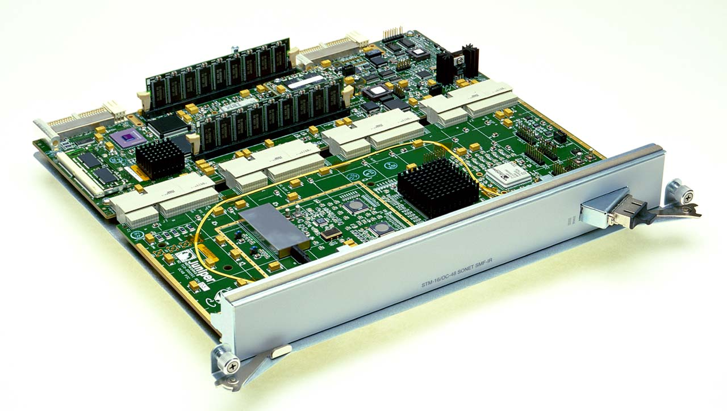
Data Plane
Streaming algorithms that act on packets
Matching on some bits, taking a simple action
… at behest of control and management plane
Wide range of functionality
Forwarding
Access control
Mapping header fields
Traffic monitoring
Buffering and marking
Shaping and scheduling
Deep packet inspection
Notes:
Question to keep in mind: is there a common way to think about all of these data-plane operations

Slide 3
Packet Forwarding
Control plane computes a forwarding table
Maps destination address(es) to an output link
Handling an incoming packet
Match: destination address
Action: direct the packet to the chosen output link
Switching fabric
Directs packet from input link to output link
Processor
Switching
Fabric

Slide 4
Context for the Paper
Programmability
Active networks (mid-to-late 1990s)
Software-Defined Networking
High-performance data planes
Operating system
FPGAs and Network Processors
ASICs
Prototyping new research ideas
Reusable modules
Simplifying integration into the kernel
Building community
Programming languages

Slide 5
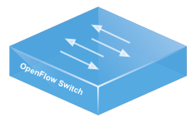
OpenFlow
Prioritized list of rules
Pattern: match packet header bits
Actions: drop, forward, modify, send to controller
Priority: disambiguate overlapping patterns
Counters: #bytes and #packets
src=1.2.*.*, dest=3.4.5.* → drop
src = *.*.*.*, dest=3.4.*.* → forward(2)
3. src=10.1.2.3, dest=*.*.*.* → send to controller

Slide 6
Protocol Independent Switch Architectures
Programmable data plane at “line rate”
Programmable using languages like P4
Parser
Persistent State
Deparser
Memory
ALU
Match-
Action
Table
Stages

Slide 7
Click Modular Router

Slide 8
Click Motivation
Flexibility
Add new features and enable experimentation
Openness
Allow users/researchers to build and extend
(In contrast to most commercial routers)
Modularity
Simplify the composition of existing features
Simplify the addition of new features
Speed/efficiency
Operation (optionally) in the operating system
Without the user needing to grapple with OS internals

Slide 9
Router as a Graph of Elements
Large number of small elements
Each performing a simple packet function
E.g., IP look-up, TTL decrement, buffering
Connected together in a graph
Elements inputs/outputs snapped together
Beyond elements in series to a graph
E.g., packet duplication or classification
Packet flow as main organizational primitive
Consistent with data-plane operations on a router
(Larger elements needed for, say, control planes)

Slide 10
Click Elements: Push vs. Pull
Packet hand-off between elements
Directly inspired by properties of routers
Annotations on packets to carry temporary state
Push processing
Initiated by the source end
E.g., when an unsolicited packet arrives (e.g., from a device)
Pull processing
Initiated by the destination end
E.g., to control timing of packet processing (e.g., based on a timer or packet scheduler)

Slide 11
Click Language
src :: FromDevice(eth0);
ctr :: Counter;
sink :: Discard;
src -> ctr;
ctr -> sink;
Declarations
Create elements
Connections
Connect elements
Compound elements
Combine multiple smaller elements, and treat as single, new element to use as a primitive class
Language extensions through element classes
Configuration strings for individual elements
Rather than syntactic extensions to the language

Slide 12
Handlers and Control Socket
Access points for user interaction
Appear like files in a file system
Can have both read and write handlers
Examples
Installing/removing forwarding-table entries
Reporting measurement statistics
Changing a maximum queue length
Control socket
Allows other programs to call read/write handlers
Command sent as single line of text to the server

