Slide 1
Replication State Machines via Primary-Backup
COS 418: Distributed Systems
Lecture 10
Michael Freedman

Slide 2
From eventual to strong consistency
Eventual consistency
Multi-master: Any node can accept operation
Asynchronously, nodes synchronize state
Eventual consistency inappropriate for many applications
Imagine NFS file system as eventually consistent
NFS clients can read/write to different masters, see different versions of files
Stronger consistency makes applications easier to write
(More on downsides later)

Slide 3
Primary-Backup Replication
Mechanism: Replicate and separate servers
Goal #1: Provide a highly reliable service (despite failures)
Goal #2: Servers should behave just like a single, more reliable server
Client C
Primary P
Backup B
Notes:
SEGUE: Don't want clients to have to resubmit their jobs.

Slide 4
Primary-Backup Replication
Client C
Nominate one replica primary, other backup
Clients send all ops to current primary
Primary orders clients’ operations
Only one primary at a time
Primary P
Backup B
Need to keep clients, primary, and backup in sync: who is primary and who is backup

Slide 5
State machine replication
Idea: A replica is essentially a state machine
Set of (key, value) pairs is state
Operations transition between states
Need an op to be executed on all replicas, or none at all
i.e., we need distributed all-or-nothing atomicity
If op is deterministic, replicas will end in same state
Key assumption: Operations are deterministic

Slide 6
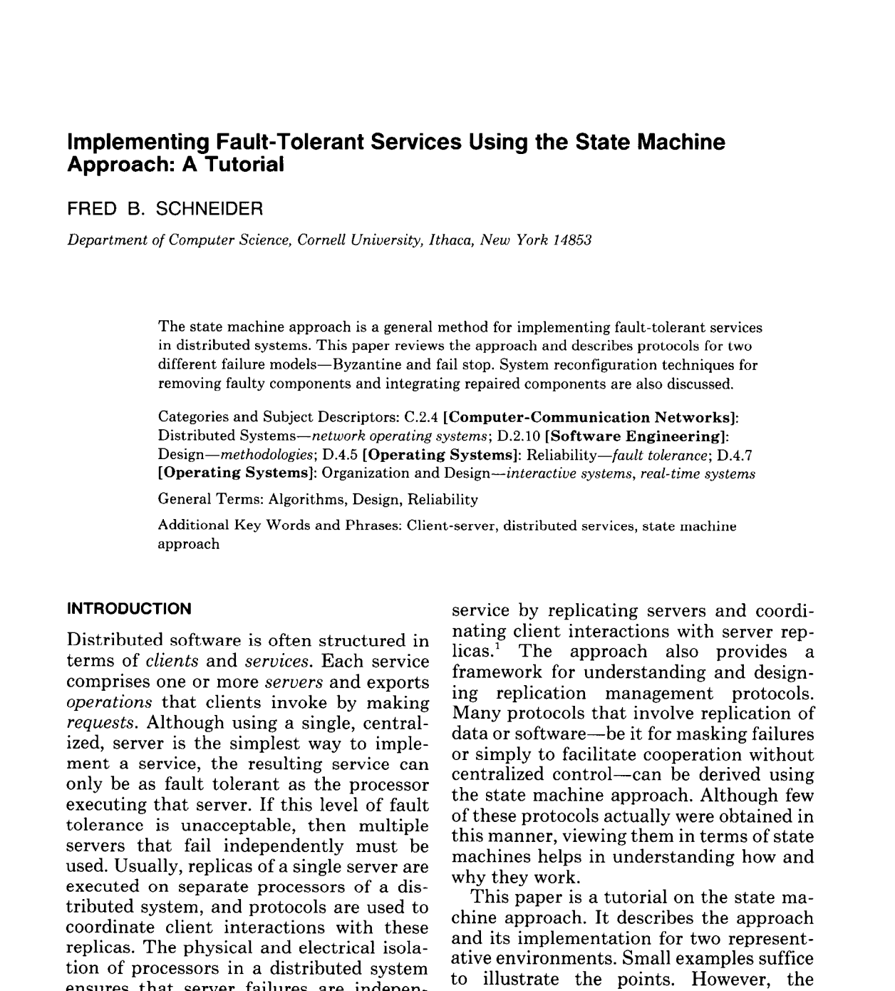
More reading: ACM Computing Surveys, Vol. 22, No. 4, December 1990 (pdf)

Slide 7
Primary-Backup Replication
Client C
Primary gets operations
Primary orders ops into log
Replicates log of ops to backup
Backup exec’s ops or writes to log
put(x,1)
Primary P
put(x,1)
Backup B

Slide 8
Primary-Backup Replication
Asynchronous Replication
Client C
put(x,1)
ack
Primary gets operations
Primary exec’s ops
Primary orders ops into log
Replicates log of ops to backup
Backup exec’s ops or writes to log
Primary P
put(x,1)
Backup B

Slide 9
Primary-Backup Replication
Synchronous Replication
Client C
put(x,1)
ack
Primary gets operations
Primary orders ops into log
Replicates log of ops to backup
Backup exec’s op or writes to log
Primary gets ack, execs ops
Primary P
put(x,1)
ack
Backup B

Slide 10
Why does this work? Synchronous Replication
Clients
shl
Logging Module
State Machine
Logging
Module
State Machine
Servers
Log
Log
add
jmp
mov
shl
add
jmp
mov
shl
Backup
Primary
Replicated log => replicated state machine
All servers execute same commands in same order

Slide 11
Why does this work? Synchronous Replication
Clients
shl
Logging
Module
State Machine
Logging Module
State Machine
Logging
Module
State Machine
Servers
Log
Log
Log
add
jmp
mov
shl
add
jmp
mov
shl
add
jmp
mov
shl
Backup
Backup
Primary
Replicated log => replicated state machine
All servers execute same commands in same order

Slide 12
Need determinism? Make it so!
Operations are deterministic
No events with ordering based on local clock
Convert timer, network, user into logged events
Nothing using random inputs
Execution order of ops is identical
Most RSMs are single threaded

Slide 13
Example: Make random() deterministic

Slide 14
Example: Make random() deterministic
Primary:
Initiates PRNG with OS-supplied randomness, gets initial seed
Sends initial seed to to backup
Backup
Initiates PRNG with seed from primary

Slide 15
Case study
The design of a practical system for
fault-tolerant virtual machines
D. Scales, M. Nelson, G. Venkitachalam, VMWare
SIGOPS Operating Systems Review 44(4), Dec. 2010 (pdf)

Slide 16
VMware vSphere Fault Tolerance (VM-FT)
Goals:
Replication of the whole virtual machine
Completely transparent to apps and clients
High availability for any existing software
Notes:
Ambitious system from VMware – want to give an entire Virtual Machine the benefits of primary-backup replication.
>>> Actually run a virtual machine on top of primary-backup replication!

Slide 17
vSphere Overview
Two virtual machines (primary, backup) on different bare metal
Logging channel runs over network
Shared disk via fiber channel
Notes:
The backup executes identically to the primary, except with a small time lag.
>>> Wrinkle: Disk not replicated, instead shared

Slide 18
Virtual Machine I/O
VM inputs
Incoming network packets
Disk reads
Keyboard and mouse events
Clock timer interrupt events
VM outputs
Outgoing network packets
Disk writes
Notes:
To replicate the VM they need to look at the VM as a black box.
VM inputs: everything that flows into the VM.
VM outputs: everything that flows out of the VM.
>>> Disk writes are considered an output because they go to the shared disk attached to both VMs.

Slide 19
Overview
Primary sends inputs to backup
Backup outputs dropped
Primary-backup heartbeats
If primary fails, backup takes over
Notes:
The backup executes identically to the primary, except with a small time lag.
>>> Wrinkle: Disk not replicated, instead shared

Slide 20
VM-FT: Challenges
Making the backup an exact replica of primary
Making the system behave like a single server
Avoiding two primaries (Split Brain)
Notes:
(Outline slide) So we have a general idea of how this works from the basic primary-backup design, but here are the subtle points that the VM-FT paper addresses.
(Exact replica:) How to cope with non-determinism

Slide 21
Log-based VM replication
Step 1: Hypervisor at primary logs causes of non-determinism
Log results of input events
Including current program counter value for each
Log results of non-deterministic instructions
e.g. log result of timestamp counter read
Notes:
Want to model VM as a deterministic state machine, so to do that we have to convert non-deterministic operations to deterministic operations so that state machine replication holds.
Inputs: packet with arbitrary data may arrive; arbitrary keystroke may arrive.
SEGUE: So once the primary has logged both causes of non-determinism, the backup can use this information.

Slide 22
Log-based VM replication
Step 2: Primary hypervisor sends log entries to backup
Backup hypervisor replays the log entries
Stops backup VM at next input event or non-deterministic instruction
Delivers same input as primary
Delivers same non-deterministic instruction result as primary
Notes:
Needs to know when the next input event occurs, so backup lags behind primary by one input event

Slide 23
VM-FT Challenges
Making the backup an exact replica of primary
Making the system behave like a single server
FT Protocol
Avoiding two primaries (Split Brain)
Notes:
So now we are reasoning about the output events that the system generates, in particular when the primary fails. And their solution to this problem is called the fault tolerant (FT) protocol.

Slide 24
Primary to backup failover
When backup takes over, non-determinism makes it execute differently than primary would have
This is okay!
Output requirement
When backup takes over, execution is consistent with outputs the primary has already sent
Notes:
>>> Want to avoid contradictions between the primary and backup when it fails over.
SEGUE: Let’s see how inconsistencies can happen.

Slide 25
The problem of inconsistency
Input
Event?
Output
Primary
Backup
Primary fails
Notes:
Suppose primary fails just after an output event. Of “in flight” events, backup doesn’t know whether they came before/after output event.
Red event may have influenced value of output, backup doesn’t know where in its execution stream to place it: before or after the output.
Primary also doesn’t know what the value of the output event was, so can’t fix it that way.
Subtle: Arbitrarily many events may have happened at primary unbeknownst to backup, can’t speculate!

Slide 26
VM-FT protocol
Primary logs each output operation
Delays sending output until Backup acknowledges it
But does not need to delay execution
Input
Primary fails
Output
Primary
ack
Backup
Duplicate output
Notes:
There are no other events in the backup’s log so it can reach the same state as the primary was when it made the output.
Might output twice but that is okay – duplicate network packet or duplicate write to disk.
>>> Primary doesn’t need to delay execution, just outputs.

Slide 27
VM-FT protocol
“If a tree falls in forest” metaphor:
If event happens and nobody sees it yet, did it really happen?
Primary logs each output operation
Delays sending output until Backup acknowledges it
But does not need to delay execution
Input
Primary fails
Output
Primary
ack
Backup
Duplicate output
Can restart execution at an output event
Notes:
There are no other events in the backup’s log so it can reach the same state as the primary was when it made the output.
Might output twice but that is okay – duplicate network packet or duplicate write to disk.
>>> Primary doesn’t need to delay execution, just outputs.

Slide 28
VM-FT: Challenges
Making the backup an exact replica of primary
Making the system behave like a single server
Avoiding two primaries (Split Brain)
Logging channel may break
Notes:
Finally, avoiding split brain gets difficult when the logging channel breaks.

Slide 29
Detecting and responding to failures
Primary and backup each run UDP heartbeats, monitor logging traffic from their peer
Before “going live” (backup) or finding new backup (primary), execute atomic test-and-set on variable in shared storage
If the replica finds variable already set, it aborts
Notes:
This avoids split-brain.

Slide 30
VM-FT: Conclusion
Challenging application of primary-backup replication
Design for correctness and consistency of replicated VM outputs despite failures
Performance results show generally high performance, low logging bandwidth overhead

