Slide 1
Distributed Systems Intro and Course Overview
COS 418 + 518: (Advanced) Distributed Systems
Lecture 1
Mike Freedman & Wyatt Lloyd

Slide 2
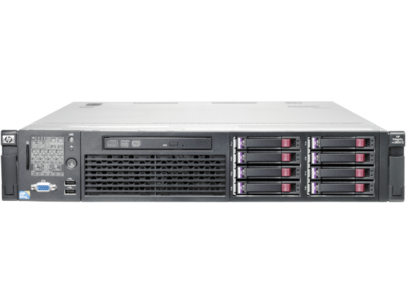
Distributed Systems, What?
Multiple computers
Connected by a network
Doing something together

Slide 3
Distributed Systems, Why?
Or, why not 1 computer to rule them all?
Failure
Limited computation/storage/…
Physical location

Slide 4
Distributed Systems, Where?
Web Search (e.g., Google, Bing)
Shopping (e.g., Amazon, Walmart)
File Sync (e.g., Dropbox, iCloud)
Social Networks (e.g., Facebook, Twitter)
Music (e.g., Spotify, Apple Music)
Ride Sharing (e.g., Uber, Lyft)
Video (e.g., Youtube, Netflix)
Online gaming (e.g., Fortnite, DOTA2)
…

Slide 5
“The Cloud” is not amorphous

Slide 6
Microsoft

Slide 7
Google

Slide 8
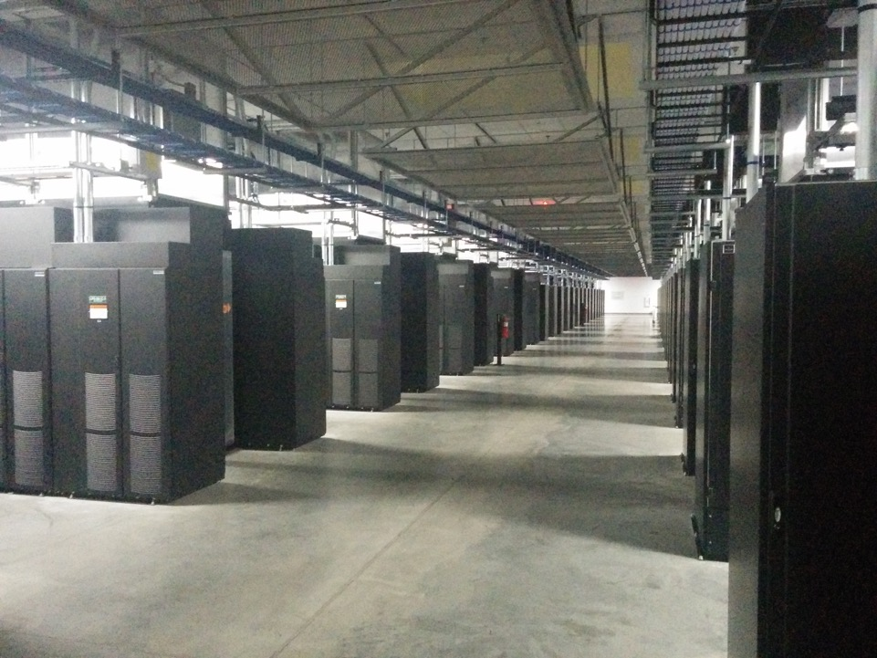
Facebook

Slide 9
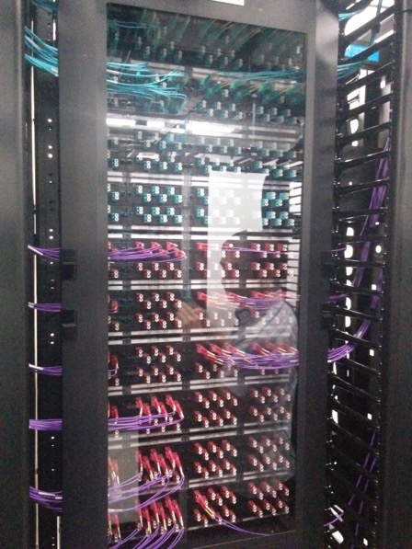
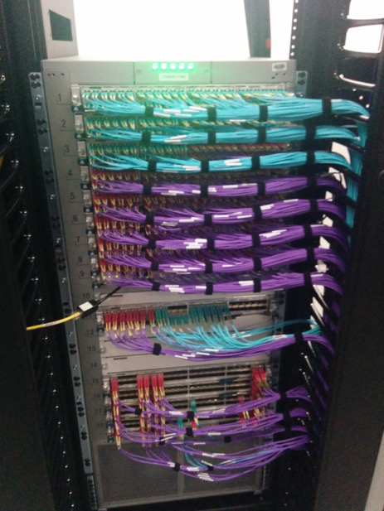

Slide 10
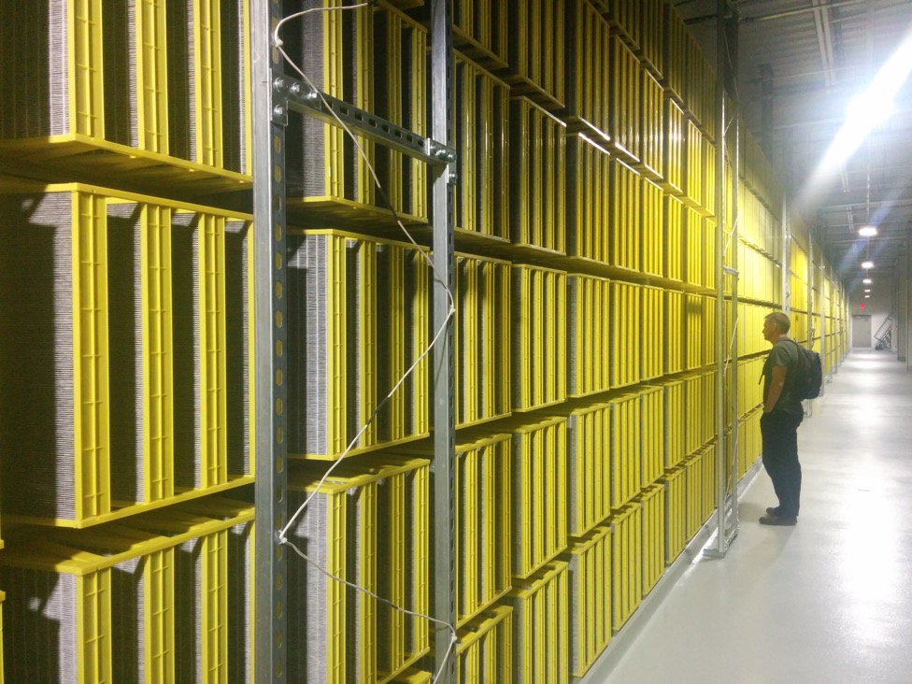
Facebook

Slide 11
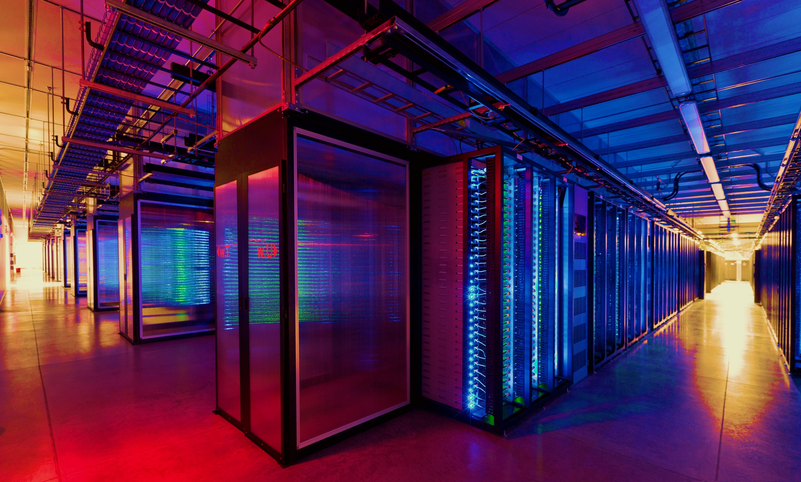
100,000s of physical servers
10s MW energy consumption
Facebook Prineville:
$250M physical infro, $1B IT infra

Slide 12
Everything changes at scale
“Pods provide 7.68Tbps to backplane”

Slide 13
Distributed Systems Goal
Service with higher-level abstractions/interface
e.g., file system, database, key-value store, programming model, …
Hide complexity
Scalable (scale-out)
Reliable (fault-tolerant)
Well-defined semantics (consistent)
Do “heavy lifting” so app developer doesn’t need to

Slide 14
Decisions matter: Layering & Naming
Abstractions everywhere: Layers partition the system
Each layer solely relies on services from layer below
Each layer solely exports services to layer above
Interface between layers defines interaction
Hides implementation details
Layers can change without disturbing other layers

Slide 15
Decisions matter: Layering & Naming
Host names: www.cs.princeton.edu
Mnemonic, variable-length, appreciated by humans
Hierarchical, based on organizations
IP addresses: 128.112.7.156
Numerical 32-bit address appreciated by routers
Hierarchical, based on organizations and topology
MAC addresses : 00-15-C5-49-04-A9
Numerical 48-bit address appreciated by adapters
Non-hierarchical, unrelated to network topology

Slide 16
Decisions matter: Layering & Naming
Host names: www.cs.princeton.edu
Domain: registrar for each top-level domain (eg, .edu)
Host name: local administrator assigns to each host
IP addresses: 128.112.7.156
Prefixes: ICANN, regional Internet registries, and ISPs
Hosts: static configuration, or dynamic using DHCP
MAC addresses: 00-15-C5-49-04-A9
Blocks: assigned to vendors by the IEEE
Adapters: assigned by the vendor from its block

Slide 17
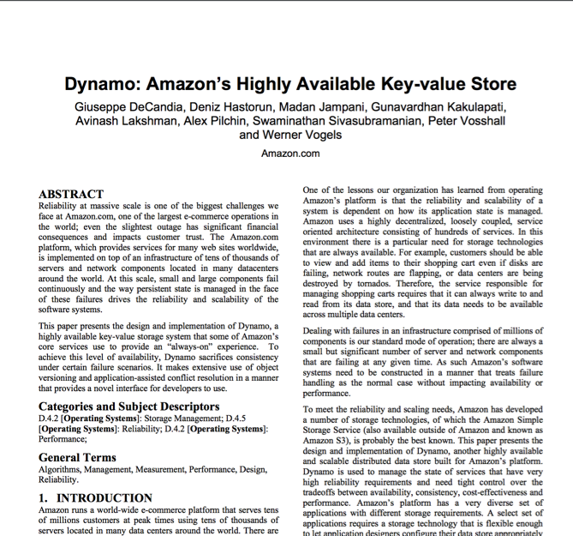
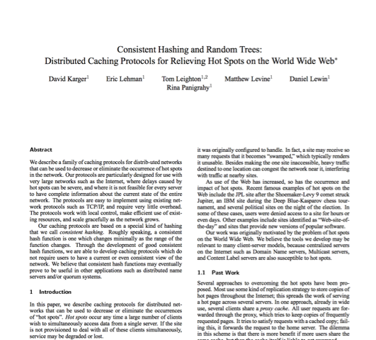
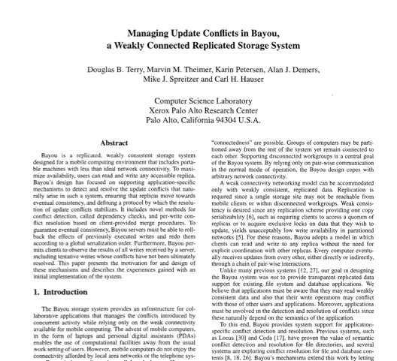
Research results matter: NoSQL
Notes:
NoSQL:
Consistent hash tables
+ consistency tradeoffs (e.g., eventual)
Amazon Dynamo popularized (published SOSP 2007), CTO was faculty at Cornell on distributed systems

Slide 18
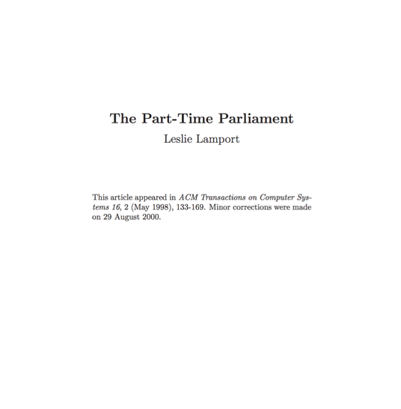
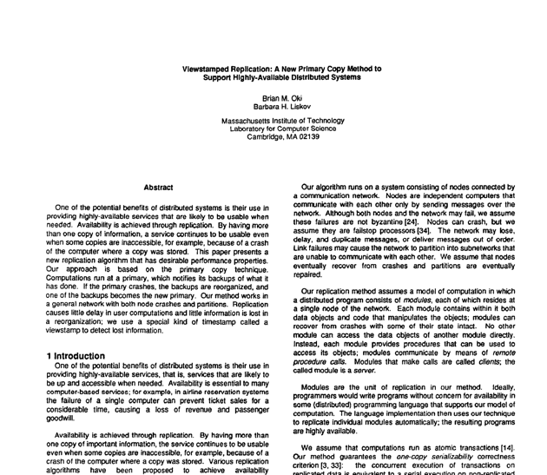
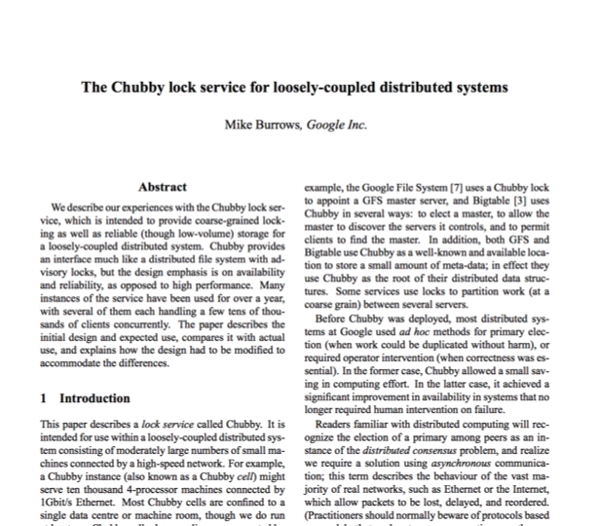
Research results matter: Paxos
Notes:
Paxos
Long history starting in early 1990s on “reaching consensus in distributed systems”
Google Chubby
Coordinate datacenters at scale
When a file server fails, who takes over?
Authors for industrial research labs and academia (DEC SRC, Cambridge/UW, etc.)
Led to open-source Apache Zookeeper

Slide 19
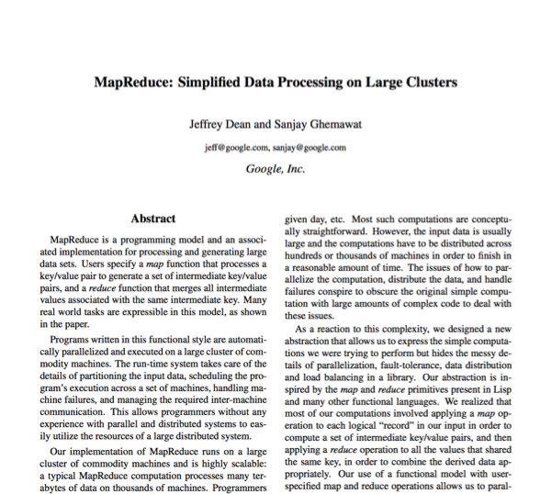
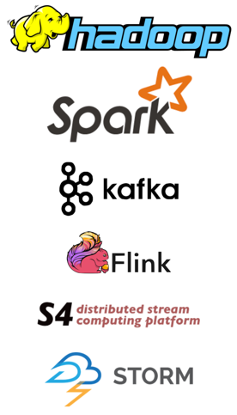
Research results matter: MapReduce
Notes:
Google MapReduce
How to process large volumes of data over 1000s of servers, even in face of failures
Authors for industrial research labs and academia (DEC WRL, MIT/UW, etc.)
Led to open-source Apache Hadoop
Created Big Data industry…

Slide 20
Course Organization

Slide 21
Course structure
Joint ugrad (418) + grad (518) course: first of kind
Why / how do they differ?
418 + 518: Both attend same lectures. Everybody needs background, few get it elsewhere
418
Precepts (review/understanding material), TA led
Programming assignments
518:
Recitations (paper reading + discussion), faculty led
Semester-long project

Slide 22
Learning the material: People
Professors Mike Freedman & Wyatt Lloyd
Teaching Assistants: Carlo Rosati, Jeffrey Helt, Jennifer Lam, Suriya Kodeswaran, Yue Tan
Lab Assistants (for programming assignments)
Main Q&A forum: www.piazza.com
No anonymous posts or questions, can DM instructors
Office hours (TAs and LAs) posted on Piazza
Setting expectation: TAs will monitor/respond to Piazza 1-2 times per day in a burst of activity

Slide 23
Learning the Material: Lectures!
Lectures: MW 10-10:50 in CS 104
Attend lectures and precepts and take notes!
Lecture slides posted day/night before
Recommendation: Print slides & take notes
Not everything covered in class is on slides
You are responsible for everything covered in class
No required textbooks
Links to Go Programming textbook and two other distributed systems textbooks on website

Slide 24
418 specifics

Slide 25
Grading
Five assignments (10% each)
90% 24 hours late, 80% 2 days late, 50% >5 days late
Three free late days (we’ll figure which one is best)
Two exams (50% total)
Midterm exam before fall recess (25%)
Final exam during exam period (25%)

Slide 26
Weekly recitations (Friday)
Supporting materials for class
Go programming
Problem solving around lecture topics
Things to think about for assignments
Taught by TAs (rotation on weekly basis)

Slide 27
Assignment 1 (in three parts)
Learn how to program in Go
Basic Go assignment (due 9/19)
“Sequential” Map Reduce (due 9/26)
Distributed Map Reduce (due 10/03)

Slide 28
Warnings
This is a 400-level course,
with expectations to match.

Slide 29
Warning #1: Assignments are a LOT of work
Assignment 1 is purposely easy to teach Go. Don’t be fooled.
Last year they gave 3-4 weeks for later assignments; many students started 3-4 days before deadline. Disaster.
Distributed systems are hard
Need to understand problem and protocol, carefully design
Can take 5x more time to debug than “initially program”
Assignment #4 builds on your Assignment #3 solution, i.e., you can’t do #4 until your own #3 is working! (That’s the real world!)

Slide 30
Warning #2: Software engineering, not just programming
COS126, 217, 226 told you how to design & structure your programs. This class doesn’t.
Real software engineering projects don’t either.
You need to learn to do it.
If your system isn’t designed well, can be significantly harder to get right.
Your friend: test-driven development. We’ll supply tests, bonus points for adding new ones

Slide 31
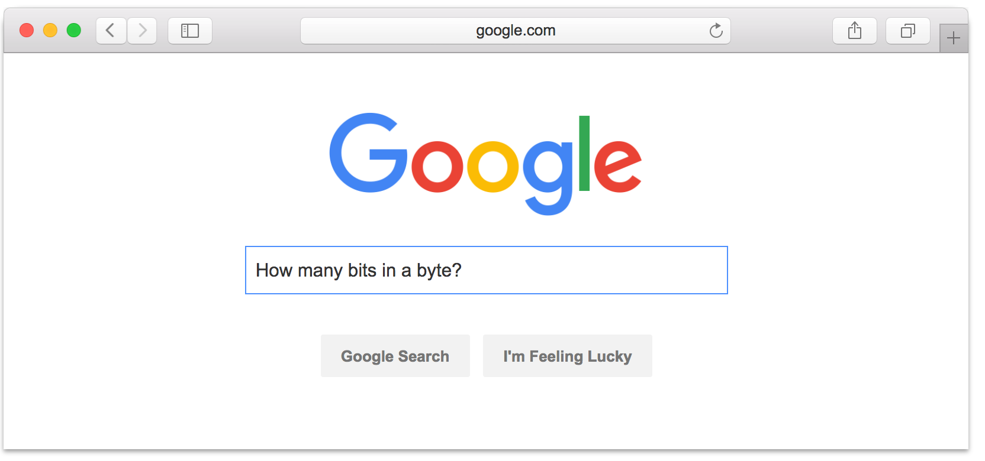
Warning #3: Don’t expect 24x7 answers
Try to figure out yourself
Piazza not designed for debugging
Utilize right venue: Go to office hours (TAs or LAs)
Send detailed Q’s / bug reports, not “no idea what’s wrong”
Instructors are not on pager duty 24 x 7
Don’t expect response before next business day
Questions Friday night @ 11pm should not expect fast responses. Be happy with something before Monday.
Implications
Students should answer each other (+ it’s worth credit)
Start your assignments early!

Slide 32
Policy: Write Your Own Code
Programming is an individual creative process. At first, discussions with friends is fine. When writing code, however, the program must be your own work.
Do not copy another person’s programs, comments, or any part of submitted assignment. This includes character-by-character transliteration but also derivative works. Cannot use another’s code, etc. even while “citing” them.
Writing code for use by another or using another’s code is academic fraud in context of coursework.
Do not publish your code e.g., on github, during/after course!

Slide 33
Policy: Write Your Own Code
Programming is an individual creative process. At first, discussions with friends is fine. When writing code, however, the program must be your own work.
Do not copy another person’s programs, comments, or any part of submitted assignment. This includes character-by-character transliteration but also derivative works. Cannot use another’s code, etc. even while “citing” them.
Writing code for use by another or using another’s code is academic fraud in context of coursework.
Do not publish your code e.g., on github, during/after course!
Don’t Plagiarize!

Slide 34
518 specifics

Slide 35
Grading
Semester-long project (40% total)
Recitation participation (30% total
Two exams (30% total)
Midterm exam before fall recess (15%)
Final exam during exam period (15%)
Mostly same midterm/final as 418, without Go/programming assignment related questions.

Slide 36
Recitations / paper readings
One paper that everybody reads
Discuss paper at length in recitation
Be prepared: We’ll cold-call students!
Friday recitations: 1:30 – 2:30, 2:30 – 3:30 pm
Mandatory: Will record attendance + participation
This Friday: Butler Lampson (Turing Laureate): “Hints for Computer System Design”

Slide 37
Course Project
Groups of 2 per project
Project schedule (to be posted online)
Team selection
Project proposal
Finalized project proposal
Interim project presentation
Final project presentation
Final project report published on Medium:
https://medium.com/princeton-systems-course

Slide 38
Course Project: Options
Choice #1: Reproducibility
Select paper from class or paper on related topic
Re-implement and carefully re-evaluate results
See detailed proposal instructions on webpage
Choice #2: Novelty (less common)
Must be in area closely related to 518 topics
We will take a narrow view on what’s permissible
Both approaches need working code, evaluation

Slide 39
Topics Preview

Slide 40
Fundamentals
Lectures
Network communication and Remote Procedure Calls
State in Network File Systems & the Web
Time, logical clocks
Vector clocks, distributed snapshots
Precepts
Lots of Go
Mapreduce (assignment 1)

Slide 41
Eventual Consistency and Scaling Out
Lectures
Eventual consistency and Bayou
Peer-to-peer systems and Distributed Hash Tables
Scale-out key-value storage and Dynamo
Precepts
More Go
Distributed snapshots (assignment 2)
Notes:
How do you build systems that continue to work and scale despite failure?

Slide 42
Replicated State Machines
Lectures
Replicated State Machines, Primary-Backup
Reconfiguration and View Change Protocols
Consensus and Paxos
Leader Election and RAFT
Precepts
Viewstamped replication
RAFT (Assignments 3,4)
Notes:
Eventually consistent programs presented a hard-to-use interface to higher-level programs
How do you build systems that really work despite failure and have a much cleaner interface? (i.e., hide all the complexity)

Slide 43
Strong Consistency and Scaling Out with Transactions
Lectures
Strong consistency and the CAP Theorem
Scalable Causal Consistency
Atomic commit and Concurrency Control
Spanner (Concurrency control + Paxos!)
The SNOW Theorem and Systems
Precepts
Consistency
Concurrency control
Notes:
How do you build systems that scale with a clean interface? (i.e.,, hide all the complexity)

Slide 44
Various Topics
Lectures
Blockchains
Big data processing
Cluster scheduling and fairness
…
Precepts
Big data systems
Notes:
So many other interesting, practical, exciting topics, we’ll try to cover as many we can!

