Slide 1




Gaze-Wasserstein: A Quantitative Screening Approach to Autism Spectrum Disorders
IEEE Conference on Wireless Health 2016
${\text{Kun} \text{Woo} \text{Cho}}^{1},{\text{Feng} \text{Lin}}^{1}$, ${\text{Chen} \text{Song}}^{1}$, ${\text{Xiaowei} \text{Xu}}^{1}$, ${\text{Michelle} \text{Hartley}\text{−}\text{McAndrew}}^{2}$, ${\text{Kathy} \text{Ralabate} \text{Doody}}^{3}$, and ${\text{Wenyao} \text{Xu}}^{1}$
$${\text{Department} \text{of} \text{Computer} \text{Science} \text{and} \text{Engineering}\text{, }\text{University} \text{at} \text{Buffalo}\text{ (}\text{SUNY}\text{)}}^{1}$$
$${\text{Children}\text{’}\text{s} \text{Guide} \text{Foundation} \text{Autism} \text{Spectrum} \text{Disorder} \text{Center}}^{2}$$
$${\text{Department} \text{of} \text{Exceptional} \text{Education}\text{, }\text{Buffalo} \text{State} \text{University}\text{ (}\text{SUNY}\text{)}}^{3}$$

Slide 2

Autism Spectrum Disorder
A neurodevelopmental condition that is defined by concerns in three major domains:
Social Interaction
  Abnormality in nonverbal behaviors related to eye-to-eye gaze, facial expression, and body gesture.
Communication
  Lack of spontaneous social imitative play
Behavior
  Persistent and intensive preoccupation with parts over whole

Slide 3
Estimated Prevalence of Child Autism
  According to CDC, about 1 in 68 children in the US has been diagnosed with ASD in 2016.
  Significant gap between the number of children diagnosed with autism and the number receiving services.
    Limitations of current diagnosis approach for ASD.
1 in 45
1 in 68

Slide 4

Current Diagnostic Practice
Low accessibility
  Autism Diagnostic Observation Schedule (ADOS)
    Specialized clinical setting.
      High costs : $3,095 per kit.
      Long duration : 30- 45 minutes per modules.
    Trained professional.
Subjectiveness
  Dependence on the expertise and experience of physicians
Late Screening
Delayed Treatment

Slide 5
Why early intervention of ASD is needed?
Early delivery of appropriate medical care
  Early treatment can encourage child’s brain to reroute around faulty neural pathways.
Pre-emptive education planning
  Improvement in autism symptoms, particularly with building social and communication skills.
Provision for family support
  Martial: High Divorce Rate of 23.5%.
  Financial: 14% more family expense.

Slide 6
Behavior Marker of ASD
Prior works show gaze is promising marker of ASD.
  Behavior:
    Abnormality in visual function of individuals with ASD on the visual perception stimulus (Dakin et al).
  Social Interaction:
    Abnormality in dynamic gaze pattern when social scene is shown (Song et al).
Basis of our Approach
Visual Stimuli Design
[1] Dakin, Steven, and Uta Frith. "Vagaries of visual perception in autism."Neuron 48.3 (2005): 497-507.
[2] Song, Chen, et al. "Analyzing dynamic components of social scene parsing strategy in autism spectrum disorder." 2016 IEEE-EMBS International Conference on Biomedical and Health Informatics (BHI). IEEE, 2016.

Slide 7
Rationale of our system: Gaze-Wasserstein
We propose a gaze pattern-based ASD screening method.
Rationale:
  Can provide objective gaze-pattern-based measurements for home-based ASD screening.
  Can be easily deployed on any mobile technologies with a front camera.
  Cost-effective, fast, and highly accessible.

Slide 8
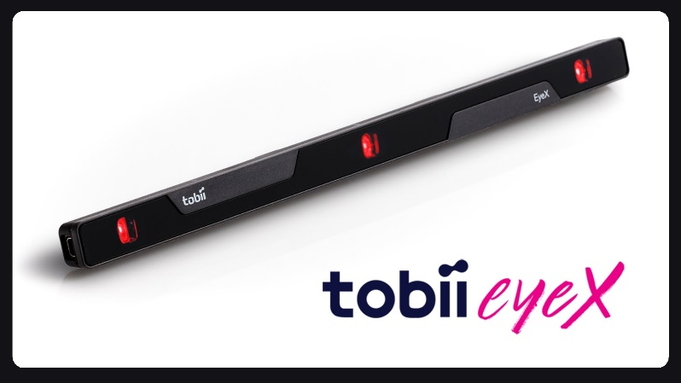
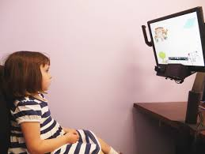
Experimental Details
Eye tracker:
  Tobii EyeX
  Sampling frequency: 80Hz
  Angel resolution: 0.1 degree
Participants:
  32 children ranging in age from 2 to 10
  16 children with ASD and 16 typically developing children
Experimental Setting:
  8 visual stimuli: 4 social scene and 4 non-social scene
  5 sec duration for each stimulus
  2 sec black screen on the monitor between two consecutive stimuli
    To refresh the participant’s gaze response
    To make each stimulus independent

Slide 9
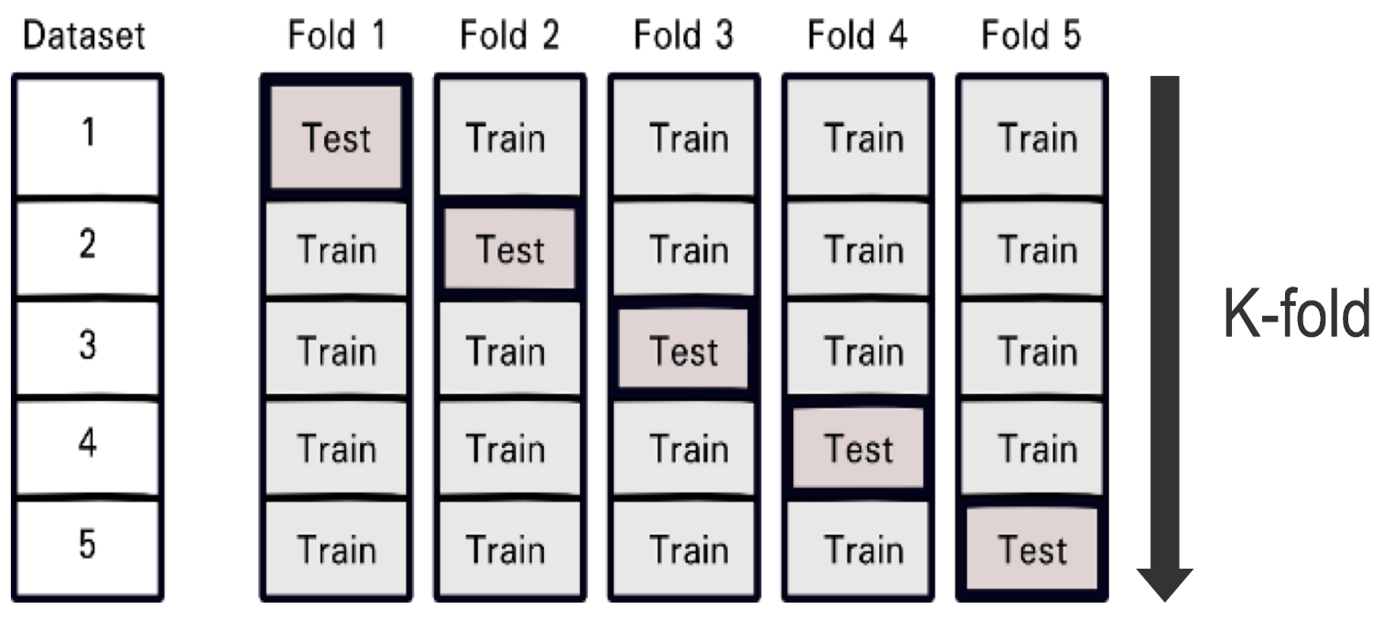
Experimental Method
Leave-one-out-cross-validation used to estimate how accurately a predictive model will perform in practice.
Classification with k nearest neighbors
  Modified 1st Wasserstein is our distance function.
  K equals 3.

Slide 10
Social(S)-Tech(T) Challenges
How to design visual stimuli? (S)
Which is the best similarity matching metric?
How long is the exposure duration for visual stimuli?

Slide 11
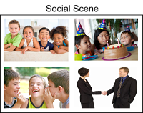
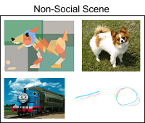
Visual Stimuli Design
Two categories of visual stimuli are designed based on previous literature review [1].
  Social Scene (SS) : Images that are illustrating social interactions of more than one human figure.
  Non-social Scene (NSS) : Images that are depicting a single non-human object.
  Background is visually clean to avoid any unintentional distraction.
[1] Song, Chen, et al. "Analyzing dynamic components of social scene parsing strategy in autism spectrum disorder." 2016 IEEE-EMBS International Conference on Biomedical and Health Informatics (BHI). IEEE, 2016.

Slide 12
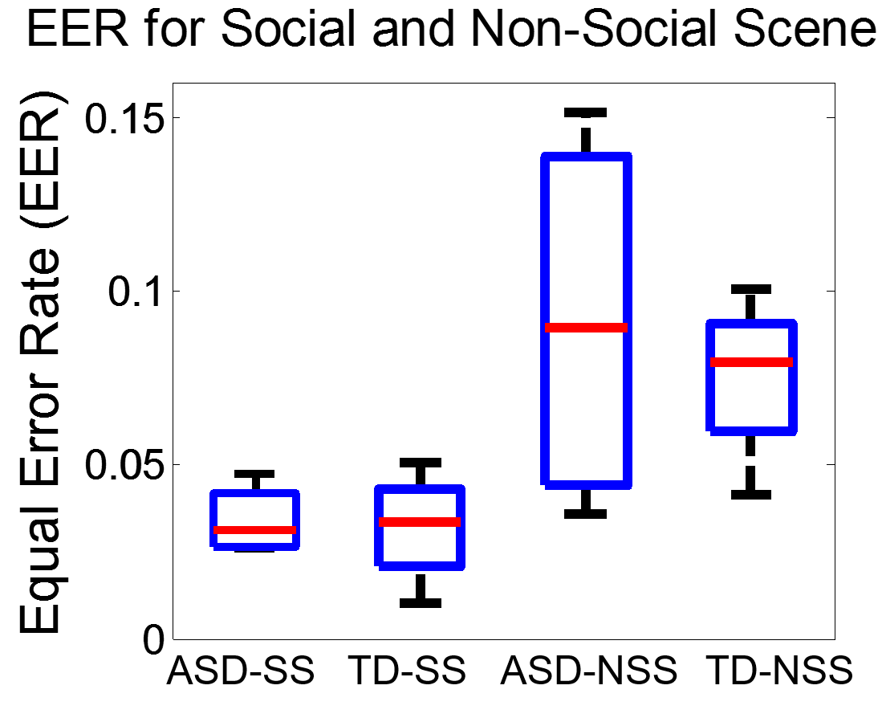
Impact of Stimuli Type on System Performance
F-score Accuracy
  Harmonic mean of precision and recall used to avoid unbalanced accuracy measurement.
Equal Error Rate
  Rate at which acceptance error (FPR) and rejection error (FNR) are equal.
  Accuracy of the system is high when EER is low.
93.8
94.12
90.21
0.075
88.84
0.034
0.032
0.092

Slide 13
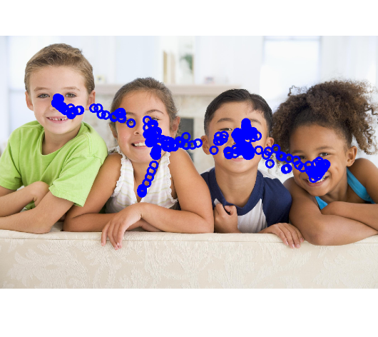
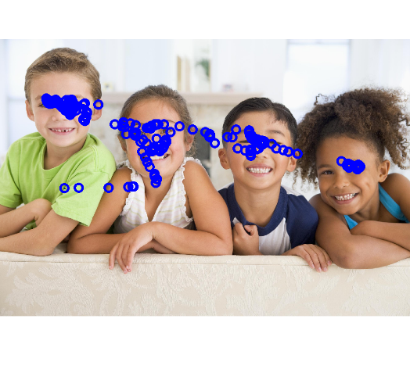
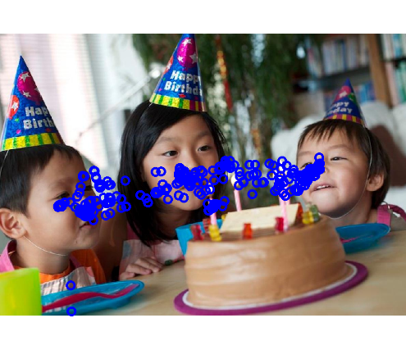
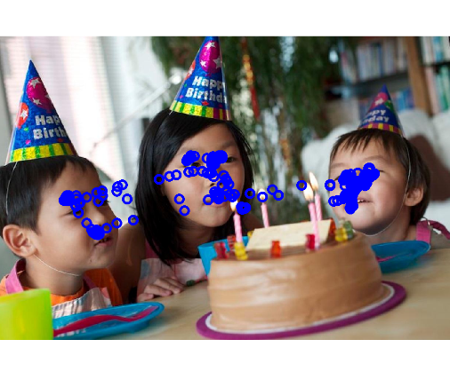
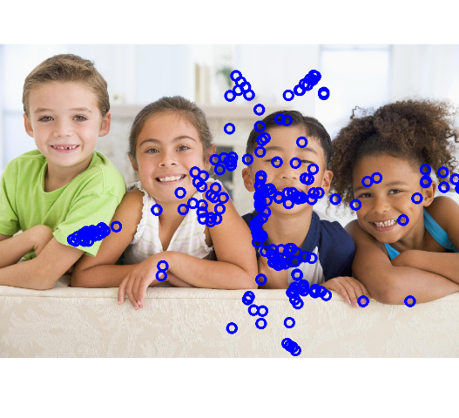


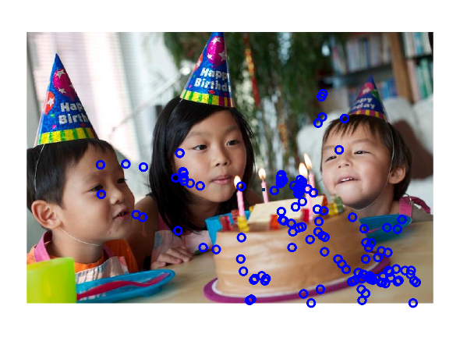
Gaze Distribution on Social Scenes
TD subjects
ASD subjects

Slide 14
Social(S)-Tech(T) Challenges
How to choose visual stimuli? (S)
Which is the best similarity matching metric? (T)
How long is the exposure duration for visual stimuli?

Slide 15
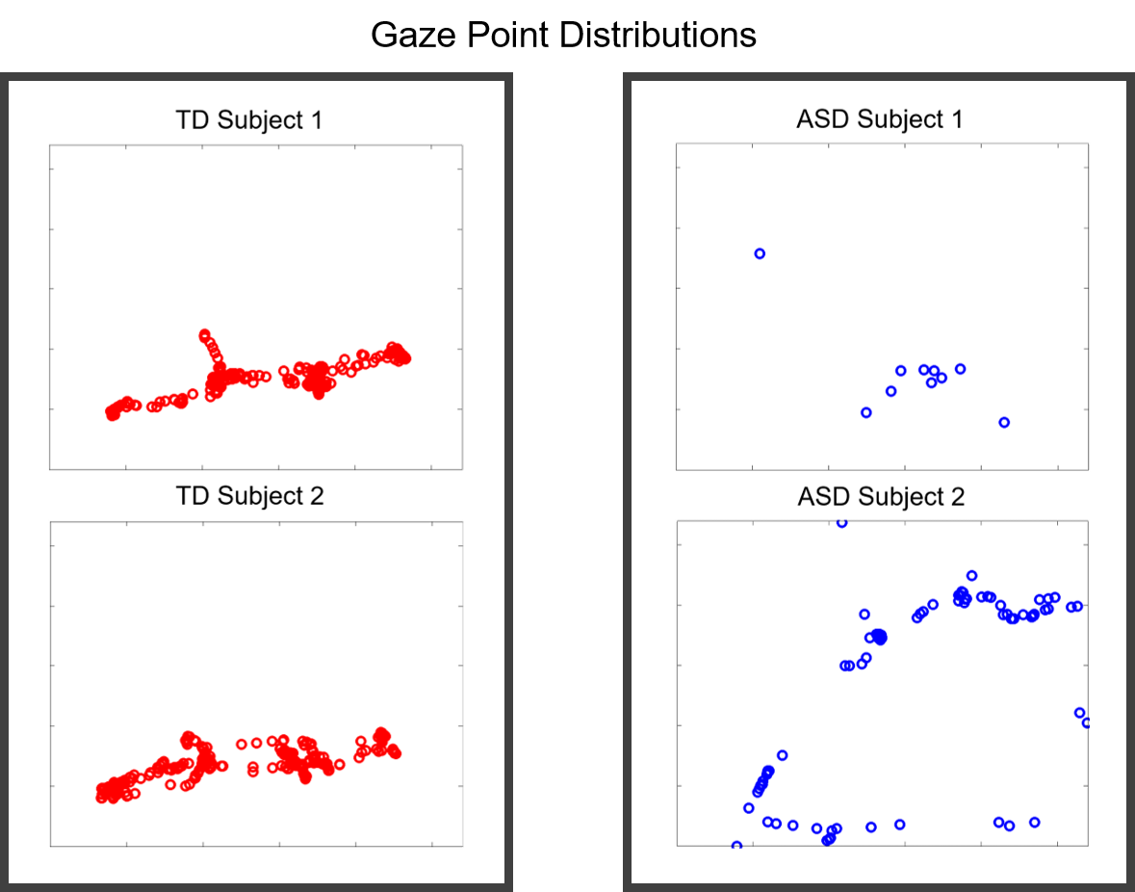
Gaze Distribution in Each Group
Similar Distribution Among TD Subjects
Dissimilar Distribution Among ASD Subjects
Gaze pattern of ASD subject is either very narrow or widely distributed.
  Persistent preoccupation with parts over whole
  Inability to focus on the social scene
Fixed Range of View
Wide Distribution

Slide 16
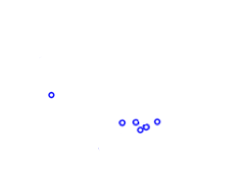

Modified 1st Wasserstein Distance
  M to N matching.
  Modified to avoid partial matching by adding a constraint [1], otherwise some ASD may misclassify as TD.
  Insensitive to noise [2] caused by accidental eye movement or possible error from eye tracking device.
TD Data
ASD Data
$$∋$$
Persistent preoccupation of part
[1] O. Pele and M. Werman, “A linear time histogram metric for improved sift matching,” in Computer Vision–ECCV 2008. Springer, 2008, pp. 495–508.
[2] E. Levina and P. Bickel, “The earth mover’s distance is the mallows distance: some insights from statistics,” in Computer Vision, 2001. ICCV 2001. Proceedings. Eighth IEEE International Conference on, vol. 2. IEEE, 2001, pp. 251–256.

Slide 17
Social(S)-Tech(T) Challenges
How to choose visual stimuli? (S)
Which is the best similarity matching metric? (T)
How long is the exposure duration for visual stimuli? (S/T)

Slide 18

Social-Tech dilemma
Longer duration better classification
Low user compliance shorter duration

Slide 19
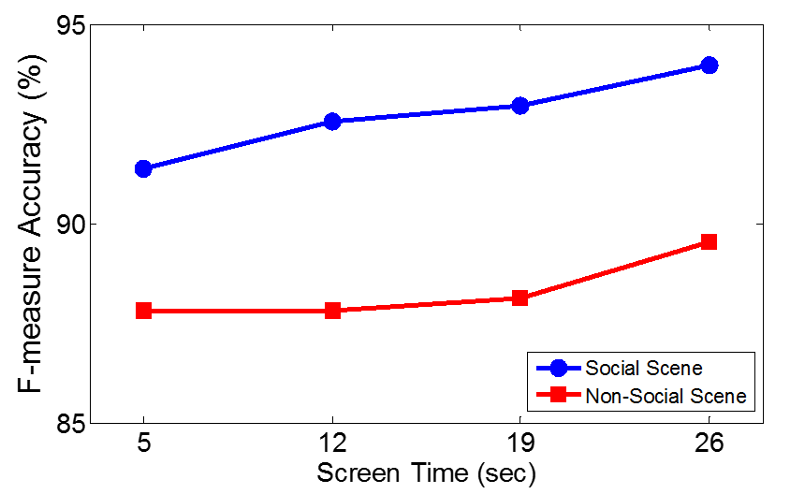
Optimization of Screen Time Efficiency
  It is important because child participant may have low compliance and limited attentions in the study.
  Accuracy at 26-second screen time for Social Scene reaches over 93%.
    Compared to duration of ADOS (30-45 min), our method is 69-104 times faster.

Slide 20
Evaluation Results
Using gaze pattern and social scene stimuli, our method can achieve f-score accuracy of 93.96% and equal error rate of 3.30%.
In order to perform Gaze-Wasserstein, only two technologies are needed:
  Monitor to display visual stimuli.
  Hardware containing the eye-tracking system.
All Stimuli | Recall (%) | Precision (%) | EER (%)
ASD | 92.19 ± 7.86 | 95.41 ± 3.07 | 3.40 ± 2.67
TD | 95.31 ± 3.13 | 92.93 ± 6.52 | 3.19 ± 2.06
F-measurement | 93.75 ± 2.55 | 94.17 ± 2.08 | 3.30± 1.28
Both can be provided by smartphones [1].
[1] Krafka, Kyle, et al. "Eye tracking for Everyone." Proceedings of the IEEE Conference on Computer Vision and Pattern Recognition. 2016.

Slide 21
Acknowledgement
UB CSE
  Feng Lin
  Chen Song
  Wenyao Xu
UB Pediatrics
  Michelle Hartley-McAndrew
UB ECRC
  X. Christine Wang
Children’s Guild Foundation Autism Spectrum Disorder Center
  Jana Mertz
Buffalo State
  Kathy Ralabate Doody
Google
  Changzhan Gu
UVa
  Yan Zhuang
Texas Tech U
  Changzhi Li
U Notre Dame
  Xiaowei Xu

Slide 22


