Slide 1
Programmable Data Plane
COS561, Fall 2018

Slide 2
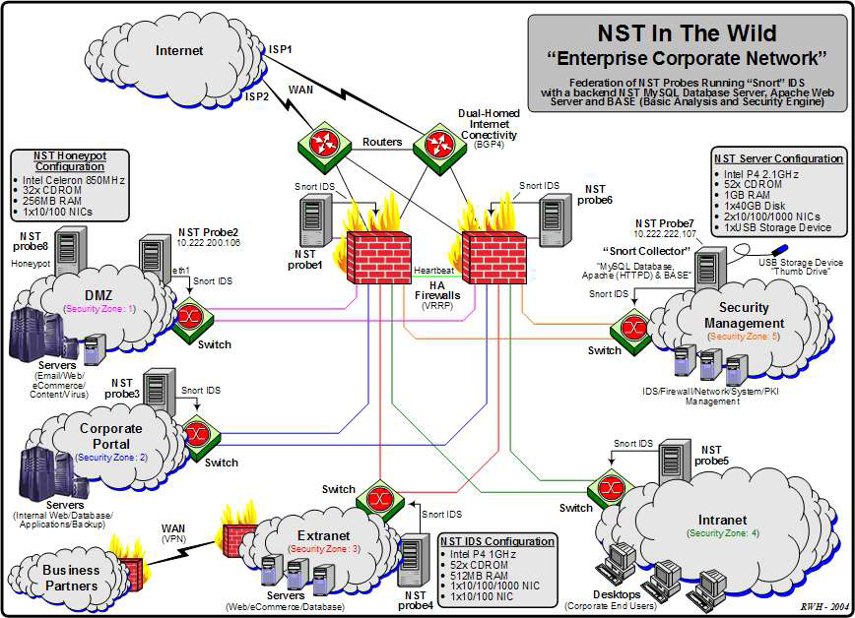
Before SDN…
Many boxes (routers, switches, firewalls, …), with different interfaces.

Slide 3
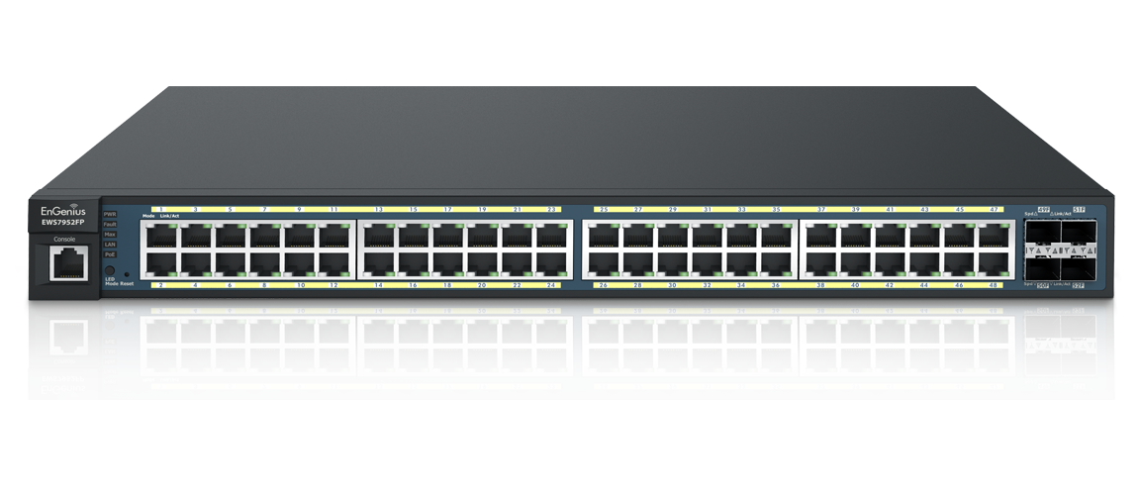
A Brief History of SDN
Many functions in networking devices
Routing, Switching, NAT, Firewall, Shaper…
“Many Boxes, But Similar Functions”
Common functions, Unified control interface!
Match + Action
Match on subset of header bits
Action: forward, flood, drop, rewrite, count, etc
Router? Switch? Firewall?

Slide 5
decouple control and data planes by providing open standard API

Slide 6
Controller Application
Controller Platform

Slide 7
From OpenFlow to P4/PISA
OpenFlow 1.0 feature set is “the intersection of all vendors”
From The Original OpenFlow paper:
Programmable action, fixed header matching
Problem: what if… (you never know!)
Version | Date | # Headers
OF 1.0 | Dec 2009 | 12
OF 1.1 | Feb 2011 | 15
OF 1.2 | Dec 2011 | 36
OF 1.3 | Jun 2012 | 40
OF 1.4 | Oct 2013 | 41

Slide 8
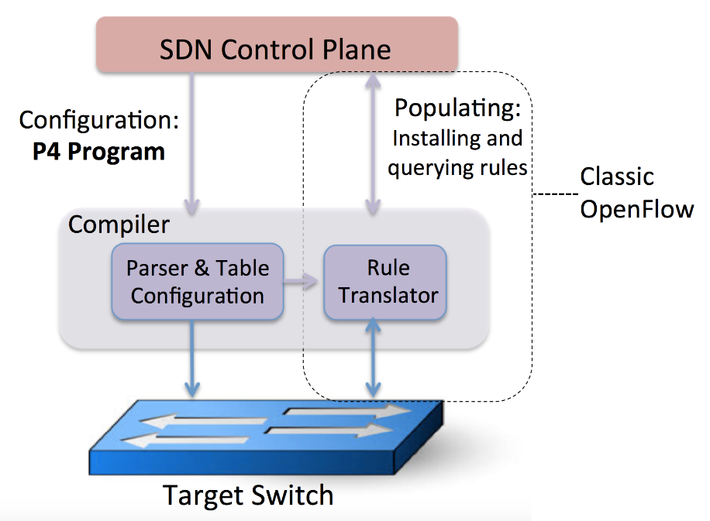
P4: more programmability
Now you define “program”, not just “rules”.

Slide 9
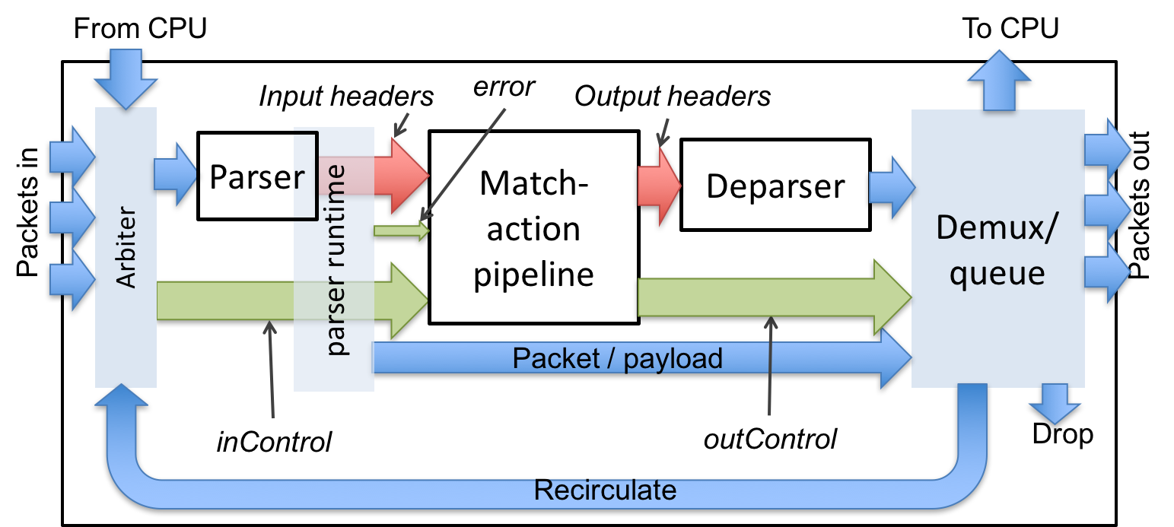
Intro to P4
A programming language for packet processing.
Key functionality:
Customized parsing
Match-action tables
Register Memory Access (what we care about)

Slide 10
Programmable Parsing (State Machine)
Start
Ether
Basically a DFA
Read some bytes -> go to new state
Example: Layer 2~4 parsing
This part can be programmable to add customized header types. (E.g., QUIC?)
0x0800
VLAN
IPv4
IPv6
6
47
TCP
UDP
ICMP
Accept

Slide 11
Match-Action Table: If…Then…
Match support exact, LPM, ternary
Example: simple IPv4+TCP routing table
Action can be:
Set egress port / drop
Set temporary variable (for other actions)
Read/Write register (persistent)
Arithmetic operation on header/metadata
Combination of above
…
Match: IPv4.dstAddr | Action
10.1.0.0/16 | EgressPort=001 IPv4.ttl -= 1
10.2.0.0/16 | EgressPort=002 IPv4.ttl -= 1
10.255.255.255 | Egress=Broadcast IPv4.ttl -= 1
Else | Drop

Slide 12
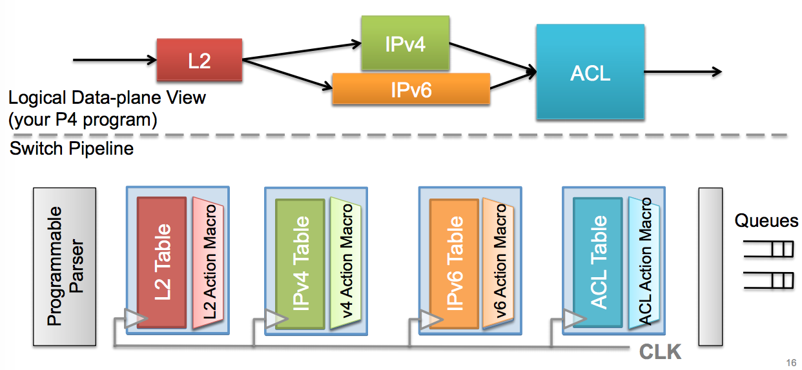
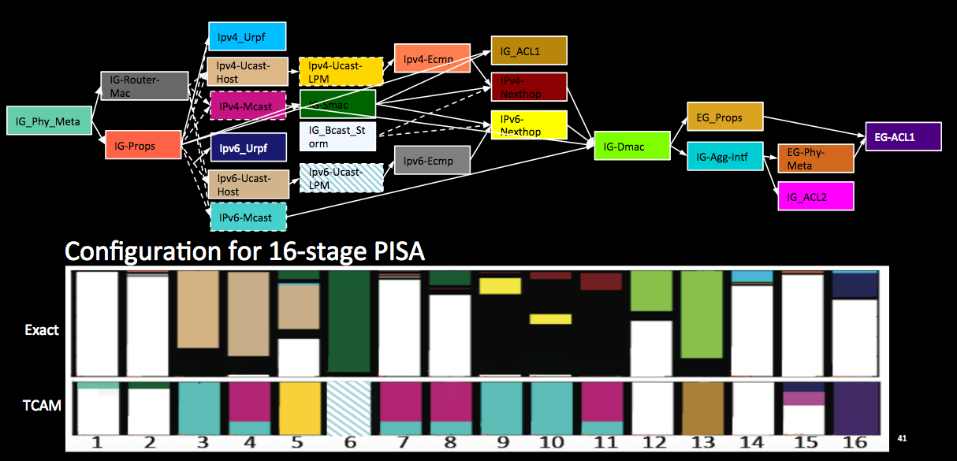
Multiple Match-Action Tables
A “control flow” applies multiple match-action tables to a packet in some order.
In hardware, the “control flow” is actually a pipeline. (Sequential)

Slide 13
Hardware Support of P4
A software emulator (very slow)
P4-netFPGA, first practical P4 switch
DPDK integration and OpenVSwitch integration – PISCES project
Barefoot Networks, making the first “P4-supported” programmable switches
An unnamed network switch vendor used P4 internally
but not exposed to their customers!
“Supported by hardware, not supported by business model” :-(

Slide 14
Memory Model in PISA Switch (Header vs Register)
Most matches and actions are stateless; no effect for the next packet.
“Interesting” ones are stateful (lifespan >1 packet)
Use SRAMs to implement stateful objects:
Counters (packet count, byte count)
Meters (e.g. 2-rate 3-color)
Registers (programmable! Random access!)

Slide 15
Register Primitive: Random Access
Read_register: variable=arr[index]
Write_register: arr[index]=variable
(disclaimer: actual P4 syntax more complicated)
Example: Ternary Match (UDP.sport, UDP.dport)
If UDP.dport==53:
Tmp=dns_count_array[hashed_src_ip]
dns_count_array[hashed_src_ip]=Tmp+1
If UDP.sport==53:
Tmp=dns_count_array[hashed_dst_ip]
dns_count_array[hashed_dst_ip]=Tmp-1
(reflection attack detection)

Slide 16
PISA Processing Model
Programmable Parser
Persistent State
Programmable Deparser
Memory
ALU
Match/Action Table
ip.src=1.1.1.1
ip.dst=2.2.2.2
...
Stages
Packet Header Vector
ip.src=3.3.3.3
ip.dst=2.2.2.2
...

Slide 17
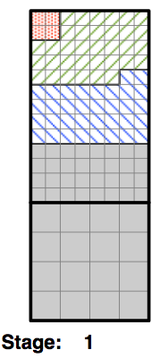
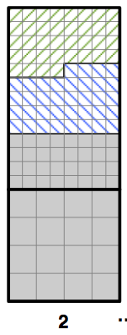
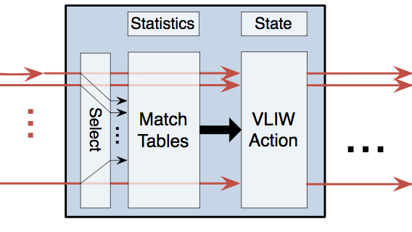
Under the hood
Register SRAM
(stateful)
Pipeline Memory
(stateless)
Pipeline Memory
(stateless)
1 | 2 | 3 | 4 | 5 | 6 | 7 | 8 | …
0 | 0 | 0 | 0 | 1 | 1 | 0 | 0
Packet N+1
Packet N
Packet N-1
Header
Header
Metadata
Metadata

Slide 18
Summary of P4 and PISA
Protocol Independent:
Any header format, future-proof
Fully programmable:
Faster feature-to-market time
Pipelined Packet Processing
Depending on hardware target!
Other targets exist (e.g., FPGA boards)

Slide 19
Application: Network Measurement
Collect statistics of network traffic, for...
Security
Performance diagnostics
Capacity planning

Slide 20
Measurement in the Data Plane?
Opportunity: programmable switches!
Only report result to controller, upon demand
Immediate per-packet action in the data plane
Challenges
Restrictive programming model
Limited state (memory)
Our solution: Probabilistic Recirculation (PRECISION)

Slide 21
Challenges of Running Algorithms on PISA
Constrained memory access:
Partitioned between stages
Can only R/W one address per stage
Computation: only basic arithmetic
Limited memory size, limited #stages

Slide 22
Recirculation to the rescue?
Programmable Parser
Persistent State
Programmable Deparser
Memory
ALU
Packet
Stages

Slide 23
Challenges of Running Algorithms on PISA
Constrained memory access:
Partitioned between stages
Can only R/W one address per stage
Computation: only basic arithmetic
Limited memory size, limited #stages
Recirculation helps, but hurts throughput

Slide 24
The Heavy-Hitter Detection Problem
A few “Heavy-Hitters”, a.k.a. elephant flows, send most of the packets.
To catch these elephants, we:
Report top-k flows
Estimate flow size for each flow
Metrics:
Recall
On-arrival MSE
Flow size
All flows

Slide 25
Example P4-based application: Heavy-Hitter Detection
How can we use programmable switches to measure heavy-hitters?
Step 1: Find a good algorithm
Run on general-purpose computer
Step 2: Adapt it to PISA switches

Slide 26
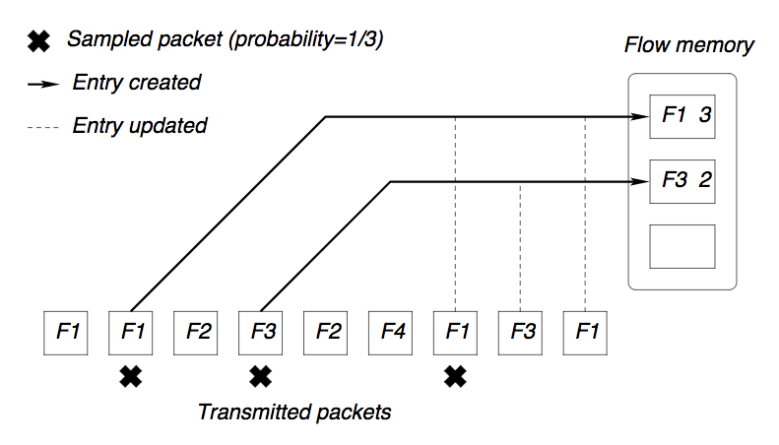
Naïve solution: Sample and Hold
Problem: Many small flows get sampled, wasting memory.

Slide 27
The Space-Saving Algorithm (Metwally et al.)
Metwally, et al. Efficient computation of frequent and top-k elements in data streams. ICDT 2005.

Slide 28
The Space-Saving Algorithm
Widely used, easy to implement
Performance suffers when there are too many small flows
Flow size
Too many!
All flows
What we care

Slide 29
Randomized Admission Policy (RAP) (Ben Basat et al.)
What if we don’t always replace the minimum?
When minimum counter is c_{min}, replace it with a small probability
“Increment 1 in expectation”: P=1/(c_{min}+1)
Ben Basat, et al. Randomized admission policy for efficient top-k and frequency estimation. INFOCOM 2017

Slide 30
Randomized Admission Policy (RAP) (Ben Basat et al.)
P=1/4 (c_{min}=3)
P=1/2 (c_{min}=1)
P=1/4 (c_{min}=3)
P=1/3 (c_{min}=2)

Slide 31
Adapting RAP to Programmable Switches
Space-Saving and RAP are for computers!
Constraints of programmable switches:
Cannot know the global minimum counter
Partitioned memory – too late to update
How to flip coin?
Recirculation hurts throughput

Slide 32
Adapting to Data Plane: Cannot Find Minimum
What if you can only R/W a few memory addresses?
Can’t find global minimum c_{min}
Find approximate minimum c’_{min}, by randomly querying 4 addresses (based on flow ID)
Count-Min Sketch (Cormode and Muthukrishnan), HashPipe (Sivaraman et al.)
Flow ID: x
h₁(x)=0 h₂(x)=2 h₃(x)=0 h₄(x)=3
h₁ |  | h₂ |  | h₃ |  | h₄
Flow ID: y
h₁(y)=3 h₂(y)=2 h₃(y)=3 h₄(y)=1
Sivaraman et al. Heavy-hitter detection entirely in the data plane. SOSR 2017
Graham Cormode and Shan Muthukrishnan. An improved data stream summary: the count-min sketch and its applications. Journal of Algorithms 55.1 (2005): 58-75.

Slide 33
Adapting to Data Plane: Too Late to Update
We know the approximate minimum count c’_{min} at the end of pipeline. Too late to update!
Solution: use a little recirculation
If coin flip succeeded, recirculate with (Flow ID, minimum stage #)
h₁ |  | h₂ |  | h₃ |  | h₄
5 |  |  |  | 7
 |  | 3
 |  |  |  |  |  | 4
4
Flow ID=x
Stage#=2, c’_{min}=3
Sivaraman et al. Heavy-hitter detection entirely in the data plane. SOSR 2017
Notes:
HashPipe choose to never recirc. The authors considered recirculation, but dismissed it as being impractical; hurts too much throughput.
We choose to recirc only a little bit…

Slide 34
Adapting to Data Plane: How to flip coin?
P | P’ | How many binary coins?
1/2 | 1/2
1/3 | 1/4
1/4 | 1/4
1/5 | 1/8
1/7 | 1/8
1/8 | 1/8
1/9 | 1/16
We need to flip coin w.p. P=1/(c’_{min}+1)
No arbitrary flip! Only binary flips
Naïve solution:
Find 2^{-N} ≥ P > 2^{-(N+1)}
Flip N binary coins, get P’=2^{-N}
(2-approximation of probability P)
Better solution: use Match-Action Table (1.125-approx., see paper)

Slide 35
Adapting to Data Plane: Recirculation Hurts Throughput
Avoid packet reordering
Send original (preserve ordering)
Copy the packet, then recirc+drop
Upper-bound recirc. to a small percentage, e.g., 1%
By initializing counters to 100
Switch may have reserved capacity for recirc; no performance penalty.
h₁ |  |  | h₂ |  |  | h₃
_{ID} | # |  | _{ID} | # |  | _{ID} | #
N/A | 100 |  | N/A | 100 |  | N/A | 100
a | 101 |  | N/A | 100 |  | N/A | 100
c | 103 |  | f | 105 |  | N/A | 100
N/A | 100 |  | N/A | 100 |  | N/A | 100
c’_{min}≥ 100, P<1%

Slide 36
PRECISION Algorithm
h₁ |  |  | h₂ |  |  | h₃
_{ID} | # |  | _{ID} | # |  | _{ID} | #
a | 106 |  | N/A | 100 |  | N/A | 100
b | 103 |  | g | 102 |  | N/A | 100
c | 105 |  | f | 130 |  | k | 160
d | 104 |  | N/A | 100 |  | l | 180
Visit d=3 random entries, one per stage
If ID matched, add 1!
Otherwise, find out c’_{min}
Flip coin, P=1/(c’_{min}+1)
If coin is head:
copy and recirculate
update minimum counter
Pkt
ID=z
z
103
S#=2
ID=z
c’_{min}=102
Coin flip: P=1/103

Slide 37
Evaluation Highlight
Problems of recirculation:
Impact throughput?
Bound probability to 1%!
No accuracy loss
Delayed update?
No accuracy loss
Other potential problems:
Approximated coin flip?
2-approx. is good
1.125-approx. is great
Limited stages?
2 stages are good
4 are great

Slide 38
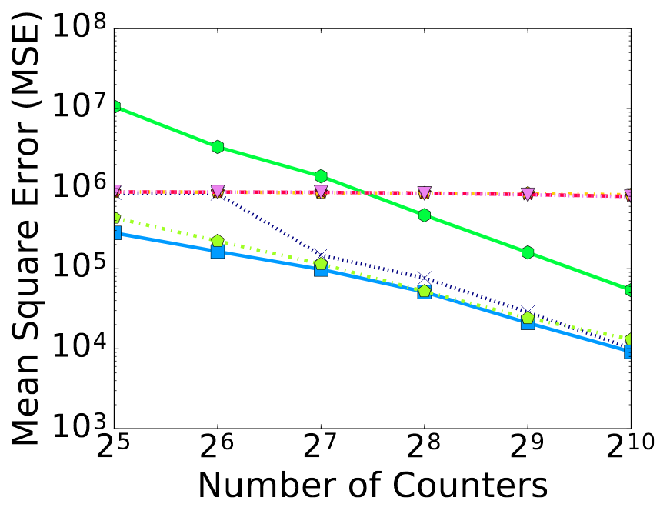
Evaluation: Mean-Square Error, CAIDA
Space-Saving:
HashPipe:
2-stage 4-stage 8-stage
PRECISION (2-stage):
2-approx. coin flip
1.125-approx. coin flip
ideal flip (RAP)

Slide 39
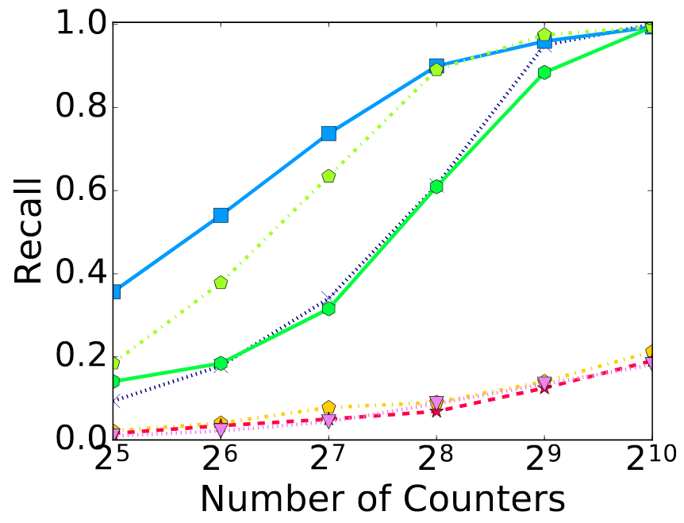
Evaluation: top-32 flows, CAIDA
Space-Saving:
HashPipe:
2-stage 4-stage 8-stage
PRECISION (2-stage):
2-approx. coin flip
1.125-approx. coin flip
ideal flip (RAP)

Slide 40
Summary
PRECISION: an accurate, hardware-friendly algorithm for heavy-hitter detection on programmable switches.
Takeaway: approximate probabilistic recirculation!
Hardware Friendly.
Little Impact on throughput.
Better Accuracy.

Slide 41
Any Questions

