Slide 1
Time
COS 418: Distributed Systems
Lecture 3
Wyatt Lloyd

Slide 2
Today
The need for time synchronization
“Wall clock time” synchronization
Logical Time: Lamport Clocks

Slide 3
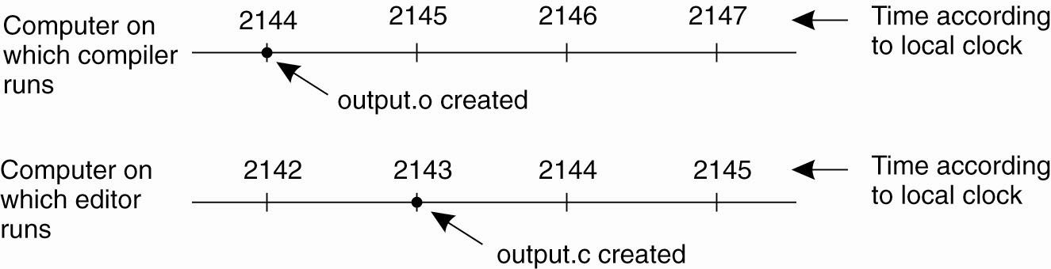
A distributed edit-compile workflow
Physical time →
2143 < 2144 ➔ make doesn’t call compiler
Lack of time synchronization result – a possible object file mismatch

Slide 4
What makes time synchronization hard?
Quartz oscillator sensitive to temperature, age, vibration, radiation
  Accuracy circa one part per million (one second of clock drift over 12 days)
  The internet is:
    Asynchronous: arbitrary message delays
    Best-effort: messages don’t always arrive

Slide 5
Today
The need for time synchronization
“Wall clock time” synchronization
  Cristian’s algorithm, NTP
Logical Time: Lamport clocks

Slide 6
Just use Coordinated Universal Time?
UTC is broadcast from radio stations on land and satellite (e.g., the Global Positioning System)
  Computers with receivers can synchronize their clocks with these timing signals
Signals from land-based stations are accurate to about 0.1−10 milliseconds
Signals from GPS are accurate to about one microsecond
  Why can’t we put GPS receivers on all our computers?
Notes:
Q: Why not GPS on everything?
A: Expensive + GPS does not work inside buildings

Slide 7


Synchronization to a time server
Suppose a server with an accurate clock (e.g., GPS-receiver)
  Could simply issue an RPC to obtain the time:
But this doesn’t account for network latency
  Message delays will have outdated server’s answer
Client
Server
Time of day?
2:50 PM
Time ↓

Slide 8
Cristian’s algorithm: Outline
Client
Server
Client sends a request packet, timestamped with its local clock T₁
Server timestamps its receipt of the request T₂ with its local clock
Server sends a response packet with its local clock T₃ and T₂
Client locally timestamps its receipt of the server’s response T₄
T₁
request:
T₁
T₂
T₃
T₄
T₂,T₃
response:
How can the client use these timestamps to synchronize its local clock to the server’s local clock?
Time ↓

Slide 9
Cristian’s algorithm: Offset sample calculation
Client
Server
Goal: Client sets clock ← T₃ + 𝛿_{resp}
Client samples round trip time 𝛿 = 𝛿_{req} + 𝛿_{resp} = (T₄ − T₁) − (T₃ − T₂)
But client knows 𝛿, not 𝛿_{resp}
T₁
request:
T₁
𝛿_{req}
T₂
𝛿_{resp}
T₃
Assume: 𝛿_{req} ≈ 𝛿_{resp}
T₄
T₂,T₃
response:
Client sets clock ← T₃ + ½𝛿
Time ↓

Slide 10
Today
The need for time synchronization
“Wall clock time” synchronization
  Cristian’s algorithm, Berkeley algorithm, NTP
Logical Time: Lamport clocks

Slide 11
Berkeley algorithm
A single time server can fail, blocking timekeeping
The Berkeley algorithm is a distributed algorithm for timekeeping
  Assumes all machines have equally-accurate local clocks
  Obtains average from participating computers and synchronizes clocks to that average

Slide 12
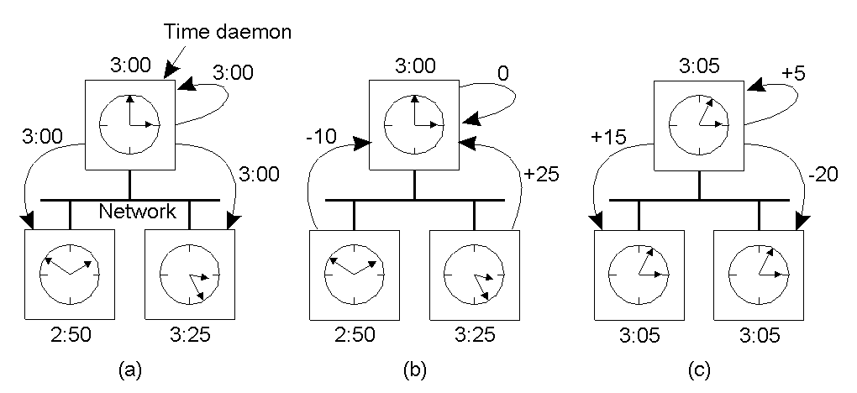
Berkeley algorithm
Master machine: polls L other machines using Cristian’s algorithm → { 𝜃_{i} } (i = 1…L)
Master
Notes:
Fault tolerance via electing a new master…

Slide 13
Today
The need for time synchronization
“Wall clock time” synchronization
  Cristian’s algorithm, NTP
Logical Time: Lamport clocks

Slide 14
The Network Time Protocol (NTP)
Enables clients to be accurately synchronized to UTC despite message delays
Provides reliable service
  Survives lengthy losses of connectivity
  Communicates over redundant network paths
Provides an accurate service
  Unlike the Cristian’s algorithm, leverages heterogeneous accuracy in clocks

Slide 15
NTP: System structure
Servers and time sources are arranged in layers (strata)
  Stratum 0: High-precision time sources themselves
    e.g., atomic clocks, shortwave radio time receivers
  Stratum 1: NTP servers directly connected to Stratum 0
  Stratum 2: NTP servers that synchronize with Stratum 1
    Stratum 2 servers are clients of Stratum 1 servers
  Stratum 3: NTP servers that synchronize with Stratum 2
    Stratum 3 servers are clients of Stratum 2 servers
Users’ computers synchronize with Stratum 3 servers

Slide 16
NTP operation: Server selection
Messages between an NTP client and server are exchanged in pairs: request and response
    Use Cristian’s algorithm
For i^{th} message exchange with a particular server, calculate:
  Clock offset 𝜃_{i} from client to server
  Round trip time 𝛿_{i} between client and server
Over last eight exchanges with server k, the client computes its dispersion 𝜎_{k} = max_{i} 𝛿_{i} − min_{i} 𝛿_{i}
  Client uses the server with minimum dispersion
Then uses a best estimate of clock offset
Notes:
Q: Why use server with min dispersion?

Slide 17
NTP operation : Clock offset calculation
Client tracks minimum round trip time and associated offset over the last eight message exchanges (𝛿₀, 𝜃₀)
  𝜃₀ is the best estimate of offset: client adjusts its clock by 𝜃₀ to synchronize to server
Offset 𝜃
Each point represents one sample
𝜃₀
𝛿₀
Round trip time 𝛿

Slide 18
NTP: How to change time (slewing)
Can’t just change time: Don’t want time to run backwards
  Recall the make example
Instead, change the update rate for the clock
  Changes time in a more gradual fashion
  Prevents inconsistent local timestamps

Slide 19
Clock synchronization: Take-away points
Clocks on different systems will always behave differently
  Disagreement between machines can result in undesirable behavior
NTP clock synchronization
  Rely on timestamps to estimate network delays
  100s 𝝁s−ms accuracy
  Clocks never exactly synchronized
Often inadequate for distributed systems
  Often need to reason about the order of events
  Might need precision on the order of ns
Notes:
Will return to real-time w/ Spanner near the end of the class. Uses worst-case bounds on aggressively synchronized clocks in datacenters in its distributed systems design.

Slide 20
Today
The need for time synchronization
“Wall clock time” synchronization
  Cristian’s algorithm, NTP
Logical Time: Lamport clocks

Slide 21
Motivation: Multi-site database replication
A New York-based bank wants to make its transaction ledger database resilient to whole-site failures
Replicate the database, keep one copy in sf, one in nyc
San Francisco
New York

Slide 22
The consequences of concurrent updates
Replicate the database, keep one copy in sf, one in nyc
  Client sends query to the nearest copy
  Client sends update to both copies
“Deposit
$100”
Inconsistent replicas!
Updates should have been performed in the same order at each copy
$1,000
$1,000
$1,010
$1,100
$1,110
$1,111
“Pay 1%
interest”

Slide 23
RFC 677 “The Maintenance of Duplicate Databases” (1975)
“To the extent that the communication paths can be made reliable, and the clocks used by the processes kept close to synchrony, the probability of seemingly strange behavior can be made very small. However, the distributed nature of the system dictates that this probability can never be zero.”

Slide 24
Idea: Logical clocks
Landmark 1978 paper by Leslie Lamport
Insight: only the events themselves matter
  Idea: Disregard the precise clock time
  Instead, capture just a “happens before” relationship between a pair of events

Slide 25
Defining “happens-before” (→)
Consider three processes: P1, P2, and P3
Notation: Event a happens before event b (a → b)
P1
P2
P3
Physical time ↓

Slide 26
Defining “happens-before” (→)
Can observe event order at a single process
P1
P2
P3
a
b
Physical time ↓

Slide 27
Defining “happens-before” (→)
If same process and a occurs before b, then a → b
P1
P2
P3
a
b
Physical time ↓

Slide 28
Defining “happens-before” (→)
If same process and a occurs before b, then a → b
Can observe ordering when processes communicate
P1
P2
P3
a
b
c
Physical time ↓

Slide 29
Defining “happens-before” (→)
If same process and a occurs before b, then a → b
If c is a message receipt of b, then b → c
P1
P2
P3
a
b
c
Physical time ↓

Slide 30
Defining “happens-before” (→)
If same process and a occurs before b, then a → b
If c is a message receipt of b, then b → c
Can observe ordering transitively
P1
P2
P3
a
b
c
Physical time ↓

Slide 31
Defining “happens-before” (→)
If same process and a occurs before b, then a → b
If c is a message receipt of b, then b → c
If a → b and b → c, then a → c
P1
P2
P3
a
b
c
Physical time ↓

Slide 32
Concurrent events
Not all events are related by →
a, d not related by → so concurrent, written as a || d
P1
P2
P3
a
d
b
c
Physical time ↓

Slide 33
Lamport clocks: Objective
We seek a clock time C(a) for every event a
Clock condition: If a → b, then C(a) < C(b)
  Plan: Tag events with clock times; use clock times to make distributed system correct

Slide 34
The Lamport Clock algorithm
Each process P_{i} maintains a local clock C_{i}
Before executing an event, C_{i} ← C_{i} + 1
P1
C₁=0
P2
C₂=0
P3
C₃=0
a
b
c
Physical time ↓

Slide 35
The Lamport Clock algorithm
Before executing an event a, C_{i} ← C_{i} + 1:
  Set event time C(a) ← C_{i}
P1
C₁=1
P2
C₂=0
P3
C₃=0
C(a) = 1
a
b
c
Physical time ↓

Slide 36
The Lamport Clock algorithm
Before executing an event b, C_{i} ← C_{i} + 1:
  Set event time C(b) ← C_{i}
P1
C₁=2
P2
C₂=0
P3
C₃=0
C(a) = 1
a
C(b) = 2
b
c
Physical time ↓

Slide 37
The Lamport Clock algorithm
Before executing an event b, C_{i} ← C_{i} + 1
Send the local clock in the message m
P1
C₁=2
P2
C₂=0
P3
C₃=0
C(a) = 1
a
C(b) = 2
b
c
Physical time ↓
C(m) = 2

Slide 38
The Lamport Clock algorithm
On process P_{j} receiving a message m:
  Set C_{j} and receive event time C(c) ←1 + max{ C_{j}, C(m) }
P1
C₁=2
P2
C₂=3
P3
C₃=0
C(a) = 1
a
C(b) = 2
C(c) = 3
b
c
Physical time ↓
C(m) = 2

Slide 39
Lamport Timestamps: Ordering all events
Break ties by appending the process number to each event:
  Process P_{i} timestamps event e with C_{i}(e).i
  C(a).i < C(b).j when:
    C(a) < C(b), or C(a) = C(b) and i < j
Now, for any two events a and b, C(a) < C(b) or C(b) < C(a)
  This is called a total ordering of events

Slide 40
Order all these events
P1
C₁=0
P2
C₂=0
P3
C₃=0
P4
C₃=0
a
b
d
f
h
c
e
i
Physical time ↓
g

Slide 41
Totally-Ordered Multicast
Goal: All sites apply updates in (same) Lamport clock order
Client sends update to one replica site j
  Replica assigns it Lamport timestamp C_{j} . j
Key idea: Place events into a sorted local queue
  Sorted by increasing Lamport timestamps
Example: P1’s
local queue:
1.1
1.2
← Timestamps
$
%
P1

Slide 42
Totally-Ordered Multicast ^{(Almost correct)}
On receiving an update from client, broadcast to others (including yourself)
On receiving an update from replica:
  Add it to your local queue
  Broadcast an acknowledgement message to every replica (including yourself)
On receiving an acknowledgement:
  Mark corresponding update acknowledged in your queue
Remove and process updates everyone has ack’ed from head of queue

Slide 43
Totally-Ordered Multicast ^{(Almost correct)}
1.1
P1 queues $, P2 queues %
P1 queues and ack’s %
  P1 marks % fully ack’ed
P2 marks % fully ack’ed
1.1
1.2
1.2
%
$
%
$
✔
✔
✔
P2
P1
1.1
1.2
$
%
ack
%
%
✘ P2 processes %
(Ack’s to self not shown here)

Slide 44
Totally-Ordered Multicast ^{(Correct version)}
On receiving an update from client, broadcast to others (including yourself)
On receiving or processing an update:
  Add it to your local queue, if received update
  Broadcast an acknowledgement message to every replica (including yourself) only from head of queue
On receiving an acknowledgement:
  Mark corresponding update acknowledged in your queue
Remove and process updates everyone has ack’ed from head of queue

Slide 45
Totally-Ordered Multicast ^{(Correct version)}
1.1
1.2
1.1
1.2
$
%
$
%
✔
✔
✔
✔
P2
P1
1.1
1.2
$
%
ack
$
$
$
ack
%
%
%
(Ack’s to self not shown here)

Slide 46
So, are we done?
Does totally-ordered multicast solve the problem of multi-site replication in general?
Not by a long shot!
Our protocol assumed:
  No node failures
  No message loss
  No message corruption
All to all communication does not scale
Waits forever for message delays (performance?)

Slide 47
Take-away points: Lamport clocks
Can totally-order events in a distributed system: that’s useful!
  We saw an application of Lamport clocks for totally-ordered multicast
But: while by construction, a → b implies C(a) < C(b),
  The converse is not necessarily true:
    C(a) < C(b) does not imply a → b (possibly, a || b)
Can’t use Lamport clock timestamps to infer causal relationships between events

