Slide 1
Tying It All Together
COS 418: Distributed Systems
Lecture 22
Wyatt Lloyd

Slide 2
Back in Lecture 1…

Slide 3
Distributed Systems, Why?
Or, why not 1 computer to rule them all?
Failure => Fault Tolerance
Limited computation/storage => Scalability
Physical location => Availability, Low Latency
Notes:
Q: Fault Tolerance Strategies
A: Replicate in time, e.g., try it again like with worker failure in MapReduce
A: Replicate in space, e.g., Raft
Q: Scaling computation/storage/…
A: Have different machines do different work at the same time (MapReduce) for computation
A: Have different machines store different data, w/ sharding, for storage
Q: Physical location
A: Have multiple replicas of data, close to people -> faster, will be available even if offline or network partition

Slide 4
Distributed Systems Goal
Service with higher-level abstractions/interface
e.g., database, programming model, …
Hide complexity - Do “heavy lifting” so app developer doesn’t need to
Reliable (fault-tolerant)
Scalable (scale-out)
Strong guarantees (consistency and transactions)
Efficiently
Lower latency (faster interactions, e.g., page load)
Higher throughput (fewer machines)

Slide 5
What We Learned
(Much of it at least, at a very high level)

Slide 6
Network communication
How can multiple computers communicate?
Networking stack solves this for us!
We use it to build distributed systems, relying on the guarantees it provides.

Slide 7
Remote Procedure Calls
Additional layer on top of networking stack
At least once – dealing with failures!
At most once – ensuring correctness despite concurrency and failures

Slide 8
Time, logical clocks
Concurrency!
Real time often inadequate for distributed systems?
Lamport clocks: A → B => LC(A) < LC(B)
Vector clocks: A → B <=> VC(A) < VC(B)

Slide 9
Eventual Consistency, Bayou
Favor availability above all else
e.g., disconnected dropbox operation
Eventual consistency
Bayou system design
Operation log (logical, not physical, replication)
Causal consistency from log propagation and lamport timestamps

Slide 10
P2P Systems & DHTs
Efficiency of various designs
Goal: scale lookup state, lookup computation, storage; fault tolerant
Scale lookup state, lookup computation w/ Chord
Scale storage with sharding
Fault tolerance through replication, robust protocols
Notes:
How do you build systems that continue to work and scale despite failure?

Slide 11
Dynamo
Favor availability above all + scalable storage
Eventual consistency (really eventual)
Zero-hop DHT on top of data sharded with consistent hashing
Virtual nodes enable better load balancing (improves throughput), but design to still ensure fault tolerance
Notes:
How do you build systems that continue to work and scale despite failure?

Slide 12
So far…
Can build systems that are fault tolerant, scalable, provide low latency, highly available
But…
Weak guarantees

Slide 13
Strong Guarantees + Fault Tolerance
Linearizability: acts just like 1 machine processing requests 1 at a time!
Replicated state machines:
Log of operations, execute in order
Primary-backup (and VM-FT)
Special mechanism for failure detection
React to failure
Viewstamped replication, Paxos, RAFT
Built in failure detection using quorums (f+1 out of 2f+1)
Mask non-leader failure

Slide 14
Some Things Are Impossible
FLP: Always achieving consensus is impossible
In practice achieve consensus constantly
CAP: Must choose either availability of all replicas or consistency between replicas
(Or engineer partitions to be sufficiently rare you don’t care)
PRAM: Must choose either low latency of operations or consistency between replicas

Slide 15
Availability + Low Latency + Scalability + Stronger Guarantees
COPS provides causal consistency
Strongest guarantees impossible w/ low latency
Like a scalable Bayou
Sharding to scale storage within a datacenter
Geo-replicate data across datacenters
Replication and sharding!
New protocols for replicating writes between replicas and reading data
Distributed protocols w/ work on only some machines in each replica for scalability
Consistently reading data across shards required transactions

Slide 16
Strong Guarantees + Scalability
Strict Serializability: acts just like 1 machine processing requests 1 at a time!
Atomic Commit w/ 2PC
Concurrency control
1 Big Lock: No concurrency ☹
2PL: Growing phase then shrinking phase
OCC: Assume you will succeed, only acquire locks during 2PC

Slide 17
Strong Guarantees + Scalability + Fault Tolerance
Google’s Spanner
Sharding to scale storage
Paxos for fault tolerance
2PL + 2PC for read-write transactions
Strict serializability
Scalable processing … mostly
So many reads, make read-only txns efficient!
Strictly serializable read-only transactions that block, but do not acquire any locks
Stale read-only transactions that do not even block
Enabled by TrueTime
TrueTime gives bounded wall-clock time interval
Commit wait ensures a transaction completes after its wall-clock commit time

Slide 18
Strong Guarantees + Scalability + Low Latency?
SNOW is impossible for read-only transactions
Must choose either the strongest guarantees (Strict Serializability & Write transactions) or the lowest latency (Non-blocking & One Round)
PRAM / CAP are for replication SNOW is for sharding

Slide 19
Now You Can!
Build systems that are fault tolerant, scalable, provide low latency, highly available
+ stronger guarantees, but not the strongest
OR
Build systems that are fault tolerant, scalable, and provide the strongest guarantees

Slide 20
Bonus Topics
Recently covered, moving on!

Slide 21
Let’s See It In Action

Slide 22
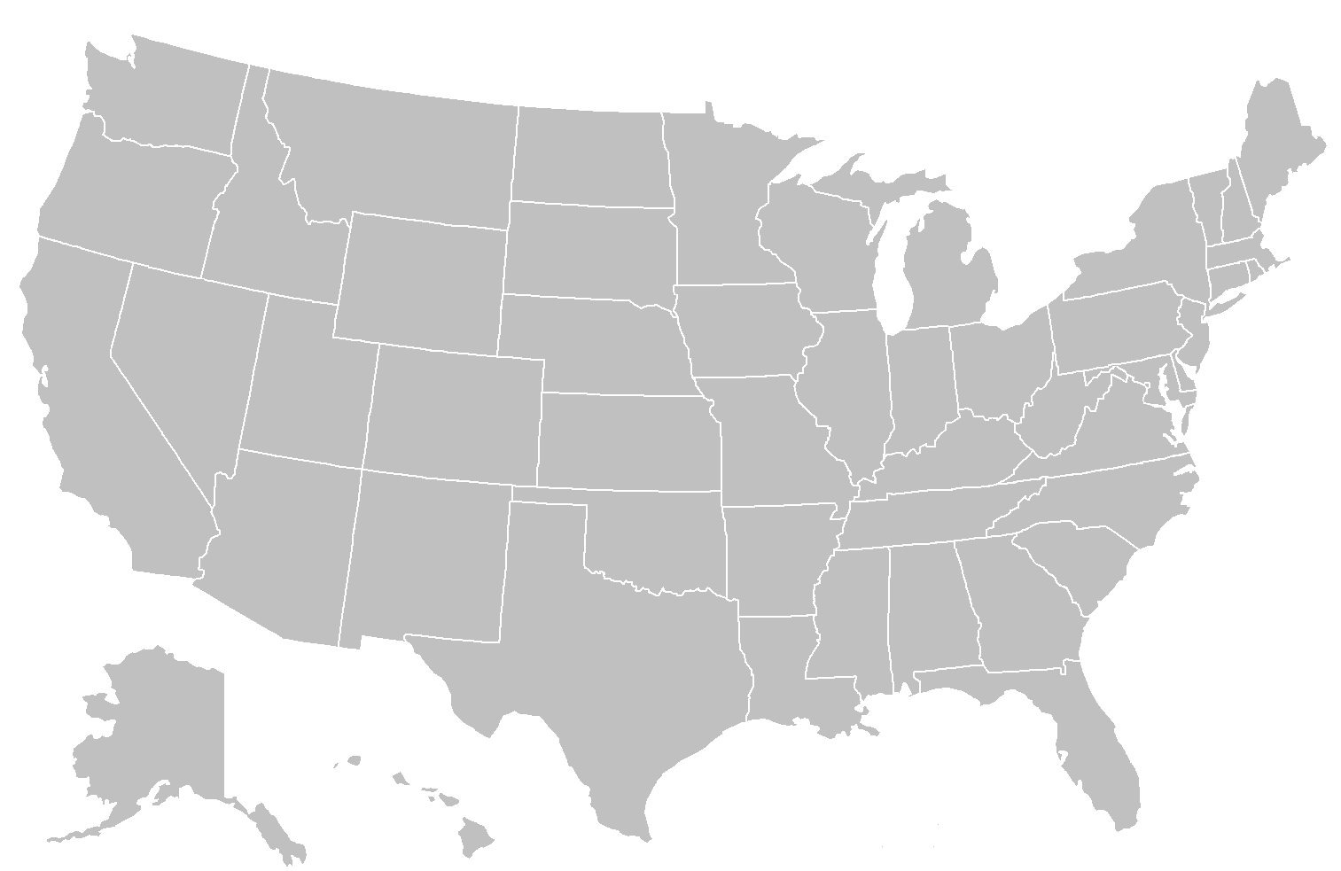
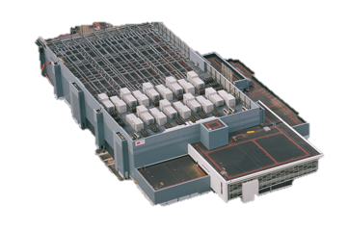
Client → Frontend Server
Notes:
How is this mapping done? Very similar to CDN location load balancing discussion in the last class!

Slide 23
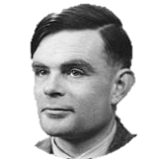
Inside the Datacenter
Web Tier
Storage Tier
Fault Tolerance?
Scalability?
A-F
Fault Tolerance?
Scalability?
G-L
M-R
Executes frontend, application code
Stores state, provides …
S-Z
Notes:
TODO: Switch to world background

Slide 24
Application Code Reads/Writes to the Storage Tier
Facebook page load has 1000s of reads,
chains of sequential reads dozens long [HotOS ‘15]
Request
Application code
Storage
Page

Slide 25
Scalable Storage is Sharded and Geo-Replicated
A-F
G-L
M-R
A-F
S-Z
G-L
M-R
A-F
G-L
S-Z
M-R
S-Z

Slide 26
So Much Concurrency!
A-F
G-L
M-R
A-F
S-Z
G-L
M-R
A-F
G-L
S-Z
M-R
S-Z

Slide 27
So Many Failures!
A-F
G-L
M-R
A-F
S-Z
G-L
M-R
A-F
G-L
S-Z
M-R
S-Z

Slide 28
Not Just One Backend System
[Diagram from Kaushik Veeraraghavan’s OSDI ‘16 Talk]

Slide 29
Each Backend System is a Distributed System
But with different tradeoffs and designs depending on use
LIKE count?
Eventually consistent storage system
User Password?
Strongly consistent storage system

Slide 30
Each Backend System is a Distributed System
Search results
Use precomputed index, precomputed with MapReduce, or a more efficient, specialized system
Trending hashtags
Use a stream processing system to continuously update computation about what is most popular

Slide 31
Distributed Systems on Distributed Systems on …
[Diagram from Malte Schwarzkopf PhD Thesis 2015]
Notes:
Separate out different levels of functionality so they can be reused across systems/applications and optimized

Slide 32
More Systems in the Spring?!

Slide 33
COS 375 - Computer Architecture & Organization
Margaret Martinosi
COS 461 – Computer Networks
Nick Feamster
COS 463 – Wireless Networks
Kyle Jamieson
COS 518 – Advanced Computer Systems
Mike Freedman
COS IW 5 – A Programmable & Safe Internet of Things
Amit Levy
Notes:
Amit Levy will be leading an IW seminar focused around building systems for Internet of Things applications. If you're excited about doing independent work in systems, this seminar is for you! Projects might include: * implementing wireless network protocols and peripheral drivers * implementing and evaluating security policy frameworks * creating novel abstractions for managing power consumption * building an emulator * building a distributed deployment system * deploying a sensor network * prototyping wearable applications Get in touch with Amit if you have questions, and sign up for IW 05!

