Slide 1
Content Distribution Networks (CDNs)
COS 418: Distributed Systems
Lecture 21
Wyatt Lloyd

Slide 2
Content Distribution Networks
Why & Overview
Load Balancing
Caching Algorithms
Hierarchy

Slide 3


Anatomy of a Web Page Fetch
Web page = HTML file + embedded images/objects
HTML page does not embed objects in it
  Q: Why not?
Client
Server
TCP SYN
TCP SYN+ACK
Web page
HTTP GET /index.html
(HTML page)
TCP FIN
TCP FIN+ACK
TCP SYN
TCP SYN+ACK
HTTP GET image1.jpg
Objects
(JPEG image)
TCP FIN
TCP FIN+ACK
…

Slide 4

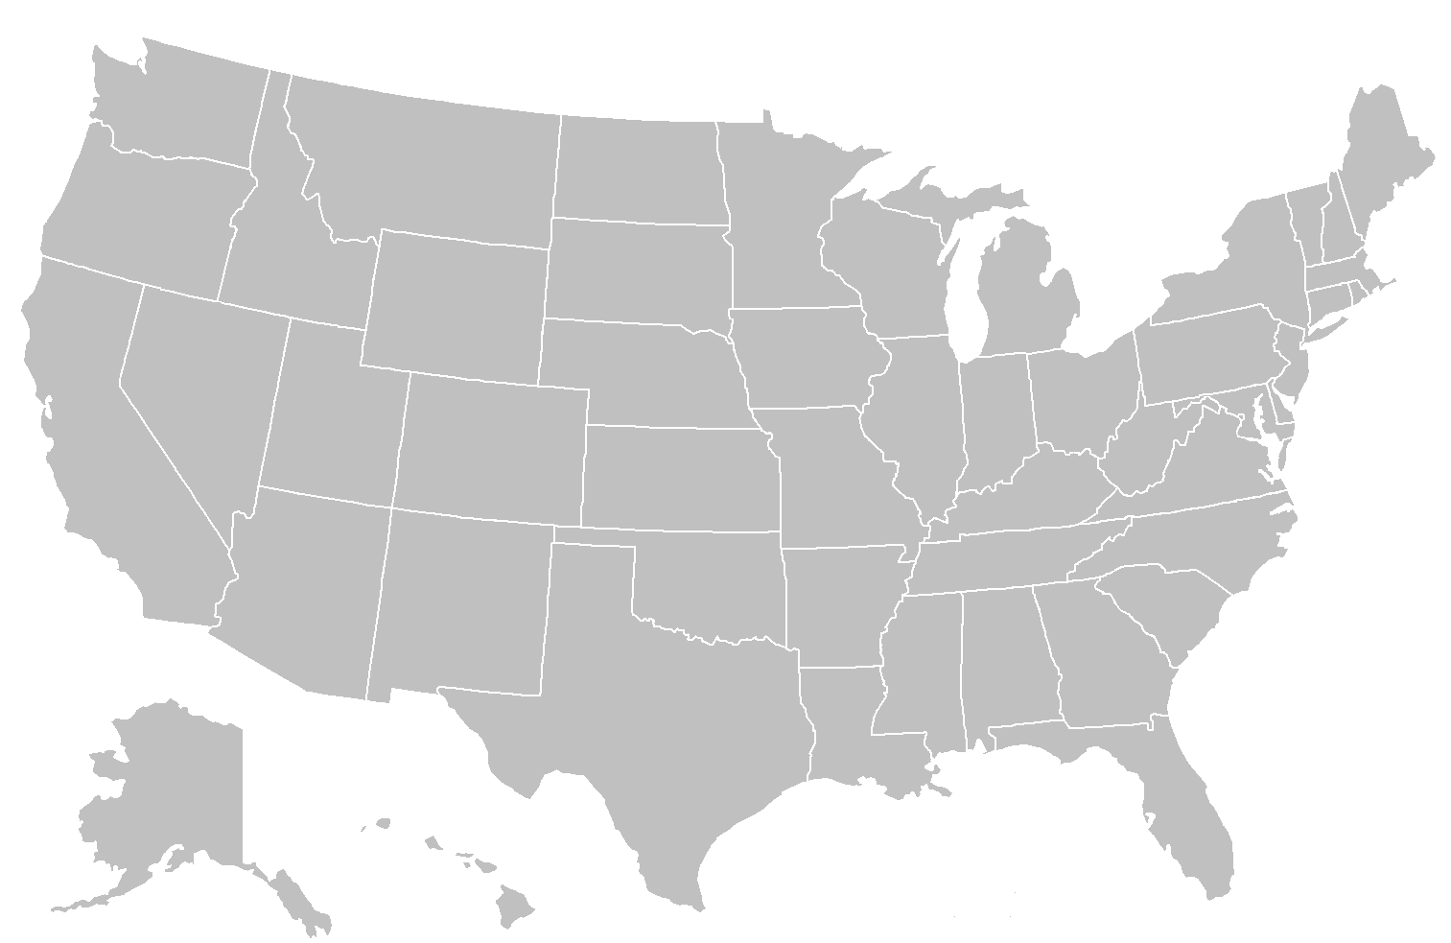
Serve It All From Datacenters?
Asia
Europe
High latency for many clients ☹
Use a ton of bandwidth to send the same objects over and over ☹

Slide 5
Serve Objects From CDN
Asia
Europe
Lower latency because content is closer ☺
Less global bandwidth ☺

Slide 6
CDN Locations
Where can we stick machines?
Inside our datacenters
At colocation facilities
(other people’s DCs)
At Internet Exchange Points
Inside others’ networks
Not that many machines
(limited space and/or high cost)

Slide 7
CDN Locations vs Datacenters
There are many more CDN locations
  e.g., Akamai has 1000+
CDNs are closer to people
  Because there are more of them
  Placed for locality
CDN locations are much wimpier
  Maybe 1 rack (~40 machines)
  …
  Maybe 8 racks (~320 machines)
Which ones do clients connect to?
What do we store on them?

Slide 8
Content Distribution Networks
Why & Overview
Load Balancing
  (Which CDN location do clients connect to?)
Caching Algorithms
  (What do we store on them?)
Hierarchy

Slide 9
CDN Load Balancing
Which of 1000+ options do I go to?
Goals?
  Nearby (lower latency)
  Not overloaded (works)
  (Cheaper bandwidth)
  …

Slide 10
Load Balancing with IP Anycast
IP Anycast
  Multiple machines announce, “I am 1.2.3.4”
  Internet routing sends packet to one of them
Nearby?
  Internet routing often sends packets to nearby machine!
  (Take 461 in the spring to learn about BGP)
Not overloaded?
  Internet routing has no idea…
Microsoft’s First-Party CDN (Bing, Xbox) uses it
  (With additional cleverness to deal with overload)

Slide 11
Load Balancing with DNS
DNS: Global, distributed, eventually consistent database that maps names to IP addresses
  E.g., “cs.princeton.edu” -> “128.112.136.35”
Give clients urls, then regularly update mapping in DNS from urls to IP addresses
  Detailed elided, take 461 in the spring!
Nearby?
  DNS protocol often allows nearby matching
Not overloaded?
  Regularly updating mapping allows pretty good load balancing
    e.g., If location X is heavily loaded, stop sending clients to it

Slide 12
Load Balancing with DC Control
Datacenter based control: tell clients what CDN location to go to directly in url
  e.g., ewr.cs.princeton.edu -> location near newark
Nearby?
  Yes, assuming you actually know where clients are
    (true for DNS as well)
Not overloaded?
  Yes, fine-grained control per client

Slide 13
Content Distribution Networks
Why & Overview
Load Balancing
  (Which CDN location do clients connect to?)
  Several options, all of which are interesting distributed systems designed to work with internet routing
Caching Algorithms
  (What do we store on them?)
Hierarchy

Slide 14
CDN Locations Store What?
Store everything?
  f4 at FB stored over 65PBs of photos/videos as of 2014[OSDI‘14]
  1 rack (40 machines):
    144 GB memory? * 40 -> 5.8TB memory … not even close…
    10x4 TB HDD? * 40 -> 1.6 PB … not even close…
Need to store a subset of objects!
  Q: But which objects to store?

Slide 15
CDN Cache Hit
G?
A B C
D E F
G H I
J K L
G

Slide 16
CDN Cache Miss
X?
X
X?
A B C
D E F
G H I
J K L
X
X
If I want to store X, what do I get rid of to make space?

Slide 17
Cache Algorithms 101
First In First Out (FIFO)
  Get rid of item put into the cache longest ago
Least recently used (LRU)
  Get rid of item in cache that was used longest ago
  (Update access time on hit)
Least frequently used (LFU)
  Get rid of item in cache that was used the fewest number of time
  (Update count on hit)

Slide 18
Content Distribution Networks
Why & Overview
Load Balancing
  (Which CDN location do clients connect to?)
Caching Algorithms
  (What do we store on them?)
Hierarchy
  [Slides from Qi Huang’s SOSP 2013 Talk]

Slide 19
Geo-distributed Edge Cache (FIFO)
Client
PoP
Browser
Cache
Edge
Cache
(Millions)
(Tens)

Slide 20
Geo-distributed Edge Cache (FIFO)
Client
PoP
Browser
Cache
Edge
Cache
(Millions)
(Tens)
Purpose
Reduce cross-country latency
Reduce Data Center bandwidth

Slide 21
Geo-distributed Edge Cache (FIFO)
Client
PoP
Browser
Cache
Edge
Cache
(Millions)
(Tens)

Slide 22
Geo-distributed Edge Cache (FIFO)
Client
PoP
Browser
Cache
Edge
Cache
(Millions)
(Tens)

Slide 23
Single Global Origin Cache (FIFO)
Client
PoP
Data Center
Browser
Cache
Edge
Cache
Origin
Cache
(Millions)
(Tens)
(Four)

Slide 24
Single Global Origin Cache (FIFO)
Client
PoP
Data Center
Browser
Cache
Edge
Cache
Origin
Cache
(Millions)
(Tens)
(Four)
Purpose
Minimize I/O-bound operations

Slide 25
Single Global Origin Cache (FIFO)
Client
PoP
Data Center
Browser
Cache
Edge
Cache
Origin
Cache
(Millions)
(Tens)
(Four)
Hash(url)

Slide 26
Single Global Origin Cache (FIFO)
Client
PoP
Data Center
Browser
Cache
Edge
Cache
Origin
Cache
(Millions)
(Tens)
(Four)

Slide 27
Haystack Backend
Client
PoP
Data Center
Browser
Cache
Edge
Cache
Origin
Cache
Backend (Haystack)
(Millions)
(Tens)
(Four)

Slide 28
How Effective Was Facebook’s CDN?

Slide 29
CDN Effectiveness [SOSP ‘13]
Client
PoP
Data Center
Browser
Cache
Edge
Cache
Origin
Cache
Backend (Haystack)
R
77.2M
26.6M
65.5%
11.2M
58.0%
7.6M
31.8%
Traffic Share
65.5%
20.0%
4.6%
9.9%

Slide 30
Can It Be Improved?

Slide 31
Edge Cache with Different Sizes
59%
Picked San Jose edge (high traffic, median hit ratio)

Slide 32
Edge Cache with Different Sizes
68%
65%
59%
“x” estimates current deployment size (59% hit ratio)

Slide 33
Edge Cache with Different Sizes
Infinite Cache
68%
65%
59%
“Infinite” size ratio needs 45x of current capacity

Slide 34
Edge Cache with Different Algos
Infinite Cache
Both LRU and LFU outperforms FIFO slightly

Slide 35
Edge Cache with Different Algos
Infinite Cache
68%
59%
1/3x
S4LRU improves the most

Slide 36
Edge Cache with Different Algos
Infinite Cache
Clairvoyant (Bélády) shows much improvement space

Slide 37
Origin Cache
Infinite Cache
14%
S4LRU improves Origin more than Edge

Slide 38
Content Distribution Networks
Serve “objects” in web pages, and much more, e.g., video segments
Load Balancing: Which CDN location?
  Several options, all of which are interesting distributed systems designed to work with internet routing
Caching Algorithms: What do we store on them?
  FIFO, LRU, LFU, … active area of research
Facebook’s CDN
  Hierarchy, effectiveness, improvements

