Slide 1
Big Data Processing
COS 418: Distributed Systems
Lecture 19
Wyatt Lloyd

Slide 2
Map Reduce Review

Slide 3
Ex: Word count using partial aggregation
Compute word counts from individual files
Then merge intermediate output
Compute word count on merged outputs

Slide 4
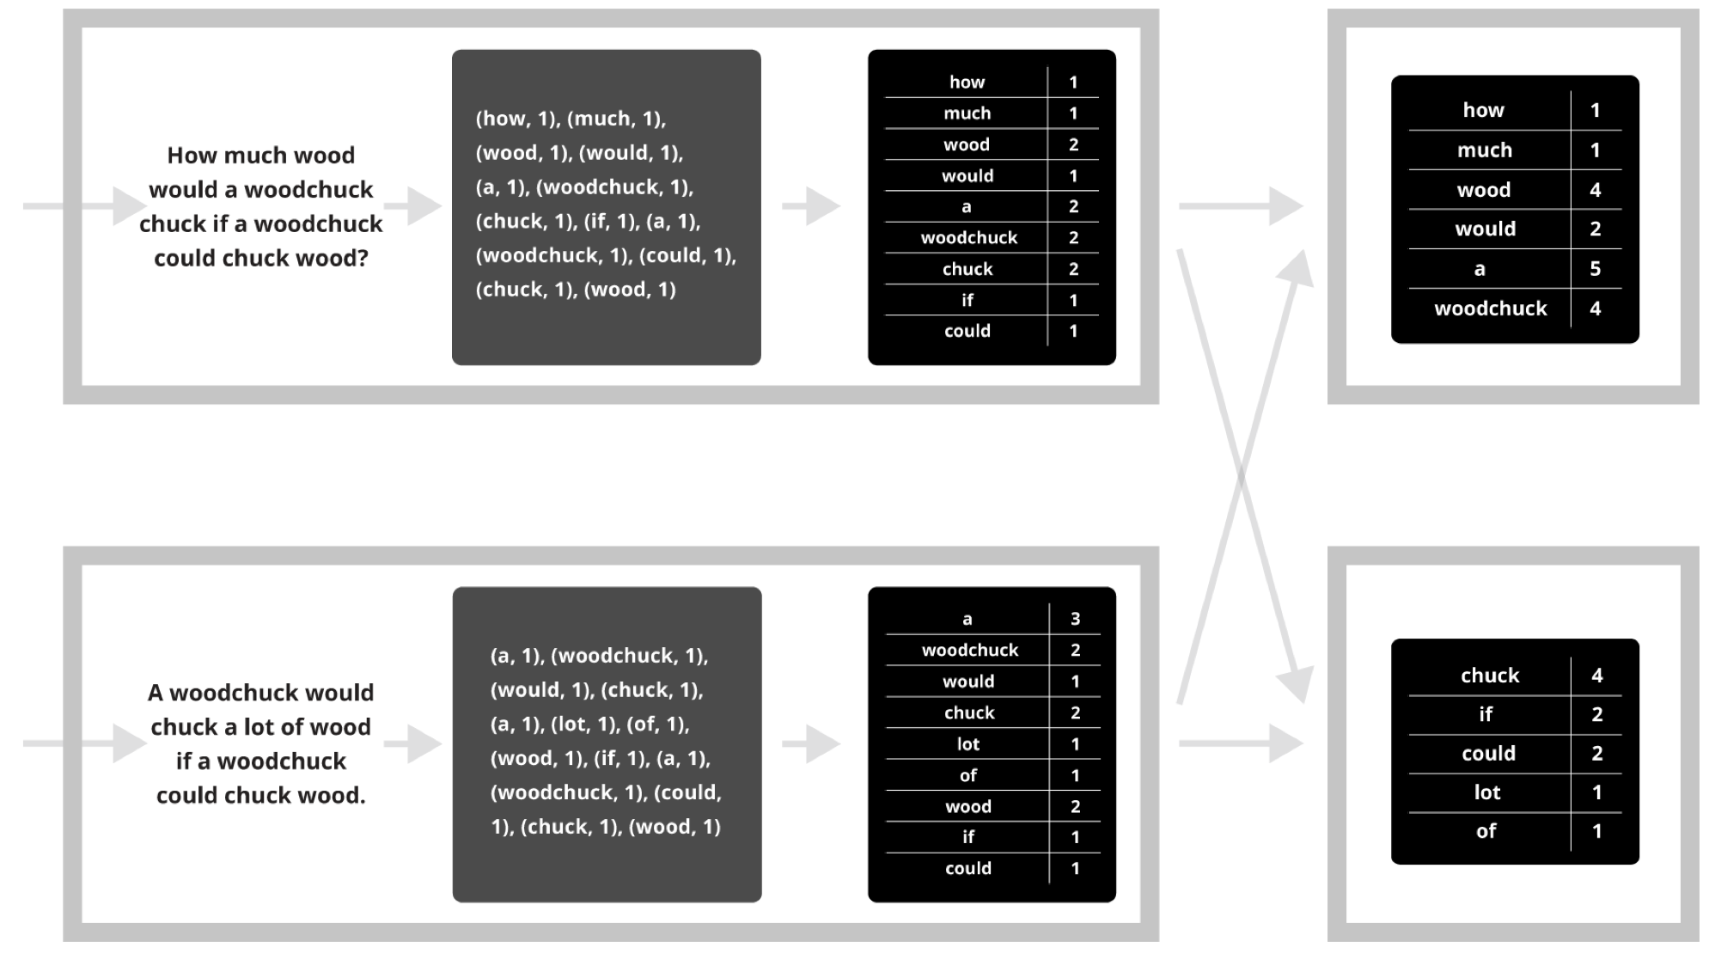
Putting it together…
map
combine
partition
reduce

Slide 5
Synchronization Barrier

Slide 6
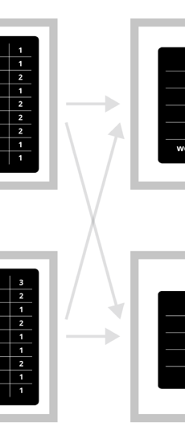
Fault Tolerance in MapReduce
Map worker writes intermediate output to local disk, separated by partitioning. Once completed, tells master node.
Reduce worker told of location of map task outputs, pulls their partition’s data from each mapper, execute function across data
Note:
“All-to-all” shuffle b/w mappers and reducers
Written to disk (“materialized”) b/w each stage

Slide 7
Generality vs Specialization

Slide 8
General Systems
Can be used for many different applications
Jack of all trades, master of none
Pay a generality penalty
Once a specific application, or class of applications becomes sufficiently important, time to build specialized systems

Slide 9
MapReduce is a General System
Can express large computations on large data; enables fault tolerant, parallel computation
Fault tolerance is an inefficient fit for many applications
Parallel programming model (map, reduce) within synchronous rounds is an inefficient fit for many applications

Slide 10
MapReduce for Google’s Index
Flagship application in original MapReduce paper
Q: What is inefficient about MapReduce for computing web indexes?
“MapReduce and other batch-processing systems cannot process small updates individually as they rely on creating large batches for efficiency.”
Index moved to Percolator in ~2010 [OSDI ‘10]
Incrementally process updates to index
Uses OCC to apply updates
50% reduction in average age of documents

Slide 11
MapReduce for Iterative Computations
Iterative computations: compute on the same data as we update it
e.g., PageRank
e.g., Logistic regression
Q: What is inefficient about MapReduce for these?
Writing data to disk between all iterations is slow
Many systems designed for iterative computations, most notable is Apache Spark
Key idea 1: Keep data in memory once loaded
Key idea 2: Provide fault tolerance via lineage:
Save data to disks occasionally, remember computation that created later version of data. Use lineage to recompute data that is lost due to failure.

Slide 12
MapReduce for Stream Processing
Stream processing: Continuously process an infinite stream of incoming events
e.g., estimating traffic conditions from GPS data
e.g., identify trending hashtags on twitter
e.g., detect fraudulent ad-clicks
Q: What is inefficient about MapReduce for these?

Slide 13
Stream Processing Systems
Many stream processing systems as well, typical structure:
Definite computation ahead of time
Setup machines to run specific parts of computation and pass data around (topology)
Stream data into topology
Repeat forever
Trickiest part: fault tolerance!
Notably systems and their fault tolerance
Apache/Twitter Storm: Record acknowledgment
Spark Streaming: Micro-batches
Google Cloud dataflow: transactional updates
Apache Flink: Distributed snapshot
Specialization is much faster, e.g., click-fraud detection at Microsoft
Batch-processing system: 6 hours
w/ StreamScope[NSDI ‘16]: 20 minute average

Slide 15
Graph-Parallel Computation

Slide 16
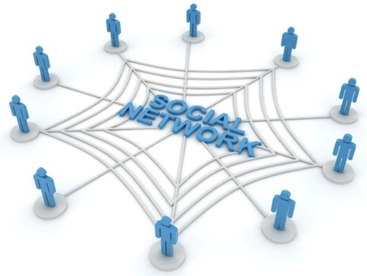
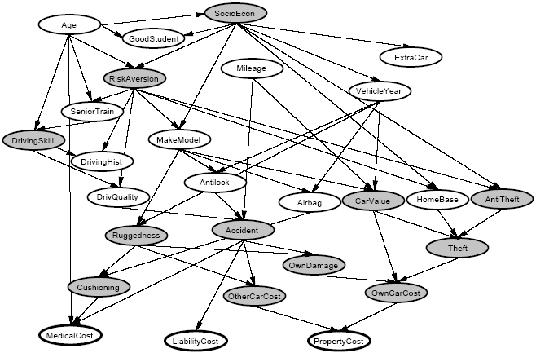
Graphs are Everywhere
Social Network
Collaborative Filtering
Users
Netflix
Movies
Probabilistic Analysis
Text Analysis
Docs
Wiki
Words
Notes:
This idea has lots of applications. Might be infering interests about people in a social network,
>>> Collaborative filtering: trying to predict movie ratings of each user given a handful of movie ratings from all users. BIPARTITE GRAPH where you have users on one side and movies on the other --> sparse matrix (RED).
>>> Textual analysis: e.g. detecting user sentiment regarding product reviews on a website like Amazon.
>>> relate random variables.

Slide 17
Properties of Graph Parallel Algorithms
Dependency
Graph
Factored
Computation
Iterative
Computation
What I Like
What My Friends Like
Notes:
Taking a step back – the big picture here is that this is one example of many GRAPH PARALLEL algorithms that have the following properties:
(L) Significant information in the DEPENDENCIES between different pieces of data, can represent those deps naturally using a graph.
(C) As a result computation FACTORS into different LOCAL neighborhoods, depends DIRECTLY only on those neighborhoods.
(R) b/c graph has many CHAINS of connections, need to ITERATE local computation, PROPAGATING information.

Slide 18
Iterative Algorithms
MR doesn’t efficiently express iterative algorithms:
Iterations
Data
Data
Data
Data
CPU 1
CPU 1
CPU 1
Data
Data
Data
Data
Data
Data
Data
Data
Slow
Processor
CPU 2
CPU 2
CPU 2
Data
Data
Data
Data
Data
Data
Data
Data
CPU 3
CPU 3
CPU 3
Data
Data
Data
Data
Data
Data
Data
Data
Barrier
Barrier
Barrier
Notes:
Many ML algorithms (like the social network example before) ITERATIVELY REFINE their variables during operation.
>>> >>> >>> MR doesn’t provide a mechanism to directly encode ITERATIVE computation, so it's forced to wait for all the data in the PRECEDING ITERATION before computing the next.
>>> SEGUE: If one processor is slow (common case) then whole system runs slowly.

Slide 19
MapAbuse: Iterative MapReduce
System is not optimized for iteration:
Iterations
Data
Data
Data
Data
CPU 1
CPU 1
CPU 1
Data
Data
Data
Data
Data
Data
Data
Data
CPU 2
CPU 2
CPU 2
Startup Penalty
Disk Penalty
Startup Penalty
Disk Penalty
Startup Penalty
Data
Data
Disk Penalty
Data
Data
Data
Data
Data
Data
CPU 3
CPU 3
CPU 3
Data
Data
Data
Data
Data
Data
Data
Data
Notes:
Finally there is a STARTUP PENALTY associated with the storage and network delays of reading and writing to disk. So the system isn’t optimized for iteration from a performance standpoint.

Slide 20
The GraphLab Framework
Graph Based
Data Representation
Update Functions
User Computation
Consistency Model
Notes:
So the high-level view of GraphLab is that it has three main parts, >>> first a graph based data representation. >>> Second, a way for the user to express computation through update functions, and >>> finally a consistency model. So let’s take the three parts in turn.

Slide 21
Data Graph
Data is associated with both vertices and edges
Graph:
Social Network
Vertex Data:
User profile
Current interests estimates
Edge Data:
Relationship
(friend, classmate, relative)
Notes:
GraphLab stores the program state as a directed graph called the Data Graph.

Slide 22
Distributed Data Graph
Partition the graph across multiple machines:
Notes:
Cut along edges
SEGUE: So we have missing pieces of data from each node’s viewpoint. So this means that a LOCAL data fetch becomes a REMOTE data fetch.

Slide 23
Distributed Data Graph
Ghost vertices maintain adjacency structure and replicate remote data.
“ghost” vertices
Notes:
So the ghost vertices live locally, maintaining adjacency. They replicate data locally so that it can be read quickly.

Slide 24
Update Function
A user-defined program, applied to a
vertex; transforms data in scope of vertex
Pagerank (scope) {
// Update the current vertex data
// Reschedule Neighbors if needed
if vertex.PageRank changes then
reschedule_all_neighbors;
}
Selectively triggers computation at neighbors
Notes:
An update function is a stateless procedure that modifies the data within the
>>> SCOPE of a vertex (all edges and adjacent nodes). The update function also SCHEDULES the future execution of update functions on OTHER VERTICES.
>>> So for e.g. if we are computing the Google PageRank of a web page, each vertex = a web page, each edge = hyperlink from one web page to another.
>>> PageRank is a weighted sum. When one page's PageRank changes, ONLY its neighbors needs to be recomputed!
>>> SEGUE: GraphLab applies the update functions in parallel until the entire computation converges.

Slide 25
Update Function
A user-defined program, applied to a
vertex; transforms data in scope of vertex
Pagerank (scope) {
// Update the current vertex data
// Reschedule Neighbors if needed
if vertex.PageRank changes then
reschedule_all_neighbors;
}
Update function applied (asynchronously)
in parallel until convergence
Many schedulers available to prioritize computation
Selectively triggers computation at neighbors
Notes:
An update function is a stateless procedure that modifies the data within the
>>> SCOPE of a vertex (all edges and adjacent nodes). The update function also SCHEDULES the future execution of update functions on OTHER VERTICES.
>>> So for e.g. if we are computing the Google PageRank of a web page, each vertex = a web page, each edge = hyperlink from one web page to another.
>>> PageRank is a weighted sum. When one page's PageRank changes, ONLY its neighbors needs to be recomputed!
>>> SEGUE: GraphLab applies the update functions in parallel until the entire computation converges.

Slide 26
How to handle machine failure?
What when machines fail? How do we provide fault tolerance?
Strawman scheme: Synchronous snapshot checkpointing
Stop the world
Write each machines’ state to disk

Slide 27
Chandy-Lamport checkpointing
Step 1. Atomically, one initiator:
Turns red
Records its own state
Sends marker to neighbors
Step 2. On receiving marker. non-red node atomically:
Turns red,
Records its own state,
Sends markers along all outgoing channels
First-in, first-out channels between nodes
Notes:
Bank balance example -- describe.

Slide 28
Stream Processing

Slide 29
Simple stream processing
Single node
Read data from socket
Process
Write output

Slide 30
Examples: Stateless conversion
CtoF
Convert Celsius temperature to Fahrenheit
Stateless operation: emit (input * 9 / 5) + 32

Slide 31
Examples: Stateless filtering
Filter
Function can filter inputs
if (input > threshold) { emit input }

Slide 32
Examples: Stateful conversion
EWMA
Compute EWMA of Fahrenheit temperature
new_temp = ⍺ * ( CtoF(input) ) + (1- ⍺) * last_temp
last_temp = new_temp
emit new_temp

Slide 33
Examples: Aggregation (stateful)
Avg
E.g., Average value per window
Window can be # elements (10) or time (1s)
Windows can be disjoint (every 5s)
Windows can be “tumbling” (5s window every 1s)

Slide 34
Stream processing as chain
CtoF
Avg
Filter

Slide 35
Stream processing as directed graph
sensor
type 1
CtoF
Avg
Filter
alerts
sensor
type 2
KtoF
storage

Slide 36
Enter “BIG DATA”

Slide 37
The challenge of stream processing
Large amounts of data to process in real time
Examples
Social network trends (#trending)
Intrusion detection systems (networks, datacenters)
Sensors: Detect earthquakes by correlating vibrations of millions of smartphones
Fraud detection
Visa: 2000 txn / sec on average, peak ~47,000 / sec

Slide 38
Scale “up”
Tuple-by-Tuple
Micro-batch
input ← read
if (input > threshold) { emit input
}
inputs ← read
out = []
for input in inputs {
if (input > threshold) {
out.append(input)
}
}
emit out

Slide 39
Scale “up”
Tuple-by-Tuple
Micro-batch
Lower Latency
Lower Throughput
Higher Latency
Higher Throughput
Why? Each read/write is an system call into kernel. More cycles performing kernel/application transitions (context switches), less actually spent processing data.

Slide 40
Scale “out”

Slide 41
Stateless operations: trivially parallelized
C
F
C
F
C
F

Slide 42
State complicates parallelization
Aggregations:
Need to join results across parallel computations
CtoF
Avg
Filter

Slide 43
State complicates parallelization
Aggregations:
Need to join results across parallel computations
CtoF
Sum
Cnt
Filter
Avg
CtoF
Sum
Cnt
Filter
CtoF
Sum
Cnt
Filter

Slide 44
Parallelization complicates fault-tolerance
Aggregations:
Need to join results across parallel computations
CtoF
Sum
Cnt
Filter
Avg
CtoF
Sum
Cnt
Filter
CtoF
Sum
Cnt
- blocks -
Filter

Slide 45
Can parallelize joins
Compute trending keywords
E.g.,
portion tweets
Sum
/ key
portion tweets
Sum
/ key
Sum
/ key
Sort
top-k
portion tweets
Sum
/ key
- blocks -

Slide 46
Can parallelize joins
Hash
partitioned
tweets
portion tweets
Sum
/ key
Sum
/ key
Sort
top-k
portion tweets
Sum
/ key
Sum
/ key
Sort
top-k
portion tweets
Sum
/ key
Sum
/ key
Sort
top-k

Slide 47
Parallelization complicates fault-tolerance
Hash
partitioned
tweets
portion tweets
Sum
/ key
Sum
/ key
Sort
top-k
portion tweets
Sum
/ key
Sum
/ key
Sort
top-k
portion tweets
Sum
/ key
Sum
/ key
Sort
top-k

