Slide 1
Atomic Commit and Concurrency Control
COS 418: Distributed Systems
Lecture 15
Wyatt Lloyd

Slide 2
Lets Scale Strong Consistency!
Atomic Commit
Two-phase commit (2PC)
Serializability
Strict serializability
Concurrency Control:
Two-phase locking (2PL)
Optimistic concurrency control (OCC)

Slide 3
Atomic Commit
Atomic: All or nothing
Either all participants do something (commit) or no participant does anything (abort)
Common use: commit a transaction that updates data on different shards

Slide 4
Transaction Examples
Bank account transfer
Turing -= $100
Lovelace += $100
Maintaining symmetric relationships
Lovelace FriendOf Turing
Turing FriendOf Lovelace
Order product
Charge customer card
Decrement stock
Ship stock

Slide 5
Relationship with Replication
Replication (e.g., RAFT) is about doing the same thing multiple places to provide fault tolerance
Sharding is about doing different things multiple places for scalability
Atomic commit is about doing different things in different places together

Slide 6
Relationship with Replication
Replication Dimension
A-F
A-F
A-F
Sharding Dimension
G-L
G-L
G-L
M-R
M-R
M-R
S-Z
S-Z
S-Z

Slide 7
Focus on Sharding for Today
Replication Dimension
A-F
A-F
A-F
Sharding Dimension
G-L
G-L
G-L
M-R
M-R
M-R
S-Z
S-Z
S-Z

Slide 8
Atomic Commit
Atomic: All or nothing
Either all participants do something (commit) or no participant does anything (abort)
Atomic commit is accomplished with the Two-phase commit protocol (2PC)

Slide 9
Two-Phase Commit
Phase 1
Coordinator sends Prepare requests to all participants
Each participant votes yes or no
Sends yes vote or no vote back to coordinator
Typically acquires locks if they vote yes
Coordinator inspects all votes
If all yes, then commit
If any no, then abort
Phase 2
Coordinator sends Commit or Abort to all participants
If commit, each participant does something
Each participant releases locks
Each participant sends an Ack back to the coordinator

Slide 10
Unilateral Abort
Any participant can cause an abort
With 100 participants, if 99 vote yes and 1 votes no => abort!
Common reasons to abort:
Cannot acquire required lock
No memory or disk space available to do write
Transaction constraint fails
(e.g., Alan does not have $100)
Q: Why do we want unilateral abort for atomic commit?

Slide 11
Atomic Commit
All-or-nothing
Unilateral abort
Two-phase commit
Prepare -> Commit/abort

Slide 12
Lets Scale Strong Consistency!
Atomic Commit
Two-phase commit (2PC)
Serializability
Strict serializability
Concurrency Control:
Two-phase locking (2PL)
Optimistic concurrency control (OCC)

Slide 13
Two Concurrent Transactions
transaction transfer(A, B):
begin_tx
a ← read(A)
if a < 10 then abort_tx
else write(A, a−10)
b ← read(B)
write(B, b+10)
commit_tx
transaction sum(A, B):
begin_tx
a ← read(A)
b ← read(B)
print a + b
commit_tx

Slide 14
Isolation Between Transactions
Isolation: sum appears to happen either completely before or completely after transfer
i.e., it appears that all operations of a transaction happened together
Schedule for transactions is an ordering of the operations performed by those transactions

Slide 15
Problem from Concurrent Execution
Serial execution of transactions—transfer then sum:
transfer: r_{A} w_{A} r_{B} w_{B} ©
sum: r_{A} r_{B} ©
Concurrent execution can result in state that differs from any serial execution:
transfer: r_{A} w_{A} r_{B} w_{B} ©
sum: r_{A} r_{B} ©
Time →
© = commit
debit
credit
debit
credit

Slide 16
Isolation Between Transactions
Isolation: sum appears to happen either completely before or completely after transfer
i.e., it appears that all operations of a transaction happened together
Given a schedule of operations:
Is that schedule in some way “equivalent” to a serial execution of transactions?

Slide 17
Equivalence of Schedules
Two operations from different transactions are conflicting if:
They read and write to the same data item
The write and write to the same data item
Two schedules are equivalent if:
They contain the same transactions and operations
They order all conflicting operations of non-aborting transactions in the same way
Notes:
Read-write conflict because changing their order changes the result
Write-write conflict because changing their order changes the result
Read-read do not conflict because changing their order does not change the result

Slide 18
Serializability
A schedule is serializable if it is equivalent to some serial schedule
i.e., non-conflicting operations can be reordered to get a serial schedule

Slide 19
A Serializable Schedule
A schedule is serializable if it is equivalent to some serial schedule
i.e., non-conflicting operations can be reordered to get a serial schedule
transfer: r_{A} w_{A} r_{B} w_{B} ©
sum: r_{A} r_{B} ©
Time →
© = commit
r_{A}
Serial schedule
Conflict-free!

Slide 20
A Non-Serializable Schedule
A schedule is serializable if it is equivalent to some serial schedule
i.e., non-conflicting operations can be reordered to get a serial schedule
transfer: r_{A} w_{A} r_{B} w_{B} ©
sum: r_{A} r_{B} ©
Time →
© = commit
But in a serial schedule, sum’s reads either both before w_{A} or both after w_{B}
Conflicting ops
Conflicting ops

Slide 21
Linearizability vs. Serializability
Linearizability: a guarantee about single operations on single objects
Once write completes, all reads that begin later should reflect that write
Serializability is a guarantee about transactions over one or more objects
Doesn’t impose real-time constraints
Strict Serializability = Serializability + real-time ordering
Intuitively Serializability + Linearizability
We’ll stick with only Strict Serializability for this class

Slide 22
Consistency Hierarchy
Strict Serializability
e.g., Spanner
Linearizability
e.g., RAFT
Sequential Consistency
CAP
PRAM 1988
(Princeton)
Causal+ Consistency
e.g., Bayou
Eventual Consistency
e.g., Dynamo

Slide 23
Lets Scale Strong Consistency!
Atomic Commit
Two-phase commit (2PC)
Serializability
Strict serializability
Concurrency Control:
Two-phase locking (2PL)
Optimistic concurrency control (OCC)

Slide 24
Concurrency Control
Concurrent execution can violate serializability
We need to control that concurrent execution so we do things a single machine executing transactions one at a time would
Concurrency control

Slide 25
Concurrency Control Strawman #1
Big global lock
Acquire the lock when transaction starts
Release the lock when transaction ends
Provides strict serializability
Just like executing transaction one by one because we are doing exactly that
No concurrency at all
Terrible for performance: one transaction at a time

Slide 26
Locking
Locks maintained on each shard
Transaction requests lock for a data item
Shard grants or denies lock
Lock types
Shared: Need to have before read object
Exclusive: Need to have before write object
 | Shared (S) | Exclusive (X)
Shared (S) | Yes | No
Exclusive (X) | No | No

Slide 27
Concurrency Control Strawman #2
Grab locks independently, for each data item (e.g., bank accounts A and B)
transfer: ◢_{A} r_{A} w_{A} ◣_{A} ◢_{B} r_{B} w_{B} ◣_{B} ©
sum: ◿_{A} r_{A} ◺_{A} ◿_{B} r_{B} ◺_{B} ©
Time →
© = commit
◢ /◿ = eXclusive- / Shared-lock; ◣ / ◺ = X- / S-unlock
Permits this non-serializable interleaving

Slide 28
Two-Phase Locking (2PL)
2PL rule: Once a transaction has released a lock it is not allowed to obtain any other locks
Growing phase: transaction acquires locks
Shrinking phase: transaction releases locks
In practice:
Growing phase is the entire transaction
Shrinking phase is during commit

Slide 29
2PL Provide Strict Serializability
2PL rule: Once a transaction has released a lock it is not allowed to obtain any other locks
transfer: ◢_{A} r_{A} w_{A} ◣_{A} ◢_{B} r_{B} w_{B} ◣_{B} ©
sum: ◿_{A} r_{A} ◺_{A} ◿_{B} r_{B} ◺_{B} ©
Time →
© = commit
◢ /◿ = X- / S-lock; ◣ / ◺ = X- / S-unlock
2PL precludes this non-serializable interleaving
Notes:
Q: What is not allowed by 2pl here?
Sum can’t grab a new lock on b once it releases its lock on A
Transfer can’t grab a new lock on B once it released its lock on A

Slide 30
2PL and Transaction Concurrency
2PL rule: Once a transaction has released a lock it is not allowed to obtain any other locks
transfer: ◿_{A} r_{A} ◢_{A} w_{A} ◿_{B} r_{B} ◢_{B} w_{B}✻©
sum: ◿_{A} r_{A} ◿_{B} r_{B}✻©
Time →
© = commit
◢ /◿ = X- / S-lock; ◣ / ◺ = X- / S-unlock; ✻ = release all locks
2PL permits this serializable, interleaved schedule

Slide 31
2PL Doesn’t Exploit All Opportunities For Concurrency
2PL rule: Once a transaction has released a lock it is not allowed to obtain any other locks
transfer: r_{A} w_{A} r_{B} w_{B} ©
sum: r_{A} r_{B} ©
Time →
© = commit
(locking not shown)
2PL precludes this serializable, interleaved schedule

Slide 32
Issues with 2PL
What do we do if a lock is unavailable?
Give up immediately?
Wait forever?
Waiting for a lock can result in deadlock
Transfer has A locked, waiting on B
Sum has B locked, waiting on A
Many different ways to detect and deal with deadlocks

Slide 33
Lets Scale Strong Consistency!
Atomic Commit
Two-phase commit (2PC)
Serializability
Strict serializability
Concurrency Control:
Two-phase locking (2PL)
Optimistic concurrency control (OCC)

Slide 34
2PL is Pessimistic
Acquires locks to prevent all possible violations of serializability
But leaves a lot of concurrency on the table that is okay

Slide 35
Be Optimistic!
Goal: Low overhead for non-conflicting txns
Assume success!
Process transaction as if would succeed
Check for serializability only at commit time
If fails, abort transaction
Optimistic Concurrency Control (OCC)
Higher performance when few conflicts vs. locking
Lower performance when many conflicts vs. locking

Slide 36
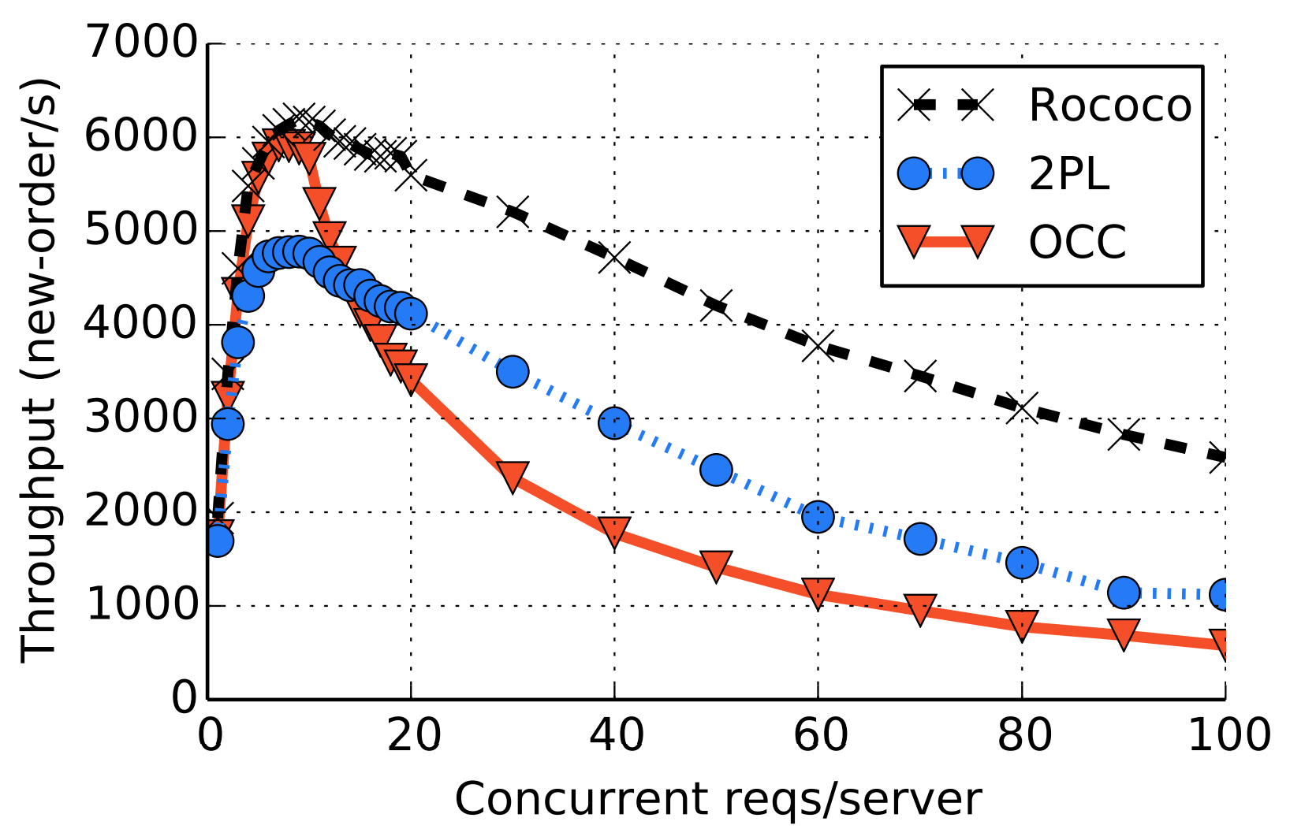
2PL vs OCC
Conflict Rate
From Rococo paper in OSDI 2014. Focus on 2PL vs. OCC.
Observe OCC better when write rate lower (fewer conflicts), worse than 2PL with write rate higher (more conflicts)

Slide 37
Optimistic Concurrency Control
Optimistic Execution:
Execute reads against shards
Buffer writes locally
Validation and Commit:
Validate that data is still the same as previously observed
(i.e., reading now would give the same result)
Commit the transaction by applying all buffered writes
Need this to all happen together, how?
Notes:
Time to check t Time to use

Slide 38
OCC Uses 2PC
Validation and Commit use Two-Phase Commit
Client sends each shard a prepare
Prepare includes read values and buffered writes for each shard
Each shard acquires shared locks on read locations and exclusive locks on write locks
Each shard checks if read values validate
Each shard sends vote to client
If all locks acquired and reads validate => Vote Yes
Otherwise => Vote No
Client collects all votes, if all yes then commit
Client sends commit/abort to all shards
If commit: shards apply buffered writes
Shards release all locks
Notes:
Time to check t Time to use

Slide 39
Lets Scale Strong Consistency!
Atomic Commit
Two-phase commit (2PC)
Serializability
Strict serializability
Concurrency Control:
Two-phase locking (2PL)
Optimistic concurrency control (OCC)
Uses 2PC
Notes:
2PL also uses 2PC, but we’ll leave discussing that to the Spanner lecture

