Slide 1
Consensus, FLP, and Paxos
COS 418: Distributed Systems
Lecture 10
Wyatt Lloyd

Slide 2
Recall the use of Views
Let different replicas assume role of primary over time
System moves through a sequence of views
How do the nodes agree on view / primary?
P
View #3
P
View #1
P
View #2
Notes:
Moving between views appeared simple in the last lecture … but we have to get all the nodes to agree on what the current view is…

Slide 3
Consensus
Definition:
A general agreement about something
An idea or opinion that is shared by all the people in a group

Slide 4
Consensus
Given a set of processors, each with an initial value:
Termination: All non-faulty processes eventually decide on a value
Agreement: All processes that decide do so on the same value
Validity: The value that has been decided must have proposed by some process

Slide 5
Consensus Used in Systems
Group of servers attempting:
Make sure all servers in group receive the same updates in the same order as each other
Maintain own lists (views) on who is a current member of the group, and update lists when somebody leaves/fails
Elect a leader in group, and inform everybody
Ensure mutually exclusive (one process at a time only) access to a critical resource like a file

Slide 6
Can We Achieve Consensus?

Slide 7
Defining Our System Model
Network model:
Synchronous (time-bounded delay) or asynchronous (arbitrary delay)
Reliable or unreliable communication
Node failures:
Crash (correct/dead) or Byzantine (arbitrary)
(Left options indicate an “easier” setting.)

Slide 8
Defining Our System Model
Network model:
Synchronous (time-bounded delay) or asynchronous (arbitrary delay)
Reliable or unreliable communication
Node failures:
Crash (correct/dead) or Byzantine (arbitrary)
(Left options indicate an “easier” setting.)

Slide 9
Consensus is Impossible

Slide 10
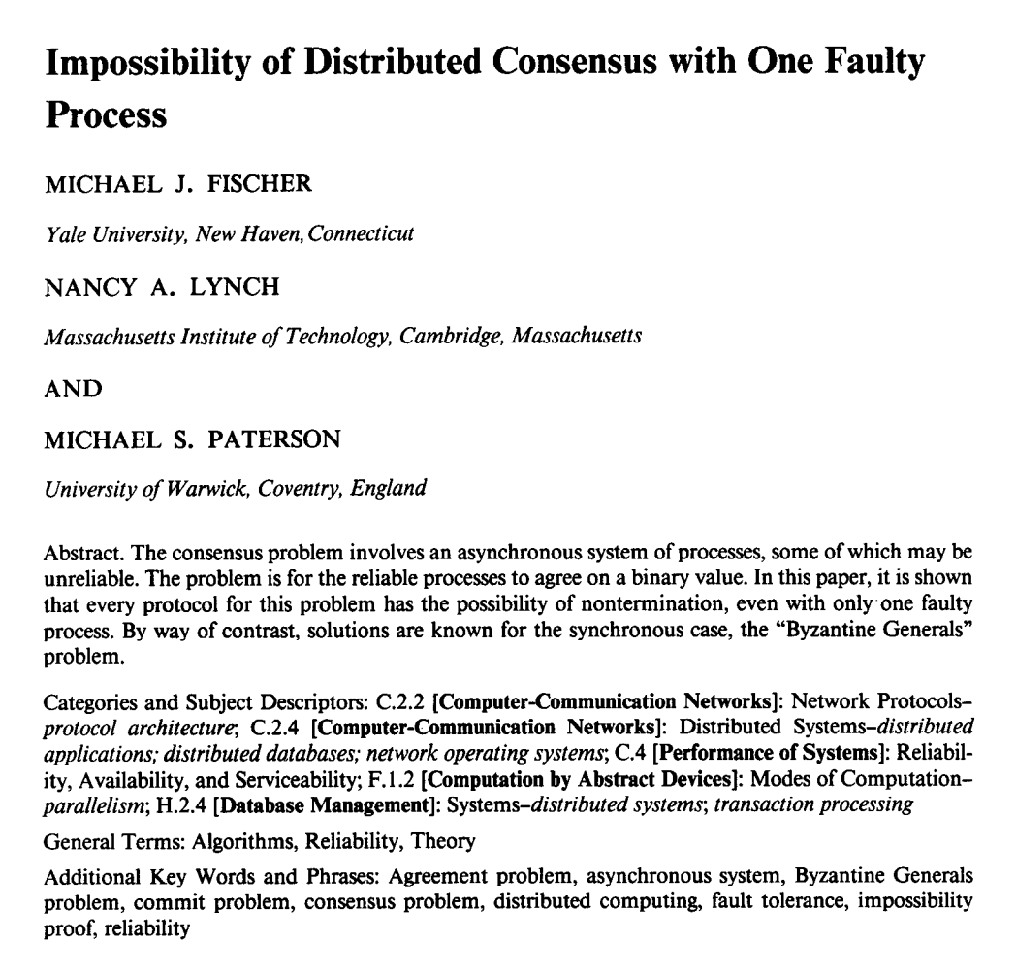
“FLP” Result
No deterministic 1-crash-robust consensus algorithm exists with asynchronous communication

Slide 11
FLP’s Weak Assumptions
Only 1 failure
→ Also impossible for more failures
For “weak” consensus (only some process needs to decide, not all)
→ Also impossible for real consensus
For reliable communication
→ Also impossible for unreliable communication
For only two states: 0 and 1
Also impossible for more failures
For crash failures
→ Also impossible for Byzantine failures

Slide 12
FLP’s Strong Assumptions
Deterministic actions at each node
Asynchronous network communication
All “runs” must eventually achieve consensus
Notes:
These are all we need to show this is impossible

Slide 13
Main Technical Approach
Initial state of system can end in decision “0” or “1”
Consider 5 processes, each in some initial state
[ 1,1,1,1,1 ] → 1
[ 1,1,1,1,0 ] → ?
[ 1,1,1,0,0 ] → ?
[ 1,1,0,0,0 ] → ?
[ 1,0,0,0,0 ] → 0
Must exist two configurations here which differ in decision

Slide 14
Main Technical Approach
Initial state of system can end in decision “0” or “1”
Consider 5 processes, each in some initial state
[ 1,1,1,1,1 ] → 1
[ 1,1,1,1,0 ] → 1
[ 1,1,1,0,0 ] → 1
[ 1,1,0,0,0 ] → 0
[ 1,0,0,0,0 ] → 0
Assume decision differs between these two processes

Slide 15
Main Technical Approach
Goal: Consensus holds in face of 1 failure
[ 1,1,0,0,0 ] →
[ 1,1,1,0,0 ] →
One of these configurations must be “bi-valent”
Both futures possible
1 | 0
0
Notes:
There exists some initial state where the result is not predetermined.

Slide 16
Main Technical Approach
Goal: Consensus holds in face of 1 failure
[ 1,1,0,0,0 ] →
[ 1,1,1,0,0 ] →
Inherent non-determinism from asynchronous network
Key result: All bi-valent states can remain in bi-valent states after performing some work
One of these configurations must be “bi-valent”
Both futures possible
1 | 0
0

Slide 17
Staying Bi-Valent Forever
System thinks process p failed, adapts to it…
But no, p was merely slow, not failed… (Can’t tell the difference between slow and failed.)
System think process q failed, adapts to it…
But no, q was merely slow, not failed…
Repeat ad infinitum …
Notes:
This is the intuition behind the proof. The actual argument is too confusing to present, because it appears in a proof by contradiction. And thus relies on behavior that will only definitely happen in the world of the contradiction, which is not real.

Slide 18
Consensus is Impossible
But, we achieve consensus all the time…

Slide 19
FLP’s Strong Assumptions
Deterministic actions at each node
Randomized algorithms can achieve consensus
Asynchronous network communication
Synchronous or even partial synchrony is sufficient
All “runs” must eventually achieve consensus
In practice, many “runs” achieve consensus quickly
In practice, “runs” that never achieve consensus happen vanishingly rarely
Both are true with good system designs
Notes:
These are all we need to show this is impossible

Slide 20
Consensus is Possible
With Paxos!

Slide 21
Consensus
Given a set of processors, each with an initial value:
Termination: All non-faulty processes eventually decide on a value ← Good thing that eventually should happen
Agreement: All processes that decide do so on the same value ← Bad thing that should never happen
Validity: The value that has been decided must have proposed by some process ← Bad thing that should never happen

Slide 22
Safety vs. Liveness Properties
Safety (bad things never happen)
Liveness (good things eventually happen)

Slide 23
Paxos
Safety
Only a single value is chosen
Only chosen values are learned by processes
Only a proposed value can be chosen
Liveness
Some proposed value eventually chosen if fewer than half of processes fail
If value is chosen, a process eventually learns it
agreement
validity
termination

Slide 24
Paxos’s Safety and Liveness
Paxos is always safe
Paxos is very often live
But not always live

Slide 25
Roles of a Process
Three conceptual roles
Proposers propose values
Acceptors accept values, where a value is chosen if a majority accept
Learners learn the outcome (chosen value)
In reality, a process can play any/all roles

Slide 26
Strawmen
3 proposers, 1 acceptor
Acceptor accepts first value received
No liveness with single failure
3 proposers, 3 acceptors
Accept first value received, acceptors choose common value known by majority
But no such majority is guaranteed
Notes:
No liveness w/ 1 failure -> need multiple acceptors No majority guaranteed -> need acceptors to be capable of accepting multiple values

Slide 27
Paxos
Each acceptor accepts multiple proposals
Hopefully one of multiple accepted proposals will have a majority vote (and we determine that)
If not, rinse and repeat (more on this)
How do we select among multiple proposals?
Ordering: proposal is tuple (proposal #, value) = (n, v)
Proposal # strictly increasing, globally unique
Globally unique?
Trick: set low-order bits to proposer’s ID

Slide 28
Paxos Protocol Overview
Proposers:
Choose a proposal number n
Ask acceptors if any accepted proposals with n_{a} < n
If existing proposal v_{a} returned, propose same value (n, v_{a})
Otherwise, propose own value (n, v)
Note altruism: goal is to reach consensus, not “win”
Accepters try to accept value with highest proposal n
Learners are passive and wait for the outcome

Slide 29
Paxos Phase 1
Proposer:
Choose proposal number n, send <prepare, n> to acceptors
Acceptors:
If n > n_{h}
n_{h} = n ← promise not to accept any new proposals n’ < n
If no prior proposal accepted
Reply < promise, n, Ø >
Else
Reply < promise, n, (n_{a ,} v_{a}) >
Else
Reply < prepare-failed >

Slide 30
Paxos Phase 2
Proposer:
If receive promise from majority of acceptors,
Determine v_{a} returned with highest n_{a}, if exists
Send <accept, (n, v_{a} || v)> to acceptors
Acceptors:
Upon receiving (n, v), if n ≥ n_{h},
Accept proposal and notify learner(s)
n_{a} = n_{h} = n
v_{a} = v

Slide 31
Paxos Phase 3
Learners need to know which value chosen
Approach #1
Each acceptor notifies all learners
More expensive
Approach #2
Elect a “distinguished learner”
Acceptors notify elected learner, which informs others
Failure-prone

Slide 32
Paxos: Well-behaved Run
1
1
1
1
1
2
2
2
.
.
.
<accept,
(1,v₁)>
.
.
.
.
.
.
decide
v₁
<prepare, 1>
<promise, 1>
n
n
n
<accepted, (1 ,v₁)>

Slide 33
Paxos is Safe
Intuition: if proposal with value v chosen, then every higher-numbered proposal issued by any proposer has value v.
Majority of acceptors accept (n, v):
v is chosen
Next prepare request with proposal n+1

Slide 34
Race Condition Leads to Liveness Problem “FLP Scenario”
Process 0
Process 1
Completes phase 1 with proposal n0
Starts and completes phase 1 with proposal n1 > n0
Performs phase 2, acceptors reject
Restarts and completes phase 1 with proposal n2 > n1
Performs phase 2, acceptors reject
… can go on indefinitely …

Slide 35
Paxos Summary
Described for a single round of consensus
Proposer, Acceptors, Learners
Often implemented with nodes playing all roles
Always safe
Quorum intersection
Often live
“FLP Scenario” prevents it from always being live
Acceptors accept multiple values
But only one value is ultimately chosen
Once a value is accepted by a majority it is chosen

Slide 36
Flavors of Paxos
Terminology is a mess
Paxos loosely, and confusingly defined…
We’ll stick with
Basic Paxos
Multi-Paxos
Notes:
The terminology around Paxos is a mess:
Phase 1, Phase 2, Phase 3
Prepare, Accept, Learn
Prepare, Accept, Commit
1-phase paxos, 2-phase paxos,…
We’ll stick with this

Slide 37
Flavors of Paxos: Basic Paxos
Run the full protocol each time
e.g., for each slot in the command log
Takes 2 rounds until a value is chosen
“FLP Scenario” is dueling proposers

Slide 38
Flavors of Paxos: Multi-Paxos
Elect a leader and have them run the 2nd phase directly
e.g., for each slot in the command log
Leader election uses Basic Paxos
Takes 1 round until a value is chosen
Faster than Basic Paxos
“FLP Scenario” is dueling proposers during leader election
Rarer than Basic Paxos
Used extensively in practice!
Notes:
Very similar to Viewstamped Replication, invented concurrently

Slide 39
Consensus Takeaways
Consensus: Terminating agreement on a valid proposal
Consensus is impossible to always achieve
FLP result
Consensus is possible to achieve in practice
With Multi-Paxos
Mostly happens in a single round to the nearest quorum
Sometimes takes a single round to a further quorum
Rarely takes multiple rounds to elect a new leader and for that node to get the request accepted
Runs exist where no new leader is ever elected

