Slide 1
Distributed Systems Intro and Course Overview
COS 418: Distributed Systems
Lecture 1
Wyatt Lloyd

Slide 2
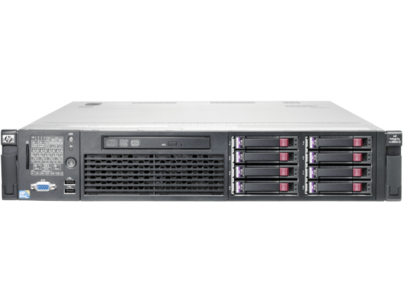
Distributed Systems, What?
Multiple computers
Connected by a network
Doing something together

Slide 3
Distributed Systems, Why?
Or, why not 1 computer to rule them all?
Failure
Limited computation/storage/…
Physical location

Slide 4
Distributed Systems, Where?
Web Search (e.g., Google, Bing)
Shopping (e.g., Amazon, Walmart)
File Sync (e.g., Dropbox, iCloud)
Social Networks (e.g., Facebook, Twitter)
Music (e.g., Spotify, Apple Music)
Ride Sharing (e.g., Uber, Lyft)
Video (e.g., Youtube, Netflix)
Online gaming (e.g., Fortnite, DOTA2)
…

Slide 5
“The Cloud” is not amorphous

Slide 6
Microsoft

Slide 7
Google

Slide 8
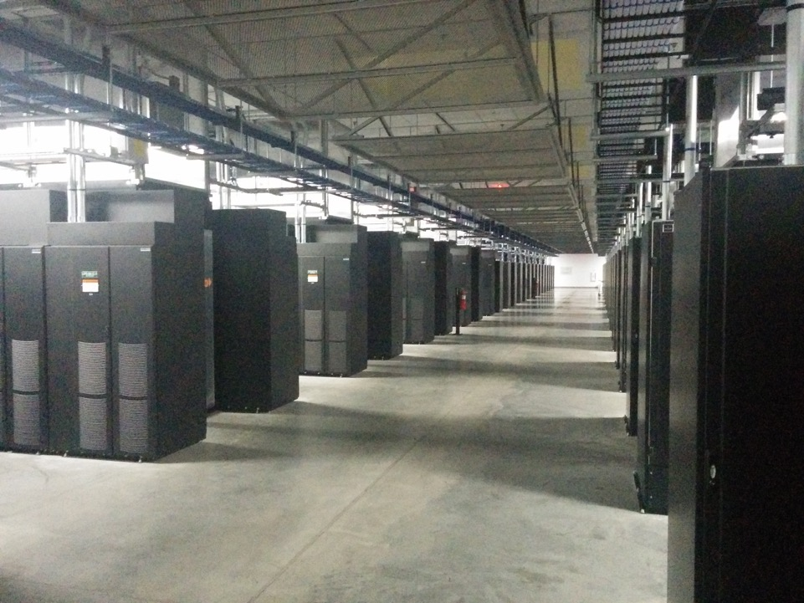
Facebook

Slide 9
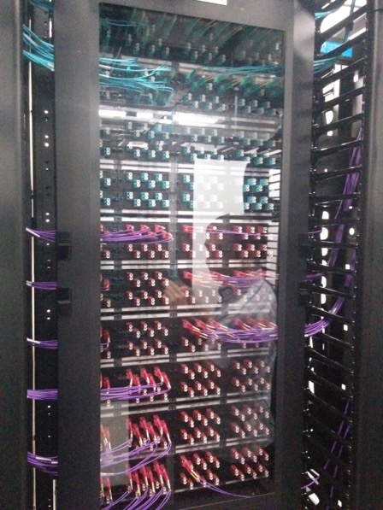
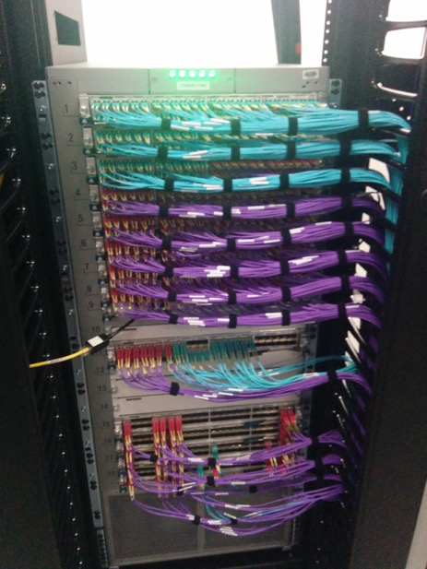
Facebook

Slide 10
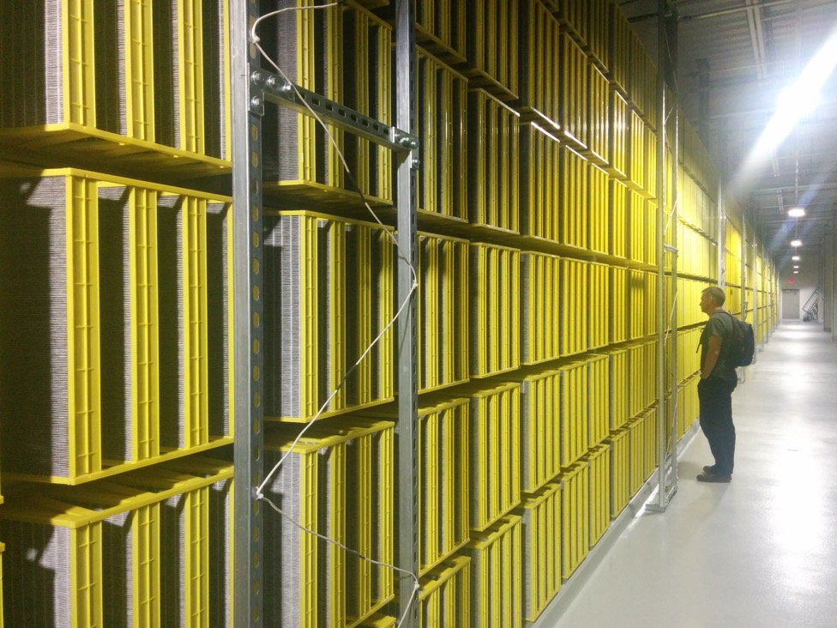
Facebook

Slide 11
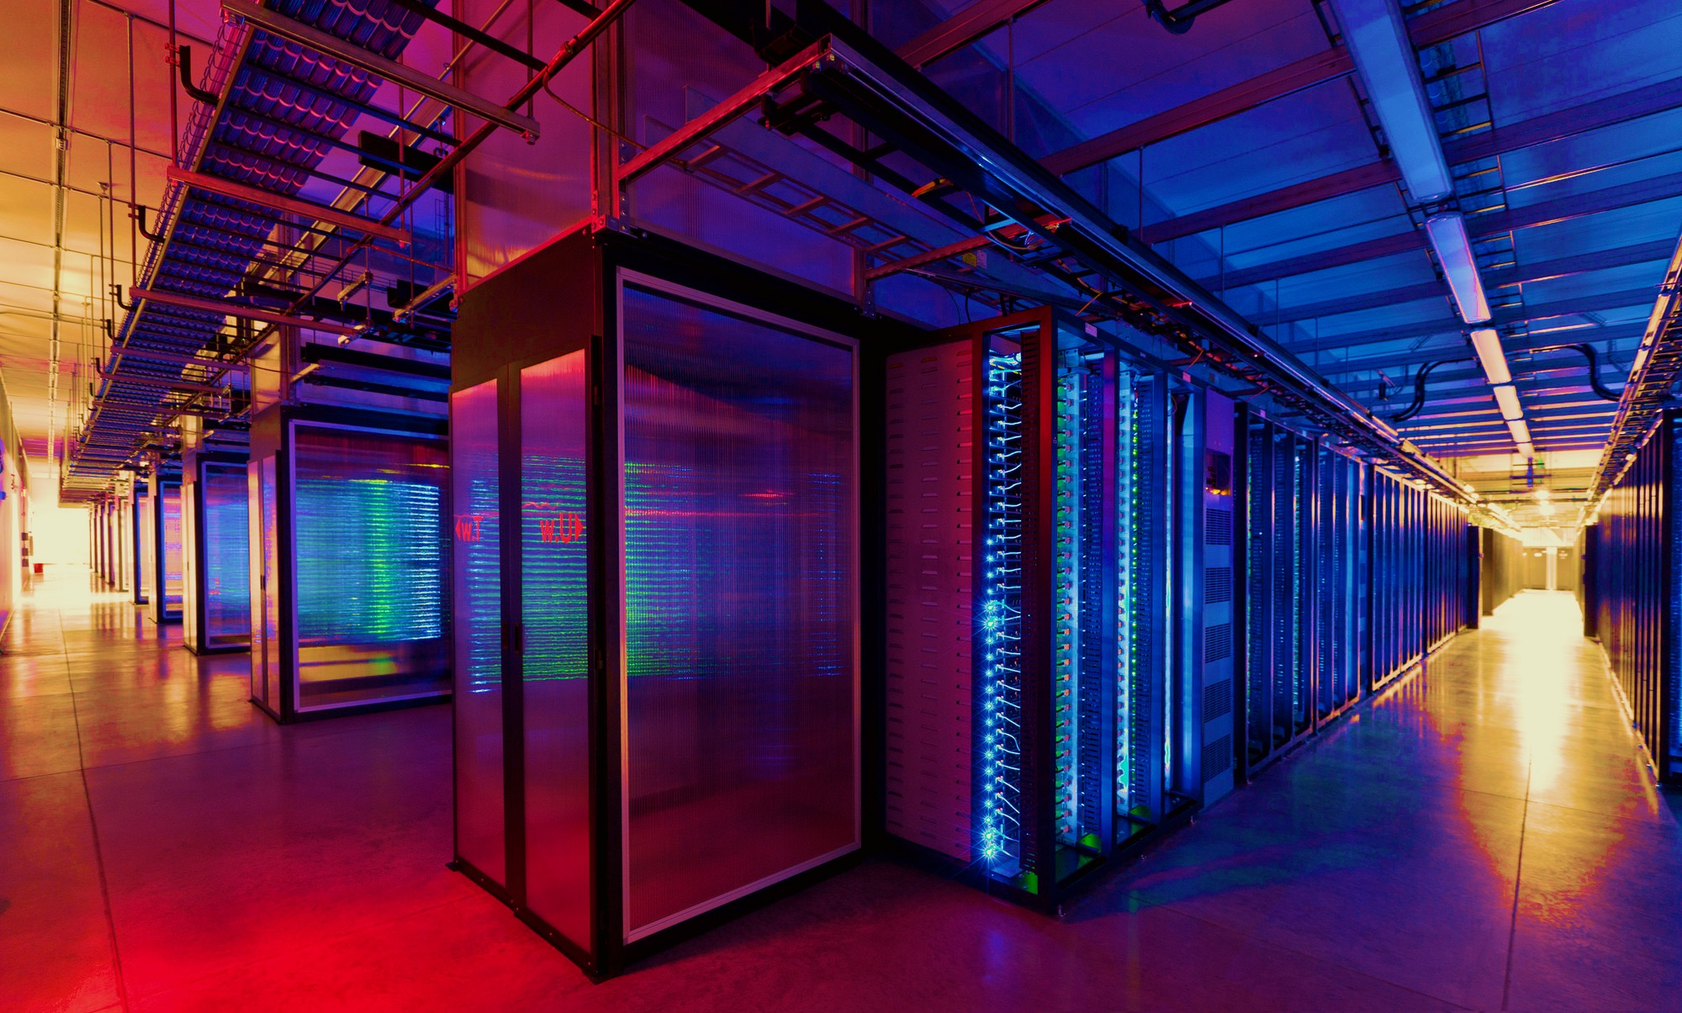
100,000s of physical servers
10s MW energy consumption
Facebook Prineville:
$250M physical infro, $1B IT infra

Slide 12
Distributed Systems Goal
Service with higher-level abstractions/interface
e.g., file system, database, key-value store, programming model, …
Hide complexity
Scalable (scale-out)
Reliable (fault-tolerant)
Well-defined semantics (consistent)
Do “heavy lifting” so app developer doesn’t need to

Slide 13
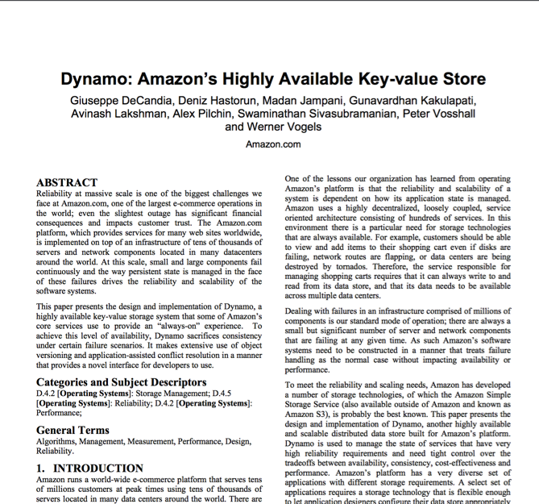
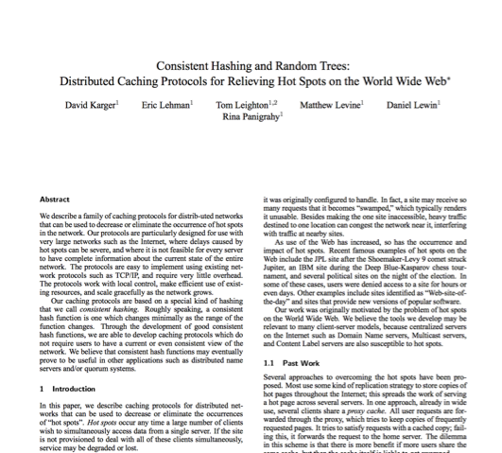
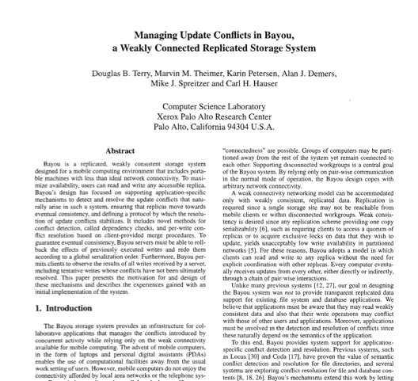
Research results matter: NoSQL
Notes:
NoSQL:
Consistent hash tables
+ consistency tradeoffs (e.g., eventual)
Amazon Dynamo popularized (published SOSP 2007), CTO was faculty at Cornell on distributed systems

Slide 14
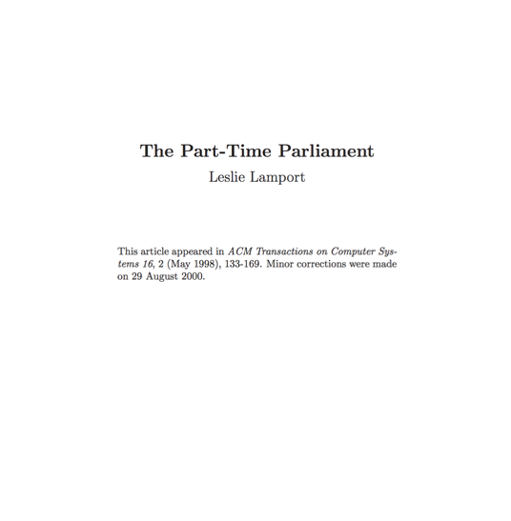
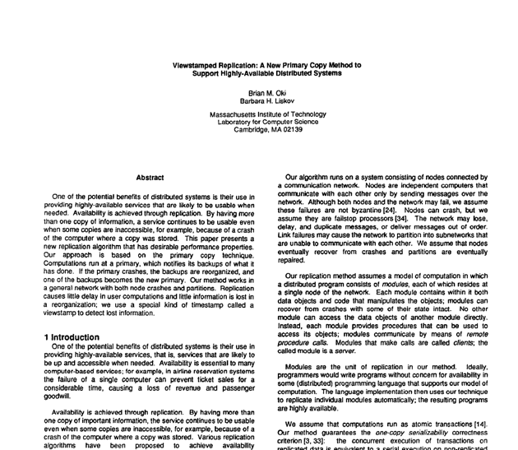
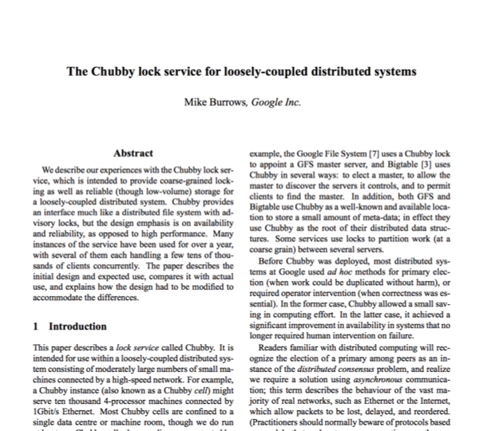
Research results matter: Paxos
Notes:
Paxos
Long history starting in early 1990s on “reaching consensus in distributed systems”
Google Chubby
Coordinate datacenters at scale
When a file server fails, who takes over?
Authors for industrial research labs and academia (DEC SRC, Cambridge/UW, etc.)
Led to open-source Apache Zookeeper

Slide 15
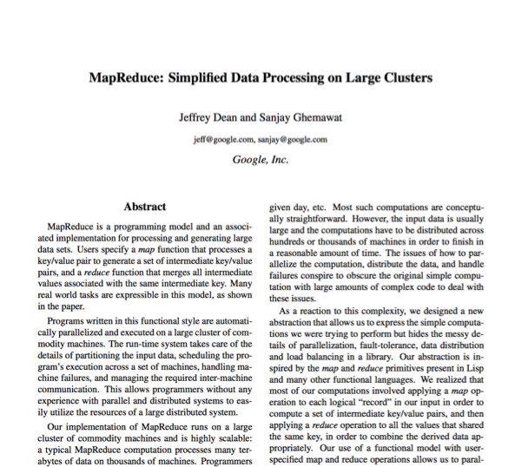
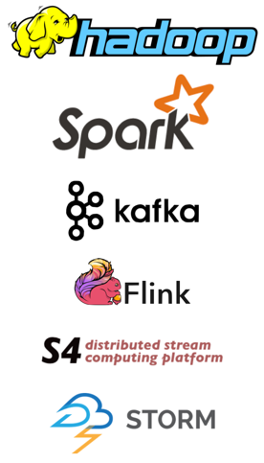
Research results matter: MapReduce
Notes:
Google MapReduce
How to process large volumes of data over 1000s of servers, even in face of failures
Authors for industrial research labs and academia (DEC WRL, MIT/UW, etc.)
Led to open-source Apache Hadoop
Created Big Data industry…

Slide 16
Course Organization

Slide 17
Learning the material: People
Lecture M/W 10-1050
Professor Wyatt Lloyd
Slides available on course website
Precept:
TAs Theano Stavrinos, Zhenyu Song, and Chris Hodsdon
Main Q&A forum: www.piazza.com
No anonymous posts or questions
Can send private messages to instructors
(Extra credit for answering)

Slide 18
Learning the Material: Lectures!
Attend lectures and precepts and take notes!
Lecture slides posted day/night before
Recommendation: Print slides & take notes
Not everything covered in class is on slides
You are responsible for everything covered in class
No required textbooks
Links to Go Programming textbook and two other distributed systems textbooks on website

Slide 19
Grading
Five assignments (10% each)
90% 24 hours late, 80% 2 days late, 50% >5 days late
Three free late days (we’ll figure which one is best)
Two exams (50% total)
Midterm exam before fall recess (25%)
Final exam during exam period (25%)

Slide 20
Policies: Write Your Own Code
Programming is an individual creative process. At first, discussions with friends is fine. When writing code, however, the program must be your own work.
Do not copy another person’s programs, comments, or any part of submitted assignment. This includes character-by-character transliteration but also derivative works. Cannot use another’s code, etc. even while “citing” them.
Writing code for use by another or using another’s code is academic fraud in context of coursework.
Do not publish your code e.g., on github, during/after course!

Slide 21
Policies: Write Your Own Code
Programming is an individual creative process. At first, discussions with friends is fine. When writing code, however, the program must be your own work.
Do not copy another person’s programs, comments, README description, or any part of submitted assignment. This includes character-by-character transliteration but also derivative works. Cannot use another’s code, etc. even while “citing” them.
Writing code for use by another or using another’s code is academic fraud in context of coursework.
Do not publish your code e.g., on github, during/after course!
Don’t Plagiarize!

Slide 22
Assignment 1 (in three parts)
Learn how to program in Go
Basic Go assignment (due Sept 20)
“Sequential” Map Reduce (due Sept 27)
Distributed Map Reduce (due Oct 4)

Slide 23
Warnings
This is a 400-level course,
with expectations to match.

Slide 24
Warning #1: Assignments are a LOT of work
Assignment 1 is purposely easy to teach Go. Don’t be fooled.
Last year they gave 3-4 weeks for later assignments; many students started 3-4 days before deadline. Disaster.
Distributed systems are hard
Need to understand problem and protocol, carefully design
Can take 5x more time to debug than “initially program”
Assignment #4 builds on your Assignment #3 solution, i.e., you can’t do #4 until your own #3 is working! (That’s the real world!)

Slide 25
Warning #2: Software engineering, not just programming
COS126, 217, 226 told you how to design & structure your programs. This class doesn’t.
Real software engineering projects don’t either.
You need to learn to do it.
If your system isn’t designed well, can be significantly harder to get right.
Your friend: test-driven development
We’ll supply tests, bonus points for adding new ones

Slide 26
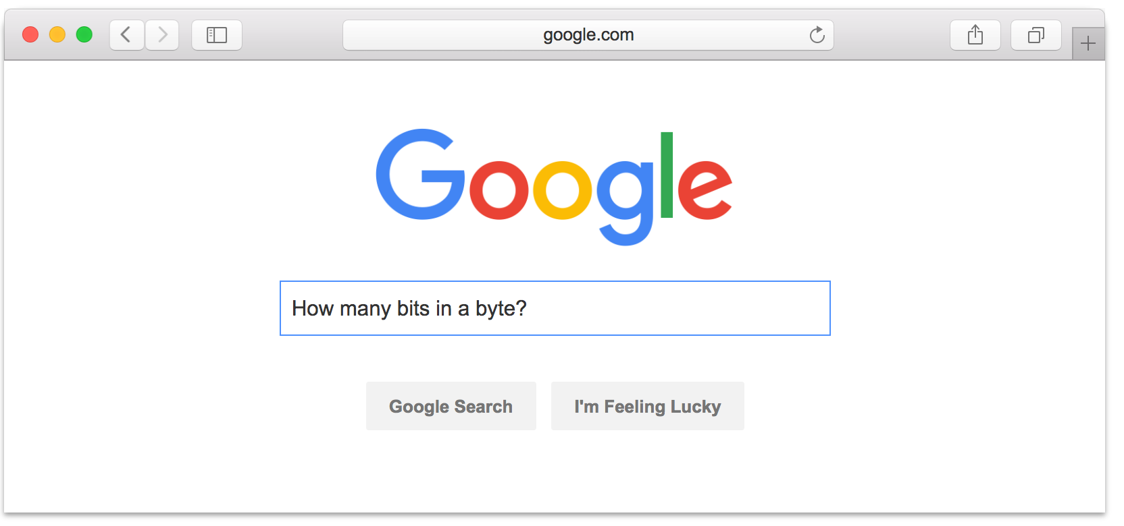
Warning #3: Don’t expect 24x7 answers
Try to figure out yourself
Piazza not designed for debugging
Utilize right venue: Go to office hours
Send detailed Q’s / bug reports, not “no idea what’s wrong”
Instructors are not on pager duty 24 x 7
Don’t expect response before next business day
Questions Friday night @ 11pm should not expect fast responses. Be happy with something before Monday.
Implications
Students should answer each other (+ it’s worth credit)
Start your assignments early!

Slide 27
Topics Preview

Slide 28
Fundamentals
Lectures
Network communication and Remote Procedure Calls
Time, logical clocks
Vector clocks, distributed snapshots
Precepts
Lots of Go
Mapreduce (assignment 1)

Slide 29
Eventual Consistency and Scaling Out
Lectures
Eventual consistency and Bayou
Peer-to-peer systems and Distributed Hash Tables
Scale-out key-value storage and Dynamo
Precepts
More Go
Distributed snapshots (assignment 2)
Notes:
How do you build systems that continue to work and scale despite failure?

Slide 30
Replicated State Machines
Lectures
Replicated State Machines, Primary-Backup
Reconfiguration and View Change Protocols
Consensus and Paxos (and FLP)
Leader Election and RAFT
Byzantine Fault Tolerance
Precepts
Viewstamped replication
RAFT (Assignments 3,4)
Notes:
Eventually consistent programs presented a hard-to-use interface to higher-level programs
How do you build systems that really work despite failure and have a much cleaner interface? (i.e., hide all the complexity)

Slide 31
Strong Consistency and Scaling Out with Transactions
Lectures
Strong consistency and the CAP Theorem
Atomic commit
Pessimistic concurrency control
Optimistic concurrency control
Spanner (Concurrency control + Paxos!)
The SNOW Theorem and Systems
Precepts
Consistency
Concurrency control
Spanner and SNOW
Notes:
How do you build systems that scale with a clean interface? (i.e.,, hide all the complexity)

Slide 32
Various Topics
Lectures
Blockchains
Big data processing
Cluster scheduling and fairness
Cluster load testing
Content delivery networks
Precepts
Big data systems
Notes:
So many other interesting, practical, exciting topics, we’ll try to cover as many we can!

