Slide 1


Dapper: Data Plane Performance Diagnosis of TCP
Mojgan Ghasemi
Princeton University
Theophilus Benson Jennifer Rexford
Duke University Princeton University
Notes:
How to diagnose TCP problems at linerate in dataplane

Slide 2
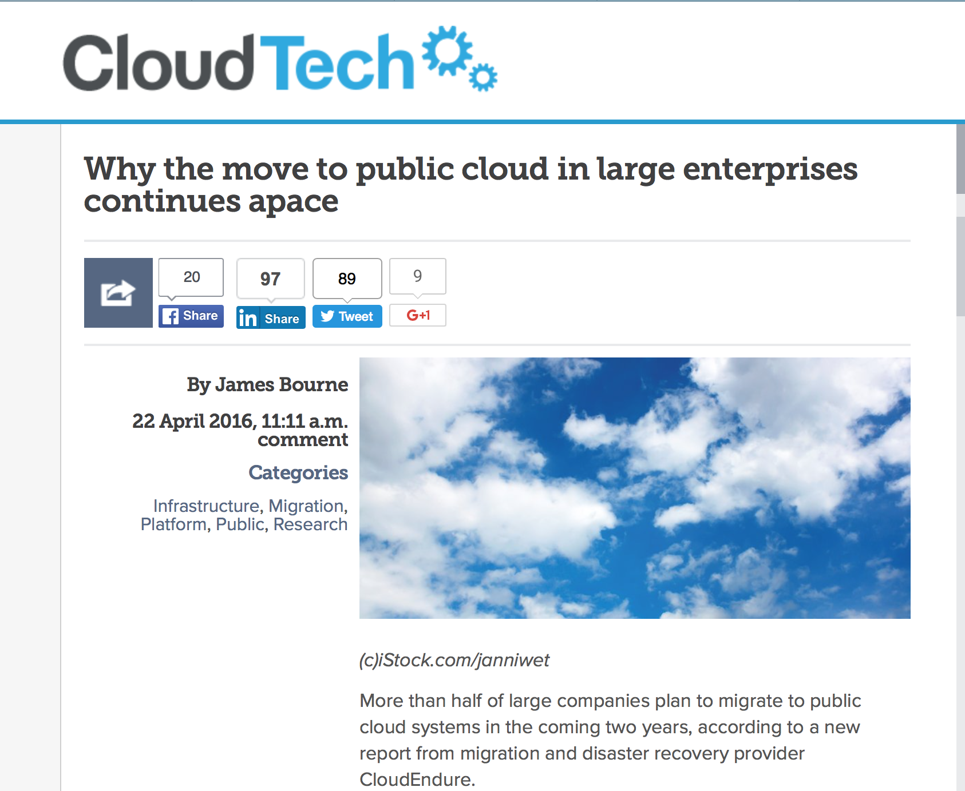
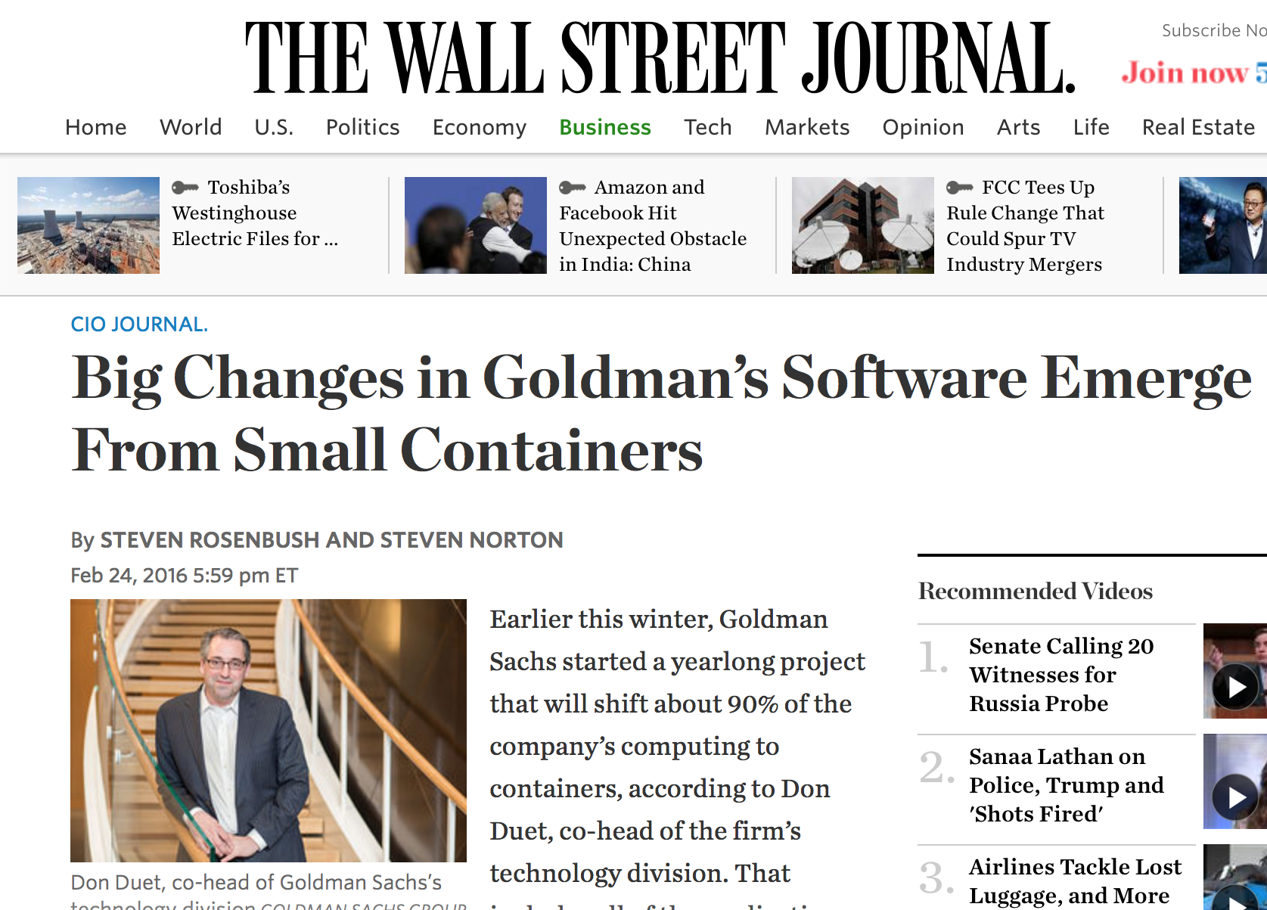
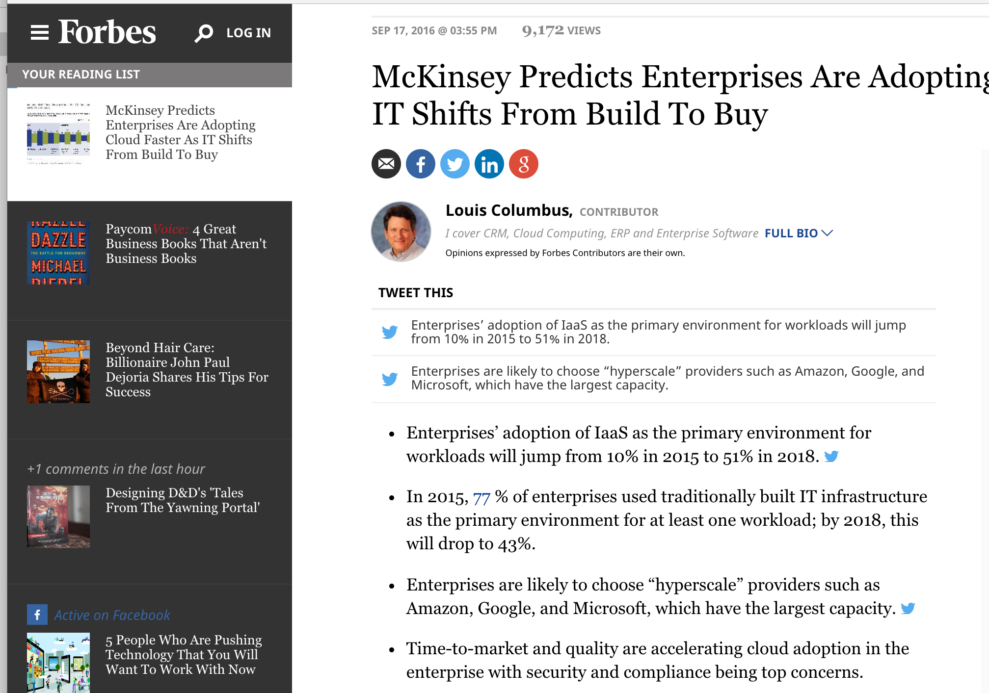
The Move to Public Clouds
Notes:
Many enterprises and applications are moving to the public cloud
Over the recent years, Many enterprises and applications have moved to public clouds
Customers bring their own VMs!

Slide 3
Public Clouds
VM1
VM2
VM3
VM1
VM2
VM3
VM1
VM2
VM3
Public cloud operators need:
  High utilization (to reduce cost)
  Good performance (to satisfy tenants)
Detecting, diagnosing, and fixing performance problems quickly is crucial!
Notes:
Our focus is on the IaaS clouds, where the cloud provider provides virtualized computing resources to the tenant in forms of a VM, these VMs are hosted in physical hosts and connected to each other through the provider’s network.
Public cloud operators need to maintain high utilization to lower the costs, and also offer good and predictable performance to meet SLAs and keep their tenants happy
That is why a timely diagnosis of performance problems is crucial in clouds

Slide 4
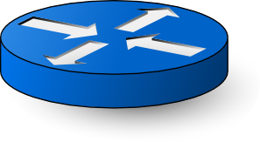
Sources of Poor TCP Performance
Segment size, MSS, App reaction time
Not backlogged!
Delayed ACK
Receive window, delayed ACK
app
High RTT
High Loss
Low BW
Receive buffer is full
app
Send buffer too small
Congestion window,
RTT, loss
Identifying the component is the most time-consuming and expensive part
Our goal: quickly pinpoint the component impairing TCP performance
Notes:
Since TCP is the dominant protocol, we’ll focus on diagnosis of TCP connections.
Let’s see what sources can cause poor performance in a TCP connection
It can take from an hour to days in data centers!
It has been shown that identifying the entity responsible for poor performance is often the most time-consuming and expensive part of failure detection and can take from an hour to days in data centers!
*selectively monitor connections*

Slide 5
Location of Performance Monitoring
No visibility into e2e metrics,
Different paths for packet stream
Violates trust in IaaS cloud,
Complicates billing
Compatible with IaaS,
Sees e2e metrics,
Sees both sides,
  Can take actions directly in data plane
Notes:
Edge: Hypervisor, NIC, top-of-rack switch
as shown in Figure 1—offers the best viable alternative. The edge (i) sees all of a TCP connection’s packets in both directions,
(ii) can closely observe the application’s interactions with the network without the tenant’s cooperation, and (iii) can measure end-to-end metrics from the end-host perspective (e.g., path loss rate) because it is only one hop away from the end-host.

Slide 6

Challenges of Diagnosis at the “Edge”
No direct access to app/OS stack (IaaS model)
Single pass on packets (replay is not possible)
Support different TCP variants (possibly unknown)
Need bi-directional monitoring
Low overhead (state and operations on switch)
Only one edge
Reno, Cubic,…
app
app
Limited registers
Notes:
, real-time diagnosis

Slide 7
Stateful Data-plane Programming
Parse
Tables
&
Actions
Operations
(+,-,max,..)
Registers
Register Array
(e.g., MSS)
Parse &
Hash
One index per bi-directional connection!
Notes:
fortunately emerging hardware and and software switches and NICs have been offering new capabilities at the edge
(for example the e.g., Barefoot switch, [switch ASIC], Xilinx [FPGA], Netronome [NIC]) and the P4 language
These emerging frameworks offer us some features, including flexible parsing.
Flexible parsing
Extract and retain packet header information (e.g., receive window, sequence and ACK numbers, five tuple, etc.)
Registers
Store state across successive packets of the flow (e.g., counters)
Tables and actions
Perform specific operations on each packet
Logic control
conditions

Slide 8

Diagnosing Sender Problem From the Edge
Detect if sender is sending “Too few” or “Too late”
MSS:
  Extract TCP options, or max of “segment sizes” seen
App Reaction Time:
  Both directions
  Arithmetic operation (subtraction)
app
app
Seq2
Ack1
Notes:
Parse and extract TCP options
Now let’s see how the inference would work. Starting with some simple metrics

Slide 9
Diagnosing Receiver Problem From the Edge
Receive Window:
  Parse header to extract TCP option
  Arithmetic operations (shift to scale the window)
Delayed ACK:
  Both directions
  Comparison operations (Seq. vs Ack)
app
Seq3
Seq2
Seq1
app
Ack
Notes:
this would require us to map both directions of the flow to the same index in register array
2 comparisons:
Sequence number vs ACK
How many outstanding segments is ACKed

Slide 10
Inferring Network Latency
RTT:
  Need both directions (sequence numbers and ACKs)
  Comparison operations (ACK ≥ Seq)
  Arithmetic operations (subtraction)
app
app
Seq, timestamp
Ack, timestamp

Slide 11
Inferring Network Loss
Loss:
  Detected via re-transmission
  Comparison operation (sequence numbers)
  Registers and metadata to compare the dup ACKs
Seq1
app
app
Seq1

Slide 12
Inferring Congestion Window
Congestion Window:
  Different TCP congestion controls
  Unkonwn threshold (e.g., ssthresh to exit slow start)
  Tuned parameters (e.g., Initial window)
TCP Invariants:
  Flight size is bounded by CWND
    Lower-bound estimate of congestion window
  Packet loss changes CWND based on the nature of loss
    A timeout resets CWND to initial window
    A fast-retransmit causes a multiplicative decrease in CWND
Notes:
the most challenging metric
every VM can run different versions of TCP
and they can tune it to use different parameters such as IW
to overcome these challenges, we use two TCP invariants that holds regardless
1. the connection cannot have more packets in flight that the network is allowing
2. all congestion control algorithms react to loss

Slide 13
Inferring Flight Size
Flight size: number of packets in flight
app
app
Seq2
Seq1
Fligh Size : 1
Flight Size : 2
Flight Size : 1
Flight Size : 0
Ack1
Ack2
Notes:
Congestion window
Receive window
Application’s own data-generation rate
We need the flight size to assess the backlogged ness of an app. How the sender is increasing its rate, and also to compare with CWND and RWND to see if the sender if sending as much as it can

Slide 14
Estimating CWND
If flight size increases:
  CWND <- flight size
If a loss is observed:
  Decrease CWND appropriately
From different starting points:
  Beginning
  After 1 sec
  After 3 sec

Slide 15
Dapper’s Implementation in P4
Operations
Stages
(conditions)
  Need symmetric hashing for bi-directional cross packet analysis
Parse &
Hash
Write to Registers
  Two sets of headers,
  In the reverse order,
  Consistent comparison of direction (srcIP > dstIP)
Parse
Extract
Hash
Read Registers,
Metadata
Notes:
this is the P4 implementation of the same flowchart I showed you
the blue boxes are registers
the yellow diamonds are conditions
and the sentences describe what each table/action does
we have taken advantage of parsing, registers, metadata, and control flow in P4 to realize the flowchart

Slide 16
Dapper’s Limitations
Diagnosis granularity:
  Identifies the component (network, sender, or receiver)
Hardware capabilities:
  Accessing a register at multiple stages
Hardware capacity:
  Switches have a limited number of registers
  Collision reduces the monitoring accuracy
Notes:
you can see more evaluations in the paper, specially about the accuracy of diagnosis
here Iwant to touch on three limitations that we face
Solution:
Dapper’s software equivalent (which uses libpcap and BPF)
Sampling and triggering, two-phase

Slide 17
Overhead in Software
Software: Not constrained for memory, CPU matters
Setup:
  Parallel TCP flows between a server-client pair, with average rate of 1 Mbps.
  Total CPU consumption (packet capturing, copying, analysis)
Notes:
We measure the CPU overhead by connecting two servers to a single switch and starting parallel TCP flows between them and measuring CPU using top. . All flows are initially established (i.e., completed the TCP handshake) and have the average rate of 1 Mbps. Figure 10 shows the total CPU consumption (including live packet capturing via libpcap and copying packets to user space) versus the aggregate bandwidth pro- cessed. Dapper’s CPU consumption
is close to approaches that use near-real time polling frequency (e.g., [40] at 50ms frequency).
Batch-processing can lower the CPU overhead.
bypass copying to userspace
fast packet IO
the overhead in system calls and memory copies caused by libpcap for packet capturing can be reduced if Dapper uses fast packet IO frameworks such as Netmap [29]
In single-phase mode, our P4 pro- totype keeps 67 bytes of state for each connection
In a typical data center, a host can have 10K connections [40], which results in 670 KB of state required to track their state.
Right figure shows
Per number of flows (k), for varying
sizes of tables (N). Assuming the N hash values are equally
possible,
the expected collision rate.
Thus, to track 10K connections with a collision rate of less than 4%, we need the table size to be at least 262,144 (218), which results in less than 18 MB space on the switch.

Slide 18
Overhead in Hardware
Hardware: Runs at line-rate, but limited memory
  keeps 67B per connection
Collision in hash table:
  K connections, hash table size of N

Slide 19
Conclusion
Performance diagnosis in the cloud is challenging but important
  Providers require real time diagnosis
Dapper, a data plane diagnosis framework for TCP
  Compatible with IaaS cloud
  Leverage functionality in emerging data plane platforms
Dapper enables a whole range of proactive resolution techniques
  Can take actions directly in the data plane
Notes:
Detecting, diagnosing and fixing performance problems quickly is crucial for cloud providers
Desirable to infer TCP metrics in a streaming fashion
Removes packet capturing and processing overhead from end-hosts
Compatible with IaaS trust model
Allows us to use functionality in emerging edge devices
Has an e2e view
Possible to infer TCP metrics online at edge devices
(e.g. stateful programming)
Implementing Dapper in the dataplane via P4 introduces limitations that a purely software solution may avoid. Yet,
wide range of existing edge architectures.
We believe that the modest overheads are an acceptable price to pay for the

Slide 20
Thank you!

