Slide 1
Vector Clocks and
Distributed Snapshots
COS 418: Distributed Systems
Lecture 5
Kyle Jamieson

Slide 2
Today
Logical Time: Vector clocks
Distributed Global Snapshots

Slide 3
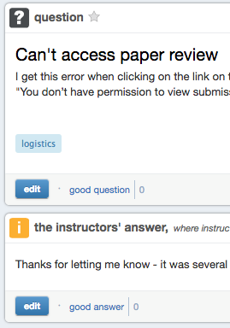

Motivation: Distributed discussion board
Happens-Before
OK
OK

Slide 4
Distributed discussion board
Users join specific discussion groups
  Each user runs a process on a different machine
  Messages (posts or replies) sent to all users in group
Goal: Ensure replies follow posts
Non-goal: Sort posts and replies chronologically
Can Lamport Clocks help here?

Slide 5
Lamport Clock-based discussion board
P1
Post
1
3
C(2) = 2
Reply
P2
1
3
P3
C(3) = 0
Want: Defer showing
Reply until Post arrives
Time →
Defer showing message if C(message) > local clock + 1?

Slide 6
Lamport Clock-based discussion board
P1
Post
1
3
C(2) = 2
Post
P2
1
3
P3
C(3) = 0
Want: Don’t defer!
Time →
No! Gap could be due to other independent posts

Slide 7
Lamport Clocks and causality
Problem generalizes: Replies to replies to posts intermingle with replies to posts
Lamport clock timestamps don’t capture causality
Given two timestamps C(a) and C(z), want to know whether there’s a chain of events linking them:
a → b → ... → y → z
Chain of events captures replies to posts in our example

Slide 8
Vector clock: Introduction
One integer can’t order events in more than one process
So, a Vector Clock (VC) is a vector of integers, one entry for each process in the entire distributed system
  Label event e with VC(e) = [c₁, c₂ …, c_{n}]
    Each entry c_{k} is a count of events in process k that causally precede e

Slide 9
Vector clock: Update rules
Initially, all vectors are [0, 0, …, 0]
Two update rules:
For each local event on process i, increment local entry c_{i}
If process j receives message with vector [d₁, d₂, …, d_{n}]:
  Set each local entry c_{k} = max{c_{k}, d_{k}}
  Increment local entry c_{j}

Slide 10
Vector clock: Example
All processes’ VCs start at [0, 0, 0]
Applying local update rule
Applying message rule
  Local vector clock piggybacks on inter-process messages
P1
P2
P3
a
[1,0,0]
e
[0,0,1]
[2,0,0]
b
[2,0,0]
[2,1,0]
c
[2,2,0]
d
[2,2,0]
[2,2,2]
f
Physical time ↓

Slide 11
Comparing vector timestamps
Rule for comparing vector timestamps:
  V(a) = V(b) when a_{k} = b_{k} for all k
  V(a) < V(b) when a_{k} ≤ b_{k} for all k and V(a) ≠ V(b)
Concurrency:
  a || b if a_{i} < b_{i} and a_{j} > b_{j}, some i, j

Slide 12
Vector clocks establish causality
V(w) < V(z) then there is a chain of events linked by Happens-Before (→) between a and z
If V(a) || V(w) then there is no such chain of events between a and w
P1
P2
P3
[1,0,0]
w
a
[0,1,0]
[2,0,0]
x
[2,1,0]
y
z
[2,2,0]

Slide 13
Two events a, z
Lamport clocks: C(a) < C(z)
Conclusion: None
Vector clocks: V(a) < V(z)
Conclusion: a → … → z
Vector clock timestamps tell us about causal event relationships

Slide 14
VC application:
Causally-ordered bulletin board system
Original
post
1’s reply
Physical time →
User 0 posts, user 1 replies to 0’s post; user 2 observes

Slide 15
Today
Logical Time: Vector clocks
Distributed Global Snapshots
  Chandy-Lamport algorithm
  Reasoning about C-L: Consistent Cuts

Slide 16
Distributed Snapshots
What is the state of a distributed system?
San Francisco
acct1 balance = $1000
acct2 balance = $2000
New York
acct1 balance = $1000
acct2 balance = $2000

Slide 17
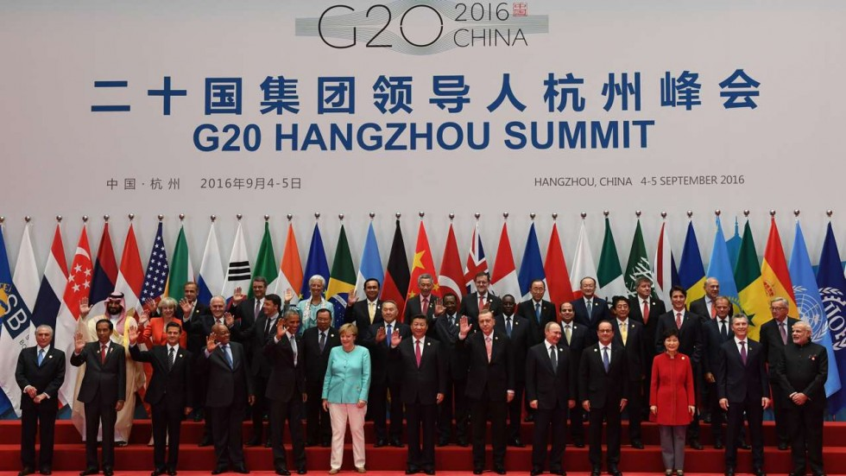
Example of a global snapshot

Slide 18
But that was easy
In our system of world leaders, we were able to capture their ‘state’ (i.e., likeness) easily
  Synchronized in space
  Synchronized in time
How would we take a global snapshot if the leaders were all at home?
What if Obama told Trudeau that he should really put on a shirt?
This message is part of our system state!

Slide 19
System model
N processes in the system with no process failures
  Each process has some state it keeps track of
There are two first-in, first-out, unidirectional channels between every process pair P and Q
  Call them channel(P, Q) and channel(Q, P)
  The channel has state, too: the set of messages inside
  For today, assume all messages sent on channels arrive intact and unduplicated

Slide 20
Global snapshot is global state
Each distributed application has a number of processes (leaders) running on a number of physical servers
These processes communicate with each other via channels
A global snapshot captures
  The local states of each process (e.g., program variables), along with
  The state of each communication channel

Slide 21
Why do we need snapshots?
Checkpointing: Restart if the application fails
Collecting garbage: Remove objects that don’t have any references
Detecting deadlocks: The snapshot can examine the current application state
  Process A grabs Lock 1, B grabs 2, A waits for 2, B waits for 1... ... ...
Other debugging: A little easier to work with than printf…

Slide 22
Just synchronize local clocks?
Each process records state at some agreed-upon time
But system clocks skew, significantly with respect to CPU process’ clock cycle
  And we wouldn’t record messages between processes
Do we need synchronization?
What did Lamport realize about ordering events?

Slide 23
System model: Graphical example
Let’s represent process state as a set of colored tokens
Suppose there are two processes, P and Q:
Process P:
Process Q:
P
Q
channel(P, Q)
Y
R
P
B
G
channel(Q, P)
O
Correct global snapshot = Exactly one of each token

Slide 24
When is inconsistency possible?
Suppose we take snapshots only from a process perspective
Suppose snapshots happen independently at each process
Let’s look at the implications...

Slide 25
Problem: Disappearing tokens
P, Q put tokens into channels, then snapshot
This snapshot misses Y, B, and O tokens
P
Q
Y
Y
R
P
B
G
B
O
O
P = { G }
Q = { R, P }

Slide 26
Problem: Duplicated tokens
P snapshots, then sends Y
Q receives Y, then snapshots
This snapshot duplicates the Y token
P
Q
Y
Y
Y
R
P
B
G
O
P = { G, Y }
Q = { Y, R, P, B, O }

Slide 27
Idea: “Marker” messages
What went wrong? We should have captured the state of the channels as well
Let’s send a marker message ▲ to track this state
  Distinct from other messages
  Channels deliver marker and other messages FIFO

Slide 28
Chandy-Lamport algorithm: Overview
We’ll designate one node (say P) to start the snapshot
  Without any steps in between, P:
    Records its local state (“snapshots”)
    Sends a marker on each outbound channel
Nodes remember whether they have snapshotted
On receiving a marker, a non-snapshotted node performs steps (1) and (2) above

Slide 29
Chandy-Lamport: Sending process
P snapshots and sends marker, then sends Y
Send Rule: Send marker on all outgoing channels
  Immediately after snapshot
  Before sending any further messages
P
Q
Y
▲
Y
R
P
B
G
O
snap: P = { G, Y }

Slide 30
Chandy-Lamport: Receiving process (1/2)
At the same time, Q sends orange token O
Then, Q receives marker ▲
Receive Rule (if not yet snapshotted)
  On receiving marker on channel c record c’s state as empty
channel(P,Q) = { }
P
Q
Y
▲
▲
R
P
B
G
O
O
P = { G, Y }
Q = { R, P, B }

Slide 31
Chandy-Lamport: Receiving process (2/2)
Q sends marker to P
P receives orange token O, then marker ▲
Receive Rule (if already snapshotted):
  On receiving marker on c record c’s state: all msgs from c since snapshot
channel(P,Q) = { }
P
Q
Y
O
▲
R
P
▲
B
G
O
P = { G, Y }
channel(Q,P) = { O }
Q = { R, P, B }

Slide 32
Terminating a snapshot
Distributed algorithm: No one process decides when it terminates
Eventually, all processes have received a marker (and recorded their own state)
All processes have received a marker on all the N–1 incoming channels (and recorded their states)
Later, a central server can gather the local states to build a global snapshot

Slide 33
Today
Logical Time: Vector clocks
Distributed Global Snapshots
  Chandy-Lamport algorithm
  Reasoning about C-L: Consistent Cuts

Slide 34
Global states and cuts
Global state is a n-tuple of local states (one per process and channel)
A cut is a subset of the global history that contains an initial prefix of each local state
  Therefore every cut is a natural global state
  Intuitively, a cut partitions the space time diagram along the time axis
Cut = { The last event of each process, and message of each channel that is in the cut }

Slide 35
Inconsistent versus consistent cuts
A consistent cut is a cut that respects causality of events
A cut C is consistent when:
  For each pair of events e and f, if:
    f is in the cut, and
    e → f,
  then, event e is also in the cut

Slide 36
Consistent versus inconsistent cuts
A
B
C
D
P1
F
P2
E
G
P3
H
Inconsistent: G → D but only D is in the cut
Consistent: H → F and H in the cut

Slide 37
C-L returns a consistent cut
A
B
C
D
P1
F
P2
E
G
C-L can’t return this cut
P3
H
Inconsistent: G → D but only D is in the cut
C-L ensures that if D is in the cut, then G is in the cut

Slide 38
C-L can’t return this inconsistent cut
A
B
C
D
P1
F
P2
E
snap!
G
P3
H

Slide 39
Friday Precept:
RPCs in Go
Monday Topic:
Eventual Consistency & Bayou

