Slide 1
Network File Systems:
Naming, cache control, consistency
COS 418: Distributed Systems
Lecture 3
Michael Freedman

Slide 2
Abstraction, abstraction, abstraction!
Local file systems
  Disks are terrible abstractions: low-level blocks, etc.
  Directories, files, links much better
Distributed file systems
  Make a remote file system look local
  Today: NFS (Network File System)
    Developed by Sun in 1980s, still used today!

Slide 3
3 Goals: Make operations appear:
Local
Consistent
Fast

Slide 4
NFS: Naming indirection, abstraction
“Mount” remote FS (host:path) as local directories
Notes:
Coulouris, Dollimore, Kindberg and Blair, Distributed Systems: Concepts and Design Edn. 5
© Pearson Education 2012

Slide 5
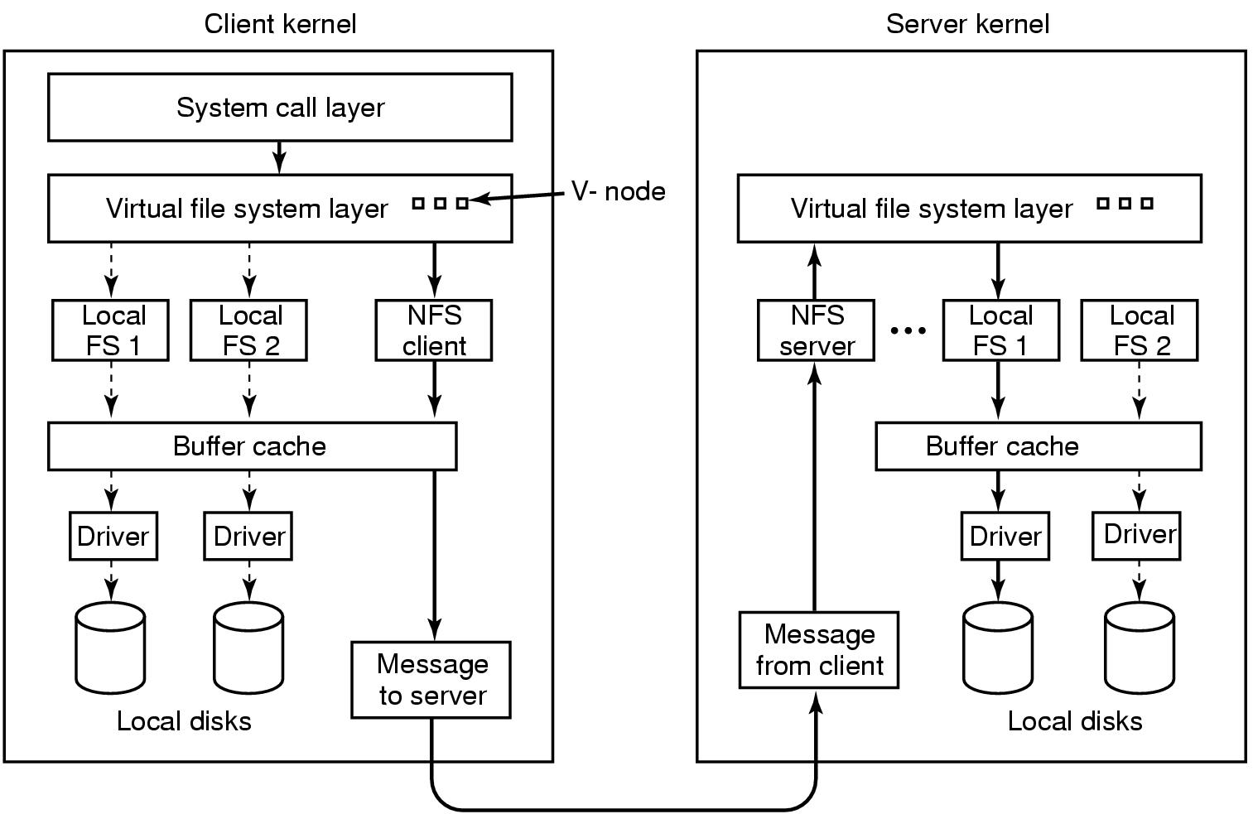
Virtual File System enables transparency

Slide 6
Interfaces matter

Slide 7
VFS / Local FS
    fd = open(“path”, flags)
    read(fd, buf, n)
    write(fd, buf, n)
    close(fd)
Computer maintains state that maps fd to inode, offset

Slide 8
Stateless NFS: Strawman 1
    fd = open(“path”, flags)
    read(“path”, buf, n)
    write(“path”, buf, n)
    close(fd)

Slide 9
Stateless NFS: Strawman 2
    fd = open(“path”, flags)
    read(“path”, offset, buf, n)
    write(“path”, offset, buf, n)
    close(fd)

Slide 10
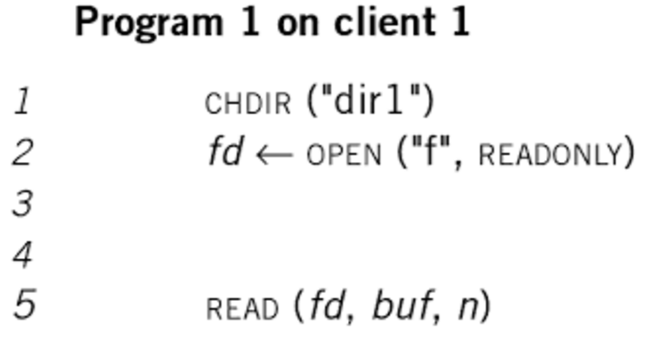
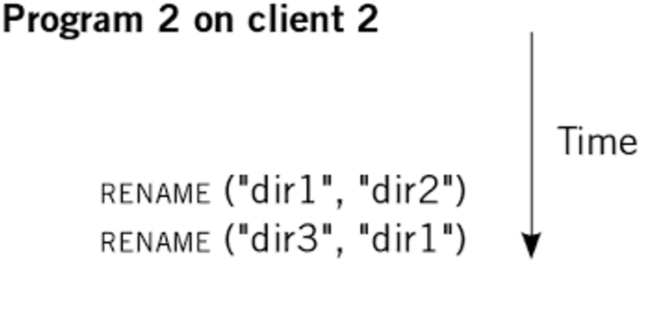
Embed pathnames in syscalls?
Should read refer to current dir1/f or dir2/f ?
In UNIX, it’s dir2/f. How do we preserve in NFS?

Slide 11
Stateless NFS (for real)
    fh = lookup(“path”, flags)
    read(fh, offset, buf, n)
    write(fh, offset, buf, n)
    getattr(fh)
Implemented as Remote Procedure Calls (RPCs)

Slide 12
NFS File Handles (fh)
Opaque identifier provider to client from server
Includes all info needed to identify file/object on server
  volume ID | inode # | generation #
It’s a trick: “store” server state at the client!

Slide 13
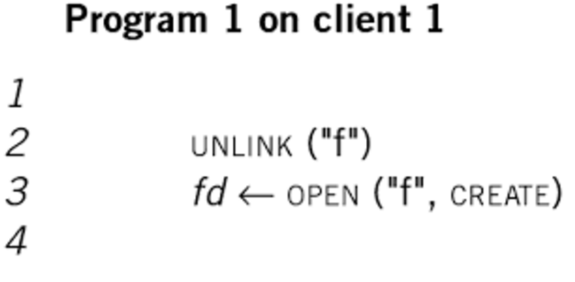
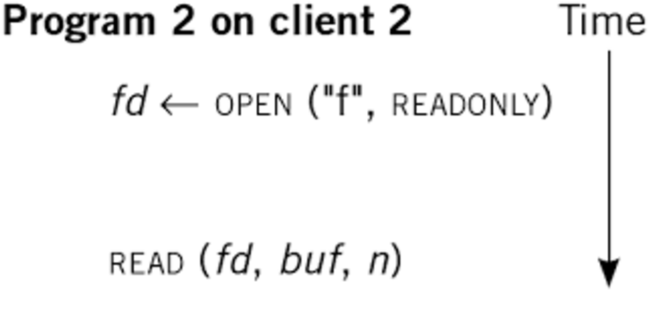
NFS File Handles (and versioning)
With generation #’s, client 2 continues to interact with “correct” file, even while client 1 has changed “ f ”
This versioning appears in many contexts, e.g., MVCC (multiversion concurrency control) in DBs

Slide 14
Are remote == local?

Slide 15
TANSTANFL
(There ain’t no such thing as a free lunch)
With local FS, read sees data from “most recent” write, even if performed by different process
  “Read/write coherence”, linearizability
Achieve the same with NFS?
  Perform all reads & writes synchronously to server
  Huge cost: high latency, low scalability
And what if the server doesn’t return?
  Options: hang indefinitely, return ERROR

Slide 16
Caching GOOD
Lower latency, better scalability
Consistency HARDER
No longer one single copy of data, to which all operations are serialized

Slide 17
Caching options
Read-ahead: Pre-fetch blocks before needed
Write-through: All writes sent to server
Write-behind: Writes locally buffered, send as batch
Consistency challenges:
  When client writes, how do others caching data get updated? (Callbacks, …)
  Two clients concurrently write? (Locking, overwrite, …)
Notes:
Paul Krzyzanowski, CS 417 Distributed Systems, Rutgers, Fall 2013.
http://www.cs.rutgers.edu/~pxk/417/notes/content/08-nas-slides-6pp.pdf

Slide 18
Should server maintain per-client state?
(which files open for reading/writing, what cached, …)
Stateful
Stateless
Pros
  Smaller requests
  Simpler req processing
  Better cache coherence, file locking, etc.
Cons
  Per-client state limits scalability
  Fault-tolerance on state required for correctness
Pros
  Easy server crash recovery
  No open/close needed
  Better scalability
Cons
  Each request must be fully self-describing
  Consistency is harder, e.g., no simple file locking
Notes:
Paul Krzyzanowski, CS 417 Distributed Systems, Rutgers, Fall 2013.
http://www.cs.rutgers.edu/~pxk/417/notes/content/08-nas-slides-6pp.pdf

Slide 19
It’s all about the state, ’bout the state, …
Hard state: Don’t lose data
  Durability: State not lost
    Write to disk, or cold remote backup
    Exact replica or recoverable (DB: checkpoint + op log)
  Availability (liveness): Maintain online replicas
Soft state: Performance optimization
  Traditionally: Lose at will
  More recently: Yes for correctness (safety), but how does recovery impact availability (liveness)?

Slide 20
NFS
Stateless protocol
  Recovery easy: crashed == slow server
  Messages over UDP (unencrypted)
Read from server, caching in NFS client
NFSv2 was write-through (i.e., synchronous)
NFSv3 added write-behind
  Delay writes until close or fsync from application

Slide 21
Exploring the consistency tradeoffs
  Write-to-read semantics too expensive
  Give up caching, require server-side state, or …
Close-to-open “session” semantics
  Ensure an ordering, but only between application close and open, not all writes and reads.
  If B opens after A closes, will see A’s writes
  But if two clients open at same time? No guarantees
    And what gets written? “Last writer wins”

Slide 22
NFS Cache Consistency
Recall challenge: Potential concurrent writers
Cache validation:
  Get file’s last modification time from server: getattr(fh)
  Both when first open file, then poll every 3-60 seconds
    If server’s last modification time has changed, flush dirty blocks and invalidate cache
When reading a block
  Validate: (current time – last validation time < threshold)
  If valid, serve from cache. Otherwise, refresh from server

Slide 23
Some problems…
“Mixed reads” across version
  A reads block 1-10 from file, B replaces blocks 1-20, A then keeps reading blocks 11-20.
Assumes synchronized clocks. Not really correct.
  We’ll learn about the notion of logical clocks later
Writes specified by offset
  Concurrent writes can change offset
  More on this later with techniques for conflict resolution

Slide 24
When statefulness helps
Callbacks
Locks + Leases

Slide 25
NFS Cache Consistency
Recall challenge: Potential concurrent writers
Timestamp invalidation: NFS
Callback invalidation: AFS, Sprite, Spritely NFS
    Server tracks all clients that have opened file
    On write, sends notification to clients if file changes. Client invalidates cache.
Leases: Gray & Cheriton ’89, NFSv4

Slide 26
Locks
A client can request a lock over a file / byte range
  Advisory: Well-behaved clients comply
  Mandatory: Server-enforced
Client performs writes, then unlocks
Problem: What if the client crashes?
  Solution: Keep-alive timer: Recover lock on timeout
    Problem: what if client alive but network route failed?
      Client thinks it has lock, server gives lock to other: “Split brain”

Slide 27
Leases
Client obtains lease on file for read or write
  “A lease is a ticket permitting an activity; the lease is valid until some expiration time.”
Read lease allows client to cache clean data
  Guarantee: no other client is modifying file
Write lease allows safe delayed writes
  Client can locally modify than batch writes to server
  Guarantee: no other client has file cached

Slide 28
Using leases
Client requests a lease
  May be implicit, distinct from file locking
  Issued lease has file version number for cache coherence
Server determines if lease can be granted
  Read leases may be granted concurrently
  Write leases are granted exclusively
If conflict exists, server may send eviction notices
  Evicted write lease must write back
  Evicted read leases must flush/disable caching
  Client acknowledges when completed

Slide 29
Bounded lease term simplifies recovery
Before lease expires, client must renew lease
Client fails while holding a lease?
  Server waits until the lease expires, then unilaterally reclaims
  If client fails during eviction, server waits then reclaims
Server fails while leases outstanding? On recovery:
  Wait lease period + clock skew before issuing new leases
  Absorb renewal requests and/or writes for evicted leases

Slide 30
Requirements dictate design
Case Study: AFS

Slide 31
Andrew File System (CMU 1980s-)
Scalability was key design goal
  Many servers, 10,000s of users
Observations about workload
  Reads much more common than writes
  Concurrent writes are rare / writes between users disjoint
Interfaces in terms of files, not blocks
  Whole-file serving: entire file and directories
  Whole-file caching: clients cache files to local disk
    Large cache and permanent, so persists across reboots

Slide 32
AFS: Consistency
Consistency: Close-to-open consistency
  No mixed writes, as whole-file caching / whole-file overwrites
  Update visibility: Callbacks to invalidate caches
What about crashes or partitions?
  Client invalidates cache iff
    Recovering from failure
    Regular liveness check to server (heartbeat) fails.
  Server assumes cache invalidated if callbacks fail + heartbeat period exceeded

