Slide 1
Big Data Processing
COS 418: Distributed Systems
Lecture 21
Michael Freedman

Slide 2
Data-Parallel Computation

Slide 3
Ex: Word count using partial aggregation
Compute word counts from individual files
Then merge intermediate output
Compute word count on merged outputs

Slide 4
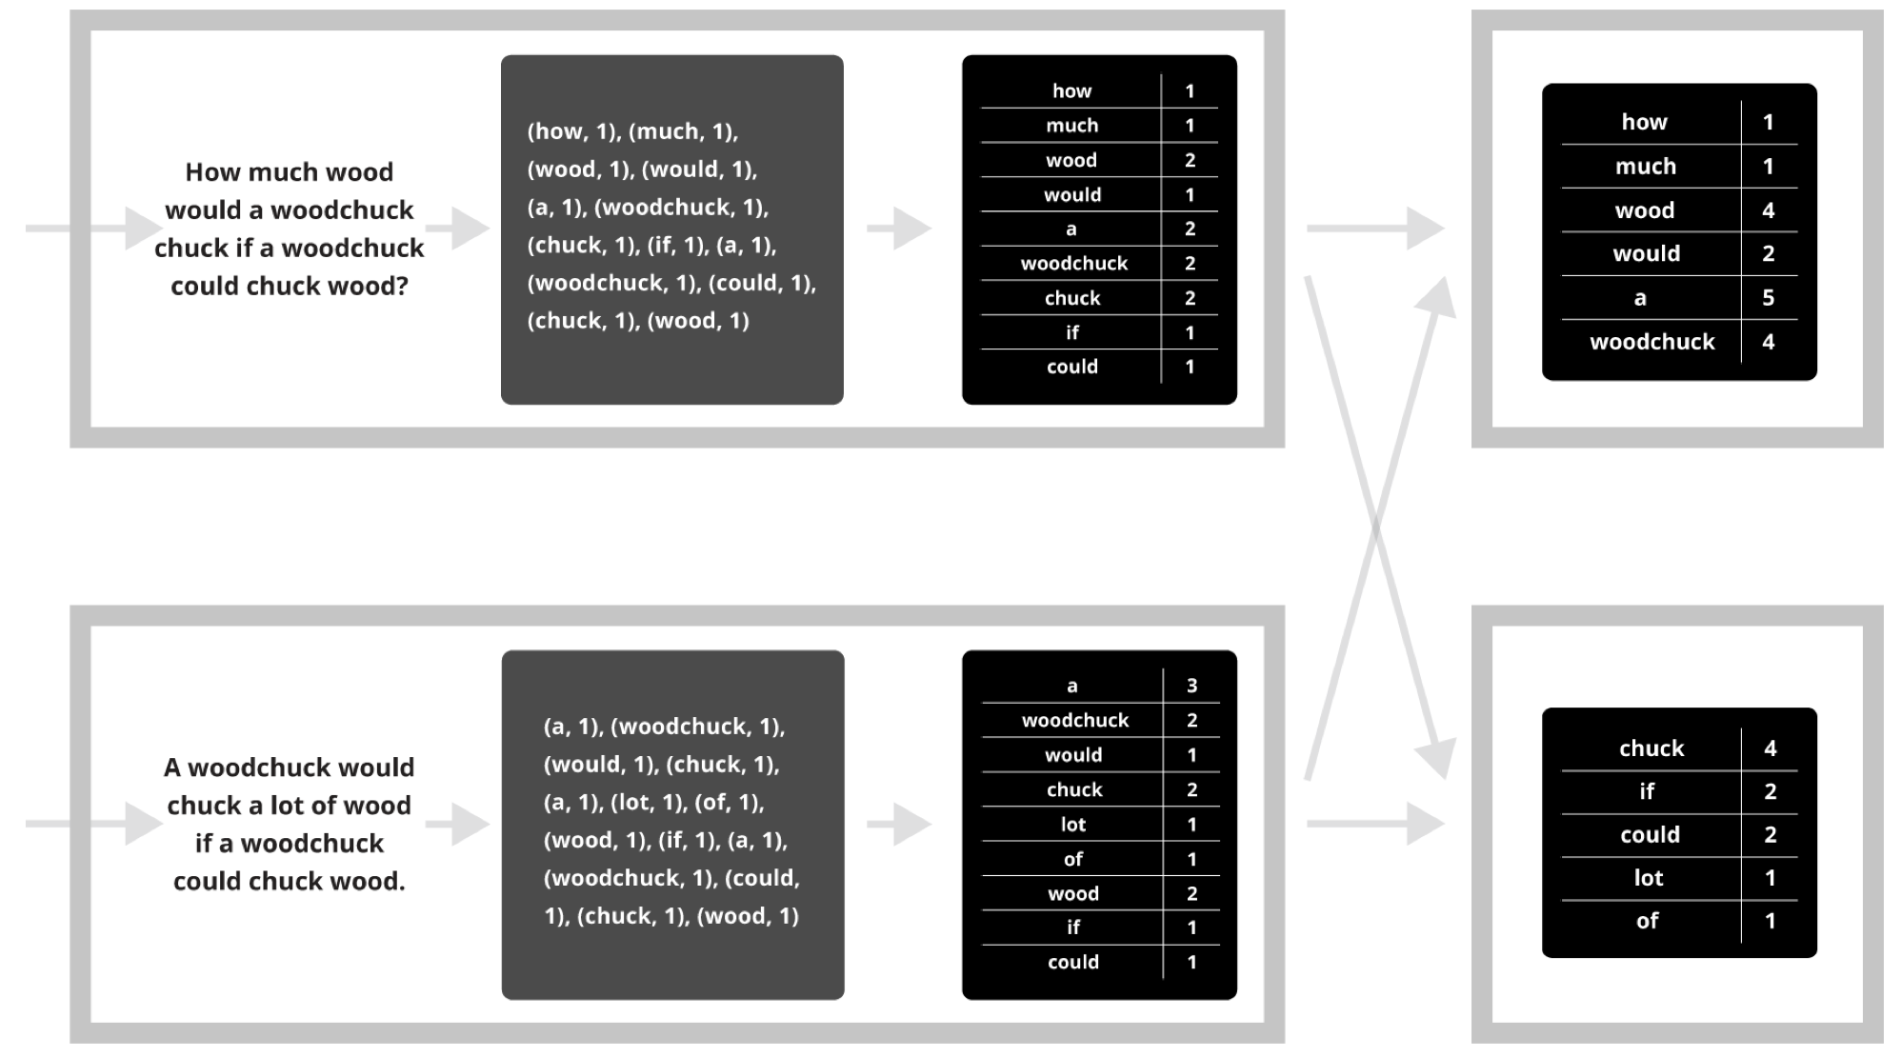
Putting it together…
map
combine
partition
reduce

Slide 5
Synchronization Barrier

Slide 6
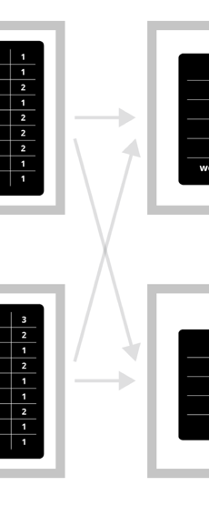
Fault Tolerance in MapReduce
Map worker writes intermediate output to local disk, separated by partitioning. Once completed, tells master node.
Reduce worker told of location of map task outputs, pulls their partition’s data from each mapper, execute function across data
Note:
“All-to-all” shuffle b/w mappers and reducers
Written to disk (“materialized”) b/w each stage

Slide 7
Graph-Parallel Computation

Slide 8
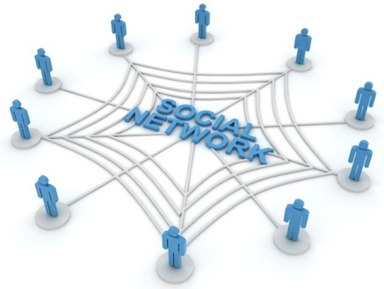
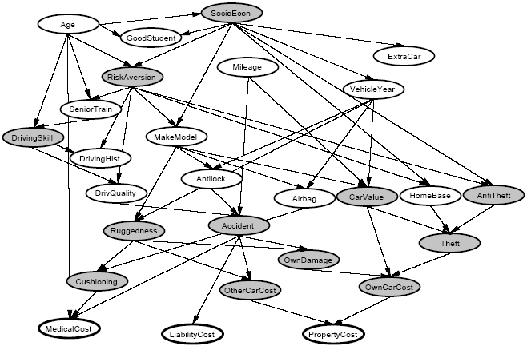
Graphs are Everywhere
Social Network
Collaborative Filtering
Users
Netflix
Movies
Probabilistic Analysis
Text Analysis
Docs
Wiki
Words
Notes:
This idea has lots of applications. Might be infering interests about people in a social network,
>>> Collaborative filtering: trying to predict movie ratings of each user given a handful of movie ratings from all users. BIPARTITE GRAPH where you have users on one side and movies on the other --> sparse matrix (RED).
>>> Textual analysis: e.g. detecting user sentiment regarding product reviews on a website like Amazon.
>>> relate random variables.

Slide 9
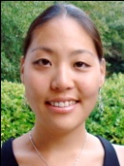
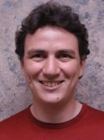
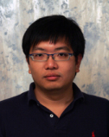
Properties of Graph Parallel Algorithms
Dependency
Graph
Factored
Computation
Iterative
Computation
What I Like
What My Friends Like
Notes:
Taking a step back – the big picture here is that this is one example of many GRAPH PARALLEL algorithms that have the following properties:
(L) Significant information in the DEPENDENCIES between different pieces of data, can represent those deps naturally using a graph.
(C) As a result computation FACTORS into different LOCAL neighborhoods, depends DIRECTLY only on those neighborhoods.
(R) b/c graph has many CHAINS of connections, need to ITERATE local computation, PROPAGATING information.

Slide 10
Iterative Algorithms
MR doesn’t efficiently express iterative algorithms:
Iterations
Data
Data
Data
Data
CPU 1
CPU 1
CPU 1
Data
Data
Data
Data
Data
Data
Data
Data
Slow
Processor
CPU 2
CPU 2
CPU 2
Data
Data
Data
Data
Data
Data
Data
Data
CPU 3
CPU 3
CPU 3
Data
Data
Data
Data
Data
Data
Data
Data
Barrier
Barrier
Barrier
Notes:
Many ML algorithms (like the social network example before) ITERATIVELY REFINE their variables during operation.
>>> >>> >>> MR doesn’t provide a mechanism to directly encode ITERATIVE computation, so it's forced to wait for all the data in the PRECEDING ITERATION before computing the next.
>>> SEGUE: If one processor is slow (common case) then whole system runs slowly.

Slide 11
MapAbuse: Iterative MapReduce
System is not optimized for iteration:
Iterations
Data
Data
Data
Data
CPU 1
CPU 1
CPU 1
Data
Data
Data
Data
Data
Data
Data
Data
CPU 2
CPU 2
CPU 2
Startup Penalty
Disk Penalty
Startup Penalty
Disk Penalty
Startup Penalty
Data
Data
Disk Penalty
Data
Data
Data
Data
Data
Data
CPU 3
CPU 3
CPU 3
Data
Data
Data
Data
Data
Data
Data
Data
Notes:
Finally there is a STARTUP PENALTY associated with the storage and network delays of reading and writing to disk. So the system isn’t optimized for iteration from a performance standpoint.

Slide 12
The GraphLab Framework
Graph Based
Data Representation
Update Functions
User Computation
Consistency Model
Notes:
So the high-level view of GraphLab is that it has three main parts, >>> first a graph based data representation. >>> Second, a way for the user to express computation through update functions, and >>> finally a consistency model. So let’s take the three parts in turn.

Slide 13
Data Graph
Data is associated with both vertices and edges
Graph:
Social Network
Vertex Data:
User profile
Current interests estimates
Edge Data:
Relationship
(friend, classmate, relative)
Notes:
GraphLab stores the program state as a directed graph called the Data Graph.

Slide 14
Distributed Data Graph
Partition the graph across multiple machines:
Notes:
Cut along edges
SEGUE: So we have missing pieces of data from each node’s viewpoint. So this means that a LOCAL data fetch becomes a REMOTE data fetch.

Slide 15
Distributed Data Graph
Ghost vertices maintain adjacency structure and replicate remote data.
“ghost” vertices
Notes:
So the ghost vertices live locally, maintaining adjacency. They replicate data locally so that it can be read quickly.

Slide 16
Update Function
A user-defined program, applied to a
vertex; transforms data in scope of vertex
Pagerank (scope) {
// Update the current vertex data
// Reschedule Neighbors if needed
if vertex.PageRank changes then
reschedule_all_neighbors;
}
Selectively triggers computation at neighbors
Notes:
An update function is a stateless procedure that modifies the data within the
>>> SCOPE of a vertex (all edges and adjacent nodes). The update function also SCHEDULES the future execution of update functions on OTHER VERTICES.
>>> So for e.g. if we are computing the Google PageRank of a web page, each vertex = a web page, each edge = hyperlink from one web page to another.
>>> PageRank is a weighted sum. When one page's PageRank changes, ONLY its neighbors needs to be recomputed!
>>> SEGUE: GraphLab applies the update functions in parallel until the entire computation converges.

Slide 17
Update Function
A user-defined program, applied to a
vertex; transforms data in scope of vertex
Pagerank (scope) {
// Update the current vertex data
// Reschedule Neighbors if needed
if vertex.PageRank changes then
reschedule_all_neighbors;
}
Update function applied (asynchronously)
in parallel until convergence
Many schedulers available to prioritize computation
Selectively triggers computation at neighbors
Notes:
An update function is a stateless procedure that modifies the data within the
>>> SCOPE of a vertex (all edges and adjacent nodes). The update function also SCHEDULES the future execution of update functions on OTHER VERTICES.
>>> So for e.g. if we are computing the Google PageRank of a web page, each vertex = a web page, each edge = hyperlink from one web page to another.
>>> PageRank is a weighted sum. When one page's PageRank changes, ONLY its neighbors needs to be recomputed!
>>> SEGUE: GraphLab applies the update functions in parallel until the entire computation converges.

Slide 18
How to handle machine failure?
What when machines fail? How do we provide fault tolerance?
Strawman scheme: Synchronous snapshot checkpointing
Stop the world
Write each machines’ state to disk

Slide 19
Chandy-Lamport checkpointing
Step 1. Atomically, one initiator:
Turns red
Records its own state
Sends marker to neighbors
Step 2. On receiving marker. non-red node atomically:
Turns red,
Records its own state,
Sends markers along all outgoing channels
First-in, first-out channels between nodes
Notes:
Bank balance example -- describe.

Slide 20
Stream Processing

Slide 21
Simple stream processing
Single node
Read data from socket
Process
Write output

Slide 22
Examples: Stateless conversion
CtoF
Convert Celsius temperature to Fahrenheit
Stateless operation: emit (input * 9 / 5) + 32

Slide 23
Examples: Stateless filtering
Filter
Function can filter inputs
if (input > threshold) { emit input }

Slide 24
Examples: Stateful conversion
EWMA
Compute EWMA of Fahrenheit temperature
new_temp = ⍺ * ( CtoF(input) ) + (1- ⍺) * last_temp
last_temp = new_temp
emit new_temp

Slide 25
Examples: Aggregation (stateful)
Avg
E.g., Average value per window
Window can be # elements (10) or time (1s)
Windows can be disjoint (every 5s)
Windows can be “tumbling” (5s window every 1s)

Slide 26
Stream processing as chain
CtoF
Avg
Filter

Slide 27
Stream processing as directed graph
sensor
type 1
CtoF
Avg
Filter
alerts
sensor
type 2
KtoF
storage

Slide 28
Enter “BIG DATA”

Slide 29
The challenge of stream processing
Large amounts of data to process in real time
Examples
Social network trends (#trending)
Intrusion detection systems (networks, datacenters)
Sensors: Detect earthquakes by correlating vibrations of millions of smartphones
Fraud detection
Visa: 2000 txn / sec on average, peak ~47,000 / sec

Slide 30
Scale “up”
Tuple-by-Tuple
Micro-batch
input ← read
if (input > threshold) { emit input
}
inputs ← read
out = []
for input in inputs {
if (input > threshold) {
out.append(input)
}
}
emit out

Slide 31
Scale “up”
Tuple-by-Tuple
Micro-batch
Lower Latency
Lower Throughput
Higher Latency
Higher Throughput
Why? Each read/write is an system call into kernel. More cycles performing kernel/application transitions (context switches), less actually spent processing data.

Slide 32
Scale “out”

Slide 33
Stateless operations: trivially parallelized
C
F
C
F
C
F

Slide 34
State complicates parallelization
Aggregations:
Need to join results across parallel computations
CtoF
Avg
Filter

Slide 35
State complicates parallelization
Aggregations:
Need to join results across parallel computations
CtoF
Sum
Cnt
Filter
Avg
CtoF
Sum
Cnt
Filter
CtoF
Sum
Cnt
Filter

Slide 36
Parallelization complicates fault-tolerance
Aggregations:
Need to join results across parallel computations
CtoF
Sum
Cnt
Filter
Avg
CtoF
Sum
Cnt
Filter
CtoF
Sum
Cnt
- blocks -
Filter

Slide 37
Can parallelize joins
Compute trending keywords
E.g.,
portion tweets
Sum
/ key
portion tweets
Sum
/ key
Sum
/ key
Sort
top-k
portion tweets
Sum
/ key
- blocks -

Slide 38
Can parallelize joins
Hash
partitioned
tweets
portion tweets
Sum
/ key
Sum
/ key
Sort
top-k
portion tweets
Sum
/ key
Sum
/ key
Sort
top-k
portion tweets
Sum
/ key
Sum
/ key
Sort
top-k

Slide 39
Parallelization complicates fault-tolerance
Hash
partitioned
tweets
portion tweets
Sum
/ key
Sum
/ key
Sort
top-k
portion tweets
Sum
/ key
Sum
/ key
Sort
top-k
portion tweets
Sum
/ key
Sum
/ key
Sort
top-k

Slide 40
A Tale of Four Frameworks
Record acknowledgement (Storm)
Micro-batches (Spark Streaming, Storm Trident)
Transactional updates (Google Cloud dataflow)
Distributed snapshots (Flink)

Slide 41
Apache Storm
Architectural components
Data: streams of tuples, e.g., Tweet = <Author, Msg, Time>
Sources of data: “spouts”
Operators to process data: “bolts”
Topology: Directed graph of spouts & bolts

Slide 42
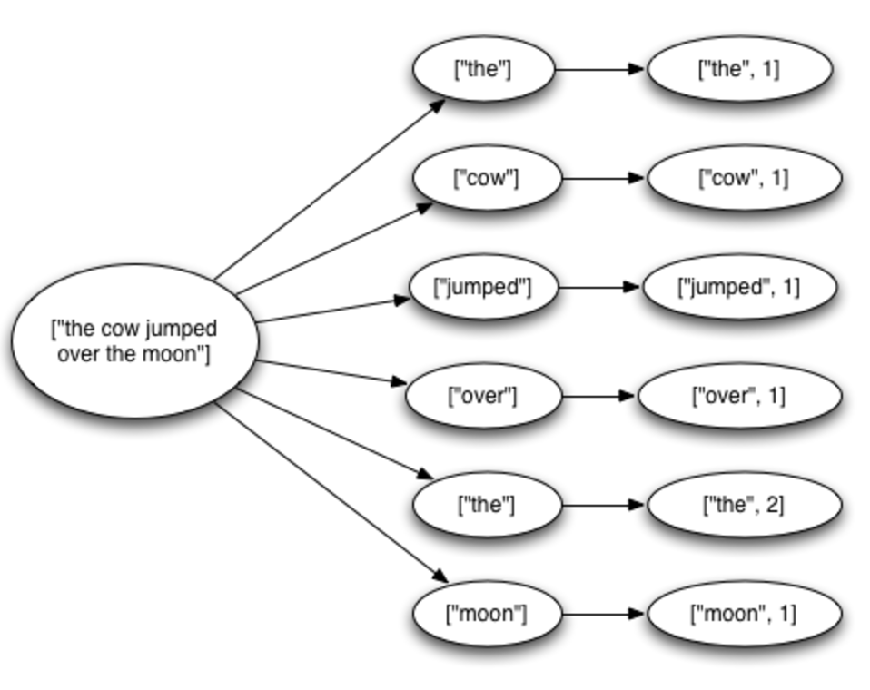
Fault tolerance via record acknowledgement (Apache Storm -- at least once semantics)
Goal: Ensure each input ”fully processed”
Approach: DAG / tree edge tracking
Record edges that get created as tuple is processed.
Wait for all edges to be marked done
Inform source (spouts) of data when complete; otherwise, they resend tuple.
Challenge: “at least once” means:
Operators (bolts) can receive tuple > once
Replay can be out-of-order
... application needs to handle.

Slide 43
Fault tolerance via record acknowledgement (Apache Storm -- at least once semantics)
Spout assigns new unique ID to each tuple
When bolt “emits” dependent tuple, it informs system of dependency (new edge)
When a bolt finishes processing tuple, it calls ACK (or can FAIL)
Acker tasks:
Keep track of all emitted edges and receive ACK/FAIL messages from bolts.
When messages received about all edges in graph, inform originating spout
Spout garbage collects tuple or retransmits
Note: Best effort delivery by not generating dependency on downstream tuples.

Slide 44
Apache Spark Streaming: Discretized Stream Processing
Split stream into series of small, atomic batch jobs (each of X seconds)
Process each individual batch using Spark “batch” framework
Akin to in-memory MapReduce
Emit each micro-batch result
RDD = “Resilient Distributed Data”
live data stream
Spark
Streaming
batches of X seconds
Spark
processed results

Slide 45
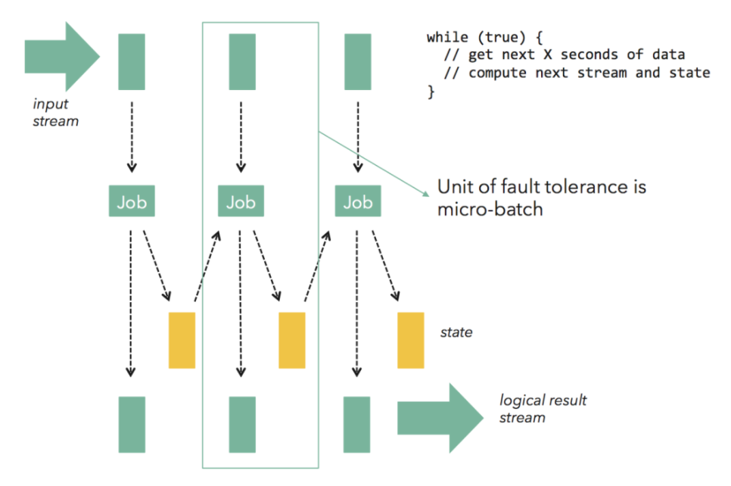
Fault tolerance via micro batches (Apache Spark Streaming, Storm Trident)
Can build on batch frameworks (Spark) and tuple-by-tuple (Storm)
Tradeoff between throughput (higher) and latency (higher)
Each micro-batch may succeed or fail
Original inputs are replicated (memory, disk)
At failure, latest micro-batch can be simply recomputed (trickier if stateful)
DAG is a pipeline of transformations from micro-batch to micro-batch
Lineage info in each RDD specifies how generated from other RDDs
To support failure recovery:
Occasionally checkpoints RDDs (state) by replicating to other nodes
To recover: another worker (1) gets last checkpoint, (2) determines upstream dependencies, then (3) starts recomputing using those usptream dependencies starting at checkpoint (downstream might filter)
Notes:
Flow control: Micro-batch architectures that use time-based batches have an inherent problem with backpressure effects. If processing of a micro-batch takes longer in downstream operations (e.g., due to a compute-intensive operator, or a slow sink) than in the batching operator (typically the source), the micro batch will take longer than configured. This leads either to more and more batches queueing up, or to a growing micro-batch size.

Slide 46
Fault Tolerance via transactional updates (Google Cloud Dataflow)
Computation is long-running DAG of continuous operators
For each intermediate record at operator
Create commit record including input record, state update, and derived downstream records generated
Write commit record to transactional log / DB
On failure, replay log to
Restore a consistent state of the computation
Replay lost records (further downstream might filter)
Requires: High-throughput writes to distributed store

Slide 47
Fault Tolerance via distributed snapshots (Apache Flink)
Rather than log each record for each operator, take system-wide snapshots
Snapshotting:
Determine consistent snapshot of system-wide state (includes in-flight records and operator state)
Store state in durable storage
Recover:
Restoring latest snapshot from durable storage
Rewinding the stream source to snapshot point, and replay inputs
Algorithm is based on Chandy-Lamport distributed snapshots, but also captures stream topology

Slide 48
Fault Tolerance via distributed snapshots (Apache Flink)
Use markers (barriers) in the input data stream to tell downstream operators when to consistently snapshot

Slide 49
Optimizing stream processing
Keeping system performant:
Careful optimizations of DAG
Scheduling: Choice of parallelization, use of resources
Where to place computation
…
Often, many queries and systems using same cluster concurrently: “Multi-tenancy”

