Slide 1
Network Communication and
Remote Procedure Calls
COS 418: Distributed Systems
Lecture 2
Kyle Jamieson

Slide 2
Context and today’s outline
A distributed system is many cooperating computers that appear to users as a single service
Today— How can processes on different cooperating computers exchange information?
Network Sockets
Remote Procedure Call
Threads

Slide 3
The problem of communication
Process on Host A wants to talk to process on Host B
  A and B must agree on the meaning of the bits being sent and received at many different levels, including:
    How many volts is a 0 bit, a 1 bit?
    How does receiver know which is the last bit?
    How many bits long is a number?

Slide 4
The problem of communication
Applications
HTTP
Skype
SSH
FTP
Transmission
media
Coaxial cable
Fiber optic
Wi-Fi
Re-implement every application for every new underlying transmission medium?
Change every application on any change to an underlying transmission medium?
No! But how does the Internet design avoid this?

Slide 5
Solution: Layering
Applications
HTTP
Skype
SSH
FTP
Intermediate layers
Transmission
media
Coaxial cable
Fiber optic
Wi-Fi
Intermediate layers provide a set of abstractions for applications and media
New applications or media need only implement for intermediate layer’s interface

Slide 6
Layering in the Internet
Transport: Provide end-to-end communication between processes on different hosts
Network: Deliver packets to destinations on other (heterogeneous) networks
Link: Enables end hosts to exchange atomic messages with each other
Physical: Moves bits between two hosts connected by a physical link
Host
Applications
Transport layer
Network layer
Link layer
Physical layer

Slide 7
Logical communication between layers
How to forge agreement on the meaning of the bits exchanged between two hosts?
Protocol: Rules that governs the format, contents, and meaning of messages
  Each layer on a host interacts with its peer host’s corresponding layer via the protocol interface
Application
Application
Transport
Transport
Network
Network
Network
Link
Link
Link
Physical
Physical
Physical
Host A
Router
Host B

Slide 8
Physical communication
Communication goes down to the physical network
Then from network peer to peer
Then up to the relevant application
Application
Application
Transport
Transport
Network
Network
Network
Link
Link
Link
Physical
Physical
Physical
Host A
Router
Host B

Slide 9
Communication between peers
How do peer protocols coordinate with each other?
Layer attaches its own header (H) to communicate with peer
  Higher layers’ headers, data encapsulated inside message
    Lower layers don’t generally inspect higher layers’ headers
Application
Application message
Transport-layer message body
Transport
H
Network-layer datagram body
Network
H

Slide 10
Network socket-based communication
Socket: The interface the OS provides to the network
  Provides inter-process explicit message exchange
Can build distributed systems atop sockets: send(), recv()
  e.g.: put(key,value) → message
Host A
Host B
Application layer
Application layer
Process
Process
Socket
Socket
Transport layer
Transport layer
Network layer
Network layer
Link layer
Link layer
Physical layer
Physical layer

Slide 11
Network sockets: Summary
Principle of transparency: Hide that resource is physically distributed across multiple computers
  Access resource same way as locally
  Users can’t tell where resource is physically located
put(key,value) → message with sockets?
Network sockets provide apps with point-to-point communication between processes

Slide 12
// Create a socket for the client
if ((sockfd = socket (AF_INET, SOCK_STREAM, 0)) < 0) {
perror(”Socket creation");
exit(2);
}
// Set server address and port
memset(&servaddr, 0, sizeof(servaddr));
servaddr.sin_family = AF_INET;
servaddr.sin_addr.s_addr = inet_addr(argv[1]);
servaddr.sin_port = htons(SERV_PORT); // to big-endian
// Establish TCP connection
if (connect(sockfd, (struct sockaddr *) &servaddr,
sizeof(servaddr)) < 0) {
perror(”Connect to server");
exit(3);
}
// Transmit the data over the TCP connection
send(sockfd, buf, strlen(buf), 0);
Sockets don’t provide transparency

Slide 13
Today’s outline
Network Sockets
Remote Procedure Call
Threads

Slide 14
Why RPC?
The typical programmer is trained to write single-threaded code that runs in one place
Goal: Easy-to-program network communication that makes client-server communication transparent
  Retains the “feel” of writing centralized code
    Programmer needn’t think about the network
COS 418 programming assignments use RPC

Slide 15
What’s the goal of RPC?
Within a single program, running in a single process, recall the well-known notion of a procedure call:
  Caller pushes arguments onto stack,
    jumps to address of callee function
  Callee reads arguments from stack,
    executes, puts return value in register,
    returns to next instruction in caller
RPC’s Goal: To make communication appear like a local procedure call: transparency for procedure calls

Slide 16
RPC issues
Heterogeneity
  Client needs to rendezvous with the server
  Server must dispatch to the required function
    What if server is different type of machine?
Failure
  What if messages get dropped?
  What if client, server, or network fails?
Performance
  Procedure call takes ≈ 10 cycles ≈ 3 ns
  RPC in a data center takes ≈ 10 μs (10³× slower)
    In the wide area, typically 10⁶× slower

Slide 17
Problem: Differences in data representation
Not an issue for local procedure call
For a remote procedure call, a remote machine may:
  Represent data types using different sizes
  Use a different byte ordering (endianness)
  Represent floating point numbers differently
  Have different data alignment requirements
    e.g., 4-byte type begins only on 4-byte memory boundary

Slide 18
Problem: Differences in programming support
Language support varies:
  Many programming languages have no inbuilt concept of remote procedure calls
    e.g., C, C++, earlier Java: won’t generate stubs
  Some languages have support that enables RPC
    e.g., Python, Haskell, Go

Slide 19
Solution: Interface Description Language
Mechanism to pass procedure parameters and return values in a machine-independent way
Programmer may write an interface description in the IDL
  Defines API for procedure calls: names, parameter/return types
Then runs an IDL compiler which generates:
  Code to marshal (convert) native data types into machine-independent byte streams
    And vice-versa, called unmarshaling
  Client stub: Forwards local procedure call as a request to server
  Server stub: Dispatches RPC to its implementation

Slide 20
A day in the life of an RPC
Client calls stub function (pushes params onto stack)
Client machine
Client process
k = add(3, 5)
Client stub (RPC library)

Slide 21
A day in the life of an RPC
Client calls stub function (pushes params onto stack)
Stub marshals parameters to a network message
Client machine
Client process
k = add(3, 5)
Client stub (RPC library)
proc: add | int: 3 | int: 5
Client OS

Slide 22
A day in the life of an RPC
Stub marshals parameters to a network message
OS sends a network message to the server
Client machine
Server machine
Client process
k = add(3, 5)
Client stub (RPC library)
Client OS
Server OS
proc: add | int: 3 | int: 5

Slide 23
A day in the life of an RPC
OS sends a network message to the server
Server OS receives message, sends it up to stub
Client machine
Server machine
Client process
k = add(3, 5)
Client stub (RPC library)
Server stub (RPC library)
Client OS
Server OS
proc: add | int: 3 | int: 5

Slide 24
A day in the life of an RPC
Server OS receives message, sends it up to stub
Server stub unmarshals params, calls server function
Client machine
Server machine
Client process
k = add(3, 5)
Server process
Implementation of add
Client stub (RPC library)
Server stub (RPC library)
proc: add | int: 3 | int: 5
Client OS
Server OS

Slide 25
A day in the life of an RPC
Server stub unmarshals params, calls server function
Server function runs, returns a value
Client machine
Server machine
Client process
k = add(3, 5)
Server process
8 ← add(3, 5)
Client stub (RPC library)
Server stub (RPC library)
Client OS
Server OS

Slide 26
A day in the life of an RPC
Server function runs, returns a value
Server stub marshals the return value, sends msg
Client machine
Server machine
Client process
k = add(3, 5)
Server process
8 ← add(3, 5)
Client stub (RPC library)
Server stub (RPC library)
Result | int: 8
Client OS
Server OS

Slide 27
A day in the life of an RPC
Server stub marshals the return value, sends msg
Server OS sends the reply back across the network
Client machine
Server machine
Client process
k = add(3, 5)
Server process
8 ← add(3, 5)
Client stub (RPC library)
Server stub (RPC library)
Client OS
Server OS
Result | int: 8

Slide 28
A day in the life of an RPC
Server OS sends the reply back across the network
Client OS receives the reply and passes up to stub
Client machine
Server machine
Client process
k = add(3, 5)
Server process
8 ← add(3, 5)
Client stub (RPC library)
Server stub (RPC library)
Client OS
Server OS
Result | int: 8

Slide 29
A day in the life of an RPC
Client OS receives the reply and passes up to stub
Client stub unmarshals return value, returns to client
Client machine
Server machine
Client process
k ← 8
Server process
8 ← add(3, 5)
Client stub (RPC library)
Server stub (RPC library)
Result | int: 8
Client OS
Server OS

Slide 30
The server stub is really two parts
Dispatcher
  Receives a client’s RPC request
    Identifies appropriate server-side method to invoke
Skeleton
  Unmarshals parameters to server-native types
  Calls the local server procedure
  Marshals the response, sends it back to the dispatcher
All this is hidden from the programmer
  Dispatcher and skeleton may be integrated
    Depends on implementation

Slide 31
Today’s outline
Message-Oriented Communication
Remote Procedure Call
  Rendezvous and coordination
  Failure
  Performance
Threads

Slide 32
What could possibly go wrong?
Client may crash and reboot
Packets may be dropped
  Some individual packet loss in the Internet
  Broken routing results in many lost packets
Server may crash and reboot
Network or server might just be very slow
All these may look the same to the client…

Slide 33


Failures, from client’s perspective
Client
Server
request
✘
reply
✘
Time ↓
The cause of the failure is hidden from the client!

Slide 34
At-Least-Once scheme
Simplest scheme for handling failures
Client stub waits for a response, for a while
  Response takes the form of an acknowledgement message from the server stub
If no response arrives after a fixed timeout time period, then client stub re-sends the request
Repeat the above a few times
  Still no response? Return an error to the application

Slide 35
At-Least-Once and side effects
Client sends a “debit $10 from bank account” RPC
Client
Server
Debit(acct, $10)
(debit $10)
ACK!
✘
Timeout
Debit(acct, $10)
(debit $10)
ACK!
Time ↓

Slide 36
At-Least-Once and writes
put(x, value), then get(x): expect answer to be value
put(x,10)
put(x,20)
Client
Server
put(x, 10)
put(x, 10)
Timeout
x←10
ACK!
put(x, 20)
x=20
x←20
ACK!
Time ↓

Slide 37
At-Least-Once and writes
Consider a client storing key-value pairs in a database
  put(x, value), then get(x): expect answer to be value
put(x,10)
put(x,20)
Client
Server
put(x, 10)
put(x, 10)
Timeout
x←10
ACK!
put(x, 20)
x=20
x←20
ACK!
x←10
Time ↓

Slide 38
So is At-Least-Once ever okay?
Yes: If they are read-only operations with no side effects
  e.g., read a key’s value in a database
Yes: If the application has its own functionality to cope with duplication and reordering
  You will need this in Assignments 3 onwards

Slide 39
At-Most-Once scheme
Idea: server RPC code detects duplicate requests
  Returns previous reply instead of re-running handler
How to detect a duplicate request?
  Test: Server sees same function, same arguments twice
    No! Sometimes applications legitimately submit the same function with same augments, twice in a row

Slide 40
At-Most-Once scheme
How to detect a duplicate request?
  Client includes unique transaction ID (xid) with each one of its RPC requests
  Client uses same xid for retransmitted requests
At-Most-Once Server
if seen[xid]:
retval = old[xid]
else:
retval = handler()
old[xid] = retval
seen[xid] = true
return retval

Slide 41
At Most Once: Providing unique XIDs
Combine a unique client ID (e.g., IP address) with the current time of day
Combine unique client ID with a sequence number
  Suppose the client crashes and restarts. Can it reuse the same client ID?
Big random number (probabilistic, not certain guarantee)

Slide 42
At-Most-Once: Discarding server state
Problem: seen and old arrays will grow without bound
Observation: By construction, when the client gets a response to a particular xid, it will never re-send it
Client could tell server “I’m done with xid x – delete it”
  Have to tell the server about each and every retired xid
    Could piggyback on subsequent requests
Significant overhead if many RPCs are in flight, in parallel

Slide 43
At-Most-Once: Discarding server state
Problem: seen and old arrays will grow without bound
Suppose xid = ⟨unique client id, sequence no.⟩
  e.g. ⟨42, 1000⟩, ⟨42, 1001⟩, ⟨42, 1002⟩
Client includes “seen all replies ≤ X” with every RPC
  Much like TCP sequence numbers, acks
How does the client know that the server received the information about retired RPCs?
  Each one of these is cumulative: later seen messages subsume earlier ones

Slide 44
At-Most-Once: Concurrent requests
Problem: How to handle a duplicate request while the original is still executing?
  Server doesn’t know reply yet. Also, we don’t want to run the procedure twice
Idea: Add a pending flag per executing RPC
  Server waits for the procedure to finish, or ignores

Slide 45
At Most Once: Server crash and restart
Problem: Server may crash and restart
Does server need to write its tables to disk?
Yes! On server crash and restart:
  If old[], seen[] tables are only in memory:
    Server will forget, accept duplicate requests

Slide 46
Go’s net/rpc is at-most-once
Opens a TCP connection and writes the request
  TCP may retransmit but server's TCP receiver will filter out duplicates internally, with sequence numbers
  No retry in Go RPC code (i.e. will not create a second TCP connection)
However: Go RPC returns an error if it doesn't get a reply
  Perhaps after a TCP timeout
  Perhaps server didn’t see request
  Perhaps server processed request but server/net failed before reply came back

Slide 47
RPC and Assignments 1 and 2
Go’s RPC isn’t enough for Assignments 1 and 2
  It only applies to a single RPC call
  If worker doesn't respond, master re-sends to another
    Go RPC can't detect this kind of duplicate
  Breaks at-most-once semantics
    No problem in Assignments 1 and 2 (handles at application level)
In Assignment 3 you will explicitly detect duplicates using something like what we’ve talked about

Slide 48
Exactly-once?
Need retransmission of at least once scheme
Plus the duplicate filtering of at most once scheme
  To survive client crashes, client needs to record pending RPCs on disk
    So it can replay them with the same unique identifier
Plus story for making server reliable
  Even if server fails, it needs to continue with full state
  To survive server crashes, server should log to disk results of completed RPCs (to suppress duplicates)
Similar to Two-Phase Commit (later)

Slide 49
Exactly-once for external actions?
Imagine that the remote operation triggers an external physical thing
  e.g., dispense $100 from an ATM
The ATM could crash immediately before or after dispensing and lose its state
  Don’t know which one happened
    Can, however, make this window very small
So can’t achieve exactly-once in general, in the presence of external actions

Slide 50
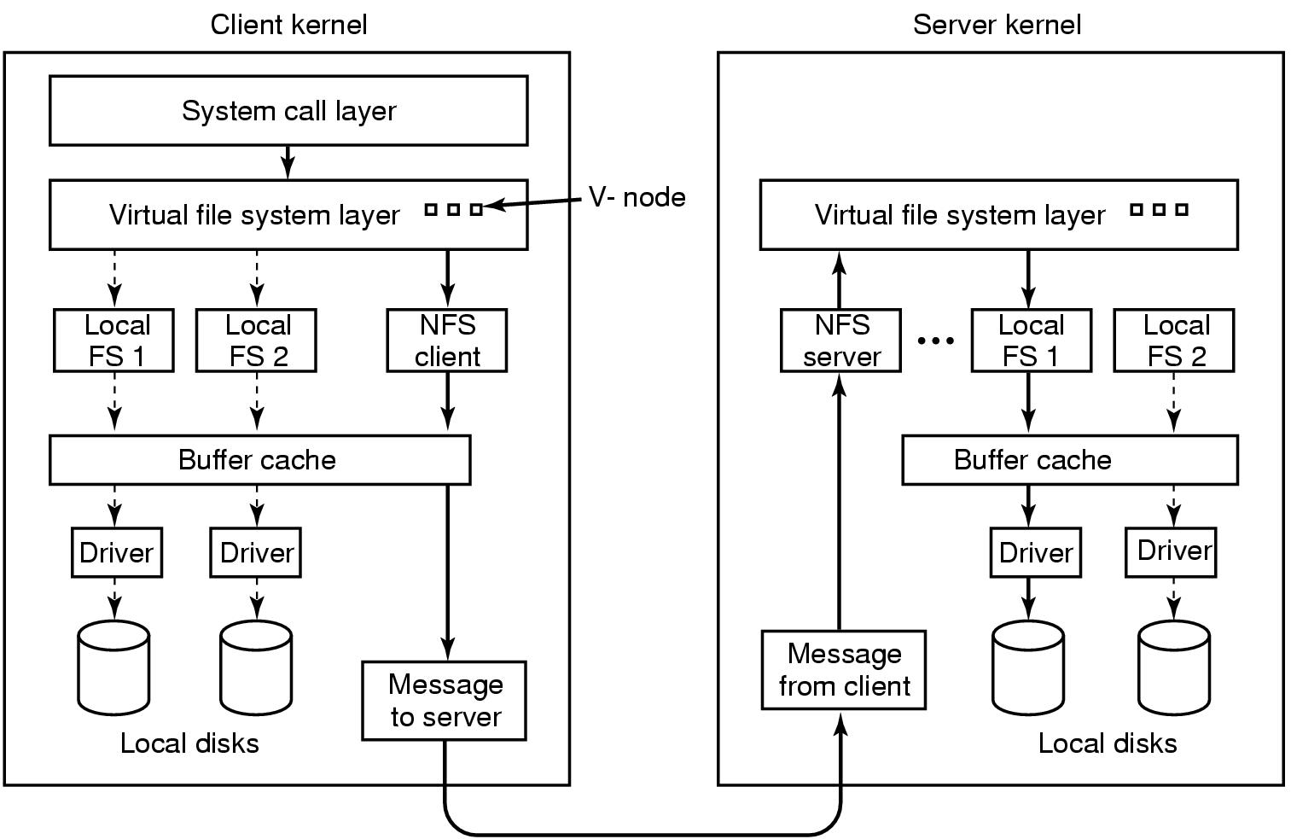
Summary: RPC
RPC is everywhere!
Necessary issues surrounding machine heterogeneity
Subtle issues around handling failures

Slide 51
Today’s outline
Network Sockets
Remote Procedure Call
Threads

Slide 52
Threads
One goal of this class is to give you experience and wisdom dealing with threads – they are tricky!
Go terminology: threads = goroutines
Thread = Program counter + set of registers: an execution context
  Can be multiple threads in the same shared memory address space

Slide 53
Data races
Challenge: Sharing data
  Two threads write same memory location
  One thread writes same memory location, other reads
Called a race
x = 0 initially. Thread 1: x ← x+1; Thread 2: x ← x+1
  Answer has to be 2, but if they run together can get 1
    Both threads read x before either writes back
To fix: wrap access to the same variable with a go mutex

Slide 54
Waiting
One thread wants to wait for the other thread to finish
In Go, use Channels for communication between threads
But beware deadlock: can be cycles in the waiting
  Thread 1 waiting for thread 2 to do something
  Thread 2 waiting for thread 1 to do something
  Sounds silly but comes up if you are not careful!

Slide 55
Wednesday topic:
Network File Systems
Friday precept:
Concurrency In Go, MapReduce

Slide 56
Appendix

Slide 57
Review: Byte order
x86-64 is a little endian architecture
  Least significant byte of multi-byte entity at lowest memory address
    “Little end goes first”
Some other systems use big endian
  Most significant byte of multi-byte entity at lowest memory address
    “Big end goes first”
int 5 at address 0x1000:
0x1000:
0000 0101
0x1001:
0000 0000
0x1002:
0000 0000
0x1003:
0000 0000
int 5 at address 0x1000:
0x1000:
0000 0000
0x1001:
0000 0000
0x1002:
0000 0000
0x1003:
0000 0101

