Slide 1
Distributed Systems
COS 418: Distributed Systems
Lecture 1, 2017
Mike Freedman

Slide 2
Backrub (Google) 1997

Slide 3
Google 2012

Slide 4
“The Cloud” is not amorphous

Slide 5
Microsoft

Slide 6
Google

Slide 7
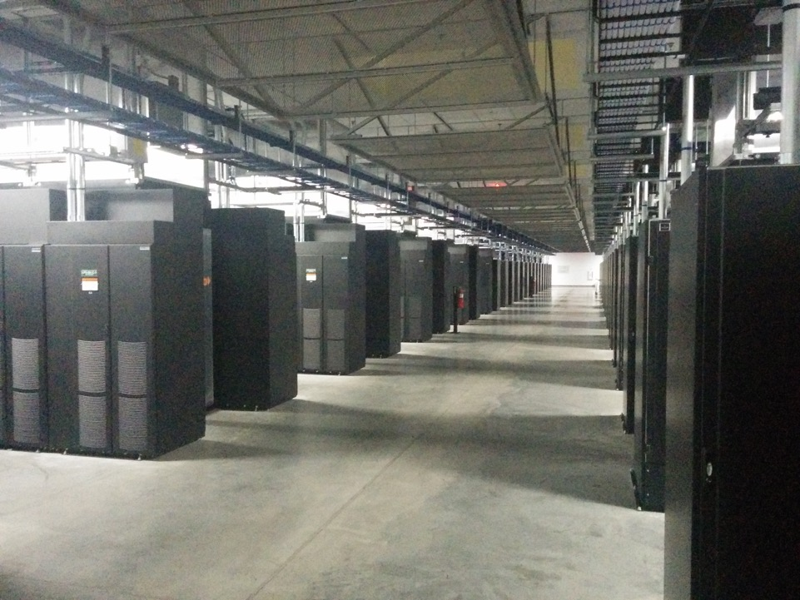
Facebook

Slide 8
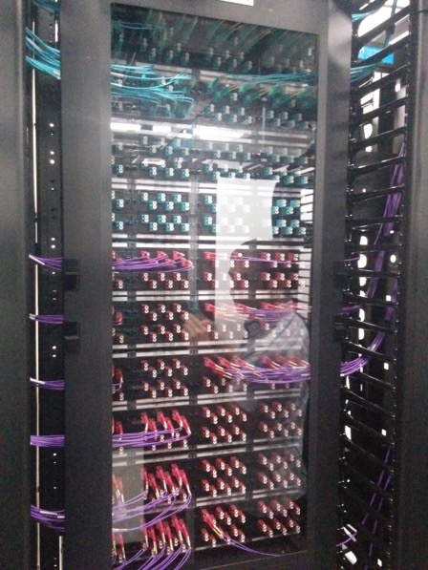
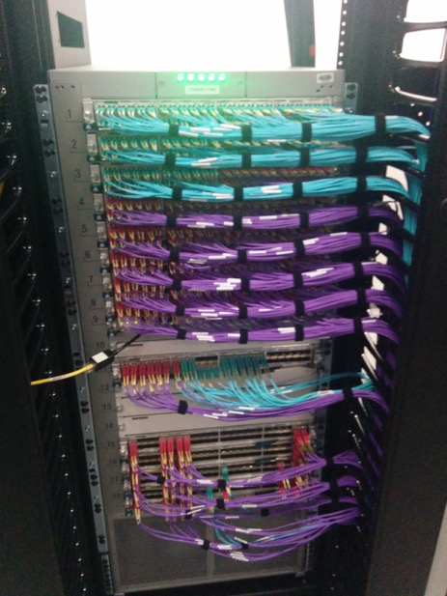
Facebook

Slide 9
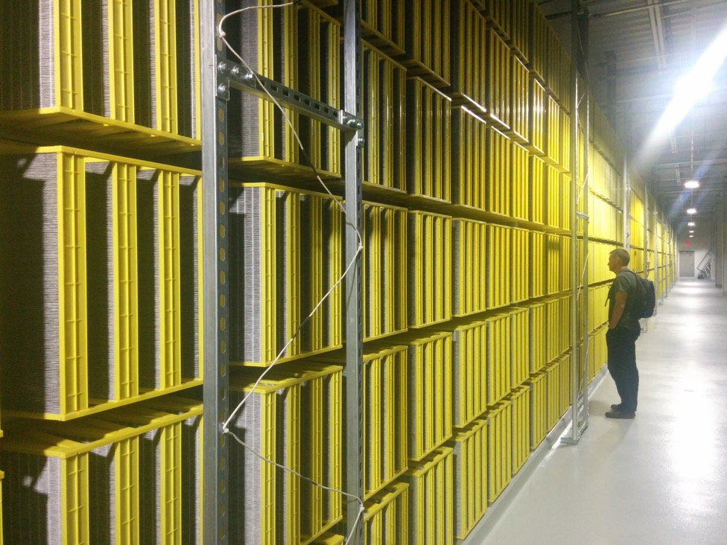
Facebook

Slide 10
100,000s of physical servers
10s MW energy consumption
Facebook Prineville:
$250M physical infro, $1B IT infra

Slide 11
Everything changes at scale
“Pods provide 7.68Tbps to backplane”

Slide 12
The goal of “distributed systems”
Service with higher-level abstractions/interface
e.g., file system, database, key-value store, programming model, RESTful web service, …
Hide complexity
Scalable (scale-out)
Reliable (fault-tolerant)
Well-defined semantics (consistent)
Security
Do “heavy lifting” so app developer doesn’t need to

Slide 13
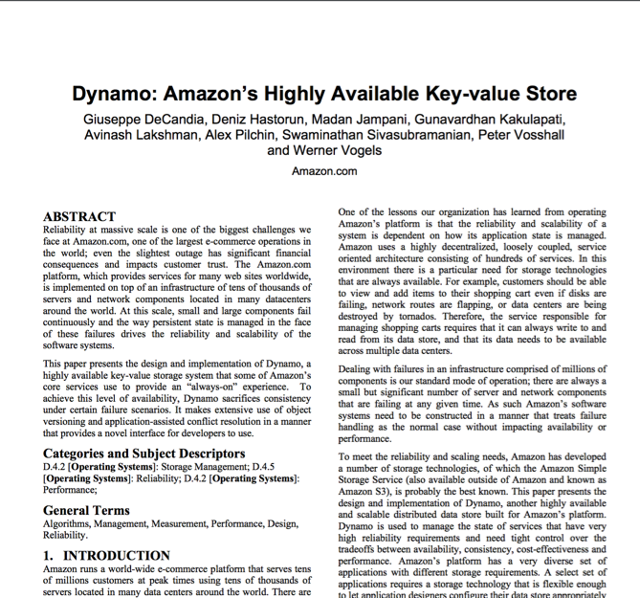
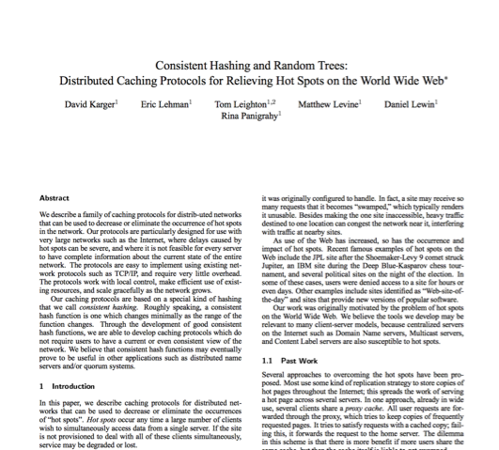
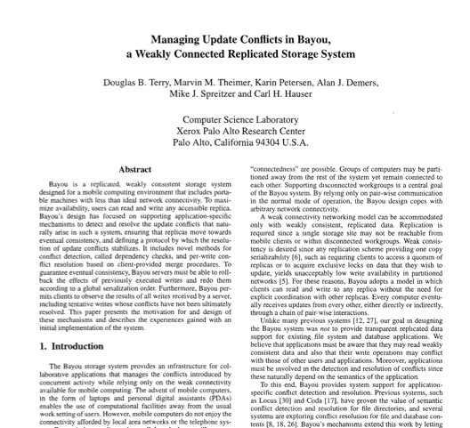
Research results matter: NoSQL
Notes:
NoSQL:
Consistent hash tables
+ consistency tradeoffs (e.g., eventual)
Amazon Dynamo popularized (published SOSP 2007), CTO was faculty at Cornell on distributed systems

Slide 14
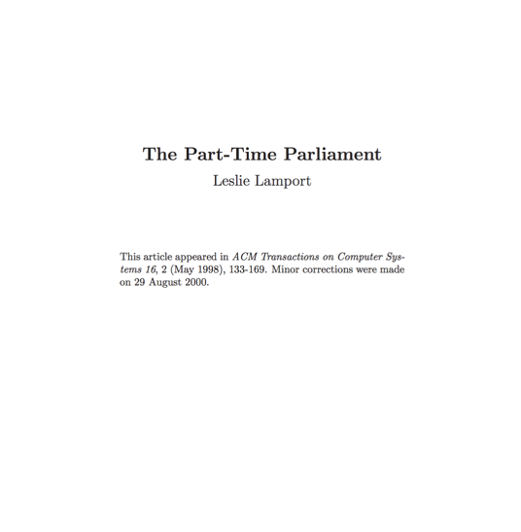
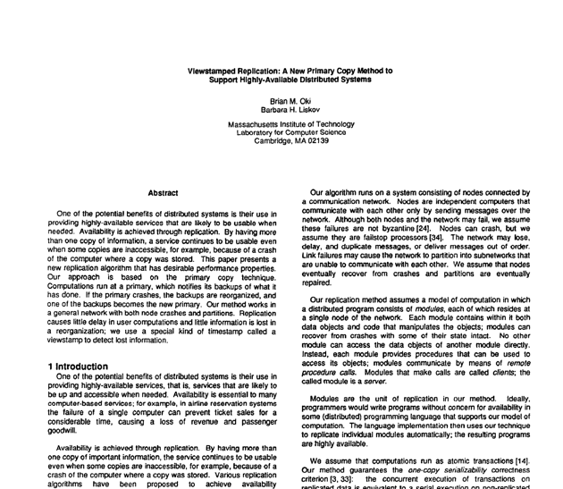
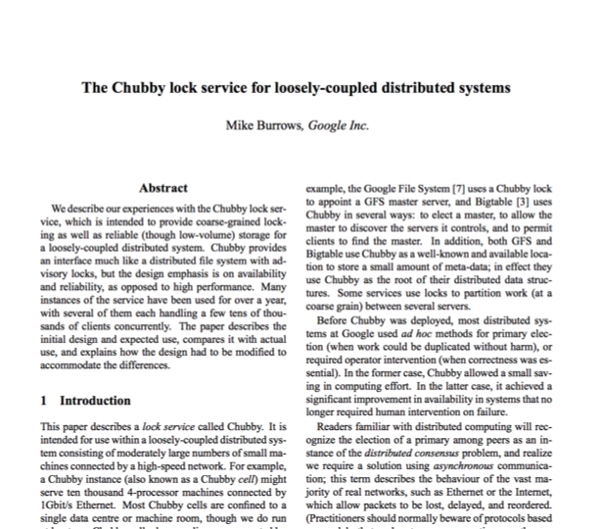
Research results matter: Paxos
Notes:
Paxos
Long history starting in early 1990s on “reaching consensus in distributed systems”
Google Chubby
Coordinate datacenters at scale
When a file server fails, who takes over?
Authors for industrial research labs and academia (DEC SRC, Cambridge/UW, etc.)
Led to open-source Apache Zookeeper

Slide 15
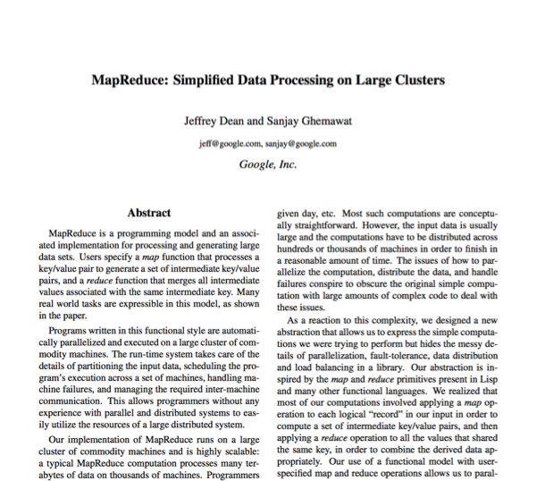
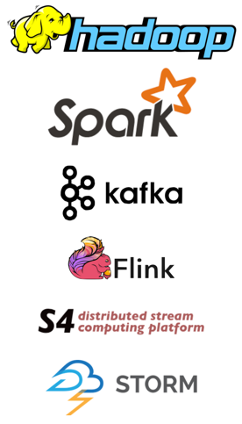
Research results matter: MapReduce
Notes:
Google MapReduce
How to process large volumes of data over 1000s of servers, even in face of failures
Authors for industrial research labs and academia (DEC WRL, MIT/UW, etc.)
Led to open-source Apache Hadoop
Created Big Data industry…

Slide 16
Course Organization

Slide 17
Learning the material: People
Lecture
Professors Mike Freedman, Kyle Jamieson
Slides available on course website
Office hours immediately after lecture
Precept:
TAs Charlie Murphy, Andrew Or
Main Q&A forum: www.piazza.com
Graded on class participation: so ask & answer!
No anonymous posts or questions
Can send private messages to instructors

Slide 18
Learning the Material: Lectures!
Attend lecture / precepts and take notes!
Lecture slides posted day/night before
Recommendation: Print slides & take notes
Not everything covered in class is on slides
You are responsible for everything covered in class
Precepts are mandatory (attendance taken)
No required textbooks
Links to Go Programming textbook and two other distributed systems textbooks on website

Slide 19
Grading
Five assignments (10% each)
90% 24 hours late, 80% 2 days late, 50% >5 days late
THREE free late days (we’ll figure which one is best)
Only failing grades I’ve given are for students who don’t (try to) do assignments
Two exams (45% total)
Midterm exam before spring break (20%)
Final exam during exam period (25%)
Class participation (5%)
In lecture, precept, and Piazza

Slide 20
Policies: Write Your Own Code
Programming is an individual creative process. At first, discussions with friends is fine. When writing code, however, the program must be your own work.
Do not copy another person’s programs, comments, README description, or any part of submitted assignment. This includes character-by-character transliteration but also derivative works. Cannot use another’s code, etc. even while “citing” them.
Writing code for use by another or using another’s code is academic fraud in context of coursework.
Do not publish your code e.g., on github, during/after course!

Slide 21
Policies: Write Your Own Code
Programming is an individual creative process. At first, discussions with friends is fine. When writing code, however, the program must be your own work.
Do not copy another person’s programs, comments, README description, or any part of submitted assignment. This includes character-by-character transliteration but also derivative works. Cannot use another’s code, etc. even while “citing” them.
Writing code for use by another or using another’s code is academic fraud in context of coursework.
Do not publish your code e.g., on github, during/after course!
Don’t Plagiarize!

Slide 22
Assignment 1 (in three parts)
Learn how to program in Go
Basic Go assignment (due Sept 21)
“Sequential” Map Reduce (due Sept 28)
Distributed Map Reduce (due Oct 5)

Slide 23
Warnings
This is a 400-level course,
with expectations to match.

Slide 24
Warning #1: Assignments are a LOT of work
Assignment 1 is purposely easy to teach Go. Don’t be fooled.
Last year we gave 3-4 weeks for later assignments; many students started 3-4 days before deadline. Disaster.
Distributed systems are hard
These aren’t simple “CRUD” interfaces
Need to understand problem and protocol, carefully design
Can take 5x more time to debug than “initially program”
Assignment #4 builds on your Assignment #3 solution, i.e., you can’t do #4 until your own #3 is working! (That’s the real world!)

Slide 25
Warning #2: Software engineering, not just programming
COS126, 217, 226 told you how to design & structure your programs. This class doesn’t.
Real software engineering projects don’t either.
You need to learn to do it.
If your system isn’t designed well, can be significantly harder to get right.
Your friend: test-driven development
We’ll supply tests, bonus points for adding new ones

Slide 26
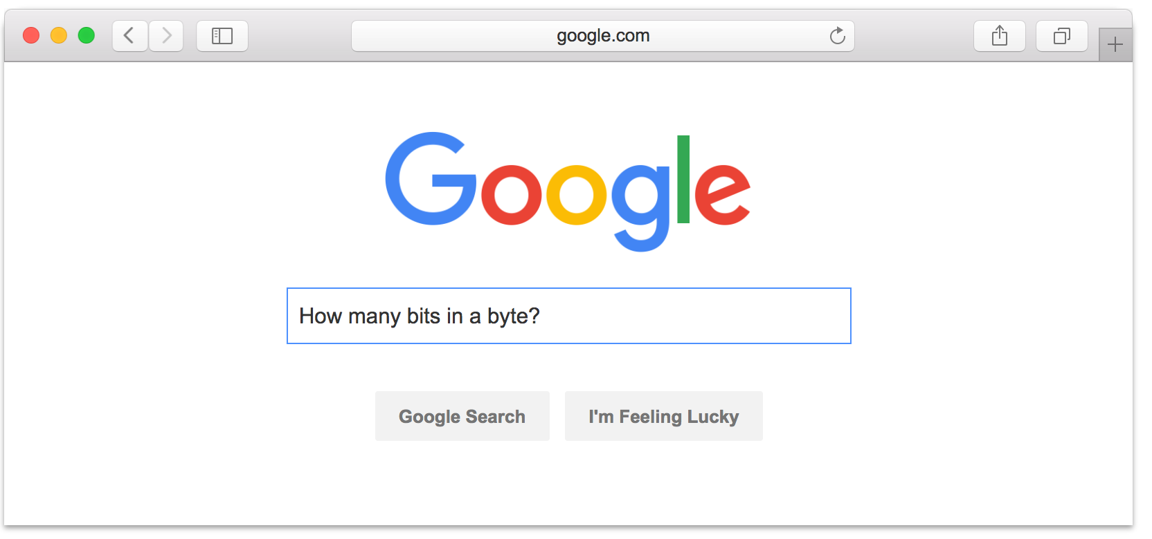
Warning #3: Don’t expect 24x7 answers
Try to figure out yourself
Piazza not designed for debugging
Utilize right venue: Go to lab, office hours; sit near friends
Send detailed Q’s / bug reports, not “no idea what’s wrong”
Instructors are not on pager duty 24 x 7
Don’t expect response before next business day
Questions Friday night @ 11pm should not expect fast responses. Be happy with something before Monday.
Implications
Students should answer each other (+ it’s worth credit)
Start your assignments early!

Slide 27
Naming and layering
(Data-parallel programming at scale)

Slide 28
Naming and system components
Caller
Callee
How to design interface between components?
Many interactions involve naming things
Naming objects that caller asks callee to manipulate
Naming caller and callee together

Slide 29
Potential Name Syntax
Human readable?
If users interact with the names
Fixed length?
If equipment processes at high speed
Large name space?
If many nodes need unique names
Hierarchical names?
If the system is very large and/or federated
Self-certifying?
If preventing “spoofing” is important

Slide 30
Properties of Naming
Enabling sharing in applications
Multiple components or users can name a shared object.
Without names, client-server interface pass entire object by value
Retrieval
Accessing same object later on, just by remembering name
Indirection mechanism
Component A knows about name N
Interposition: can change what N refers to without changing A
Hiding
Hides impl. details, don’t know where google.com located
For security purposes, might only access resource if know name (e.g., dropbox or Google docs URL –> knowledge gives access)

Slide 31
Names all around…
Registers: LD R0, 0x1234
IP addresses: 128.112.132.86
Host names: www.cs.princeton.edu
Path names: /courses/archive/spring17/cos518/syllabus.html vs. “syllabus.html”
“..” (to parent directory)
URLs: http://www.cs.princeton.edu/courses/archive/spring17/cos518/
Email addresses
Function names: ls
Phone numbers: 609-258-9169 vs. x8-9179
SSNs

Slide 32
High-level view of naming
Set of possible names
Syntax and semantics?
Set of possible values that names map to
Lookup algorithm that translates name to value
What is context used to resolve (if any)?
Who supplies context?

Slide 33
Different Kinds of Names
Host names: www.cs.princeton.edu
Mnemonic, variable-length, appreciated by humans
Hierarchical, based on organizations
IP addresses: 128.112.7.156
Numerical 32-bit address appreciated by routers
Hierarchical, based on organizations and topology
MAC addresses : 00-15-C5-49-04-A9
Numerical 48-bit address appreciated by adapters
Non-hierarchical, unrelated to network topology

Slide 34
Hierarchical Assignment Processes
Host names: www.cs.princeton.edu
Domain: registrar for each top-level domain (eg, .edu)
Host name: local administrator assigns to each host
IP addresses: 128.112.7.156
Prefixes: ICANN, regional Internet registries, and ISPs
Hosts: static configuration, or dynamic using DHCP
MAC addresses: 00-15-C5-49-04-A9
Blocks: assigned to vendors by the IEEE
Adapters: assigned by the vendor from its block

Slide 35
Layering

Slide 36
Layering: abstractions, abstractions, abstractions …
Partition the system
Each layer solely relies on services from layer below
Each layer solely exports services to layer above
Interface between layers defines interaction
Hides implementation details
Layers can change without disturbing other layers

Slide 37
Five Layers Summary
Lower three layers implemented everywhere
Top two layers implemented only at hosts
Logically, layers interacts with peer’s corresponding layer
Application
Application
Transport
Transport
Network
Network
Network
Datalink
Datalink
Datalink
Physical
Physical
Physical
Host A
Router
Host B

Slide 38
Physical Communication
Communication goes down to physical network
Then from network peer to peer
Then up to relevant layer
Application
Application
Transport
Transport
Network
Network
Network
Datalink
Datalink
Datalink
Physical
Physical
Physical
Host A
Router
Host B

Slide 39
Drawbacks of Layering
Layer N may duplicate layer N-1 functionality
E.g., error recovery to retransmit lost data
Layers may need same information
E.g., timestamps, maximum transmission unit size
Layering can hurt performance
E.g., hiding details about what is really going on
Some layers are not always cleanly separated
Inter-layer dependencies for performance reasons
Some dependencies in standards (header checksums)
Headers start to get really big
Sometimes header bytes >> actual content

Slide 40
Placing Network Functionality
Hugely influential paper: “End-to-End Arguments in System Design” by Saltzer, Reed, and Clark (1984)
“Sacred Text” of the Internet
Endless disputes about what it means
Everyone cites it as supporting their position

Slide 41
Monday: Network communication and RPC

