Slide 1
Peer-to-Peer Systems and Distributed Hash Tables
COS 418: Distributed Systems
Lecture 7
Kyle Jamieson
[Credit: Selected content adapted from B. Karp, R. Morris]

Slide 2
Today
Peer-to-Peer Systems
  Napster, Gnutella, BitTorrent, challenges
Distributed Hash Tables
The Chord Lookup Service

Slide 3
What is a Peer-to-Peer (P2P) system?
Node
Node
Node
Internet
Node
Node
A distributed system architecture:
  No centralized control
  Nodes are roughly symmetric in function
Large number of unreliable nodes

Slide 4
Why might P2P be a win?
High capacity for services through parallelism:
  Many disks
  Many network connections
  Many CPUs
Absence of a centralized server or servers may mean:
  Less chance of service overload as load increases
  Easier deployment
  A single failure won’t wreck the whole system
  System as a whole is harder to attack

Slide 5
P2P adoption
Successful adoption in some niche areas –
Client-to-client (legal, illegal) file sharing
  Popular data but owning organization has no money
Digital currency: no natural single owner (Bitcoin)
Voice/video telephony: user to user anyway
  Issues: Privacy and control

Slide 6
Example: Classic BitTorrent
User clicks on download link
  Gets torrent file with content hash, IP addr of tracker
User’s BitTorrent (BT) client talks to tracker
  Tracker tells it list of peers who have file
User’s BT client downloads file from one or more peers
User’s BT client tells tracker it has a copy now, too
User’s BT client serves the file to others for a while
Provides huge download bandwidth, without expensive server or network links

Slide 7
The lookup problem
get(“Star Wars.mov”)
N₂
N₃
N₁
Client
?
Internet
Publisher (N₄)
N₆
put(“Star Wars.mov”, [content])
N₅

Slide 8
Centralized lookup (Napster)
N₂
N₃
N₁
Client
SetLoc(“Star Wars.mov”, IP address of N₄)
Lookup(“Star Wars.mov”)
DB
Publisher (N₄)
N₆
N₅
key=“Star Wars.mov”, value=[content]
Simple, but O(N) state and a single point of failure

Slide 9
Flooded queries (original Gnutella)
Lookup(“Star Wars.mov”)
N₂
N₃
N₁
Client
Robust, but O(N = number of peers) messages per lookup
Publisher (N₄)
N₆
N₅
key=“Star Wars.mov”, value=[content]

Slide 10
Routed DHT queries (Chord)
Lookup(H(audio data))
N₂
N₃
N₁
Client
Publisher (N₄)
N₆
N₅
Can we make it robust, reasonable state, reasonable number of hops?
key=“H(audio data)”, value=[content]

Slide 11
Today
Peer-to-Peer Systems
Distributed Hash Tables
The Chord Lookup Service

Slide 12
What is a DHT (and why)?
Local hash table:
  key = Hash(name)
  put(key, value)
  get(key) → value
Service: Constant-time insertion and lookup
How can I do (roughly) this across millions of hosts on the Internet?
Distributed Hash Table (DHT)

Slide 13
What is a DHT (and why)?
Distributed Hash Table:
key = hash(data)
lookup(key) → IP addr (Chord lookup service)
send-RPC(IP address, put, key, data)
send-RPC(IP address, get, key) → data
Partitioning data in truly large-scale distributed systems
  Tuples in a global database engine
  Data blocks in a global file system
  Files in a P2P file-sharing system

Slide 14
Cooperative storage with a DHT
Distributed application
put(key, data)
get (key)
data
Distributed hash table
(DHash)
lookup(key)
node IP address
Lookup service
(Chord)
node
node
….
node
App may be distributed over many nodes
DHT distributes data storage over many nodes

Slide 15
BitTorrent over DHT
BitTorrent can use DHT instead of (or with) a tracker
BT clients use DHT:
  Key = file content hash (“infohash”)
  Value = IP address of peer willing to serve file
    Can store multiple values (i.e. IP addresses) for a key
Client does:
  get(infohash) to find other clients willing to serve
  put(infohash, my-ipaddr) to identify itself as willing

Slide 16
Why might DHT be a win for BitTorrent?
The DHT comprises a single giant tracker, less fragmented than many trackers
  So peers more likely to find each other
Maybe a classic BitTorrent tracker is too exposed to legal & c. attacks

Slide 17
Why the put/get DHT interface?
API supports a wide range of applications
  DHT imposes no structure/meaning on keys
Key-value pairs are persistent and global
  Can store keys in other DHT values
  And thus build complex data structures

Slide 18
Why might DHT design be hard?
Decentralized: no central authority
Scalable: low network traffic overhead
Efficient: find items quickly (latency)
Dynamic: nodes fail, new nodes join

Slide 19
Today
Peer-to-Peer Systems
Distributed Hash Tables
The Chord Lookup Service
  Basic design
  Integration with DHash DHT, performance

Slide 20
Chord lookup algorithm properties
Interface: lookup(key) → IP address
Efficient: O(log N) messages per lookup
  N is the total number of servers
Scalable: O(log N) state per node
Robust: survives massive failures
Simple to analyze

Slide 21
Chord Lookup: Identifiers
Key identifier = SHA-1(key)
Node identifier = SHA-1(IP address)
SHA-1 distributes both uniformly
How does Chord partition data?
  i.e., map key IDs to node IDs

Slide 22
Consistent hashing [Karger ‘97]
Key 5
K5
N105
K20
Node 105
Circular 7-bit
ID space
N32
N90
K80
Key is stored at its successor: node with next-higher ID

Slide 23
Chord: Successor pointers
N120
N10
N105
N32
K80
N90
N60

Slide 24
Basic lookup
N120
N10
“Where is K80?”
N105
“N90 has K80”
N32
K80
N90
N60

Slide 25
Simple lookup algorithm
Lookup(key-id)
succ ← my successor
if my-id < succ < key-id // next hop
call Lookup(key-id) on succ
else // done
return succ
Correctness depends only on successors

Slide 26
Improving performance
Problem: Forwarding through successor is slow
Data structure is a linked list: O(n)
Idea: Can we make it more like a binary search?
  Need to be able to halve distance at each step

Slide 27
“Finger table” for O(log N)-time lookups
¼
½
1/8
1/16
1/32
1/64
N80

Slide 28
Finger i Points to Successor of n+2^{i}
N120
K112
½
¼
1/8
1/16
1/32
1/64
N80

Slide 29
Implication of finger tables
A binary lookup tree rooted at every node
  Threaded through other nodes' finger tables
This is better than simply arranging the nodes in a single tree
  Every node acts as a root
    So there's no root hotspot
    No single point of failure
    But a lot more state in total

Slide 30
Lookup with finger table
Lookup(key-id)
look in local finger table for
highest n: my-id < n < key-id
if n exists
call Lookup(key-id) on node n // next hop
else
return my successor // done

Slide 31
Lookups Take O(log N) Hops
N5
N10
N110
K19
N20
N99
N32
Lookup(K19)
N80
N60

Slide 32
An aside: Is O(log N) fast or slow?
For a million nodes, it’s 20 hops
If each hop takes 50 milliseconds, lookups take one second
If each hop has 10% chance of failure, it’s a couple of timeouts
So in practice log(n) is better than O(n) but not great

Slide 33
Joining: Linked list insert
N25
N36
1. Lookup(36)
K30
K38
N40

Slide 34
Join (2)
N25
2. N36 sets its own
successor pointer
N36
K30
K38
N40

Slide 35
Join (3)
N25
3. Copy keys 26..36
from N40 to N36
N36
K30
K30
K38
N40

Slide 36
Notify messages maintain predecessors
N25
notify N25
N36
N40
notify N36

Slide 37
Stabilize message fixes successor
N25
✔
✘
stabilize
N36
N40
“My predecessor is N36.”

Slide 38
Joining: Summary
N25
N36
K30
K30
K38
N40
Predecessor pointer allows link to new node
Update finger pointers in the background
Correct successors generally produce correct lookups

Slide 39
Failures may cause incorrect lookup
N120
N10
N113
N102
N85
Lookup(K90)
N80
N80 does not know correct successor, so incorrect lookup

Slide 40
Successor lists
Each node stores a list of its r immediate successors
  After failure, will know first live successor
  Correct successors generally produce correct lookups
    Guarantee is with some probability

Slide 41
Choosing successor list length r
Assume one half of the nodes fail
P(successor list all dead) = (½)^{r}
  i.e., P(this node breaks the Chord ring)
  Depends on independent failure
Successor list of size r = O(log N) makes this probability 1/N: low for large N

Slide 42
Lookup with fault tolerance
Lookup(key-id)
look in local finger table and successor-list
for highest n: my-id < n < key-id
if n exists
call Lookup(key-id) on node n // next hop
if call failed,
remove n from finger table and/or
successor list
return Lookup(key-id)
else
return my successor // done

Slide 43
Today
Peer-to-Peer Systems
Distributed Hash Tables
The Chord Lookup Service
  Basic design
  Integration with DHash DHT, performance

Slide 44
The DHash DHT
Builds key/value storage on Chord
Replicates blocks for availability
  Stores k replicas at the k successors after the block on the Chord ring
Caches blocks for load balancing
  Client sends copy of block to each of the servers it contacted along the lookup path
Authenticates block contents

Slide 45
DHash data authentication
Two types of DHash blocks:
  Content-hash: key = SHA-1(data)
  Public-key: key is a cryptographic public key, data are signed by corresponding private key
Chord File System example:

Slide 46
DHash replicates blocks at r successors
N5
N110
N10
N20
N99
Block 17
N40
N80
N50
N68
N60
Replicas are easy to find if successor fails
Hashed node IDs ensure independent failure

Slide 47
Experimental overview
Quick lookup in large systems
Low variation in lookup costs
Robust despite massive failure
Goal: Experimentally confirm theoretical results

Slide 48
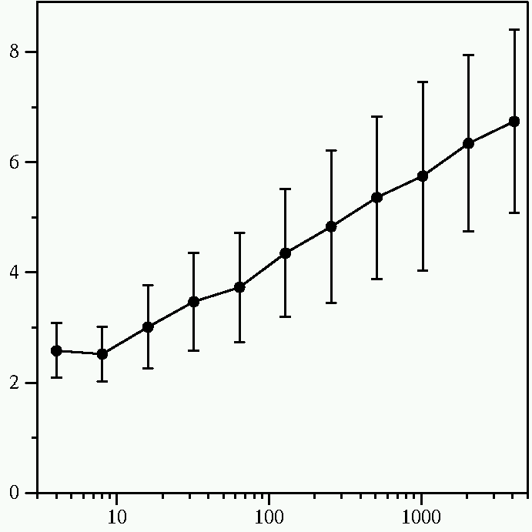
Chord lookup cost is O(log N)
Average Messages per Lookup
Number of Nodes
Constant is 1/2

Slide 49
Failure experiment setup
Start 1,000 Chord servers
  Each server’s successor list has 20 entries
  Wait until they stabilize
Insert 1,000 key/value pairs
  Five replicas of each
Stop X% of the servers, immediately make 1,000 lookups

Slide 50
Massive failures have little impact
(1/2)⁶ is 1.6%
Failed Lookups (Percent)
Failed Nodes (Percent)

Slide 51
Today
Peer-to-Peer Systems
Distributed Hash Tables
The Chord Lookup Service
  Basic design
  Integration with DHash DHT, performance
Concluding thoughts on DHT, P2P

Slide 52
DHTs: Impact
Original DHTs (CAN, Chord, Kademlia, Pastry, Tapestry) proposed in 2001-02
Following 5-6 years saw proliferation of DHT-based applications:
  Filesystems (e.g., CFS, Ivy, OceanStore, Pond, PAST)
  Naming systems (e.g., SFR, Beehive)
  DB query processing [PIER, Wisc]
  Content distribution systems (e.g., Coral)
  distributed databases (e.g., PIER)

Slide 53
Why don’t all services use P2P?
High latency and limited bandwidth between peers (cf. between server cluster in datacenter)
User computers are less reliable than managed servers
Lack of trust in peers’ correct behavior
  Securing DHT routing hard, unsolved in practice

Slide 54
DHTs in retrospective
Seem promising for finding data in large P2P systems
Decentralization seems good for load, fault tolerance
But: the security problems are difficult
But: churn is a problem, particularly if log(n) is big
So DHTs have not had the impact that many hoped for

Slide 55
What DHTs got right
Consistent hashing
  Elegant way to divide a workload across machines
  Very useful in clusters: actively used today in Amazon Dynamo and other systems
Replication for high availability, efficient recovery after node failure
Incremental scalability: “add nodes, capacity increases”
Self-management: minimal configuration
Unique trait: no single server to shut down/monitor

Slide 56
Friday precept:
Chandy-Lamport examples,
Go and channels,
Assignment 2 Introduction & API
Monday topic:
Scaling out Key-Value Storage:
Amazon Dynamo

