Slide 1
Stream Processing
COS 418: Distributed Systems
Lecture 22
Michael Freedman

Slide 2
Simple stream processing
Single node
Read data from socket
Process
Write output

Slide 3
Examples: Stateless conversion
CtoF
Convert Celsius temperature to Fahrenheit
Stateless operation: emit (input * 9 / 5) + 32

Slide 4
Examples: Stateless filtering
Filter
Function can filter inputs
if (input > threshold) { emit input }

Slide 5
Examples: Stateful conversion
EWMA
Compute EWMA of Fahrenheit temperature
new_temp = ⍺ * ( CtoF(input) ) + (1- ⍺) * last_temp
last_temp = new_temp
emit new_temp

Slide 6
Examples: Aggregation (stateful)
Avg
E.g., Average value per window
Window can be # elements (10) or time (1s)
Windows can be disjoint (every 5s)
Windows can be “tumbling” (5s window every 1s)

Slide 7
Stream processing as chain
CtoF
Avg
Filter

Slide 8
Stream processing as directed graph
sensor
type 1
CtoF
Avg
Filter
alerts
sensor
type 2
KtoF
storage

Slide 9
Enter “BIG DATA”

Slide 10
The challenge of stream processing
Large amounts of data to process in real time
Examples
Social network trends (#trending)
Intrusion detection systems (networks, datacenters)
Sensors: Detect earthquakes by correlating vibrations of millions of smartphones
Fraud detection
Visa: 2000 txn / sec on average, peak ~47,000 / sec

Slide 11
Scale “up”
Tuple-by-Tuple
Micro-batch
input ← read
if (input > threshold) { emit input
}
inputs ← read
out = []
for input in inputs {
if (input > threshold) {
out.append(input)
}
}
emit out

Slide 12
Scale “up”
Tuple-by-Tuple
Micro-batch
Lower Latency
Lower Throughput
Higher Latency
Higher Throughput
Why? Each read/write is an system call into kernel. More cycles performing kernel/application transitions (context switches), less actually spent processing data.

Slide 13
Scale “out”

Slide 14
Stateless operations: trivially parallelized
C
F
C
F
C
F

Slide 15
State complicates parallelization
Aggregations:
Need to join results across parallel computations
CtoF
Avg
Filter

Slide 16
State complicates parallelization
Aggregations:
Need to join results across parallel computations
CtoF
Sum
Cnt
Filter
Avg
CtoF
Sum
Cnt
Filter
CtoF
Sum
Cnt
Filter

Slide 17
Parallelization complicates fault-tolerance
Aggregations:
Need to join results across parallel computations
CtoF
Sum
Cnt
Filter
Avg
CtoF
Sum
Cnt
Filter
CtoF
Sum
Cnt
- blocks -
Filter

Slide 18
Parallelization complicates fault-tolerance
Can we ensure exactly-once semantics?
CtoF
Sum
Cnt
Filter
Avg
CtoF
Sum
Cnt
Filter
CtoF
Sum
Cnt
- blocks -
Filter

Slide 19
Can parallelize joins
Compute trending keywords
E.g.,
portion tweets
Sum
/ key
portion tweets
Sum
/ key
Sum
/ key
Sort
top-k
portion tweets
Sum
/ key
- blocks -

Slide 20
Can parallelize joins
Hash
partitioned
tweets
merge
sort
top-k
portion tweets
Sum
/ key
Sum
/ key
Sort
top-k
portion tweets
Sum
/ key
Sum
/ key
Sort
top-k
portion tweets
Sum
/ key
Sum
/ key
Sort
top-k

Slide 21
Parallelization complicates fault-tolerance
Hash
partitioned
tweets
merge
sort
top-k
portion tweets
Sum
/ key
Sum
/ key
Sort
top-k
portion tweets
Sum
/ key
Sum
/ key
Sort
top-k
portion tweets
Sum
/ key
Sum
/ key
Sort
top-k

Slide 22
A Tale of Four Frameworks
Record acknowledgement (Storm)
Micro-batches (Spark Streaming, Storm Trident)
Transactional updates (Google Cloud dataflow)
Distributed snapshots (Flink)

Slide 23
Apache Storm
Architectural components
Data: streams of tuples, e.g., Tweet = <Author, Msg, Time>
Sources of data: “spouts”
Operators to process data: “bolts”
Topology: Directed graph of spouts & bolts

Slide 24
Apache Storm: Parallelization
Multiple processes (tasks) run per bolt
Incoming streams split among tasks
Shuffle Grouping: Round-robin distribute tuples to tasks
Fields Grouping: Partitioned by key / field
All Grouping: All tasks receive all tuples (e.g., for joins)

Slide 25
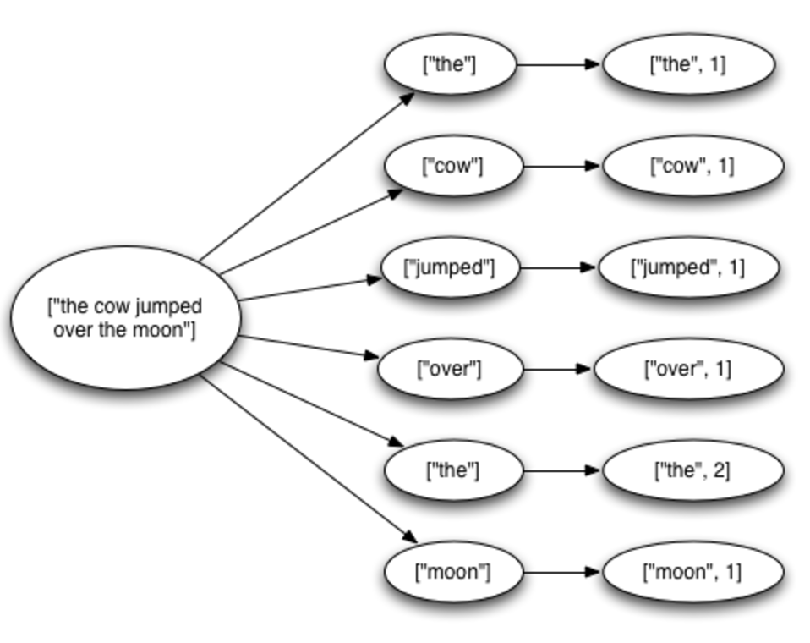
Fault tolerance via record acknowledgement (Apache Storm -- at least once semantics)
Goal: Ensure each input ”fully processed”
Approach: DAG / tree edge tracking
Record edges that get created as tuple is processed.
Wait for all edges to be marked done
Inform source (spout) of data when complete; otherwise, they resend tuple.
Challenge: “at least once” means:
Bolts can receive tuple > once
Replay can be out-of-order
... application needs to handle.

Slide 26
Fault tolerance via record acknowledgement (Apache Storm -- at least once semantics)
Spout assigns new unique ID to each tuple
When bolt “emits” dependent tuple, it informs system of dependency (new edge)
When a bolt finishes processing tuple, it calls ACK (or can FAIL)
Acker tasks:
Keep track of all emitted edges and receive ACK/FAIL messages from bolts.
When messages received about all edges in graph, inform originating spout
Spout garbage collects tuple or retransmits
Note: Best effort delivery by not generating dependency on downstream tuples.

Slide 27
Apache Spark Streaming: Discretized Stream Processing
Split stream into series of small, atomic batch jobs (each of X seconds)
Process each individual batch using Spark “batch” framework
Akin to in-memory MapReduce
Emit each micro-batch result
RDD = “Resilient Distributed Data”
live data stream
Spark
Streaming
batches of X seconds
Spark
processed results

Slide 28
Apache Spark Streaming: Dataflow-oriented programming
# Create a local StreamingContext with batch interval of 1 second
ssc = StreamingContext(sc, 1)
# Create a DStream that reads from network socket
lines = ssc.socketTextStream("localhost", 9999)
words = lines.flatMap(lambda line: line.split(" ")) # Split each line into words
# Count each word in each batch
pairs = words.map(lambda word: (word, 1))
wordCounts = pairs.reduceByKey(lambda x, y: x + y)
wordCounts.pprint()
ssc.start() # Start the computation
ssc.awaitTermination() # Wait for the computation to terminate

Slide 29
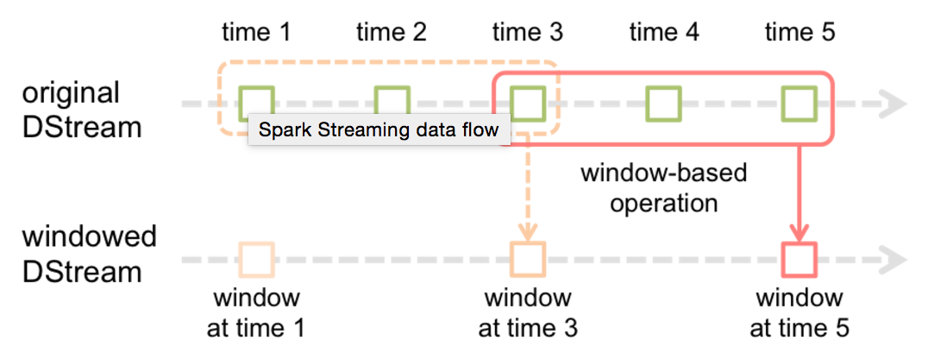
Apache Spark Streaming: Dataflow-oriented programming
# Create a local StreamingContext with batch interval of 1 second
ssc = StreamingContext(sc, 1)
# Create a DStream that reads from network socket
lines = ssc.socketTextStream("localhost", 9999)
words = lines.flatMap(lambda line: line.split(" ")) # Split each line into words
# Count each word in each batch
pairs = words.map(lambda word: (word, 1))
wordCounts = pairs.reduceByKeyAndWindow( lambda x, y: x + y,
lambda x, y: x - y, 3, 2)
wordCounts.pprint()
ssc.start() # Start the computation
ssc.awaitTermination() # Wait for the computation to terminate

Slide 30
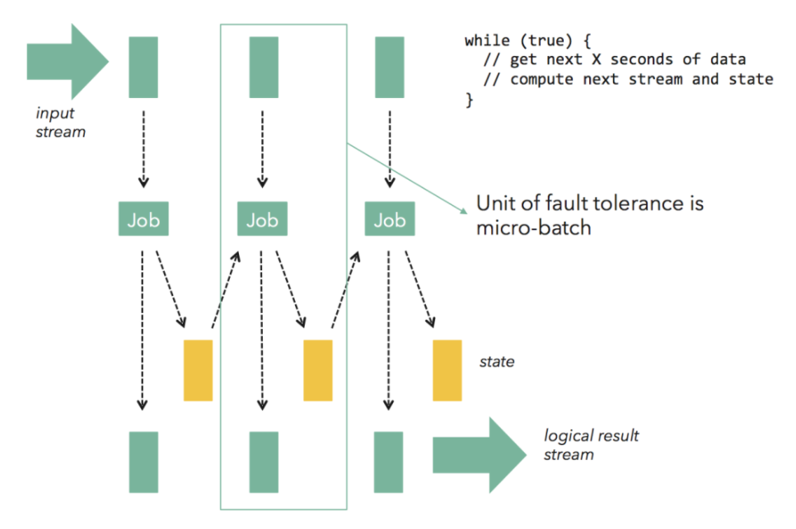
Fault tolerance via micro batches (Apache Spark Streaming, Storm Trident)
Can build on batch frameworks (Spark) and tuple-by-tuple (Storm)
Tradeoff between throughput (higher) and latency (higher)
Each micro-batch may succeed or fail
Original inputs are replicated (memory, disk)
At failure, latest micro-batch can be simply recomputed (trickier if stateful)
DAG is a pipeline of transformations from micro-batch to micro-batch
Lineage info in each RDD specifies how generated from other RDDs
To support failure recovery:
Occasionally checkpoints RDDs (state) by replicating to other nodes
To recover: another worker (1) gets last checkpoint, (2) determines upstream dependencies, then (3) starts recomputing using those usptream dependencies starting at checkpoint (downstream might filter)
Notes:
Flow control: Micro-batch architectures that use time-based batches have an inherent problem with backpressure effects. If processing of a micro-batch takes longer in downstream operations (e.g., due to a compute-intensive operator, or a slow sink) than in the batching operator (typically the source), the micro batch will take longer than configured. This leads either to more and more batches queueing up, or to a growing micro-batch size.

Slide 31
Fault Tolerance via transactional updates (Google Cloud Dataflow)
Computation is long-running DAG of continuous operators
For each intermediate record at operator
Create commit record including input record, state update, and derived downstream records generated
Write commit record to transactional log / DB
On failure, replay log to
Restore a consistent state of the computation
Replay lost records (further downstream might filter)
Requires: High-throughput writes to distributed store

Slide 32
Fault Tolerance via distributed snapshots (Apache Flink)
Rather than log each record for each operator, take system-wide snapshots
Snapshotting:
Determine consistent snapshot of system-wide state (includes in-flight records and operator state)
Store state in durable storage
Recover:
Restoring latest snapshot from durable storage
Rewinding the stream source to snapshot point, and replay inputs
Algorithm is based on Chandy-Lamport distributed snapshots, but also captures stream topology

Slide 33
Fault Tolerance via distributed snapshots (Apache Flink)
Use markers (barriers) in the input data stream to tell downstream operators when to consistently snapshot

Slide 34
Optimizing stream processing
Keeping system performant:
Careful optimizations of DAG
Scheduling: Choice of parallelization, use of resources
Where to place computation
…
Often, many queries and systems using same cluster concurrently: “Multi-tenancy”

Slide 35
Wednesday lecture
Cluster Scheduling

