Slide 1
Distributed Mesh Wireless Networks
COS 418: Distributed Systems
Lecture 20
Kyle Jamieson
[Selected content adapted from B. Karp]

Slide 2
Today
Roofnet: An unplanned Wi-Fi Mesh network
  Wireless mesh link measurements
  Routing and bit rate selection
  End-to-end performance evaluation
Advertisement for COS-598A

Slide 3
Context, ca. 2000-2005
Mobile ad hoc networking research
  Mobile, hence highly dynamic topologies
  Chief metrics: routing protocol overhead, packet delivery success rate, hop count
  Largely evaluated in simulation
Today: Roofnet, a real mesh network deployment
  Fixed, PC-class nodes
  Motivation: shared Internet access in community
  Chief metric: TCP throughput
  “Test of time” system, led to Cisco Meraki

Slide 4
Roofnet: Design Choices
Volunteer users host nodes at home
  Open participation without central planning
  No central control over topology
Omnidirectional rather than directional antennas
  Ease of installation: no choice of neighbors/aiming
  Links interfere, likely low quality
Multi-hop routing (not single-hop hot spots)
  Improved coverage (path diversity)
  Must build a routing protocol
Goal: high TCP throughput

Slide 5
Roofnet: Goals and non-goals
Each part of the mesh architecture had been previously examined in isolation
Paper contribution: A systematic evaluation of whether their architecture can achieve the goal of providing Internet access
Stated non-goals for paper:
  Throughput of multiple concurrent flows
  Scalability in number of nodes
  Design of routing protocols

Slide 6
Roofnet deployment
Each node: PC, 802.11b card, roof-mounted omni antenna

Slide 7
Hardware design
PC Ethernet interface provides wired Internet for user
Omnidirectional antenna in azimuthal direction
  3 dB vertical beam width of 20 degrees
    Wide beam sacrifices gain but removes the need for perfect vertical antenna orientation
802.11b radios (Intersil Prism 2.5 chipset)
  200 mW transmit power
  All share same 802.11 channel (frequency)

Slide 8
Node addresses
Auto-configuration of wireless interface IP address
  High byte: private (e.g., net 10) prefix
    Roofnet nodes not reachable from Internet
  Low three bytes: low 24 bits of Ethernet address
NAT between wired Ethernet and Roofnet
  Private addresses (192.168.1/24) for wired hosts
    Can’t connect to one another; only to Internet
  Result: No address allocation coordination across Roofnet boxes required

Slide 9
Internet gateways
Node sends DHCP request on Ethernet then tests reachability to Internet hosts
  Success indicates node is an Internet gateway
    Gateways translate between Roofnet and Internet IP address spaces
Roofnet nodes track gateway used for each open TCP connection they originate
  If best gateway changes, open connections continue to use gateway they already do
If a Roofnet gateway fails, existing TCP connections through that gateway will fail

Slide 10
Links: Wired v. wireless
Wired links
  Most wired links offer bit error rate ca. 10⁻¹²
  Links are “all” (connected) or “nothing” (cut)
Wireless links
  Bit error rate depends on signal to interference plus noise ratio (SNR) at receiver
  Dependent on distance, attenuation, interference
Would like: Wireless links like wired links

Slide 11
Example: Varying link loss rates
90% loss
A
B
C
10% loss
10% loss
A → C: 1 hop; high loss
A → B → C: 2 hops; lower loss
But does this happen in practice?

Slide 12
Hop count and throughput (1)
Minimum-hop-count routes are significantly throughput-suboptimal

Slide 13
Hop count and throughput
Must choose paths with care
Two-hop path is suboptimal
Some 3-hop paths better, some worse than 2-hop

Slide 14
Link loss is high and asymmetric
Vertical bar ends = loss rate on 1 link in each direction
Many links asymmetric and very lossy in ≥ 1 way
Wide range of loss rates

Slide 15
Today
Roofnet: An unplanned Wi-Fi Mesh network
  Wireless mesh link measurements
  Routing and bit rate selection
  End-to-end performance evaluation
Advertisement for COS-598A

Slide 16
Routing protocol: Srcr (1)
Each link has an associated metric (not necessarily 1!)
Data packets contain source routes
Nodes keep database of link metrics
  Nodes write current metric into source route of all forwarded packets
  Nodes flood route queries when they can’t find a route; queries accumulate link metrics
    Route queries contain route from requesting node
  Nodes cache overheard link metrics
Dijkstra’s algorithm computes source routes

Slide 17
Routing Protocol: Srcr (2)
Gateways periodically flood queries for a non-existent destination address
  Everyone learns route to the gateway
  When a node sends data to gateway, gateway learns route back to the node
Flooded queries might not follow the best route; solution:
  Add link metric info in query’s source route to database
  Compute best route from query’s source
  Replace query’s path from source with best route
  Rebroadcast the modified query

Slide 18
Link metric: Strawmen
Discard links with loss rate above a threshold?
  Risks unnecessarily disconnecting nodes
Product of link delivery rates → prob. of e2e delivery?
  Ignores inter-hop interference
    Prefers 2-hop, 0% loss route over 1-hop, 10% loss route (but latter is double throughput)
Throughput of highest-loss link on path?
  Also ignores inter-hop interference

Slide 19
ETX: Expected Transmission Count
Link ETX: predicted number of transmissions
  Calculate link ETX using forward, reverse delivery rates
  To avoid retry, data packet and ACK must succeed
  Link ETX = 1 / (d_{f} × d_{r})
    d_{f} = forward link delivery ratio (data packet)
    d_{r} = reverse link delivery ratio (ack packet)
Path ETX: sum of the link ETX values on a path

Slide 20
Measuring link delivery ratios
Nodes periodically send broadcast probe packets
  All nodes know the sending period of probes
  All nodes compute loss rate based on how many probes arrive, per measurement interval
Nodes enclose these loss measurements in their transmitted probes
  e.g. B tells node A the link delivery rate from A to B

Slide 21
Multi-bitrate radios
ETX assumes all radios run at same bit-rate
  But 802.11b rates: {1, 2, 5.5, 11} Mbit/s
Can’t compare two transmissions at 1 Mbit/s with two at 2 Mbit/s
Solution: Use expected time spent on a packet, rather than transmission count

Slide 22
ETT: Expected Transmission Time
ACKs always sent at 1 Mbps, data packets 1500 bytes
Nodes send 1500-byte broadcast probes at every bit rate b to compute forward link delivery rates d_{f}(b)
  Send 60-byte (min size) probes at 1 Mbps → d_{r}
At each bit-rate b, ETX_{b} = 1 / (d_{f}(b) × d_{r})
For packet of length S, ETT_{b} = (S / b) × ETX_{b}
Link ETT = min_{b} (ETT_{b})

Slide 23
ETT: Assumptions
Path throughput estimate t is given by
  t_{i} = throughput of hop i
Does ETT maximize throughput? No!
Underestimates throughput for long (≥ 4-hop) paths
  Distant nodes can send simultaneously
Overestimates throughput when transmissions on different hops collide and are lost

Slide 24
Auto bit-rate selection
Prism radio firmware (ca. 2005) automatically chose bit-rate among {1, 2, 5.5, 11} Mbps
  Avoids bit-rates with high loss rates
Undesirable policy!
faster!
40% loss
A
B
C
0% loss
0% loss

Slide 25
Auto bit-rate selection (cont’d)
Ideally, could choose exact bit-rate that at given SNR, gives highest throughput and nearly zero loss
Instead, 802.11b bit-rates are quantized at roughly powers of two
Result: Over a single hop, bit-rate 2R with up to 50% loss always higher throughput than bit-rate R!

Slide 26
Bit-rate selection in RoofNet: SampleRate
Samples delivery rates of actual data packets using 802.11 retransmit indication
Occasionally sends packets at rates other than current rate
Sends most packets at rate predicted to offer best throughput (as with ETT)
Adjusts per-packet bit-rate faster than ETT route selection
  Only one hop of information required
  Delivery ratio estimates not periodic, but per-packet

Slide 27
Today
Roofnet: An unplanned Wi-Fi Mesh network
  Wireless mesh link measurements
  Routing and bit rate selection
  End-to-end performance evaluation
Advertisement for COS-598A

Slide 28
Roofnet evaluation
Datasets:
Multi-hop TCP: 15-second, 1-way bulk TCP transfers between all node pairs
Single-hop TCP: same, direct link between all node pairs
Loss matrix: loss rate between all node pairs for 1500-byte broadcasts at each bit-rate
TCP flows, always a single flow at a time
But background traffic present: users always active

Slide 29
Wide spread of end-to-end throughput
10% of pairs: routing queries fail
Multi-hop TCP dataset
Mean: 627 kbps; median: 400 kbps

Slide 30
End-to-end throughput by hop count
Higher hop count correlates with lower throughput
  Neighboring nodes interfere with one another

Slide 31
Comparing with computed throughput
All-pairs empirical
Theoretical, loss-free maximum throughput
Computed analytically, assuming hops don’t forward in parallel
One-hop routes seem to use 5.5 Mbps
Longer routes far slower than 5.5 Mbps

Slide 32
Forwarding indeed creates interference
Multi-hop measured throughput often less than predicted
Reason: Interference between successive forwarding hops

Slide 33
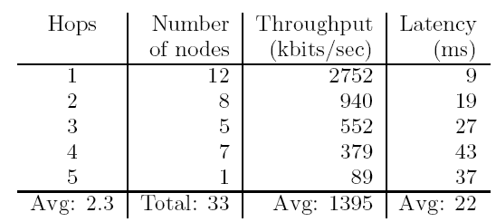
User experience:
Mean throughput from gateway
Latency: 84-byte ping; okay for interactive use
Acceptable throughput (379 Kbit/sec), even four hops out

Slide 34
What link ranges/speeds to expect?
Single-hop TCP workload
Many links of varying lengths support ≈ 500 Kbit/s
A few short and fast links; very few long and fast links

Slide 35
Which network links does Srcr use?
Multi-hop TCP workload: links Srcr uses in red, all others (single-hop TCP) in black
Srcr somewhat favors short, fast links

Slide 36
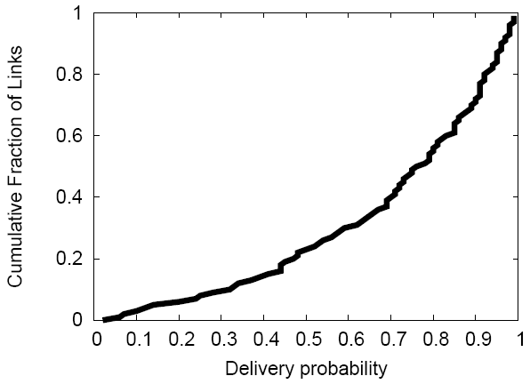
Lossy Links are Useful
Delivery probability for links Srcr uses, at the bit rate SampleRate chooses
>25%-loss links used half the time

Slide 37
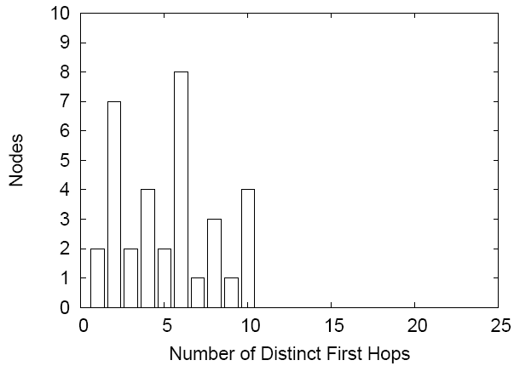
Diversity in node use: “Meshness”
Most nodes route via a diverse set of neighbors

Slide 38
Why not Access Points?
Mesh networking is far from perfect
  Complexity of multi-hop routing and path selection, vs. single-hop access point choice
  Interference between neighboring forwarding hops
  Loss substantially increases with path length
Could we do better with the same hardware?
  Place nodes as before
  Same goal: Internet access for all nodes
  Constrain topology to access point (AP) case
    All nodes are one hop from an Internet gateway AP

Slide 39
Evaluation strategy: Multi-hop v. AP
Add gateways (GWs) to the network one by one
“Optimal”: at each step, add the GW that maximizes number of newly connected nodes
“Random”: use randomly selected set of GWs of designated size; repeat for 250 trials; take median set (by number of connected nodes)

Slide 40
Optimal AP (GW) placement
Complete coverage: 5 GWs for single-hop versus 1 for multi-hop
Multi-hop is faster for any number of gateways
  Can use short, high-quality links

Slide 41
Random AP (GW) placement
More realistic scenario
Complete coverage: eight GWs for multi-hop, 25 for single-hop
  Route query failure (no retransmissions)
For ≤ 5 GWs, randomly chosen multi-hop GWs outperform optimally chosen single-hop APs

Slide 42
Roofnet: Concluding thoughts
Network’s architecture designed for ease of deployment
  Omni-directional antennas, self-configuring software, multi-hop routing
Performance evaluation showed that an unplanned mesh works well

Slide 43
Today
Roofnet: An unplanned Wi-Fi Mesh network
Advertisement for COS-598A

Slide 44
COS-598A Wireless Networking and
Sensing Systems
Graduate-level seminar open to advanced undergraduates (see me to discuss)
Explores recent developments in:
  Wireless data communication networks
  Wireless sensing systems
Introduces you to the wireless physical layer
  In a way that is accessible for students with solely a computer systems and networking background
www.cs.princeton.edu/courses/archive/spring17/cos598A

Slide 45
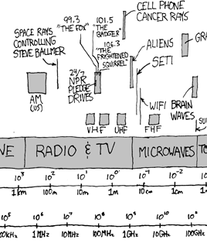
COS-598A: Topics and goals
TCP over wireless
Rateless error control codes
Wi-Fi based localization
Indoor radar
Full-duplex wireless
Goal: Understand the state of the art in the above areas
  Develop taste in research
Goal: Investigate novel ideas in the above areas thru project

Slide 46
Wednesday topic:
Big Data Processing
Graph processing (GraphLab)

