Slide 1
Content Distribution Networks
COS 418: Distributed Systems
Lecture 19
Kyle Jamieson
[Selected content adapted from M. Freedman, B. Maggs and S. Shenker]

Slide 2
Today
Domain Name System (DNS) primer
  A word on DNS security
The Web: HTTP, hosting, and caching
Content distribution networks (CDNs)

Slide 3
DNS hostname versus IP address
DNS host name (e.g. www.cs.princeton.edu)
  Mnemonic name appreciated by humans
  Variable length, full alphabet of characters
  Provides little (if any) information about location
IP address (e.g. 128.112.136.35)
  Numerical address appreciated by routers
  Fixed length, decimal number
  Hierarchical address space, related to host location

Slide 4
Many uses of DNS
Hostname to IP address translation
  IP address to hostname translation (reverse lookup)
Host name aliasing: other DNS names for a host
  Alias host names point to canonical hostname
Email: Lookup domain’s mail server by domain name

Slide 5
Original design of the DNS
  Per-host file named /etc/hosts
  Flat namespace: each line = IP address & DNS name
  SRI (Menlo Park, California) kept the master copy
  Everyone else downloads regularly
But, a single server doesn’t scale
  Traffic implosion (lookups and updates)
  Single point of failure
Need a distributed, hierarchical collection of servers

Slide 6
DNS: Goals and non-goals
A wide-area distributed database
Goals:
  Scalability; decentralized maintenance
  Robustness
  Global scope
    Names mean the same thing everywhere
  Distributed updates/queries
  Good performance
But don’t need strong consistency properties

Slide 7
Domain Name System (DNS)
Hierarchical name space divided into contiguous sections called zones
  Zones are distributed over a collection of DNS servers
Hierarchy of DNS servers:
  Root servers (identity hardwired into other servers)
  Top-level domain (TLD) servers
  Authoritative DNS servers
Performing the translations:
  Local DNS servers located near clients
  Resolver software running on clients

Slide 8
The DNS namespace is hierarchical
.
Root
TLDs:
com.
gov.
edu.
fcc.gov.
princeton.edu.
nyu.edu.
cs.princeton.edu.
Hierarchy of namespace matches hierarchy of servers
Set of nameservers answers queries for names within zone
Nameservers store names and links to other servers in tree

Slide 9
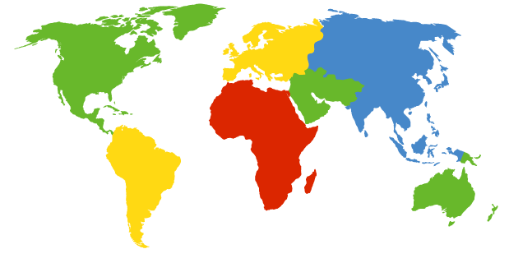
DNS root nameservers
13 root servers. Does this scale?
A Verisign, Dulles, VA
C Cogent, Herndon, VA
D U Maryland College Park, MD
G US DoD Vienna, VA
H ARL Aberdeen, MD
J Verisign
K RIPE London
I Autonomica, Stockholm
E NASA Mt View, CA
F Internet Software
Consortium,
Palo Alto, CA
M WIDE Tokyo
B USC-ISI Marina del Rey, CA
L ICANN Los Angeles, CA

Slide 10
DNS root nameservers
13 root servers. Does this scale?
Each server is really a cluster of servers (some geographically distributed), replicated via IP anycast
A Verisign, Dulles, VA
C Cogent, Herndon, VA (also Los Angeles, NY, Chicago)
D U Maryland College Park, MD
G US DoD Vienna, VA
H ARL Aberdeen, MD
J Verisign (21 locations)
K RIPE London (plus 16 other locations)
I Autonomica, Stockholm (plus 29 other locations)
E NASA Mt View, CA
F Internet Software
Consortium,
Palo Alto, CA
(and 37 other locations)
M WIDE Tokyo
plus Seoul, Paris,
San Francisco
B USC-ISI Marina del Rey, CA
L ICANN Los Angeles, CA

Slide 11
TLD and Authoritative Servers
Top-level domain (TLD) servers
  Responsible for com, org, net, edu, etc, and all top-level country domains: uk, fr, ca, jp
  Network Solutions maintains servers for com TLD
  Educause non-profit for edu TLD
Authoritative DNS servers
  An organization’s DNS servers, providing authoritative information for that organization
  May be maintained by organization itself, or ISP

Slide 12
Local name servers
Do not strictly belong to hierarchy
Each ISP (or company, or university) has one
  Also called default or caching name server
When host makes DNS query, query is sent to its local DNS server
  Acts as proxy, forwards query into hierarchy
  Does work for the client

Slide 13
DNS resource records
DNS is a distributed database storing resource records
Resource record includes: (name, type, value, time-to-live)
Type = A (address)
name = hostname
value is IP address
Type = NS (name server)
name = domain (e.g. princeton.edu)
value is hostname of authoritative name server for this domain
Type = CNAME
name = alias for some “canonical” (real) name
value is canonical name
Type = MX (mail exchange)
name = domain
value is name of mail server for that domain

Slide 14


DNS in operation
Most queries and responses are UDP datagrams
  Two types of queries:
Recursive: Nameserver responds with answer or error
Iterative: Nameserver may respond with a referral
Client
Nameserver
www.princeton.edu?
Answer: www.princeton.edu A 140.180.223.42
Client
Nameserver
www.princeton.edu?
Referral: .edu NS a.edu-servers.net.

Slide 15

A recursive DNS lookup
. (root) authority 198.41.0.4
edu.: NS 192.5.6.30
com.: NS 158.38.8.133
io.: NS 156.154.100.3
www.princeton.edu?
edu. authority 192.5.6.30
princeton.edu.: NS 66.28.0.14
pedantic.edu.: NS 19.31.1.1
Contact 192.5.6.30 for edu.
Client
www.princeton.edu?
Contact 66.28.0.14 for princeton.edu.
www.princeton.edu?
www.princeton.edu?
www.princeton.edu A 140.180.223.42
Local nameserver
. (root): NS 198.41.0.4
princeton.edu. authority 66.28.0.14
www.princeton.edu.: A 140.180.223.42
edu.: NS 192.5.6.30
princeton.edu.: NS 66.28.0.14
www.princeton.edu.: A 140.180.223.42

Slide 16
Recursive versus iterative queries
Recursive query
Iterative query
Less burden on entity initiating the query
More burden on nameserver (has to return an answer to the query)
Most root and TLD servers won’t answer (shed load)
  Local name server answers recursive query
More burden on query initiator
Less burden on nameserver (simply refers the query to another server)

Slide 17
$ dig @a.root-servers.net www.freebsd.org +norecurse
;; Got answer:
;; ->>HEADER<<- opcode: QUERY, status: NOERROR, id: 57494
;; QUERY: 1, ANSWER: 0, AUTHORITY: 2, ADDITIONAL: 2
;; QUESTION SECTION:
;www.freebsd.org. IN A
;; AUTHORITY SECTION:
org. 172800 IN NS b0.org.afilias-nst.org.
org. 172800 IN NS d0.org.afilias-nst.org.
;; ADDITIONAL SECTION:
b0.org.afilias-nst.org. 172800 IN A 199.19.54.1
d0.org.afilias-nst.org. 172800 IN A 199.19.57.1
Glue records
[Output edited for clarity]

Slide 18
$ dig @199.19.54.1 www.freebsd.org +norecurse
;; Got answer:
;; ->>HEADER<<- opcode: QUERY, status: NOERROR, id: 39912
;; QUERY: 1, ANSWER: 0, AUTHORITY: 3, ADDITIONAL: 0
;; QUESTION SECTION:
;www.freebsd.org. IN A
;; AUTHORITY SECTION:
freebsd.org. 86400 IN NS ns1.isc-sns.net.
freebsd.org. 86400 IN NS ns2.isc-sns.com.
freebsd.org. 86400 IN NS ns3.isc-sns.info.
(authoritative for org.)
[Output edited for clarity]

Slide 19
$ dig @ns1.isc-sns.net www.freebsd.org +norecurse
;; Got answer:
;; ->>HEADER<<- opcode: QUERY, status: NOERROR, id: 17037
;; QUERY: 1, ANSWER: 1, AUTHORITY: 3, ADDITIONAL: 3
;; QUESTION SECTION:
;www.freebsd.org. IN A
;; ANSWER SECTION:
www.freebsd.org. 3600 IN A 69.147.83.33
;; AUTHORITY SECTION:
freebsd.org. 3600 IN NS ns2.isc-sns.com.
freebsd.org. 3600 IN NS ns1.isc-sns.net.
freebsd.org. 3600 IN NS ns3.isc-sns.info.
;; ADDITIONAL SECTION:
ns1.isc-sns.net. 3600 IN A 72.52.71.1
ns2.isc-sns.com. 3600 IN A 38.103.2.1
ns3.isc-sns.info. 3600 IN A 63.243.194.1
(authoritative for freebsd.org.)
[Output edited for clarity]

Slide 20
DNS caching
Performing all these queries takes time
  And all this before actual communication takes place
Caching can greatly reduce overhead
  The top-level servers very rarely change
    Popular sites visited often
  Local DNS server often has the information cached
How DNS caching works
  All DNS servers cache responses to queries
  Responses include a time-to-live (TTL) field
    Server deletes cached entry after TTL expires
Plays a key role in CDN (Akamai) load balancing

Slide 21
Today
Domain Name System (DNS) primer
  A word on DNS security
The Web: HTTP, hosting, and caching
Content distribution networks (CDNs)

Slide 22
A word on DNS security
Implications of subverting DNS:
Redirect victim’s web traffic to rogue servers
Redirect victim’s email to rogue email servers (MX records in DNS)
Does Secure Sockets Layer (SSL) provide protection?
  Yes―user will get “wrong certificate” if SSL enabled
  No―SSL not enabled or user ignores warnings
  No―how is SSL trust established? Often, by email!

Slide 23
Security Problem #1: Coffee shop
As you sip your latte and surf the Web, how does your laptop find google.com?
Answer: it asks the local DNS nameserver
  Which is run by the coffee shop or their contractor
  And can return to you any answer they please
How can you know you’re getting correct data?
  Today, you can’t. (Though HTTPS site helps.)
  One day, hopefully: DNSSEC extensions to DNS

Slide 24
Security Problem #2: Cache poisoning
You receive request to resolve www.foobar.com & reply:
;; QUESTION SECTION:
;www.foobar.com. IN A
;; ANSWER SECTION:
www.foobar.com. 300 IN A 212.44.9.144
;; AUTHORITY SECTION:
foobar.com. 600 IN NS dns1.foobar.com.
foobar.com. 600 IN NS google.com.
;; ADDITIONAL SECTION:
google.com. 5 IN A 212.44.9.155
Evidence disappears five sec. later!
A foobar.com machine, not google.com

Slide 25
DNS cache poisoning (cont’d)
Okay, but how do you get the victim to look up www.foobar.com in the first place?
Perhaps you connect to their mail server and send
  HELO www.foobar.com
  Which their mail server then looks up to see if it corresponds to your source address (anti-spam measure)
Perhaps you send many spam or phishing emails containing a link to www.foobar.com

Slide 26
Mitigation: Bailiwick checking
Local nameserver ignores any RR not in or under same zone as question
  Widely deployed since ca. 1997
But, other attacks are possible (e.g. Kaminsky poisoning)
;; QUESTION SECTION:
;www.foobar.com. IN A
;; ANSWER SECTION:
www.foobar.com. 300 IN A 212.44.9.144
;; AUTHORITY SECTION:
foobar.com. 600 IN NS dns1.foobar.com.
foobar.com. 600 IN NS google.com.
;; ADDITIONAL SECTION:
google.com. 5 IN A 212.44.9.155

Slide 27
Today
Domain Name System (DNS) primer
The Web: HTTP, hosting, and caching
Content distribution networks (CDNs)

Slide 28


Anatomy of an HTTP/1.0 web page fetch
Web page = HTML file + embedded images/objects
Stop-and-wait at the granularity of objects:
  Close then open new TCP connection for each object
    Incurs a TCP round-trip-time delay each time
  Each TCP connection may stay in “slow start”
Client
Server
TCP SYN
TCP SYN+ACK
Web page
HTTP GET /index.html
(HTML page)
TCP FIN
TCP FIN+ACK
TCP SYN
TCP SYN+ACK
HTTP GET image1.jpg
Objects
(JPEG image)
TCP FIN
TCP FIN+ACK
…

Slide 29
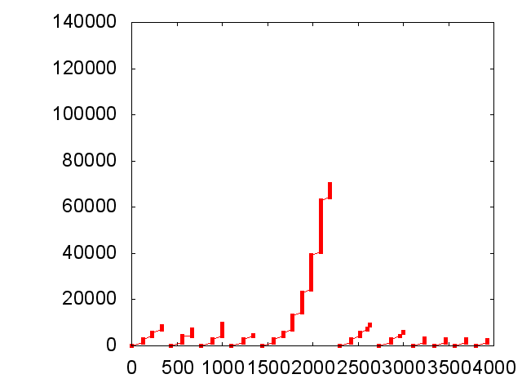
HTTP/1.0 webpage fetch: Timeline
Bytes
received
HTTP/1.0 finish
Object downloads
Page download
Time (milliseconds)
Fetch 8.5 Kbyte page with 10 objects, most < 10 Kbyte

Slide 30
Letting the TCP connection persist
Known as HTTP keepalive
Still stop-and-wait at the granularity of objects, at the application layer
  HTTP response fully received before next HTTP GET dispatched
    ≥ 1 RTT per object
Client
Server
TCP SYN
SYN+ACK
HTTP GET index.html
HTTP Response
HTTP GET img1.jpg
HTTP Response
…
TCP FIN

Slide 31
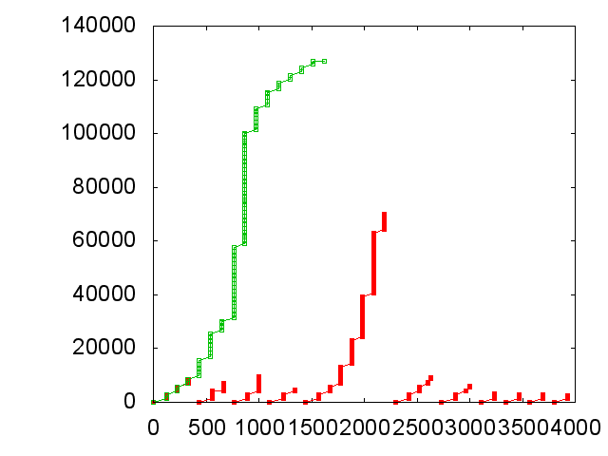
HTTP Keepalive avoids TCP slow starts
Bytes
received
HTTP/1.0 finish
Keep-alive finish
Time (milliseconds)
Incur one slow start, but stop-and-wait to issue next request

Slide 32
Pipelining within HTTP
Idea: Pipeline HTTP GETs and their responses
Main benefits:
Amortizes the RTT across multiple objects retrieved
Reduces overhead of HTTP requests, packing multiple requests into one packet
Implemented in HTTP/1.1
Client
Server
SYN
SYN+ACK
HTTP GET img1.jpg
HTTP GET img2.jpg
…
HTTP Response
HTTP Response
…
FIN

Slide 33
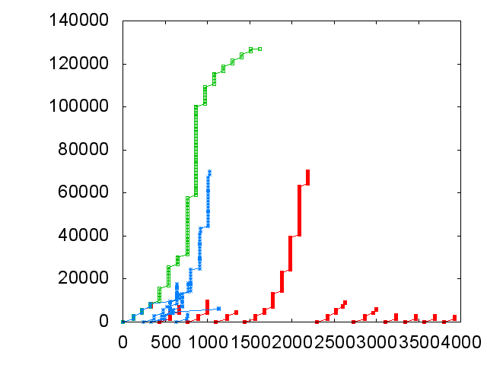
Pipelined HTTP requests overlap RTTs
Bytes
received
HTTP/1.0 finish
Keep-alive finish
HTTP/1.1 finish
Time (milliseconds)
Many HTTP requests and TCP connections at once
Overlaps RTTs of all requests

Slide 34
Today
Domain Name System (DNS) primer
The Web: HTTP, hosting, and caching
  Handling heavy loads
Content distribution networks (CDNs)

Slide 35
Hosting: Multiple machines per site
Problem: Overloaded popular web site
  Replicate the site across multiple machines
    Helps to handle the load
Want to direct client to a particular replica. Why?
  Balance load across server replicas
Solution #1: Manual selection by clients
  Each replica has its own site name
  Some Web page lists replicas (e.g., by name, location), asks clients to click link to pick

Slide 36
Hosting: Load-balancer approach
Solution #2: Single IP address, multiple machines
  Run multiple machines behind a single IP address
  Ensure all packets from a single
  TCP connection go to the same replica
Load Balancer
64.236.16.20

Slide 37
Hosting: DNS redirection approach
Solution #3: Multiple IP addresses, multiple machines
  Same DNS name but different IP for each replica
    DNS server returns IP addresses “round robin”
12.1.1.1
64.236.16.20
DNS
173.72.54.131

Slide 38
Hosting: Summary
Load-balancer approach
  No geographical diversity ✘
  TCP connection issue ✘
  Does not reduce network traffic✘
DNS redirection
  No TCP connection issues ✔
  Simple round-robin server selection
    May be less responsive ✘
  Does not reduce network traffic✘

Slide 39
Web caching
Many clients transfer the same information
  Generates redundant server and network load
  Also, clients may experience high latency
Origin server
ISP-1
Backbone ISP
ISP-2
Clients

Slide 40
Why web caching?
Motivation for placing content closer to client:
  User gets better response time
    Content providers get happier users
  Network gets reduced load
Why does caching work? Exploits locality of reference
How well does caching work?
  Very well, up to a limit
  Large overlap in content
  But many unique requests

Slide 41
Caching with Reverse Proxies
Cache data close to origin server → decrease server load
  Typically done by content providers
  Client thinks it is talking to the origin server (the server with content)
Does not work for dynamic content
Reverse proxies
Origin server
Backbone ISP
ISP-1
ISP-2
Clients

Slide 42
Caching with Forward Proxies
Cache close to clients → less network traffic, less latency
  Typically done by ISPs or corporate LANs
  Client configured to send HTTP requests to forward proxy
Reduces traffic on ISP-1’s access link, origin server, and backbone ISP
Reverse proxies
Origin server
Backbone ISP
ISP-1
ISP-2
Forward proxies
Clients

Slide 43
Caching & Load-Balancing: Outstanding problems
Problem ca. 2002: How to reliably deliver large amounts of content to users worldwide?
  Popular event: “Flash crowds” overwhelm (replicated) web server, access link, or back-end database infrastructure
  More rich content: audio, video, photos
Web caching: Diversity causes low cache hit rates (25−40%)

Slide 44
Today
Domain Name System (DNS) primer
The Web: HTTP, hosting, and caching
Content distribution networks (CDNs)
  Akamai case study

Slide 45
Content Distribution Networks
Proactive content replication
  Content provider (e.g. CNN) pushes content out from its own origin server
CDN replicates the content
  On many servers spread throughout the Internet
Updating the replicas
  Updates pushed to replicas when the content changes
Origin server
in N. America
CDN distribution node
CDN server
in S. America
CDN server
in Asia
CDN server
in Europe

Slide 46
Replica selection: Goals
Live server
  For availability
Lowest load
  To balance load across the servers
Closest
  Nearest geographically, or in round-trip time
Best performance
  Throughput, latency, reliability…
Requires continuous monitoring of liveness, load, and performance

Slide 47
Akamai statistics
Distributed servers
  Servers: ~100,000
  Networks: ~1,000
  Countries: ~70
Many customers
  Apple, BBC, FOX, GM IBM, MTV, NASA, NBC, NFL, NPR, Puma, Red Bull, Rutgers, SAP, …
Client requests
  20+M per second
  Half in the top
  45 networks
  20% of all Web traffic worldwide

Slide 48
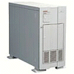

How Akamai Uses DNS
cnn.com (content provider)
HTTP
DNS TLD server
GET index.html
cache.cnn.com/foo.jpg
Akamai
cluster
Akamai global
DNS server
1
2
HTTP
Akamai regional
DNS server
Nearby
Akamai
cluster
End user

Slide 49
How Akamai Uses DNS
cnn.com (content provider)
HTTP
DNS TLD server
DNS lookup
cache.cnn.com
Akamai
cluster
Akamai global
DNS server
1
2
3
ALIAS:
g.akamai.net
4
Akamai regional
DNS server
Nearby
Akamai
cluster
End user

Slide 50
How Akamai Uses DNS
cnn.com (content provider)
HTTP
DNS TLD server
DNS lookup
g.akamai.net
Akamai
cluster
Akamai global
DNS server
5
1
2
3
4
6
Akamai regional
DNS server
ALIAS
a73.g.akamai.net
Nearby
Akamai
cluster
End user

Slide 51
How Akamai Uses DNS
cnn.com (content provider)
HTTP
DNS TLD server
Akamai
cluster
Akamai global
DNS server
5
1
2
3
4
6
Akamai regional
DNS server
7
DNS a73.g.akamai.net
8
Address
1.2.3.4
Nearby
Akamai
cluster
End user

Slide 52
How Akamai Uses DNS
cnn.com (content provider)
HTTP
DNS TLD server
Akamai
cluster
Akamai global
DNS server
5
1
2
3
4
6
Akamai regional
DNS server
7
8
9
Nearby
Akamai
cluster
End user
GET /foo.jpg
Host: cache.cnn.com

Slide 53

How Akamai Uses DNS
cnn.com (content provider)
HTTP
DNS TLD server
GET foo.jpg
11
12
Akamai
cluster
Akamai global
DNS server
5
1
2
3
4
6
Akamai regional
DNS server
7
8
9
Nearby
Akamai
cluster
End user
GET /foo.jpg
Host: cache.cnn.com

Slide 54
How Akamai Uses DNS
cnn.com (content provider)
HTTP
DNS TLD server
11
12
Akamai
cluster
Akamai global
DNS server
5
1
2
3
4
6
Akamai regional
DNS server
7
8
9
Nearby
Akamai
cluster
End user
10

Slide 55
How Akamai Works: Cache Hit
cnn.com (content provider)
HTTP
DNS TLD server
Akamai
cluster
Akamai global
DNS server
1
2
Akamai regional
DNS server
3
4
5
Nearby
Akamai
cluster
End user
6

Slide 56
Mapping System
Equivalence classes of IP addresses
  IP addresses experiencing similar performance
  Quantify how well they connect to each other
Collect and combine measurements
  Ping, traceroute, BGP routes, server logs
    e.g., over 100 TB of logs per days
  Network latency, loss, throughput, and connectivity

Slide 57
Routing client requests with the map
Map each IP class to a preferred server cluster
  Based on performance, cluster health, etc.
  Updated roughly every minute
    Short, 60-sec DNS TTLs in Akamai regional DNS accomplish this
Map client request to a server in the cluster
  Load balancer selects a specific server
  e.g., to maximize the cache hit rate

Slide 58
Adapting to failures
Failing hard drive on a server
  Suspends after finishing “in progress” requests
Failed server
  Another server takes over for the IP address
  Low-level map updated quickly (load balancer)
Failed cluster, or network path
  High-level map updated quickly (ping/traceroute)

Slide 59
Take-away points: CDNs
Content distribution is hard
  Many, diverse, changing objects
  Clients distributed all over the world
Moving content to the client is key
  Reduces latency, improves throughput, reliability
Content distribution solutions evolved:
  Load balancing, reactive caching, to
  Proactive content distribution networks

Slide 60
Friday precept:
How to transition from
Assignment 3 to Assignment 4
Monday topic:
Distributed Wireless Networks: Roofnet

