Slide 1
Bitcoin and the Blockchain
COS 418: Distributed Systems
Lecture 18
Michael Freedman

Slide 2
Bitcoin: 10,000 foot view
New bitcoins are “created” every ~10 min, owned by “miner” (more on this later)
Thereafter, just keep record of transfers
  e.g., Alice pays Bob 1 BTC
Basic protocol:
  Alice signs transaction: txn = Sign_{Alice} (BTC, PK_{Bob})
  Alice shows transaction to others…
Notes:
So that motivates the 2PL algorithm.

Slide 3
Problem: Equivocation!
Can Alice “pay” both Bob and Charlie with same bitcoin ?
( Known as “double spending” )

Slide 4
How traditional e-cash handled problem
Bank
Alice
Bob
When Alice pays Bob with a coin, Bob validates that coin hasn’t been spend with trusted third party
Introduced “blind signatures” and “zero-knowledge protocols” so bank can’t link withdrawals and deposits
Notes:
So that motivates the 2PL algorithm.

Slide 5
How traditional e-cash handled problem
Bank
Alice
Bob
When Alice pays Bob with a coin, Bob validates that coin hasn’t been spend with trusted third party
Introduced “blind signatures” and “zero-knowledge protocols” so bank can’t link withdrawals and deposits
Bank maintains linearizable log of transactions
Notes:
So that motivates the 2PL algorithm.

Slide 6
Problem: Equivocation!
Goal: No double-spending in decentralized environment
      Approach: Make transaction log
        public
        append-only
        strongly consistent

Slide 7
Bitcoin: 10,000 foot view
Public
  Transactions are signed: txn = Sign_{Alice} (BTC, PK_{Bob})
  All transactions are sent to all network participants
No equivocation: Log append-only and consistent
  All transactions part of a hash chain
  Consensus on set/order of operations in hash chain
Notes:
So that motivates the 2PL algorithm.

Slide 8
Blockchain: Append-only hash chain
prev: H( )
prev: H( )
prev: H( )
txn 5
txn 6
txn 7
Recall: hash chain creates “tamper-evident” log of txns
Security based on collision-resistance of hash function
  Given m and h = hash(m), difficult to find m’ such that h = hash(m’) and m != m’

Slide 9
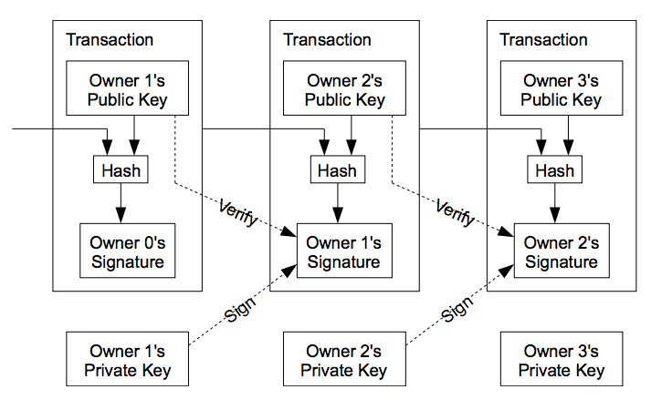
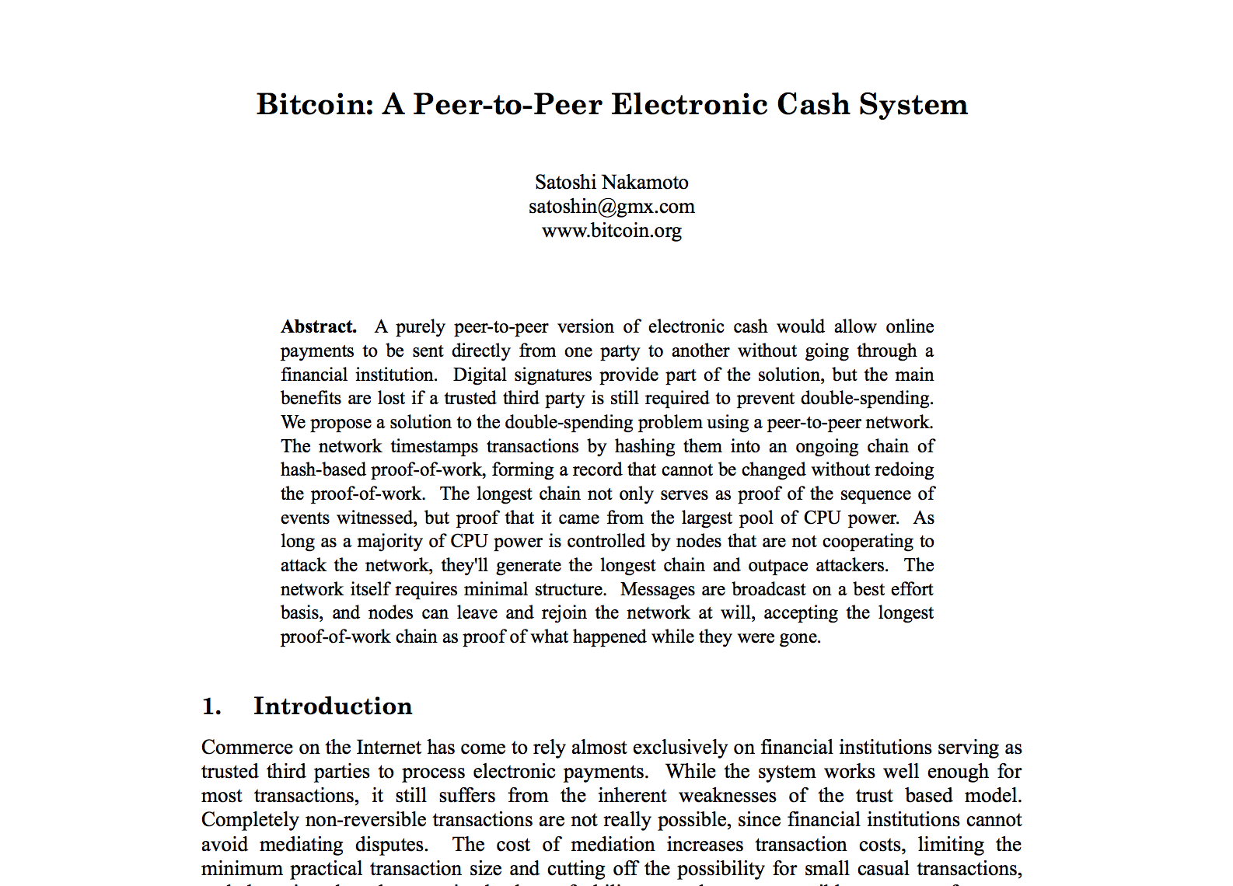
Blockchain: Append-only hash chain

Slide 10
Problem remains: forking
prev: H( )
prev: H( )
prev: H( )
txn 5
txn 6
txn 7
prev: H( )
prev: H( )
txn 6’
txn 7’

Slide 11
Goal: Consensus
Recall Byzantine fault-tolerant protocols to achieve consensus of replicated log
  Requires: n >= 3f + 1 nodes, at most f faulty
Problem
  Communication complexity is n²
  Requires view of network participants

Slide 12
Consensus susceptible to Sybils
All consensus protocols based on membership…
  … assume independent failures …
  … which implies strong notion of identity
“Sybil attack” (p2p literature ~2002)
  Idea: one entity can create many “identities” in system
  Typical defense: 1 IP address = 1 identity
  Problem: IP addresses aren’t difficult / expensive to get, esp. in world of botnets & cloud services

Slide 13
Consensus based on “work”
Rather than “count” IP addresses, bitcoin “counts” the amount of CPU time / electricity that is expended
Proof-of-work: Cryptographic “proof” that certain amount of CPU work was performed
“The system is secure as long as honest nodes collectively control more CPU power than any cooperating group of attacker nodes.” - Satoshi Nakamoto

Slide 14
Key idea: Chain length requires work
prev: H( )
prev: H( )
prev: H( )
prev: H( )
prev: H( )
txn 5
txn 6
txn 7
txn 8
txn 9
prev: H( )
txn 6’
Generating a new block requires “proof of work”
“Correct” nodes accept longest chain
Creating fork requires rate of malicious work >> rate of correct
  So, the older the block, the “safer” it is from being deleted

Slide 15
Use hashing to determine work!
Recall hash functions are one-way / collision resistant
  Given h, hard to find m such that h = hash(m)
But what about finding partial collision?
  m whose hash has most significant bit = 0?
  m whose hash has most significant bit = 00?
  Assuming output is randomly distributed, complexity grows exponentially with # bits to match

Slide 16
Bitcoin proof of work
Find nonce such that
hash (nonce || prev_hash || block data) < target
i.e., hash has certain number of leading 0’s
What about changes in total system hashing rate?
Target is recalculated every 2 weeks
Goal: One new block every 10 minutes

Slide 17
Historical hash rate trends of bitcoin
Currently: 2 Exahash/s
2 x 10¹⁸
Tech: CPU → GPU → FPGA → ASICs

Slide 18
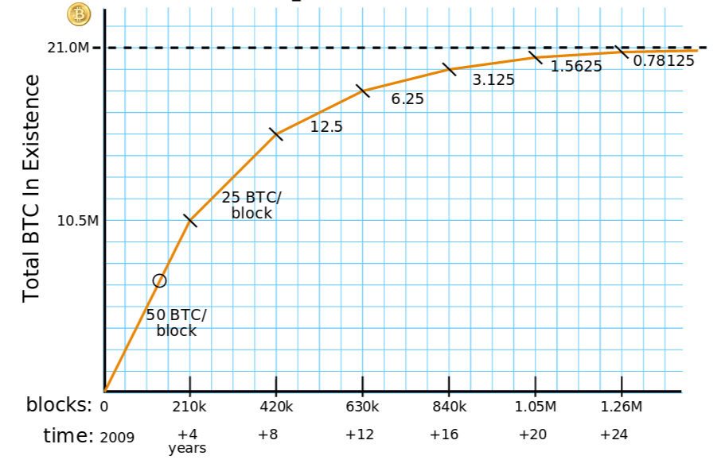
Why consume all this energy?
Creating a new block creates bitcoin!
  Initially 50 BTC, decreases over time, currently 12.5
  New bitcoin assigned to party named in new block
  Called “mining” as you search for gold/coins

Slide 19
Incentivizing correct behavior?
Race to find nonce and claim block reward, at which time race starts again for next block
hash (nonce || prev_hash || block data)
  As solution has prev_hash, corresponds to particular chain
Correct behavior is to accept longest chain
  “Length” determined by aggregate work, not # blocks
  So miners incentivized only to work on longest chain, as otherwise solution not accepted
  Remember blocks on other forks still “create” bitcoin, but only matters if chain in collective conscious (majority)

Slide 20
Form of randomized leader election
Each time a nonce is found:
  New leader elected for past epoch (~10 min)
  Leader elected randomly, probability of selection proportional to leader’s % of global hashing power
  Leader decides which transactions comprise block

Slide 21
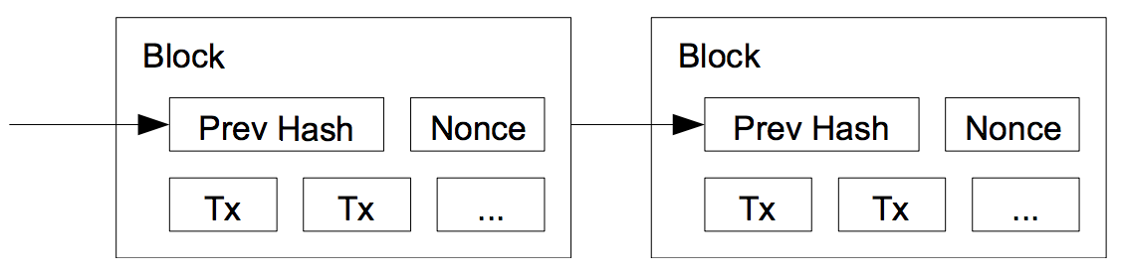
One block = many transactions
Each miner picks a set of transactions for block
Builds “block header”: prevhash, version, timestamp, txns, …
Until hash < target OR another node wins:
  Pick nonce for header, compute hash = SHA256(SHA256(header))

Slide 22
Transactions are delayed
At some time T, block header constructed
Those transactions had been received [ T – 10 min, T]
Block will be generated at time T + 10 min (on average)
So transactions are from 10 - 20 min before block creation
Can be much longer if “backlog” of transactions are long

Slide 23
Commitments further delayed
When do you trust a transaction?
  After we know it is “stable” on the hash chain
  Recall that the longer the chain, the hard to “revert”
Common practice: transaction “committed” when 6 blocks deep
  i.e., Takes another ~1 hour for txn to become committed

Slide 24
Transaction format: strawman
Create 12.5 coins, credit to Alice
Transfer 3 coins from Alice to Bob _{SIGNED(Alice)}
Transfer 8 coins from Bob to Carol _{SIGNED(Bob)}
Transfer 1 coins from Carol to Alice _{SIGNED(Carol)}
How do you determine if Alice has balance?
Scan backwards to time 0 !

Slide 25
Transaction format
Inputs: Ø // Coinbase reward
Outputs: 25.0→PK_Alice
Inputs: H(prevtxn, 0) // 25 BTC from Alice
Outputs: 25.0→PK_Bob _{SIGNED(Alice)}
Inputs: H (prevtxn, 0) // 25 BTC From Alice
Outputs: 5.0→PK_Bob, 20.0 →PK_Alice2 _{SIGNED(Alice)}
Inputs: H (prevtxn1, 1), H(prevtxn2, 0) // 10+5 BTC
Outputs: 14.9→PK_Bob _{SIGNED(Alice)}
Transaction typically has 1+ inputs, 1+ outputs
Making change: 1st output payee, 2nd output self
Output can appear in single later input (avoids scan back)

Slide 26
Transaction format
Inputs: Ø // Coinbase reward
Outputs: 25.0→PK_Alice
Inputs: H(prevtxn, 0) // 25 BTC from Alice
Outputs: 25.0→PK_Bob _{SIGNED(Alice)}
Inputs: H (prevtxn, 0) // 25 BTC From Alice
Outputs: 5.0→PK_Bob, 20.0 →PK_Alice _{SIGNED(Alice)}
Inputs: H (prevtxn1, 1), H(prevtxn2, 0) // 10+5 BTC
Outputs: 14.9→PK_Bob _{SIGNED(Alice)}
Unspent portion of inputs is “transaction fee” to miner
In fact, “outputs” are stack-based scripts
1 Block = 1MB max

Slide 27
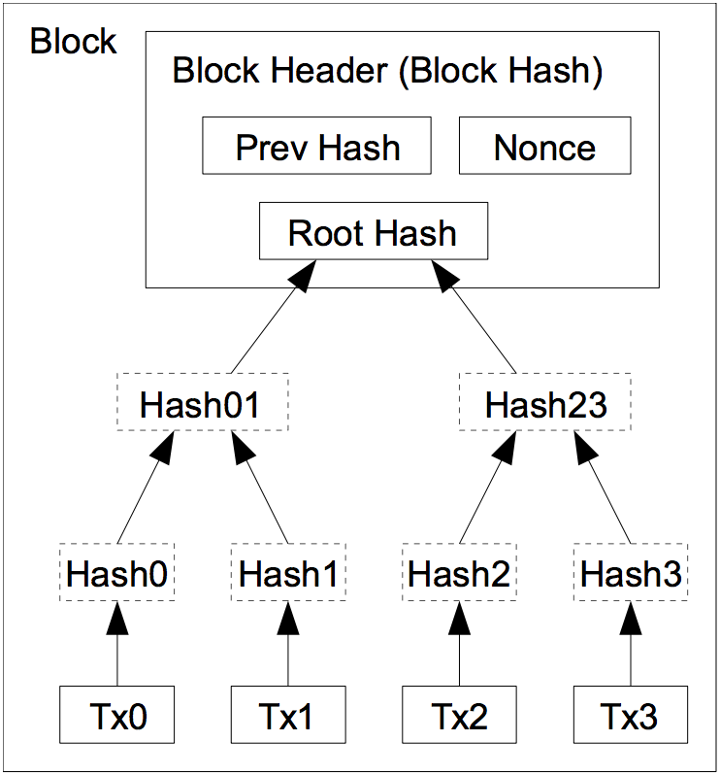
Storage / verification efficiency
Merkle tree
  Binary tree of hashes
  Root hash “binds” leaves given collision resistance
Using a root hash
  Block header now constant size for hashing
  Can prune tree to reduce storage needs over time

Slide 28
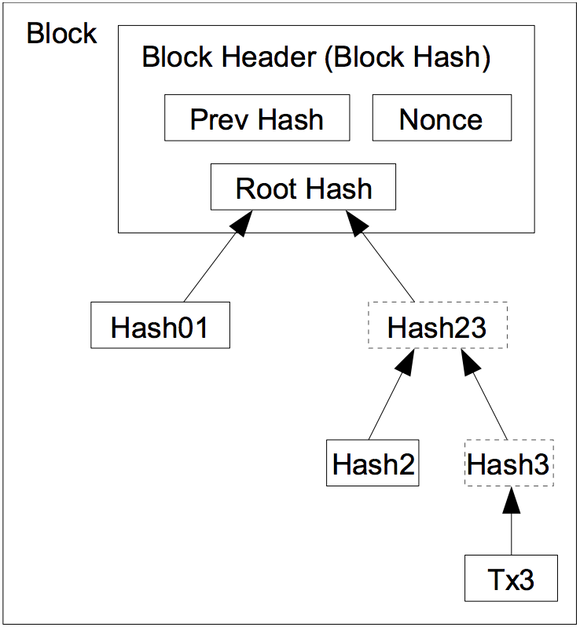
Storage / verification efficiency
Merkle tree
  Binary tree of hashes
  Root hash “binds” leaves given collision resistance
Using a root hash
  Block header now constant size for hashing
  Can prune tree to reduce storage needs over time
    Can prune when all txn outputs are spent
    Now: 80GB pruned, 300GB unpruned

Slide 29
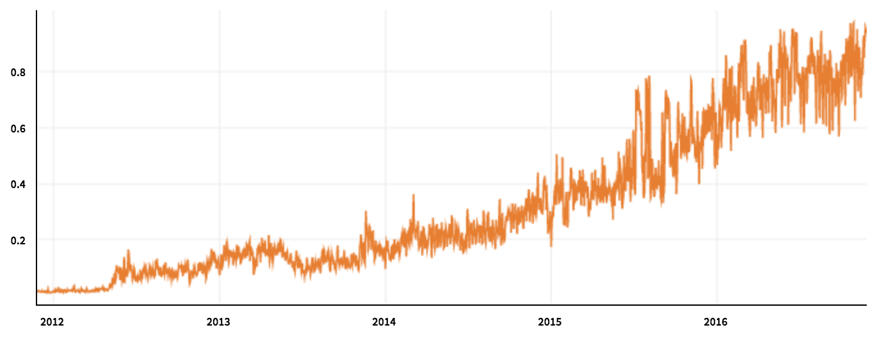
Not panacea of scale as some claim
Scaling limitations
  1 block = 1 MB max
  1 block ~ 2000 txns
  1 block ~ 10 min
  So, 3-4 txns / sec
  Log grows linearly, joining requires full dload and verification
Visa peak load comparison
  Typically 2,000 txns / sec
  Peak load in 2013: 47,000 txns / sec
block size

Slide 30
Summary
Coins xfer/split between “addresses” (PK) in txns
Blockchain: Global ordered, append-only log of txns
  Reached through decentralized consensus
    Each epoch, “random” node selected to batch transactions into block and append block to log
  Nodes incentivized to perform work and act correctly
    When “solve” block, get block rewards + txn fees
    Reward: 12.5 BTC @ ~730 USD/BTC (11-25-16) = $9125 / 10 min
    Only “keep” reward if block persists on main chain
Notes:
So that motivates the 2PL algorithm.

Slide 31
Bitcoin & blockchain intrinsically linked
security of block chain
health of mining ecosystem
value of currency
Notes:
So that motivates the 2PL algorithm.

Slide 32
Rich ecosystem: Mining pools
health of mining ecosystem
Mining == gambling:
  Electricity costs $, huge payout, low probability of winning
Development of mining pools to amortize risk
  Pool computational resources, participants “paid” to mine e.g., rewards “split” as a fraction of work, etc
  Verification? Demonstrate “easier” proofs of work to admins
  Prevent theft? Block header (coinbase txn) given by pool
Notes:
So that motivates the 2PL algorithm.

Slide 33
More than just currency…

Slide 34
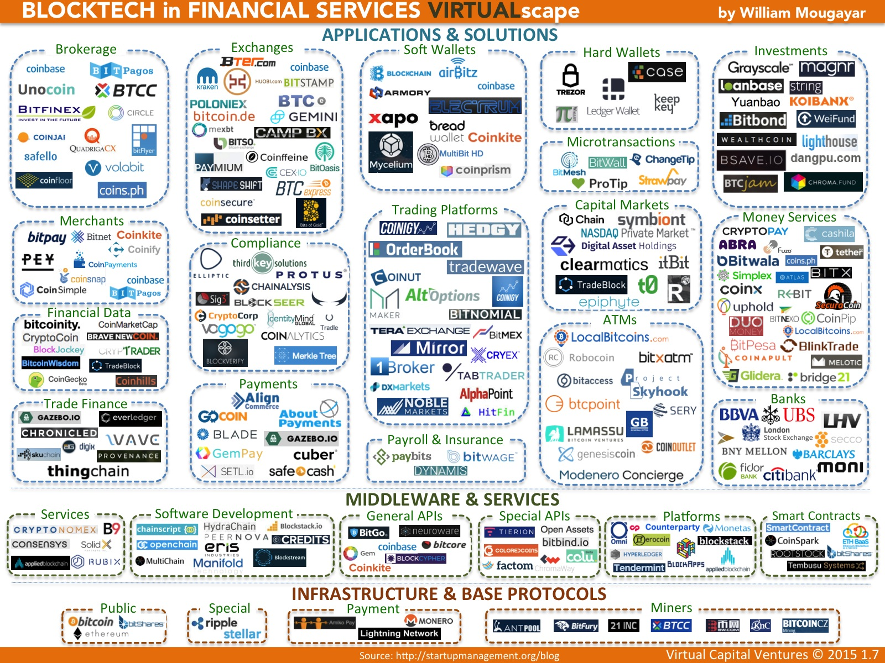

Slide 35
Wednesday lecture
Content Delivery Networks

