Slide 1
Conflict Resolution (OT), Crypto, and Untrusted Cloud Services
COS 418: Distributed Systems
Lecture 17
Michael Freedman

Slide 2
Warning: This lecture jumps around But there is some logic + crypto background for blockchain

Slide 3
Today’s Topics
Conflict resolution
Operational Transformation (OT)
Crypto Introduction
Crypto (encryption, digital signatures), hash functions
Untrusted Cloud Storage (SPORC)
OT + crypto + fork* consistency
Next lecture: Bitcoin and blockchains and consensus, oh my!
Notes:
So that motivates the 2PL algorithm.

Slide 4
Conflict Resolution

Slide 5
Concurrent writes can conflict
Encountered in many different settings:
Peer-to-peer (Bayou)
Multi-master: single cluster (Dynamo), wide-area (COPS)
Potential solutions
“Last writer wins”
Thomas Write Rule for DBs with timestamp-based concurrency control: Ignore outdated writes
Application-specific merge/update: Bayou, Dynamo

Slide 6
General approach: Encode ops as incremental update
Consider banking (double-entry bookkeeping):
Initial: Alice = $50, Bob = $20
Alice pays Bob $10
Option 1: set Alice to $40, set Bob to $30
Option 2: decrement Alice -$10, incremental Bob +$10
#2 better, but can’t always ensure Alice >= $0
Works because common mathematical ops are
Commutative: A ◎ B == B ◎ A
Invertible: A ◎ A⁻¹ == 1

Slide 7
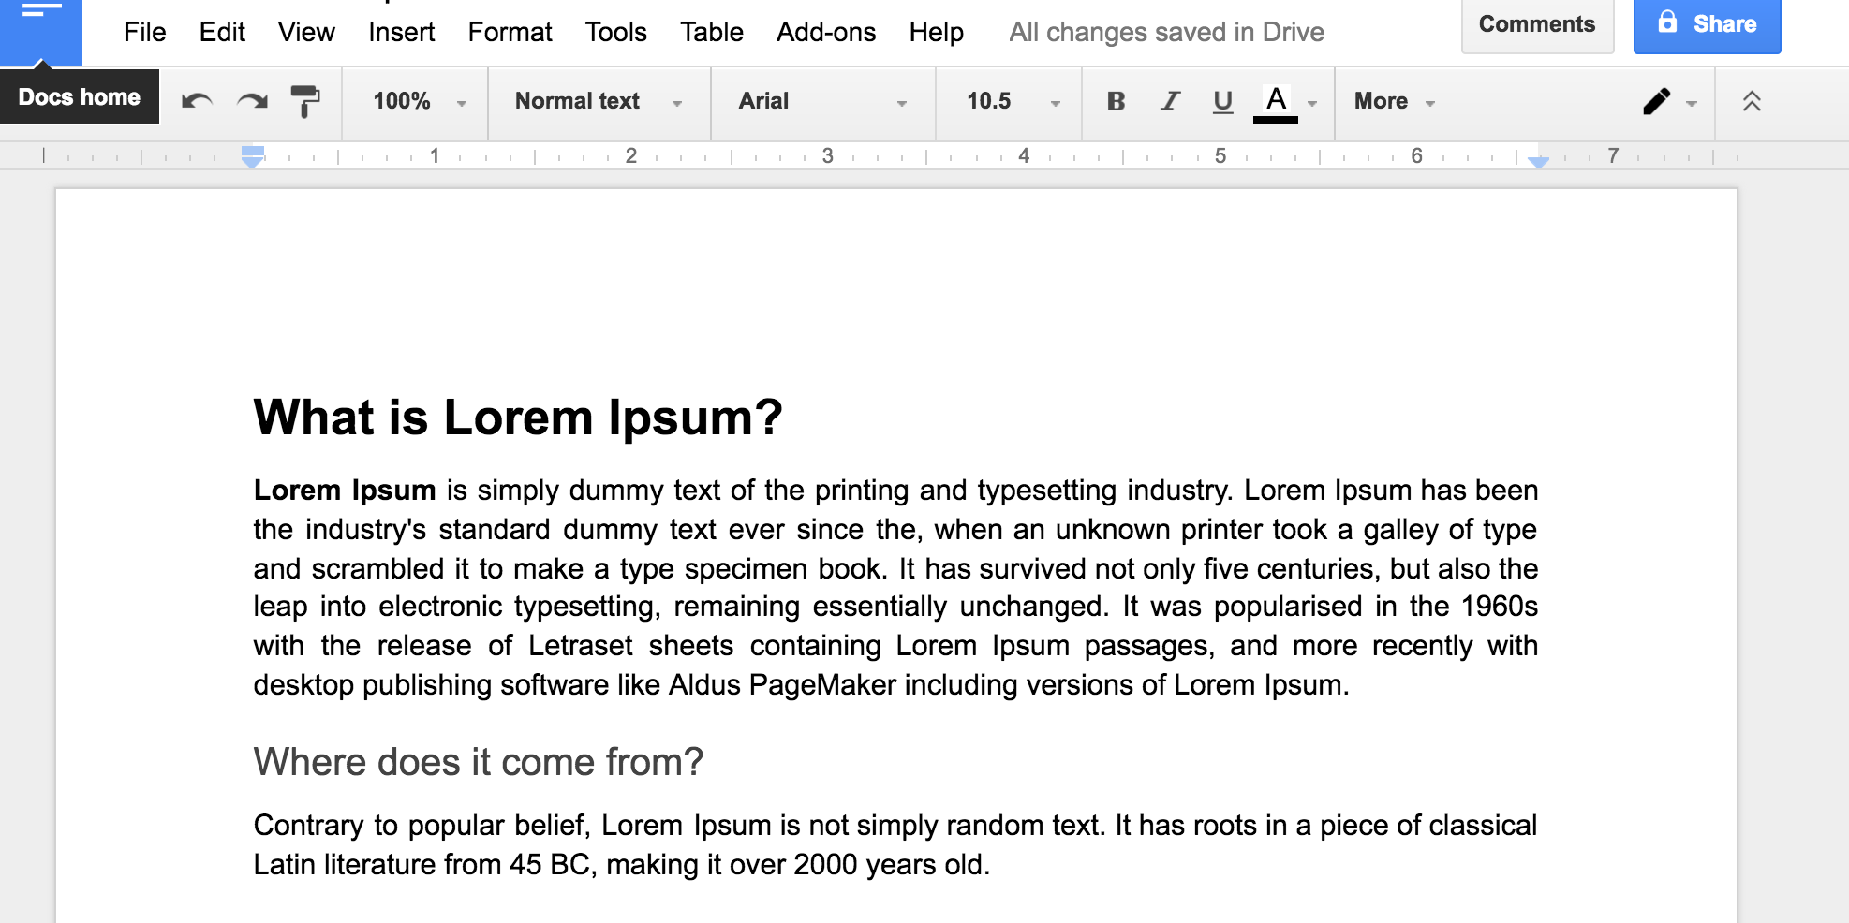
Consider shared word processing
How do I insert a new word?
Send entire doc to server? Not efficient
Send update operation!

Slide 8
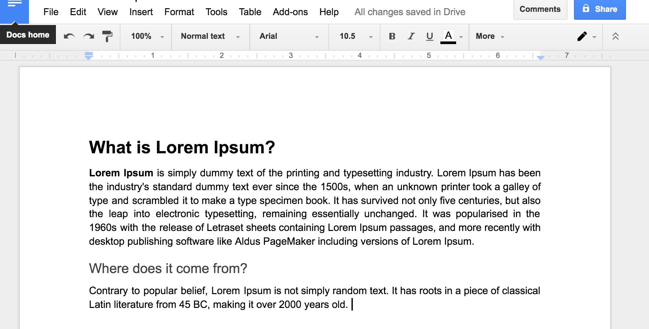
Consider shared word processing
How do I insert a new word?
Send entire doc to server? Not efficient
Send update operation! insert (string, position) = insert(“1500s”, 166)
Warning: Insert (rather than replace) shifted position of all following text

Slide 9
Operations must be commutative
$40
A
Withdraw
$10
Deposit
$15
Insert
(“1500s”, 166)
Delete
(1, 0)
$30
$55
B
C
Deposit
$15
Withdraw
$10
Delete
(1, 0)
[ delete 1 char as pos 0 ]
$45
D

Slide 10
Operations must be commutative
$40
A
Withdraw
$10
Deposit
$15
Insert
(“1500s”, 166)
Delete
(1, 0)
$30
$55
B
C
Deposit
$15
Withdraw
$10
Delete
(1, 0)
[ delete 1 char as pos 0 ]
Insert
(“1500s”, 166)
$45
D
PROBLEM!

Slide 11
Operations must be commutative
$40
A
Withdraw
$10
Deposit
$15
Insert
(“1500s”, 166)
Delete
(1, 0)
$30
$55
B
C
Deposit
$15
Withdraw
$10
Delete
(1, 0)
[ delete 1 char as pos 0 ]
Insert
(“1500s”, 165)
$45
D

Slide 12
Operations must be commutative
$40
A
Withdraw
$10
Deposit
$15
Insert
(“1500s”, 166)
Delete
(1, 0)
$30
$55
B
C
Deposit
$15
Withdraw
$10
$45
E
D
F
G
H

Slide 13
Operational Transformation (OT)
State of system is S, ops a and b performed by concurrently on state S
Different servers can apply concurrent ops in different sequential order
Server 1:
Receives a, applies a to state S: S ◎ a
Receives b (which is dependent on S, not S ◎ a )
Transforms b across all ops applied since S (namely a): b’ = OT( b, { a })
Applies b’ to state: S ◎ a ◎ b’
Server 2
Receives b, applies b to state: S ◎ b
Receives a, performs transformation a’ = OT( a, { b }),
Applies a’ to state: S ◎ b ◎ a’
Servers 1 and 2 have identical final states: S ◎ a ◎ b’ == S ◎ b ◎ a’

Slide 14
Operational Transformation (OT)
(Used in Google Docs, EtherPad, etc.)
Server
Alice
Bob
State:
ABCDE
State:
ABCDE
Ops:
ins “ABC”
ins “DE”
Ops:
ins “ABC”
ins “DE”

Slide 15
Operational Transformation (OT)
(Used in Google Docs, EtherPad, etc.)
Server
del 2
del 4
Alice
Bob
State:
ACDE
State:
ABCE
Ops:
ins “ABC”
ins “DE”
del 2
Ops:
ins “ABC”
ins “DE”
del 4

Slide 16
Operational Transformation (OT)
(Used in Google Docs, EtherPad, etc.)
Server
Alice
Bob
State:
ACD
State:
ACE
ins “ABC”
ins “DE”
del 2
del 4
ins “ABC”
ins “DE”
del 4
del 2
Ops:
Ops:
del 2

Slide 17
Operational Transformation (OT)
(Used in Google Docs, EtherPad, etc.)
Server
Alice
Bob
State:
ACE
State:
ACE
ins “ABC”
ins “DE”
del 2
del 4
ins “ABC”
ins “DE”
del 4
del 3
del 2
Ops:
Ops:
del 2
T
T
del 4
del 2

Slide 18
jump
jump
jump
jump

Slide 19
Intro to crypto in 15 minutes

Slide 20
What is Cryptography?
From Greek, meaning “secret writing”
Confidentiality: encrypt data to hide content
Include “signature” or “message authentication code”
Integrity: Message has not been modified
Authentication: Identify source of message
Modern encryption:
Algorithm public, key secret and provides security
Symmetric (shared secret) or asymmetric (public-private key)
encryption
decryption
plaintext
ciphertext
plaintext

Slide 21
Symmetric (Secret Key) Crypto
Sender and recipient share common key
Main challenge: How to distribute the key?
Provides dual use:
Confidentiality (encryption)
Message authentication + integrity (MAC)
1000x more computationally efficient than asymmetric

Slide 22
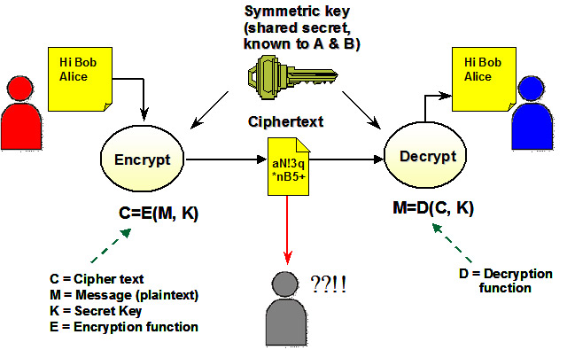
Symmetric Cipher Model

Slide 23
Public-Key Cryptography
Each party has (public key, private key)
Alice’s public key PK
Known by anybody
Bob uses PK to encrypt messages to Alice
Bob uses PK to verify signatures from Alice
Alice’s private/secret key: sk
Known only by Alice
Alice uses sk to decrypt ciphertexts sent to her
Alice uses sk to generate new signatures on messages

Slide 24
Public-Key Cryptography
(PK, sk) = generateKey(keysize)
Encryption API
ciphertext = encrypt (message, PK)
message = decrypt (ciphertext, sk)
Digital signatures API
Signature = sign (message, sk)
isValid = verify (signature, message, PK)

Slide 25
(Simple) RSA Algorithm
Generating a key:
Generate composite n = p * q, where p and q are secret primes
Pick public exponent e
Solve for secret exponent d in d⋅e ≡ 1 (mod (p -1) (q – 1))
Public key = (e, n), private key = d
Encrypting message m: c = m^{e} mod n
Decrypting ciphertext c: m = c^{d} mod n
Security due to cost of factoring large numbers
Finding (p,q) given n takes O(e ^{log n log log n}) operations
n chosen to be 2048 or 4096 bits long

Slide 26
Cryptographic hash function
( and using them in systems )

Slide 27
Cryptography Hash Functions I
Take message m of arbitrary length and produces fixed-size (short) number H(m)
One-way function
Efficient: Easy to compute H(m)
Hiding property: Hard to find an m, given H(m)
Assumes “m” has sufficient entropy, not just {“heads”, “tails”}
Random: Often assumes for output to “look” random
Notes:
Balls and bins analogy: weak collision is finding a collision on a SPECIFIC bin (the "m"), strong collision is finding a collision on ANY bin.

Slide 28
Cryptography Hash Functions II
Collisions exist: | possible inputs | >> | possible outputs | … but hard to find
Collision resistance:
Strong resistance: Find any m != m’ such that H(m) == H(m’)
Weak resistance: Given m, find m’ such that H(m) == H(m’)
For 160-bit hash (SHA-1)
Finding any collision is birthday paradox: 2^{160/2} = 2^80
Finding specific collision requires 2^160
Notes:
Balls and bins analogy: weak collision is finding a collision on a SPECIFIC bin (the "m"), strong collision is finding a collision on ANY bin.

Slide 29
Example use #1: Passwords
Can’t store passwords in a file that could be read
Concerned with insider attacks / break-ins
Must compare typed passwords to stored passwords
Does H (input) == H (password) ?
Memory cheap: build table of all likely password hashes?
Use “salt” to compute h = H (password || salt)
Store salt as plaintext in password file, not a secret
Then check whether H (input, salt) == h
Notes:
A salt is random data that is used as an additional input to a one-way function that hashes a password or passphrase. The primary function of salts is to defend against dictionary attacks and pre-computed rainbow table attacks.
A new salt is randomly generated for each password. In a typical setting, the salt and the password are concatenated and processed with a cryptographic hash function, and the resulting output (but not the original password) is stored with the salt in a database. Hashing allows for later authentication while defending against compromise of the plaintext password in the event that the database is somehow compromised.

Slide 30
Hash Pointers
h = H( )
(data)

Slide 31
Self-certifying names
F_{name} = H( )
(data)
P2P file sharing software (e.g., Limewire)
File named by F_{name} = H (data)
Participants verify that H (downloaded) == F_{name}

Slide 32
Self-certifying names
C_{name} = H( )
H( )
H( )
H( )
H( )
chunk
chunk
chunk
chunk
chunk
BitTorrent
Large file split into smaller chunks (~256KB each)
Torrent file specifies the name/hash of each chunk
Participants verify that H (downloaded) == C_{name}
Security relies on getting torrent file from trustworthy source

Slide 33
Hash chains
H( )
prev: H( )
prev: H( )
prev: H( )
data
data
data
Creates a “tamper-evident” log of data

Slide 34
Hash chains
H( )
prev: H( )
prev: H( )
prev: H( )
data
data
data
If data changes, all subsequent hash pointers change
Otherwise, found a hash collision!

Slide 35
merge
merge
merge
merge

Slide 36
Untrusted Cloud Storage
Operational Transformation
+
Hash Chains & Digital Signatures
+
Fork* Linearizability

Slide 37
SPORC: Group Collaboration using Untrusted Cloud Resources
Ariel J. Feldman, William P. Zeller, Michael J. Freedman, Edward W. Felten
OSDI 2010

Slide 38
SPORC goals
Practical cloud apps
Flexible framework
Real-time collaboration
Work offline
Untrusted servers
Can’t read user data
Can’t tamper with user data without risking detection
Clients can recover from tampering

Slide 39
Making servers untrusted
Server
State
App logic
Server
Client 1
Client 2
App logic
App logic
Client

Slide 40
Making servers untrusted
Server
SPORC Server’s limited role:
Storage
Ordering msgs
Encrypted
state
App logic
Client 1
Client 2
Copy of state
Copy of state
App logic
App logic
Client
App logic
App logic

Slide 41
Problem #1
How do you keep clients’ local copies consistent?
(esp. with offline access)
Server
Encrypted
state
A
Insert
(“1500s”, 166)
Delete
(1, 0)
B
C
Delete
(1, 0)
Insert
(“1500s”, 165)
D
Client 1
Client 2
Copy of state
Copy of state
App logic
App logic
Client

Slide 42
Problem #2:
How do you deal with a malicious server?
Server
Encrypted
state
Client 1
Client 2
Copy of state
Copy of state
App logic
App logic
Client

Slide 43
Dealing with a malicious server
Digital signatures aren’t enough
Server can equivocate
Server
fork* consistency [LM07]
Honest server: linearizability
Malicious server: Alice and Bob detect equivocation after exchanging 2 messages
Embed hash chain in every msg
A
B
C
C
A
Client
Client
Server can still fork the clients, but can’t unfork

Slide 44
System design
Client app
Local
state
SPORC lib

Slide 45
System design
Client app
Local
state
Committed
Pending
fork*
consistent
causally
consistent
SPORC lib

Slide 46
System design
Client app
Local
state
Server
Encrypted state
Committed
Pending
Encrypt & sign
SPORC lib

Slide 47
System design
Client app
Local
state
Server
Encrypted state
Committed
Pending
Compare history hash chains
Verify & decrypt
Client
SPORC lib

Slide 48
System design
Client app
Local
state
Server
Encrypted state
Committed
Pending
If op_{k} depends on op_{i} , it includes
H(op_{i} || H(op_{i-1} || H(op_{i-2} …))
Possible as ops sequentially ordered by server
Compare history hash chains
Verify & decrypt
Client
SPORC lib

Slide 49
System design
Client app
Local
state
Server
Encrypted state
Committed
Pending
T
Decrypt & verify
Client
SPORC lib

Slide 50
System design
Client app
Local
state
Server
Encrypted state
Committed
Pending
T
Client
SPORC lib

Slide 51
Recovering from a fork
Alice’s history:
Fork!
Bob’s history:
Can use OT to resolve malicious forks too

Slide 52
Access control
Challenges
Server can’t do it — it’s untrusted!
Preserving causality
Concurrency makes it harder
Encrypted
state
Solutions
Ops encrypted with symmetric key shared by clients
ACL changes are ops too
Concurrent ACL changes handled with barriers

Slide 53
Summary
Concurrent operations in eventual-/casual-consistent systems introduce conflicts
OT provides general way to merge conflicting ops
Newer, more powerful techniques: CRDTs
Collision resistance in cryptographic hashes can be leveraged to ensure data integrity
Used in variety of settings. Key idea in Bitcoin!

Slide 54
Monday lecture
Bitcoin
and blockchains
and consensus,
oh my!

