Slide 1
Distributed Systems
COS 418: Distributed Systems
Lecture 1
Mike Freedman

Slide 2
Backrub (Google) 1997

Slide 3
Google 2012

Slide 4
“The Cloud” is not amorphous

Slide 5
Microsoft

Slide 6
Google

Slide 7
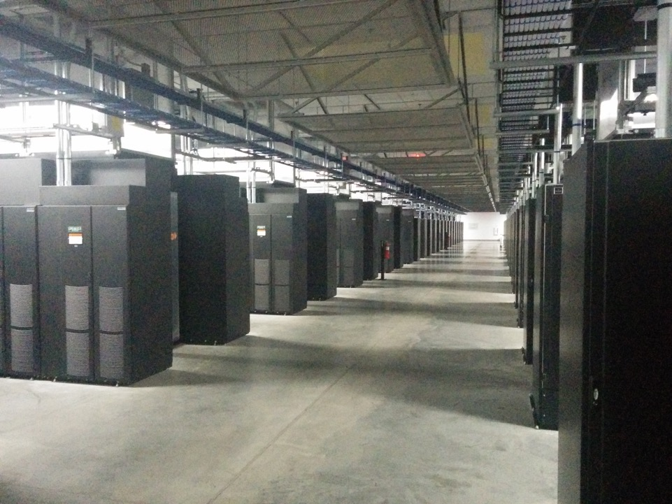
Facebook

Slide 8
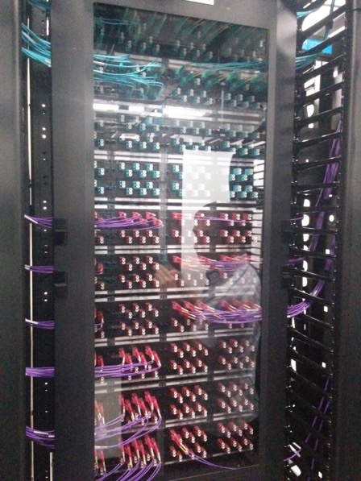
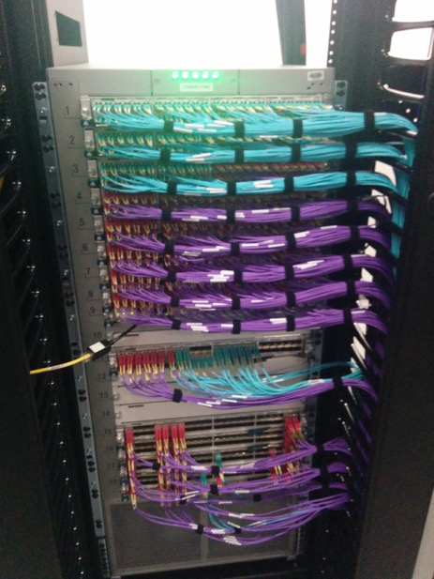

Slide 9
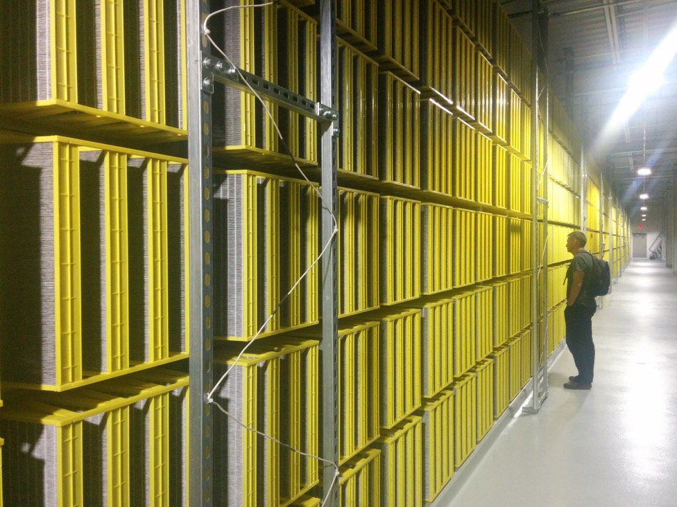

Slide 10
100,000s of physical servers
10s MW energy consumption
Facebook Prineville:
$250M physical infro, $1B IT infra

Slide 11
Everything changes at scale
“Pods provide 7.68Tbps to backplane”

Slide 12
The goal of “distributed systems”
Service with higher-level abstractions/interface
e.g., file system, database, key-value store, programming model, RESTful web service, …
Hide complexity
Scalable (scale-out)
Reliable (fault-tolerant)
Well-defined semantics (consistent)
Security
Do “heavy lifting” so app developer doesn’t need to

Slide 13
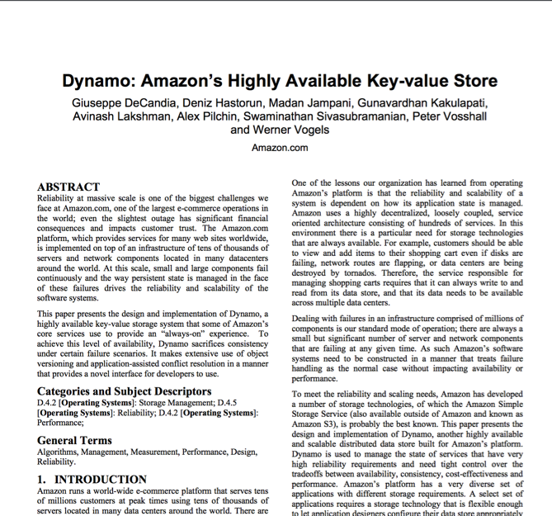
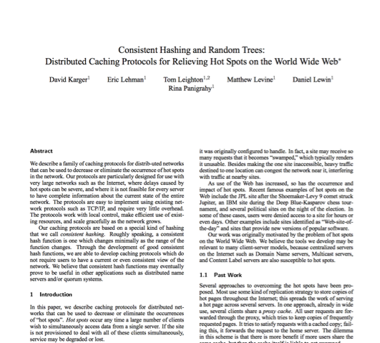
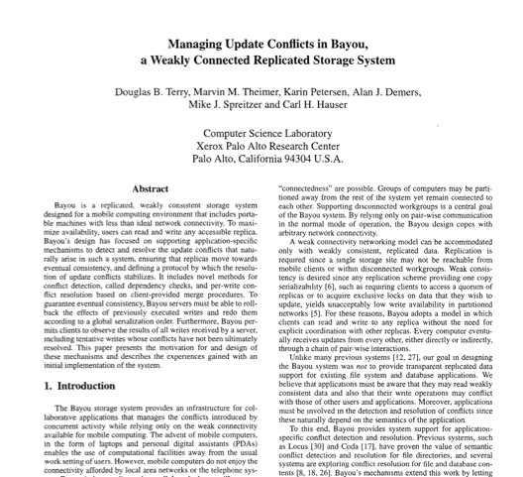
Research results matter: NoSQL
Notes:
NoSQL:
Consistent hash tables
+ consistency tradeoffs (e.g., eventual)
Amazon Dynamo popularized (published SOSP 2007), CTO was faculty at Cornell on distributed systems

Slide 14
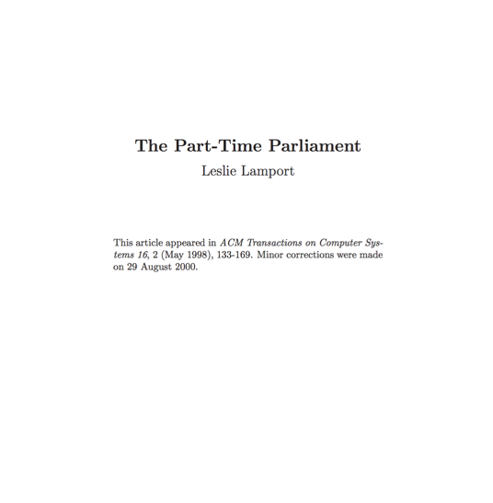
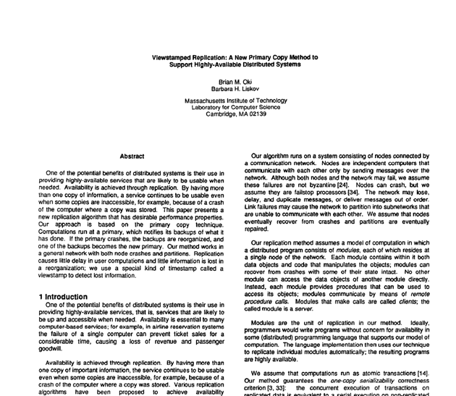
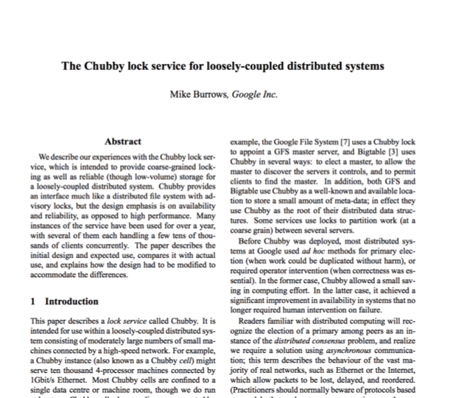
Research results matter: Paxos
Notes:
Paxos
Long history starting in early 1990s on “reaching consensus in distributed systems”
Google Chubby
Coordinate datacenters at scale
When a file server fails, who takes over?
Authors for industrial research labs and academia (DEC SRC, Cambridge/UW, etc.)
Led to open-source Apache Zookeeper

Slide 15
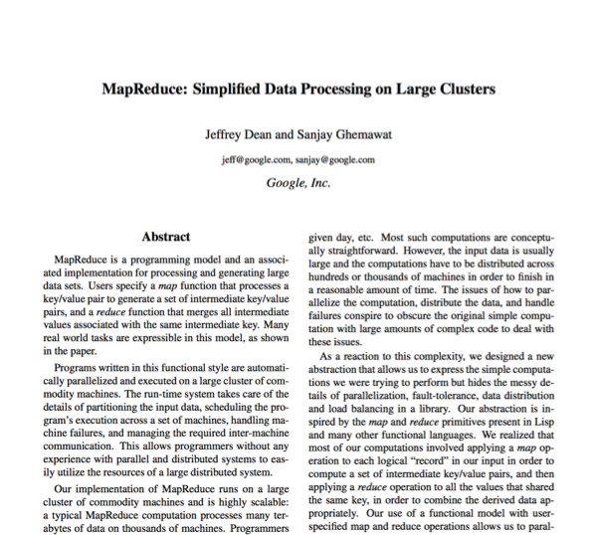
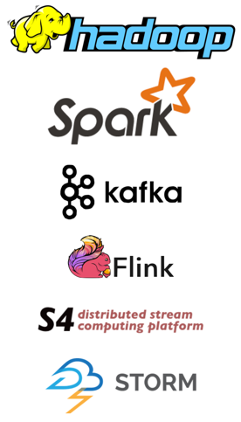
Research results matter: MapReduce
Notes:
Google MapReduce
How to process large volumes of data over 1000s of servers, even in face of failures
Authors for industrial research labs and academia (DEC WRL, MIT/UW, etc.)
Led to open-source Apache Hadoop
Created Big Data industry…

Slide 16
Course Organization

Slide 17
Learning the material: People
Lecture
Professors Mike Freedman, Kyle Jamieson
Slides available on course website
Office hours immediately after lecture
Precept:
TAs Themis Melissaris, Daniel Suo
Main Q&A forum: www.piazza.com
Graded on class participation: so ask & answer!
No anonymous posts or questions
Can send private messages to instructors

Slide 18
Learning the Material: Books
Lecture notes!
No required textbooks.
Programming reference:
The Go Programming Language, Alan Donovan and Brian Kernighan (www.gopl.io, $17 Amazon!)
Topic reference:
Distributed Systems: Principles and Paradigms. Andrew S. Tanenbaum and Maaten Van Steen
Guide to Reliable Distributed Systems. Kenneth Birman

Slide 19
Grading
Five assignments (5% for first, then 10% each)
90% 24 hours late, 80% 2 days late, 50% >5 days late
THREE free late days (we’ll figure which one is best)
Only failing grades I’ve given are for students who don’t (try to) do assignments
Two exams (50% total)
Midterm exam before spring break (25%)
Final exam during exam period (25%)
Class participation (5%)
In lecture, precept, and Piazza

Slide 20
Policies: Write Your Own Code
Programming is an individual creative process. At first, discussions with friends is fine. When writing code, however, the program must be your own work.
Do not copy another person’s programs, comments, README description, or any part of submitted assignment. This includes character-by-character transliteration but also derivative works. Cannot use another’s code, etc. even while “citing” them.
Writing code for use by another or using another’s code is academic fraud in context of coursework.
Do not publish your code e.g., on github, during/after course!

Slide 21
Assignment 1
Learn how to program in Go
Implement “sequential” Map/Reduce
Instructions on assignment web page
Due September 28 (two weeks)

Slide 22
meClickers®: Quick Surveys
Why are you here?
Needed to satisfy course requirements
Want to learn Go or distributed programming
Interested in concepts behind distributed systems
Thought this course was “Bridges”

Slide 23
Case Study: MapReduce
(Data-parallel programming at scale)

Slide 24
Application: Word Count
SELECT count(word) FROM data
GROUP BY word
cat data.txt
| tr -s '[[:punct:][:space:]]' '\n'
| sort | uniq -c

Slide 25
Using partial aggregation
Compute word counts from individual files
Then merge intermediate output
Compute word count on merged outputs

Slide 26
Using partial aggregation
In parallel, send to worker:
Compute word counts from individual files
Collect result, wait until all finished
Then merge intermediate output
Compute word count on merged intermediates

Slide 27
MapReduce: Programming Interface
map(key, value) -> list(<k’, v’>)
Apply function to (key, value) pair and produces set of intermediate pairs
reduce(key, list<value>) -> <k’, v’>
Applies aggregation function to values
Outputs result

Slide 28
MapReduce: Programming Interface
map(key, value):
for each word w in value:
EmitIntermediate(w, "1");
reduce(key, list(values):
int result = 0;
for each v in values:
result += ParseInt(v);
Emit(AsString(result));

Slide 29
MapReduce: Optimizations
combine(list<key, value>) -> list<k,v>
Perform partial aggregation on mapper node:
<the, 1>, <the, 1>, <the, 1> → <the, 3>
reduce() should be commutative and associative
partition(key, int) -> int
Need to aggregate intermediate vals with same key
Given n partitions, map key to partition 0 ≤ i < n
Typically via hash(key) mod n

Slide 30
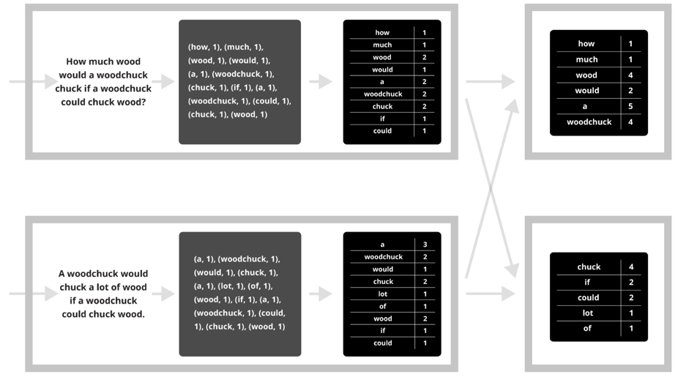
Putting it together…
map
combine
partition
reduce

Slide 31
Synchronization Barrier

Slide 32
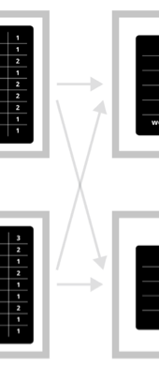
Fault Tolerance in MapReduce
Map worker writes intermediate output to local disk, separated by partitioning. Once completed, tells master node.
Reduce worker told of location of map task outputs, pulls their partition’s data from each mapper, execute function across data
Note:
“All-to-all” shuffle b/w mappers and reducers
Written to disk (“materialized”) b/w each stage

Slide 33
Fault Tolerance in MapReduce
Master node monitors state of system
If master failures, job aborts and client notified
Map worker failure
Both in-progress/completed tasks marked as idle
Reduce workers notified when map task is re-executed on another map worker
Reducer worker failure
In-progress tasks are reset to idle (and re-executed)
Completed tasks had been written to global file system

Slide 34
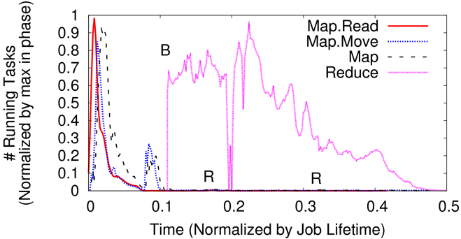
Straggler Mitigation in MapReduce
Tail latency means some workers finish late
For slow map tasks, execute in parallel on second map worker as “backup”, race to complete task

Slide 35
You’ll build (simplified) MapReduce!
Assignment 1: Sequential Map/Reduce
Learn to program in Go!
Due September 28 (two weeks)
Assignment 2: Distributed Map/Reduce
Learn Go’s concurrency, network I/O, and RPCs
Due October 19

Slide 36
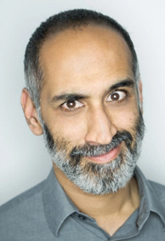
This Friday “Grouped” Precept, Room CS 105
“Program your next service in Go”
Sameer Ajmani
Manages Go lang team @ Google
(Earlier: PhD w/ Barbara Liskov @ MIT)

