Slide 1
Cluster computing for Big Data, and MapReduce
Kai Li
Computer Science Department
Princeton University
(COS 521 guest lecture, Fall 2014)

Slide 2
Parallel Computing
Moore’s law has slowed, with no solution in sight.
Only way to handle big data computations: use multiple processors (ubiquitous in scientific computing, data centers)
New challenges in systems/architecture/algorithms

Slide 3
Types of Parallel Systems
Shared-memory multiprocessors
Multiple processors operate on the same memory; explicit mechanisms for handling conflicting updates.
Up to 512 CPU chips
Message-passing supercomputers (multicomputers)
Distributed memory with fast interconnection network. ( Each processor controls its own memory; usually custom design )
Commodity clusters
Network of off-the-shelf processors.
Google estimated to have > 1M servers in 2011, 2-4M CPUs, ~20PB Mem, >1EB storage

Slide 4
Programming with Shared Memory
Threads (e.g. POSIX)
Built-in a language or library
Shared data, synchronizing among threads (monitors, PV, etc)
OpenMP
APIs and compiler directive
Shared data, synchronizing threads via barriers
Share any complex structures
Relatively easy to program
Assume no hardware failures

Slide 5
Programming with Message Passing
MPI (Message Passing Interface)
APIs for data movements among different nodes
Send and receive imply synchronizations
Pros and cons
Scale to a large number of nodes
Checkpoint/Recovery to deal with failures
Difficult to move trees, graphs, and complex data

Slide 6
Commodity Clusters
Web datasets are big
Perabytes to Exabytes
Cannot process on a single server
“grep …” will take decades to return
Standard architecture
Cluster of commodity nodes
Commodity LAN interconnect
Main Issue:
Need to deal with failures (hardware, software)
Notes:
On the software side: what is the programming model?
On the hardware side: how to deal with failures – hardware and data corruption?

Slide 7
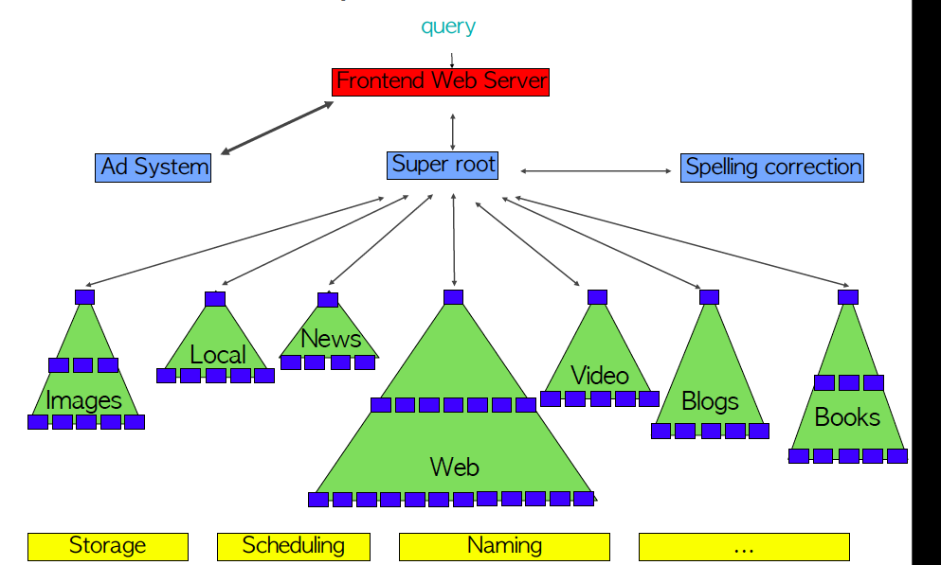
Google Infrastructure (from Jeff Dean)

Slide 8
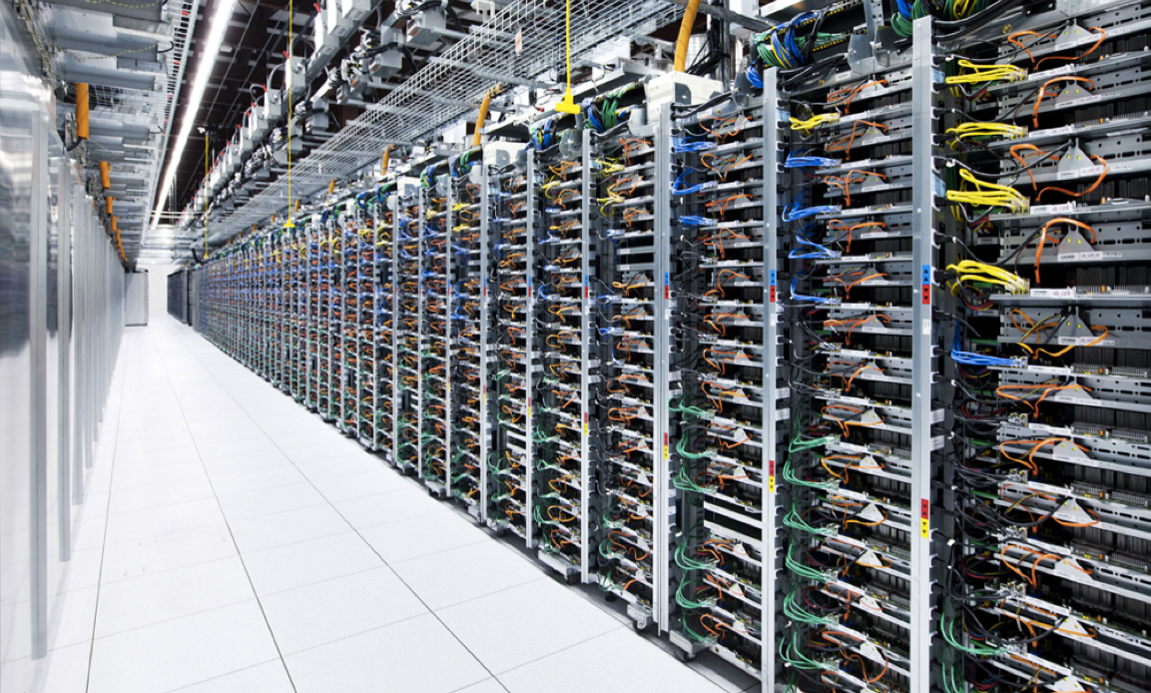
A Data Center for Big Data

Slide 9
A Cluster for Big Data
Racks of commodity servers
Each rack
LAN switch
Commodity servers
Each server
CPUs, Memory, disks
Commodity OS (e.g. Linux)
10-100Gbits
Switch
1-10Gbits
Switch
Switch
Switch
Node
Node
Node
Node
Node
Node
Node
Node
…
Node
Node
Node
Node
Node
Node
Node
Node
Node
Node
Node
Node
Node
Linux
Node
Node
Node
Node
Node
Node
CPUs
Node
Node
Node
MEM
Node
Node
Node
Node
Node
Node
No physically shared memory or shared storage
Many things can fail

Slide 10
Failures at Google
First year for a new cluster (Jeff Dean):
1 network rewiring: ~5% machines down for ~2 days
~20 racks failures: 40-80 nodes disappear, 1-6 hours
~5 racks go wonky (50% packet loss on 40-80 nodes)
~1,000 individual node failures
thousands disk failures
…
Reliability/availability must comes from Software

Slide 11
Replication
Data loss
Replicate data on multiple disks/machines
Geoplex
Slow nodes
Replicate the computation (MapReduce)
Too much workload
Replicate for better throughput
Long latency
Utilize replicas to improve latency
Utilize placement of data

Slide 12
Goals
Node
Node
Node
Node
Node
Node
Node
Node
Node
Node
Node
Node
Node
Node
Node
Node
Node
Node
Node
Node
Node
Node
Node
Node
Node
Node
Node
Node
Node
Node
Node
Node
Node
Node
Node
Node
Node
Node
Node
Node
Node
Node
Node
Node
Node
Node
Node
Node
Shared Data
Shared data storage
Run your program on any number of nodes
Get linear speedup
Tolerate node failures

Slide 13
Modern Software Stack
Google’s cluster services
GFS/Colossus: reliable cluster-level file system
MapReduce: reliable large-scale computations
Cluster scheduling (WorkQueue): abstracted nodes
BigTable: scaling of high-level structured storage
Open source alternatives: Hadoop, SPARK, etc.
…
Notes:
DFS: provides a unified view of the file system and hides the details of replication and consistency management

Slide 14
Rest of this lecture
MapReduce: Google’s programming interface (evolved from older functional programming, databases etc.)
Easy to pick up
Hard to master
Issues of data replication, processor failure/retry etc. abstracted away from programmer (consequence: no guarantee on running time)
Well-suited for some tasks; highly inefficient for others
“MapReduce: Simplified Data Processing on Large Clusters”[ Dean, Ghemawat 2004]
(for critical view see: [DeWitt, Stonebraker 2008])

Slide 15
MapReduce in High-Level Langauges
APL
+/ N × N ⬅ 1 2 3 4
Lisp
(map square ‘(1 2 3 4)) = (1 4 9 16)
(reduce plus ‘(1 4 9 16)) = 30

Slide 16
Word Count Example
A large file of words
Count the number of times each distinct word appears in the file
<word₁, count₁>
<word₂, count₂>
…
Possible application
Analyze web server logs to find popular URLs

Slide 17
Word Count, cont’d
Entire file fits in memory
Easy to implement
File too large for memory
All <word, count> pairs fit in memory
File too large for memory, <word,count> pairs won’t fit in memory
One word on each line, then
sort bigdatafile | uniq -c
Notes:
How can file size be too large to fit into memory but wc-pairs can?
All files? Stop-words filtered out?
Single machine adequate for this kind of processing
---
http://www.softpanorama.org/Tools/uniq.shtml
Syntax
uniq [ -cdu [ +n ][ -n ][ input [ output ] ] Options
-c Precedes each line with a count of the number of times it occurred in the input.
-d Deletes duplicate copies. Only one line out of a set of repeated lines is displayed.
-u Displays only lines not duplicated (uniq lines).
-n Ignores the first n fields of an input line when comparing for duplicate lines. A field is a string of nonblank characters. A blank is a space or tab.
+n Ignores the first n characters of an input line when comparing for duplicate lines.

Slide 18
Word Count, cont’d
There are many documents
Count the number of times each distinct word occurs in all the documents
words(docs/*) | sort | uniq –c
words inputs a file and outputs the words in it, one on each a line
Very parallelizable and require a lot of work
MapReduce

Slide 19
Map Example
Map input
Worker 1: “Alice sees Bob”
Worker 2: “Bob sees Cindy”
Worker 3: “Cindy sees David”
Map output:
Worker 1: (<Alice 1>, <sees 1>, <Bob 1>)
Worker 2: (<Bob 1>, <sees 1>, <Cindy 1>)
Worker 3: (<Cindy 1>, <sees 1>, <David 1>)

Slide 20
Reduce Example
Reduce Input
Worker 1: (<Alice 1>)
Worker 2: (<sees 1>, <sees 1>, <sees 1>)
Worker 3: (<Bob 1>, <Bob 1>)
Worker 4: (<Cindy 1>, <Cindy 1>)
Worker 5: (<David 1>)
Reduce output
(<Alice 1>, <sees 3>, <Bob 2>, <Cindy 2>, <David 1>)

Slide 21
Example Applications using MapReduce
Distributed grep
Count of URL access frequency
Web-link graph reversal
Term-vector/host
Inverted index
Distributed sort

Slide 22
MapReduce (behind the scenes)
Input are stored in a distributed file system
Global name space (e.g. GFS or HDFS)
Scheduler distributes map tasks to nodes near data
Move compute to data
Map outputs are stored locally
Perhaps locally to Reduce workers
Again, move compute to data
Reduce output goes to the distributed file system
Global name space
May be the input to another MapReduce

