Slide 1
Data-Center Traffic Management
COS 597E: Software Defined Networking
Jennifer Rexford
Princeton University
MW 11:00am-12:20pm

Slide 2
Cloud Computing

Slide 3
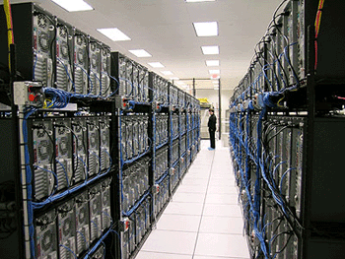
Cloud Computing
Elastic resources
Expand and contract resources
Pay-per-use
Infrastructure on demand
Multi-tenancy
Multiple independent users
Security and resource isolation
Amortize the cost of the (shared) infrastructure
Flexible service management

Slide 4
Cloud Service Models
Software as a Service
Provider licenses applications to users as a service
E.g., customer relationship management, e-mail, …
Avoid costs of installation, maintenance, patches…
Platform as a Service
Provider offers platform for building applications
E.g., Google’s App-Engine
Avoid worrying about scalability of platform

Slide 5
Cloud Service Models
Infrastructure as a Service
Provider offers raw computing, storage, and network
E.g., Amazon’s Elastic Computing Cloud (EC2)
Avoid buying servers and estimating resource needs

Slide 6
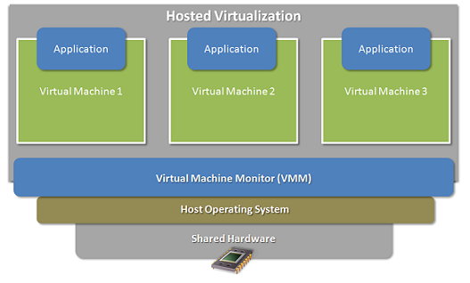
Enabling Technology: Virtualization
Multiple virtual machines on one physical machine
Applications run unmodified as on real machine
VM can migrate from one computer to another

Slide 7
Multi-Tier Applications
Applications consist of tasks
Many separate components
Running on different machines
Commodity computers
Many general-purpose computers
Not one big mainframe
Easier scaling

Slide 8
Multi-Tier Applications
Front end Server
Aggregator
… …
Aggregator
Aggregator
Aggregator
…
…
Worker
Worker
Worker
Worker
Worker

Slide 9
Data Center Network

Slide 10
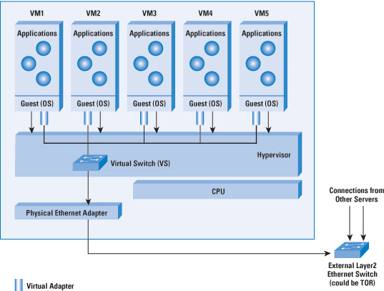
Virtual Switch in Server

Slide 11
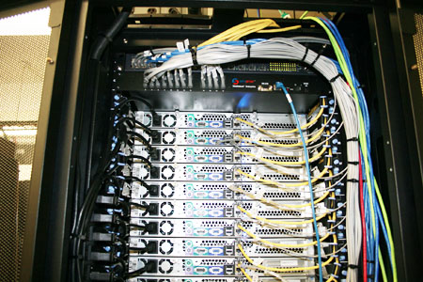
Top-of-Rack Architecture
Rack of servers
Commodity servers
And top-of-rack switch
Modular design
Preconfigured racks
Power, network, and storage cabling

Slide 12
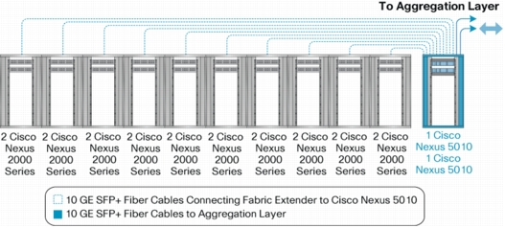
Aggregate to the Next Level

Slide 13
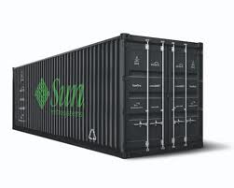
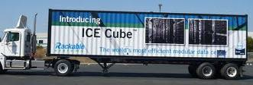
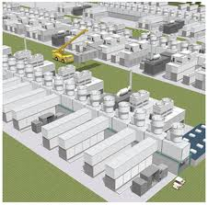
Modularity, Modularity, Modularity
Containers
Many containers

Slide 14
Data Center Network Topology
Internet
CR
CR
. . .
AR
AR
AR
AR
S
S
S
S
S
S
. . .
A
A
…
A
A
A
…
A
Key
CR = Core Router
AR = Access Router
S = Ethernet Switch
A = Rack of app. servers
~ 1,000 servers/pod

Slide 15
Capacity Mismatch
CR
CR
~ 200:1
AR
AR
AR
AR
S
S
S
S
~ 40:1
S
S
S
S
. . .
S
S
S
S
~ 5:1
A
A
…
A
A
A
…
A
A
A
…
A
A
A
…
A

Slide 16
Data-Center Routing
Internet
CR
CR
DC-Layer 3
. . .
AR
AR
AR
AR
DC-Layer 2
S
S
S
S
S
S
S
S
. . .
S
S
S
S
A
A
…
A
A
A
…
A
Key
CR = Core Router (L3)
AR = Access Router (L3)
S = Ethernet Switch (L2)
A = Rack of app. servers
~ 1,000 servers/pod == IP subnet

Slide 17
Traffic Management
Hedera and HONE

Slide 18
Traffic Management Challenges
High volumes of “east-west traffic”
Low bisection bandwidth
Volatile traffic patterns
Elephant flows
TCP incast
Naïve application programmers
Performance problems due to stragglers
Difficulty of collecting measurement data

Slide 19
Traffic Management Opportunities
Low latencies within the data center
Small TCP round-trip times
Easier to use central controller
End-to-end control
Applications, servers, and switches
Greater visibility
Monitoring on the end hosts and soft switches
Green-field deployments
VM placement and migration
Simple, symmetric topologies

Slide 20
Discussion
Granularity of monitoring and control
Individual flows?
Larger traffic aggregates?
End host vs. network
Where to measure?
Where to exercise control?
Integrating end hosts with the controller

