Slide 1
Testing and Debugging
COS 597E: Software Defined Networking
Jennifer Rexford
Princeton University
MW 11:00am-12:20pm

Slide 2
Challenges for SDN Programmers

Slide 3
SDN Enables New Functionality
Application
Network OS
OpenFlow
Switch
Switch
Switch

Slide 4


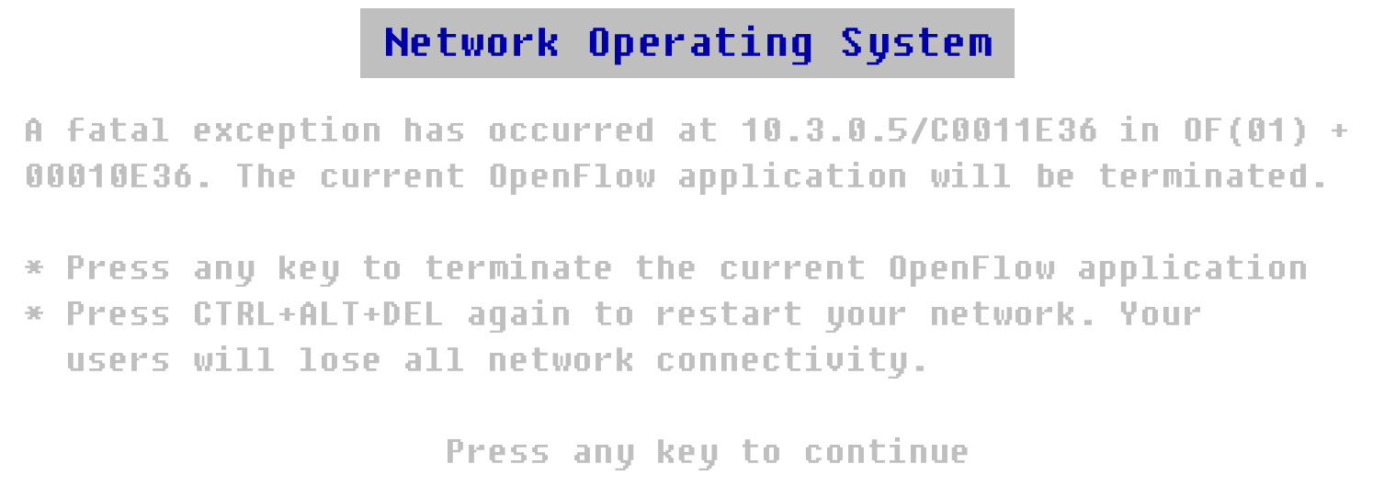
… at the Risk of Bugs

Slide 5
MAC-Learning Application
Packet-In Event Handler
mactable[srcmac] = inport
if (dstmac is broadcast address)
flood packet
else if (dstmac is in mactable)
outport = mactable[dstmac]
install rule matching (inport, srcmac, dstmac)
with action of forwarding packet to outport
else
flood packet

Slide 6
Challenge #1: Two-Tiered Program
Two-tiered application
  Controller
  Switches
Rules in the switches
  Crucial for performance
  … but limits visibility
Example
  MAC learning bug from Monday’s class
  Matching on dstmac, without inport and srcmac
Application
Switch

Slide 7
Challenge #2: Control-Plane Delays
Common programming idiom
  First packet goes to the controller
  Controller application installs rules
packets

Slide 8
Challenge #3: Timing and Ordering
Multiple switches
  Different delays
Example
  Installing rules
  along a path
packets

Slide 9
Challenge #4: Overlapping Rules
Semantics of a rule depend on context
  Overlapping patterns
  Disambiguated by priorities
Example
  Initial rule matching srcip==12.1.0.0/16
  Add a rule matching srcip==12.0.0.0/8
Two scenarios
  Overlap: 12.1.0.0/16 with higher priority
  Shadowing: 12.0.0.0/8 with higher priority

Slide 10
Challenge #5: Conflicting Modules
Modular programs
  Multiple modules for different tasks
  E.g., firewall and routing
Routing
  Match(dstip=12.0.0.0/8) → forward(3)
Firewall
  Match(srcip=1.2.3.4, dstip=12.1.1.1) → drop
One rule may conflict with another

Slide 11
Challenge #6: Topologies
Many different network topologies
  Chain
  Tree
  Arbitrary graph
Program should work for all topologies
Example
  Program that (implicitly) assumes the graph has no cycles

Slide 12
Challenge #7: End-to-End Protocols
Internet applications are robust to errors
  Retransmission of lost packets
  Reordering of out-of-order packets
This can mask some bugs
  E.g., forgetting to handle the packet that triggered an event
  E.g., forgetting to handle packets that arrive before you install rules in the switches

Slide 13
Discussing the Papers
NICE and ndb

Slide 14
Testing vs. Debugging
Debugging
  Fixing a known problem in your program
  Locating and fixing bugs
  E.g., using tools like gdb
Testing
  Convincing yourself that your program (probably) works
  Systematically finding inputs that lead to incorrect outputs

Slide 15
Discussion
Debugging
  What debugging features are useful for SDN programmers?
  How can we exploit OpenFlow capabilities to support debugging?
Testing
  How to overcome the scalability challenges?
  How to detect performance bugs?
Preventing bugs
  How can we change the programming environment to prevent bugs?
  How can we change the programming environment to make testing easier?

Slide 16
MAC-Learning Application
Packet-In Event Handler
mactable[srcmac] = inport
if (dstmac is broadcast address)
flood packet
else if (dstmac is in mactable)
outport = mactable[dstmac]
install rule matching (inport, srcmac, dstmac)
with action of forwarding packet to outport
else
flood packet

