Slide 1
SDN Software Stack
COS 597E: Software Defined Networking
Jennifer Rexford
Princeton University
MW 11:00am-12:20pm

Slide 2
Background: Enterprise Networks and VLANs

Slide 3

Simple Enterprise Design
Single layer-two subnet
  Hubs and switches
  Gateway to the Internet
  Single IP address block
Local services
  DHCP
  DNS
DHCP
server
1.2.3.1
S
S
1.2.3.0/24
G
Internet
1.2.3.76
0.0.0.0/0
S
DNS
server
1.2.3.5
S
1.2.3.150

Slide 4
Limitations of Simple Design
Performance
  Spanning tree
Security
  No access control
  No isolation
Scalability
  Large switch tables
  Flooding overhead
  Broadcast (ARP, DHCP)
DHCP
server
1.2.3.1
S
S
1.2.3.0/24
G
Internet
1.2.3.76
0.0.0.0/0
S
DNS
server
1.2.3.5
S
1.2.3.150

Slide 5
Hybrid of Switches and Routers
1.2.3.0/26
Ethernet Bridging
- Flat addressing
- Self-learning
- Flooding
- Forwarding along a tree
R
R
IP Routing
- Hierarchical addressing
- Subnet configuration
- Host configuration
- Forwarding along shortest paths
R
Internet
1.2.3.192/26
R
1.2.3.128/26
R
1.2.3.64/26

Slide 6
Virtual Local Area Networks
Group related hosts
  Same company
  Same role (e.g., faculty vs. students)
  All WiFi users
Treat them as a single LAN
  Single IP address block
  Single broadcast domain
  No access control
Independent of their location
Rewire the network in software!

Slide 7
Example: Two VLANs
R
O
O
O
R
O
R
R
O
R
RO
O
R
O
R
O
R
Red VLAN and Orange VLAN
Switches forward traffic as needed

Slide 8
Making VLANs Work
Changing the Ethernet header
  Adding a field for a VLAN tag
  Implemented on the bridges/switches
  … but can interoperate with old Ethernet cards
Bridges/switches trunk links
  Say which VLANs are accessible via which interfaces
Approaches to mapping access links to VLANs
  Each interface has a VLAN “color”
  Each MAC address has a VLAN “color”

Slide 9
VLANs in SDN
Hybrid deployment
  VLAN for SDN adopters
  Remaining traffic using legacy protocols
Switch-controller communication
  Separate VLAN
  Using legacy protocols
Tagging of packets
  VLAN header as a virtual “tag” on packets

Slide 10
Server Virtualization and Virtual Switches

Slide 11
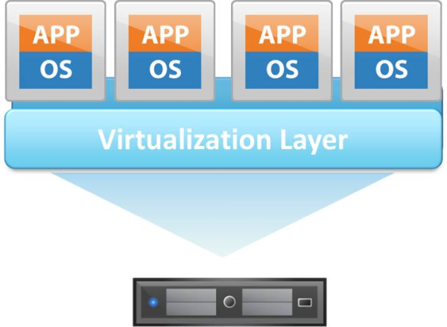
Virtual Machines (VMs)

Slide 12
Virtual Machine (VM)
Virtual machine
  Software implementation of a computer
  With interface identical to bare hardware
  Devices, interrupts, memory, page tables, etc.
Hypervisor (virtual machine monitor)
  Creates and runs virtual machines
  Manages execution of the guest OSes
  Subdivides the hardware resources
  Executes privileged instructions

Slide 13
Motivations for VMs
Diverse operating systems
  Running software for obsolete platforms
  Research, experimentation, and testing
Sharing a single host
  Server consolidation (lower cost, energy)
  Isolation of applications or customers/tenants
Fast provisioning of new servers
Snapshotting system state
  Backup and redeployment
  Migrating a VM to a different host machine
VM introspection
  Track configuration settings
  Identify configuration mistakes or compromises

Slide 14
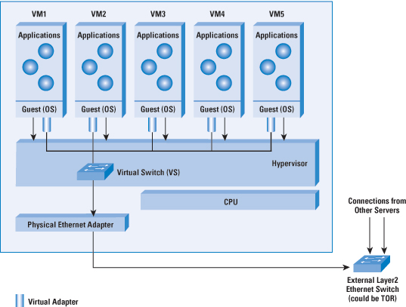
Virtual Switches

Slide 15
SDN Software Stack

Slide 16
SDN Software Stack
Application
Network OS
API
Switch
Switch
Switch

Slide 17
SDN Software Stack
Application
NOX
OpenFlow
OVS
OVS
OVS

Slide 18
Discussion
What is a good “division of labor”?
Good design for the protocol?
Good abstractions for the NOS?
How apt is the “operating system” analogy?
What parts of the system need standards?
What are interesting SDN applications?

