Slide 1
COS 597E: Software
Defined Networking
Jennifer Rexford
Princeton University
MW 11:00am-12:20pm

Slide 2
The State of Networking

Slide 3

The Internet: A Remarkable Story
Tremendous success
  From research experiment
  to global infrastructure
Brilliance of under-specifying
  Network: best-effort packet delivery
  Programmable hosts: arbitrary applications
Enables innovation
  Apps: Web, P2P, VoIP, social networks, …
  Links: Ethernet, fiber optics, WiFi, cellular, …

Slide 4
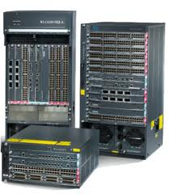
Inside the ‘Net: A Different Story…
Closed equipment
  Software bundled with hardware
  Vendor-specific interfaces
Over specified
  Slow protocol standardization
Few people can innovate
  Equipment vendors write the code
  Long delays to introduce new features

Slide 5
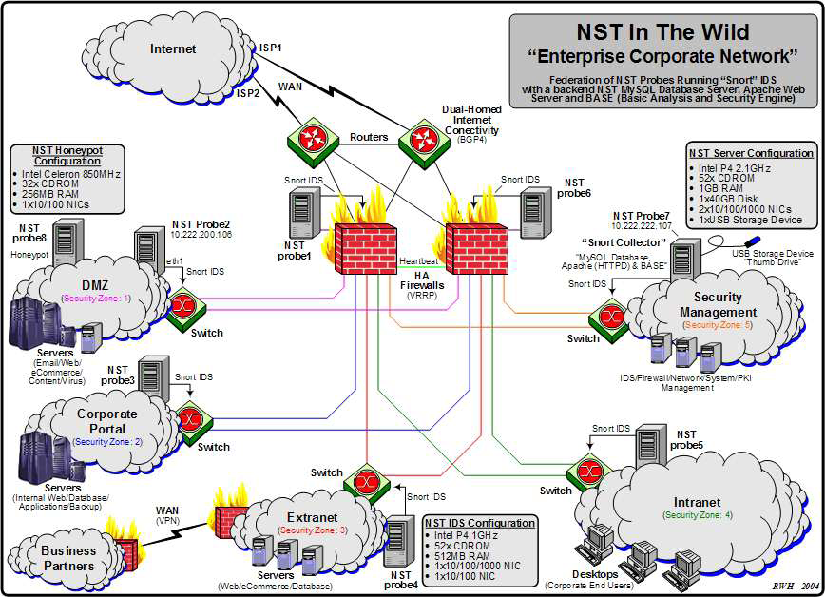
Do We Need Innovation Inside?
Many boxes (routers, switches, firewalls, …), with different interfaces.
Notes:
Enterprise network.

Slide 6
Do We Need Intellectual Progress?
Lots of domain details
  Plethora of protocols
  Heaps of header formats
  Big bunch of boxes
  Tons of tools
Teaching networking
  Practitioners: certification courses, on the job
  Undergraduates: how the Internet works

Slide 7
Software Defined Networking

Slide 8



Software Defined Networks
control plane: distributed algorithms
data plane: packet processing

Slide 9
Software Defined Networks
decouple control and data planes

Slide 10
Software Defined Networks
decouple control and data planes
by providing open standard API

Slide 11

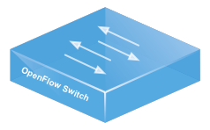
Simple, Open Data-Plane API
Prioritized list of rules
  Pattern: match packet header bits
  Actions: drop, forward, modify, send to controller
  Priority: disambiguate overlapping patterns
  Counters: #bytes and #packets
src=1.2.*.*, dest=3.4.5.* → drop
src = *.*.*.*, dest=3.4.*.* → forward(2)
3. src=10.1.2.3, dest=*.*.*.* → send to controller

Slide 12
(Logically) Centralized Controller
Controller Platform

Slide 13
Protocols ➔ Applications
Controller Application
Controller Platform

Slide 14


Seamless Mobility
See host sending traffic at new location
Modify rules to reroute the traffic

Slide 15
Server Load Balancing
Pre-install load-balancing policy
Split traffic based on source IP
10.0.0.1
src=0*,
dst=1.2.3.4
10.0.0.2
src=1*,
dst=1.2.3.4

Slide 16
Example SDN Applications
Seamless mobility and migration
Server load balancing
Dynamic access control
Using multiple wireless access points
Energy-efficient networking
Adaptive traffic monitoring
Denial-of-Service attack detection
Network virtualization
See http://www.openflow.org/videos/

Slide 17


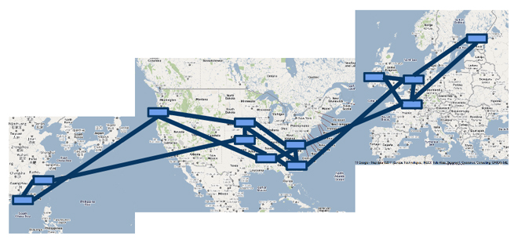

A Major Trend in Networking
Entire backbone
runs on SDN
Bought for $1.2 x 10⁹
(mostly cash)

Slide 18
An Opportunity to Rethink
How should future networks be
  Designed
  Managed
  Programmed
What are the right abstractions
  Simple
  Powerful
  Reusable

Slide 19
Structure of the Course

Slide 20
Syllabus
Introduction (3)
SDN abstractions (6)
SDN applications (4)
SDN systems challenges (4)
Enhancing the data plane (5)
Course wrap-up (2)

Slide 21
Paper Reading
Read ~2 papers for each class
  Recent research papers on SDN
  Basis for discussions in class
Write reviews (1 page each)
  Summary (problem, solution)
  What you like
  What could use improvement
  What you would do next
Upload reviews to CS Dropbox before class
See “How to Read” on today’s syllabus

Slide 22
Lightweight Assignments
Programming assignments
  MiniNet platform (due 5pm Mon Sep 16)
  Ryu controller (due 5pm Tue Oct 1)
  Pyretic language (due 5pm Fri Oct 11)
Assignments are not graded
Collaboration policy
  Can freely collaborate with others
  Each person should understand all material
Will help with your course project

Slide 23
Course Project
Final research project
  Work alone or in teams of 2-3
  Your own topic, or from a list we suggest
Schedule
  Talk to me (and others) about project ideas
  5pm Mon Oct 21: short proposal due
  5pm Tue Jan 14: written report due
  Later that week: short oral presentation

Slide 24
Grading
0% programming assignments
30% class participation
30% paper reviews
40% course project (paper, talk)

Slide 25
To Do
Next steps
  Join the Piazza site:https://piazza.com/princeton/fall2013/cos597e/home
  Complete assignment 1 (due Tuesday)
  Read and review 4D and Ethane papers
Brush up on basic Python programming
  http://docs.python.org/2/tutorial/
  http://www.greenteapress.com/thinkpython/html/index.html

Slide 26
Review of “How the Internet Works”

Slide 27
Why Review?
SDN interacts with “legacy” networks
  Unmodified end-host computers
  Hybrid deployments of SDN
  Connecting to non-SDN domains
SDN is a reaction to legacy networks
  Challenges of managing and changing them
General lessons on abstractions
  Practice talking about abstractions
  Some abstractions should be retained

Slide 28
Main Ideas
Best-effort packet delivery
Protocol layering for modularity
  Internet hourglass design
Relationships between layers
  Naming and addressing
  Directories and routing
Scalability
  Through hierarchy and indirection

Slide 29
Best-Effort Packet Switching
Packet switching
  Divide data into packets
  Packets travel separately
  Enables statistical multiplexing
Best-effort delivery
  Packets may be lost, delayed, out-of-order
  Simplify network design and failure handling
  Build timely, ordered, reliability delivery on top

Slide 30
Layering: Internet Protocol Stack
Application
Applications
Transport
Reliable streams
Messages
Network
Best-effort global packet delivery
Best-effort local packet delivery
Link

Slide 31
Layering: End-to-End
host
host
HTTP message
HTTP
HTTP
TCP segment
TCP
TCP
router
router
IP packet
IP packet
IP packet
IP
IP
IP
IP
Ethernet
interface
Ethernet
interface
SONET
interface
SONET
interface
Ethernet
interface
Ethernet
interface
Ethernet frame
SONET frame
Ethernet frame

Slide 32
Layering: Packet Encapsulation
Different devices switch different things
  Network layer: packets (routers)
  Link layer: frames (bridges and switches)
  Physical layer: electrical signals (repeaters and hubs)
Application
Transport
Frame
header
Packet
header
TCP
header
User
data
Router
Bridge, switch
Repeater, hub

Slide 33
Link Layer: Adaptors Communicating
packet
link layer protocol
packet
frame
frame
sending
node
adapter
adapter
receiving
node
Sending side
  Encapsulates packet
  in a frame
  Adds error checking bits, flow control, etc.
Receiving side
  Looks for errors, flow control, etc.
  Extracts datagram and passes to receiving node

Slide 34
Link Layer: Medium Access Control Address
MAC address (e.g., 00-15-C5-49-04-A9)
  Numerical address used within a link
  Unique, hard-coded in the adapter when it is built
  Flat name space of 48 bits
Hierarchical allocation
  Blocks: assigned to vendors (e.g., Dell) by the IEEE
  Adapters: assigned by the vendor from its block
Broadcast address (i.e., FF-FF-FF-FF-FF-FF)
  Send the frame to all adapters

Slide 35
Link Layer: Why Not Just Use IP Addresses?
Links can support any network protocol
  Not just for IP (e.g., IPX, Appletalk, X.25, …)
  Different addresses on different kinds of links
An adapter may move to a new location
  So, cannot simply assign a static IP address
  Instead, must reconfigure the adapter’s IP address
Must identify the adapter during bootstrap
  Need to talk to the adapter to assign it an IP address

Slide 36
Link Layer: Who am I?
71-65-F7-2B-08-53
1A-2F-BB-76-09-AD
????
1.2.3.5
DHCP server
0C-C4-11-6F-E3-98
1.2.3.6
Dynamic Host Configuration Protocol (DHCP)
  Broadcast “I need an IP address, please!”
  Response “You can have IP address 1.2.3.4.”

Slide 37
Link Layer: Who are You?
71-65-F7-2B-08-53
1A-2F-BB-76-09-AD
1.2.3.4
1.2.3.5
0C-C4-11-6F-E3-98
1.2.3.6
Address Resolution Protocol (ARP)
  Broadcast “who has IP address 1.2.3.6?”
  Response “0C-C4-11-6F-E3-98 has 1.2.3.6!”

Slide 38
Network Layer: Connect Local Networks
host
host
...
host
host
host
...
host
LAN 1
LAN 2
router
router
router
WAN
WAN
Main challenges
  Scalability
  Autonomy

Slide 39
Network Layer: Hierarchical Addressing
Network and host portions (left and right)
12.34.158.0/24 is a 24-bit prefix with 2⁸ addresses
12
34
158
5
00001100
00100010
10011110
00000101
Network (24 bits)
Host (8 bits)

Slide 40
Network Layer: Address and Mask
Address
12
34
158
5
00001100
00100010
10011110
00000101
11111111
11111111
11111111
00000000
Mask
255
255
255
0

Slide 41
Network Layer: Scalability
Number related hosts from a common subnet
  1.2.3.0/24 on the left LAN
  5.6.7.0/24 on the right LAN
1.2.3.4
1.2.3.7
1.2.3.156
5.6.7.8
5.6.7.9
5.6.7.212
host
host
...
host
host
host
...
host
LAN 1
LAN 2
router
router
router
WAN
WAN
1.2.3.0/24
5.6.7.0/24
forwarding table

Slide 42
Network Layer: Who are You?
root DNS server
Domain Name System
  Hierarchical names
  E.g., gaia.cs.umass.edu
Scalability
  Hierarchical directory
  Caching of results
Autonomy
  Separate name space
  Separate servers
2
3
TLD DNS server
4
local DNS server
dns.poly.edu
5
7
6
1
8
authoritative DNS server
dns.cs.umass.edu
requesting host
cis.poly.edu

Slide 43
Transport Layer: Two Main Ideas
Demultiplexing: port numbers
Error detection: checksums
Server host 128.2.194.242
Service request for
128.2.194.242:80
(i.e., the Web server)
Client host
Web server
(port 80)
Client
OS
Echo server
(port 7)
IP
payload
detect corruption

Slide 44
Transport Layer: User Datagram Protocol (UDP)
Datagram messaging service
  Demultiplexing: port numbers
  Detecting corruption: checksum
Lightweight communication between processes
  Send and receive messages
  Avoid overhead of ordered, reliable delivery
SRC port
DST port
checksum
length
DATA

Slide 45
Transport Layer: Transmission Control Protocol (TCP)
Stream-of-bytes service
  Sends and receives a stream of bytes
Reliable, in-order delivery
  Corruption: checksums
  Detect loss/reordering: sequence numbers
  Reliable delivery: acknowledgments and retransmissions
Connection oriented
  Explicit set-up and tear-down of TCP connection
Flow control
  Prevent overflow of the receiver’s buffer space
Congestion control
  Adapt to network congestion for the greater good

Slide 46
Application Layer: HyperText Transfer Protocol
GET /courses/archive/spr12/cos461/ HTTP/1.1
Host: www.cs.princeton.edu
User-Agent: Mozilla/4.03
CRLF
Request
HTTP/1.1 200 OK
Date: Mon, 6 Feb 2012 13:09:03 GMT
Server: Netscape-Enterprise/3.5.1
Last-Modified: Mon, 7 Feb 2011 11:12:23 GMT
Content-Length: 21
CRLF
Site under construction
Response

Slide 47
Relationship Between Layers
name
link
session

Slide 48
Discovery: Mapping Name to Address
name
link
session
address
path

Slide 49
Routing: Mapping Link to Path
link
name
session
address
path

Slide 50
Names: Different Kinds
Host name (e.g., www.cs.princeton.edu)
  Mnemonic, variable-length, appreciated by humans
  Hierarchical, based on organizations
IP address (e.g., 128.112.7.156)
  Numerical 32-bit address appreciated by routers
  Hierarchical, based on organizations and topology
MAC address (e.g., 00-15-C5-49-04-A9)
  Numerical 48-bit address appreciated by adapters
  Non-hierarchical, unrelated to network topology

Slide 51
Names: Hierarchical Assignment
Host name: www.cs.princeton.edu
  Domain: registrar for each top-level domain (e.g., .edu)
  Host name: local administrator assigns to each host
IP addresses: 128.112.7.156
  Prefixes: ICANN, regional Internet registries, and ISPs
  Hosts: static configuration, or dynamic using DHCP
MAC addresses: 00-15-C5-49-04-A9
  Blocks: assigned to vendors by the IEEE
  Adapters: assigned by the vendor from its block

Slide 52
Directories
A key-value store
  Key: name, value: address(es)
  Answer queries: given name, return address(es)
Caching the response
  Reuse the response, for a period of time
  Better performance and lower overhead
Allow entries to change
  Updating the address(es) associated with a name
  Invalidating or expiring cached responses

Slide 53
Directory Design: Three Extremes
Flood the query (e.g., ARP)
  The named node responds with its address
  But, high overhead in large networks
Push data to all clients (/etc/hosts)
  All nodes store a full copy of the directory
  But, high overhead for many names and updates
Central directory server
  All data and queries handled by one machine
  But, poor performance, scalability, and reliability

Slide 54
Directory Design: Distributed Solutions
Hierarchical directory (e.g., DNS)
  Follow the hierarchy in the name space
  Distribute the directory, distribute the queries
  Enable decentralized updates to the directory
Distributed Hash Table (e.g. P2P applications)
  Directory as a hash table with flat names
  Each node handles range of hash outputs
  Use hash to direct query to the directory node

Slide 55
Routing
More Next Time!

Slide 56
Conclusions
SDN is exciting
  Great industry traction
  Fresh intellectual space
For next time
  Join the Piazza site
  Read and review 4D and Ethane papers
  Assignment 1: MiniNet set-up

