Slide 1
Some thoughts on giving talks
Vivek Pai

Slide 2
Was The Opening Slide a Good Idea?
Wasted top 2/3 of screen
Top is the valuable real estate
Bottom may be obscured based on room

Slide 3
Was The Opening Slide a Good Idea?
What about the color scheme?
White on light blue is asking for trouble
Some projectors may make that light blue look like white
Light colors are fine for accents, but bad for critical areas

Slide 4
Was The Opening Slide a Good Idea?
How about branding?
What should people remember? What do you tell them?
Title is important, and so is name. What about affiliation?
Better yet, make title larger

Slide 5
What About the Body Slides?
Title size, location looks decent
Slide format is uncluttered – that’s a plus
Font is ok – it’s not Comic Sans, for example
People hate Comic Sans
Avoid it if only for that reason

Slide 6
Do The Body Slides Use Real Estate Wisely?
Size of title block ok
Body text block uses most of available area
What about the very bottom?
What should go there?

Slide 7
What To Put At The Bottom
Your name – use this opportunity to remind people who you are
Talk title – again, drive it home
Page number – if someone wants to ask a question, they can do so by page number
Your Name
Talk Title
Page Number

Slide 8
What About More Complicated Designs?
This is a horrible choice
There’s too much contrast
Too many high frequencies

Slide 9
What About This?

Slide 10
What About This?

Slide 11
When Should You Use Images
All the time
As appropriate
Images convey information
Not distraction
Not jokes, humor
Use them instead of describing

Slide 12
But My Computer Is So Powerful!
It can do transitions!
It can make this magically appear
It can make things bounce!
It can draw all sorts of cool letters

Slide 13
But What Is Your Goal?
Presentation, not distraction
Do not overshadow your message

Slide 14
Simple Slides Are Important
Pick a good design
Simple background
Good color choices
Do not crowd yourself
7 x 7 rule
7 lines of text
7 words per line
Use as much of screen as realistic

Slide 15
General CS Slide Rules
Make text readable
Minimize eyestrain
Avoid complete sentences

Slide 16
Other Slide Types - Consulting
Justify extremely high rates
Obviate need to read actual report
Meant to be read printed
Lots of lines of text
Lots of complete sentences
Small fonts

Slide 18
Other Slide Types - Military
Lots of acronyms
Very dense – like consulting
Avoid complete sentences

Slide 20
Font Choices
Simple fonts
Stick to main font families
Not something weird, like Lucida Blackletter
Serif vs San Serif
Serifs maybe minimize eyestrain
San Serif may pack tighter
Avoid parallelism problems of Arial Narrow

Slide 21
Color Choices
Primary colors: red, green, blue
Easy to project
Easy to specify
Bad for color-blind users
Red-green color-blindness is common
More prevalent in males
About 7-10% of population
Orange-blue safer than red-green

Slide 22
Graphing Choices
Paper is about accuracy
Presentation is about understanding
It’s ok to decrease precision to improve understanding

Slide 23
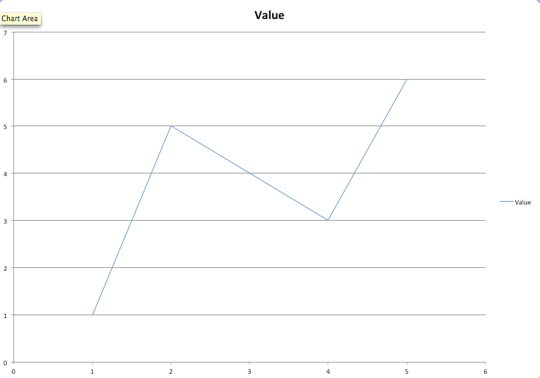

Slide 24
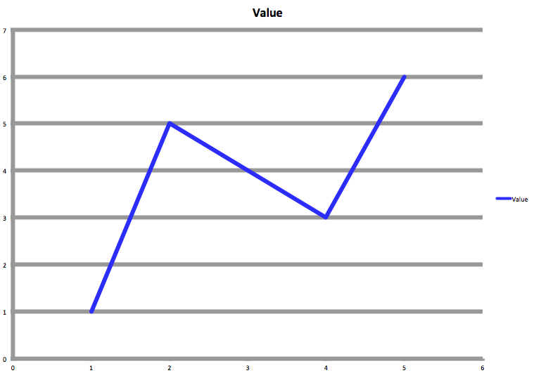

Slide 25
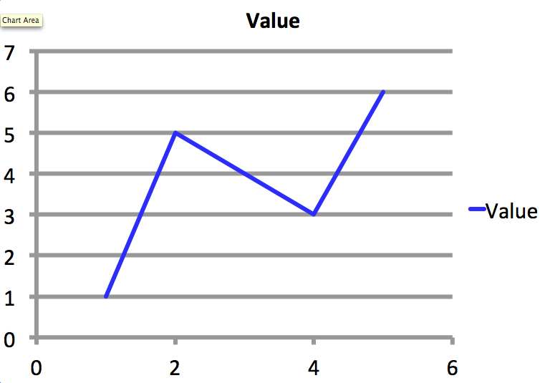

Slide 26
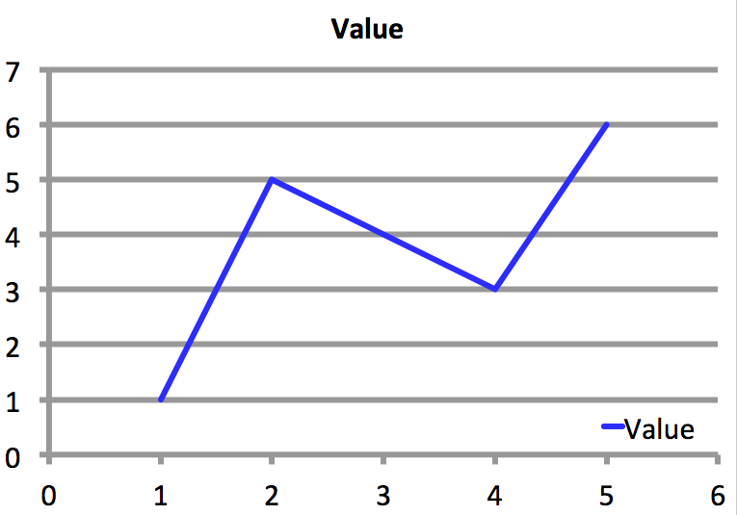

Slide 27
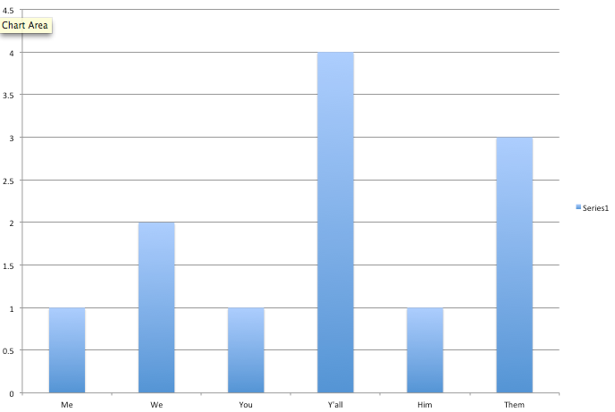

Slide 28
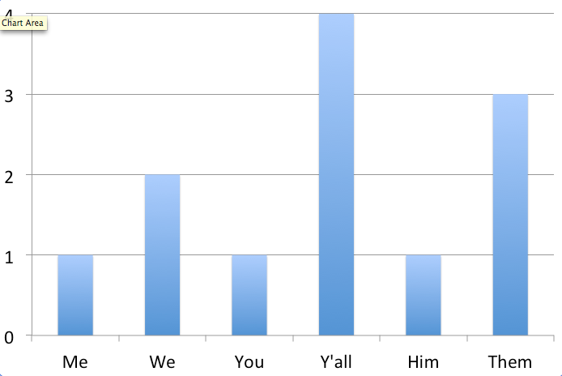

Slide 29
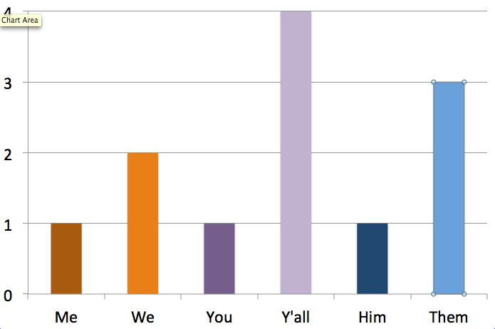

Slide 30
Other Talk Guidelines
Don’t fidget
Don’t stand in the way
Turn off automatic notifications
Speak into microphone
Have fun

Slide 31
Summary
Make slides readable
Use space wisely
Make graphs non-default
Goal: make people want to follow your talk

