Slide 1
MATLAB Tutorial
Dmitry Drutskoy
Some material borrowed from the departmental MATLAB info session by
Philippe Rigollet
Kevin Wayne

Slide 2
Overview
Getting MATLAB set up
Scalar/matrix creation and operations
MATLAB programming
Plotting

Slide 3
Installation
Princeton has a license for all students to use MATLAB, even on personal computers.
www.princeton.edu/software/licenses/software/matlab/
You have to be on the university network; It takes your university username/password. Instructions are available.

Slide 4
Working Directory
Default location is C:\Users\<user>\Documents\MATLAB
Type ‘pwd’ or use the current folder window.
For each project, create a new directory for simplicity.
Change directory to the new one, all new files created will be stored here.
MATLAB automatically finds functions in current directory files.

Slide 5
Finding help
Click the fx symbol next to your current command line for help on functions
Use “help <name>” or “doc <name>” for the function
www.mathworks.com/help/techdoc/ref/funcalpha.html
If everything else fails, google it!

Slide 6
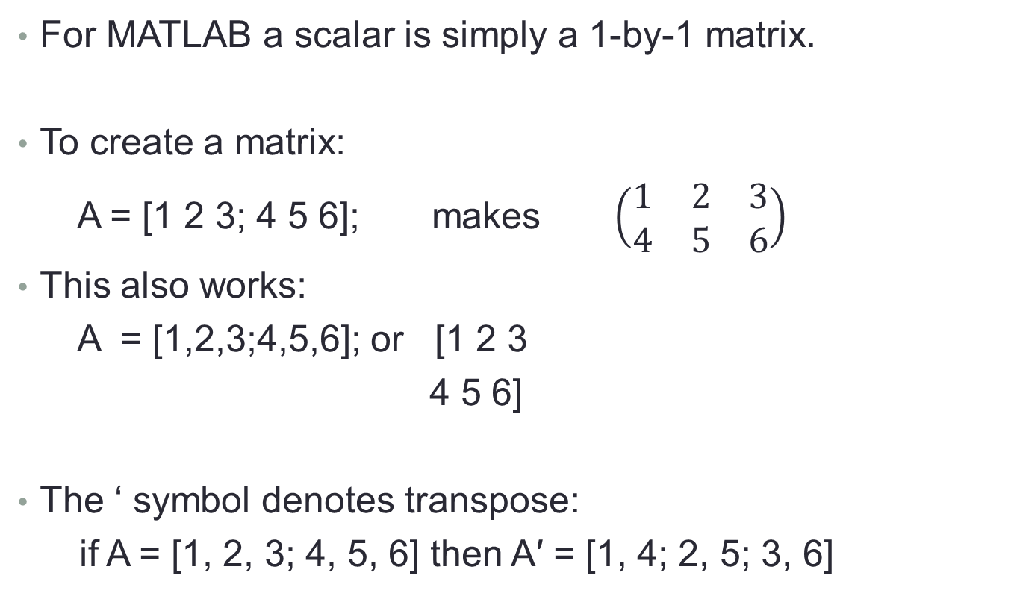
Basic Scalars/Matrices
For MATLAB a scalar is simply a 1-by-1 matrix.
To create a matrix:
A = [1 2 3; 4 5 6]; makes $\left(\begin{matrix}1 & 2 & 3 \\ 4 & 5 & 6\end{matrix}\right)$
This also works:
A = [1,2,3;4,5,6]; or [1 2 3
4 5 6]
The ‘ symbol denotes transpose:
if A = [1, 2, 3; 4, 5, 6] then A′ = [1, 4; 2, 5; 3, 6]

Slide 7
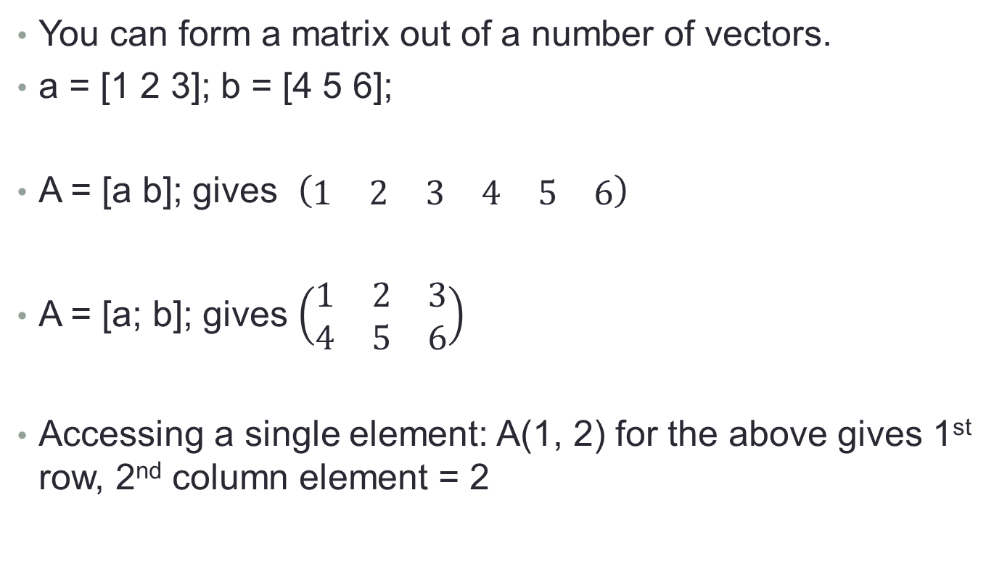
More matrices
You can form a matrix out of a number of vectors.
a = [1 2 3]; b = [4 5 6];
A = [a b]; gives $\left(\begin{matrix}1 & 2 & 3 & 4 & 5 & 6\end{matrix}\right)$
A = [a; b]; gives $\left(\begin{matrix}1 & 2 & 3 \\ 4 & 5 & 6\end{matrix}\right)$
Accessing a single element: A(1, 2) for the above gives 1st row, 2nd column element = 2

Slide 8
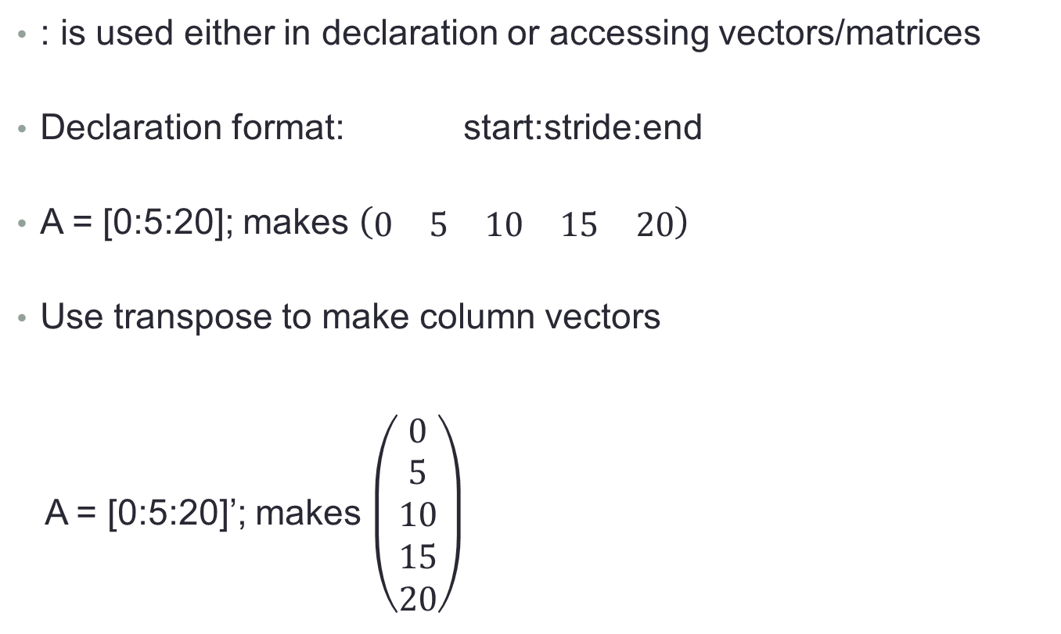
Using the : symbol
: is used either in declaration or accessing vectors/matrices
Declaration format: start:stride:end
A = [0:5:20]; makes $\left(\begin{matrix}0 & 5 & 10 & 15 & 20\end{matrix}\right)$
Use transpose to make column vectors
A = [0:5:20]’; makes $\left(\begin{matrix}0 \\ 5 \\ 10 \\ 15 \\ 20\end{matrix}\right)$

Slide 9
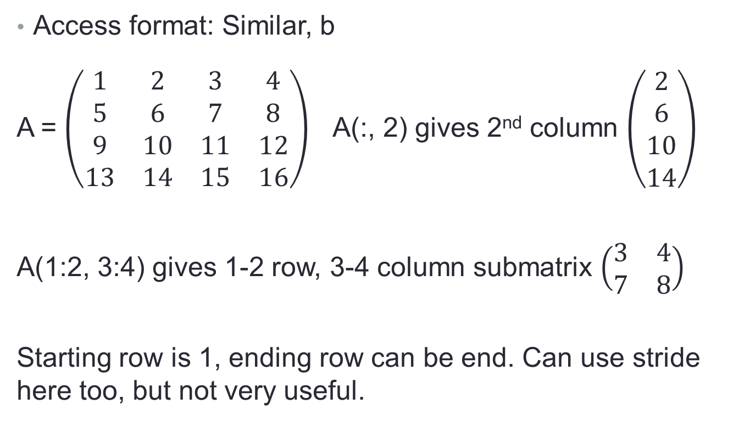
Using the : symbol
Access format: Similar, b
A = $\left(\begin{matrix}1 & 2 & 3 & 4 \\ 5 & 6 & 7 & 8 \\ 9 & 10 & 11 & 12 \\ 13 & 14 & 15 & 16\end{matrix}\right)$A(:, 2) gives 2nd column $\left(\begin{matrix}2 \\ 6 \\ 10 \\ 14\end{matrix}\right)$
A(1:2, 3:4) gives 1-2 row, 3-4 column submatrix $\left(\begin{matrix}3 & 4 \\ 7 & 8\end{matrix}\right)$
Starting row is 1, ending row can be end. Can use stride here too, but not very useful.

Slide 10
Special Matrices
eye(n) is the identity matrix of size n x n.
zeros(m, n) is the m x n matrix with only zeroes.
ones(m, n) is the m x n with only 1’s.
magic(n) gives a n x n matrix with integer coefficients from 1 to n² with equal column and row sums.

Slide 11
Random Matrices
rand(m, n) is a matrix of size m by n with independent entries that are uniformly distributed on the interval [0, 1]
randn(m, n) is a matrix of size m by n with independent entries that are normally distributed
rand(n) and randn(n) return square matrices of size n by n.

Slide 12
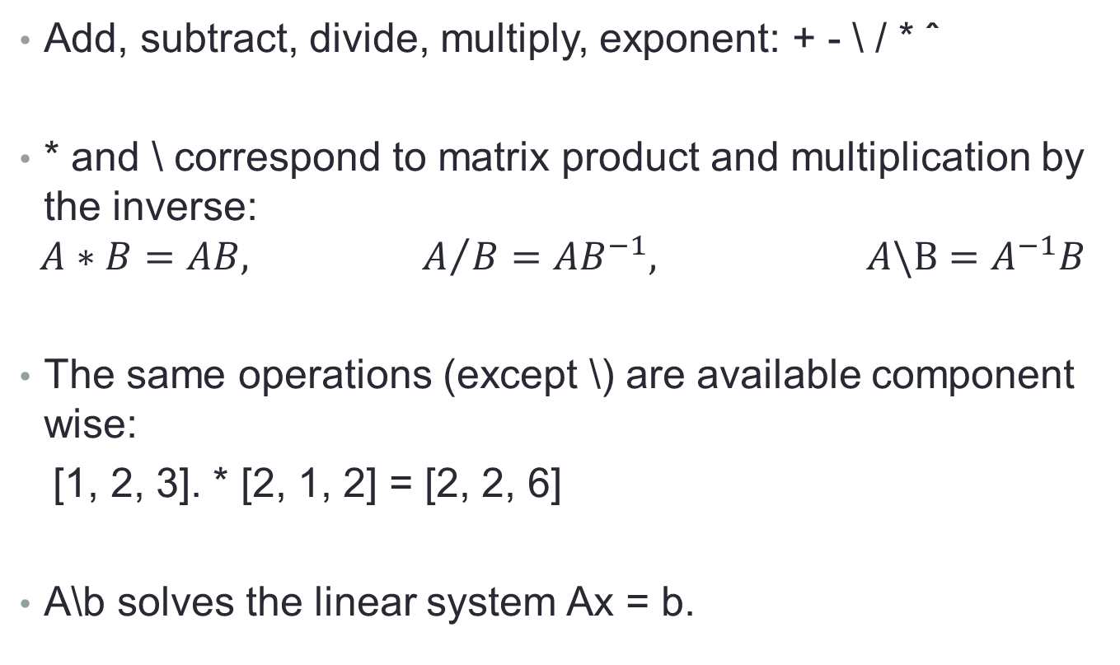
Matrix Operations
Add, subtract, divide, multiply, exponent: + - \ / * ˆ
* and \ correspond to matrix product and multiplication by the inverse:
$$A∗B=AB, { A}/B=AB^{−1}, A\backslash B=A^{−1}B$$
The same operations (except \) are available component wise:
[1, 2, 3]. * [2, 1, 2] = [2, 2, 6]
A\b solves the linear system Ax = b.

Slide 13
Matrix Operations cont.
null(A) is an orthogonal basis for the null space of A
sum(A) returns a row vector containing the sum of the
columns of A.

Slide 14
Logical Operations
Tests such as A < b return logical values
These can be manipulated as regular integers (1 for true, 0 for false).
find will return all the elements for which a condition is true:
find([1, 2, 3] > 1) returns [2, 3]

Slide 15
Logical Operations cont.
[v, id] = max(a) returns the maximum element of the vector a and the corresponding indices in id.
[s, id] = sort(a) returns the elements of a sorted in ascending order and the permutation id such that s(id) is increasing.

Slide 16
Usual Functions
Mathematics: sin, cos, exp, log, log10, sqrt, ceil, floor, round, ...
Information: size, length, who, whos, ls
Management: save, load, clear
save filename x y A
load filename

Slide 17
Writing functions
File -> new -> function
Functions/scripts/classes are all .m files, but different semantics. To be able call functions, place them in your project directory.
function [ output_args ] = Silly( input_args )
%SILLY Summary of this function goes here
% Detailed explanation goes here
end

Slide 18
Programming Logic
if, else statements:
for statements can be used too:
Similar behavior for repeat, until, while, etc.
if (a > 1)
blah
else
blahblah
end
for i=1:n
moreblah
end

Slide 19
Function parameters
function [ output1, output2 ] = Silly( input1, input2)
To input values, use the as many arguments after the function name as you need, then use them in your program.
some_value = input1*input2;
Output values must be set before the “end” statement.
output1 = some_value;
output2 = 15.7;
end

Slide 20
Calling Functions
Note that the type of input1, input2 is not set anywhere. Can be scalars, vectors, matrices…
To call this function with 2 return values, do:
This will save output1 as a and output2 as b.
If we specify fewer return parameters, the first few are used.
[a, b] = Silly(5, 7);
[a, b] = Silly(vector1, vector2);

Slide 21
Scripts
You should write all you commands in a script using the editor.
Use F5 to run the script. Using the name of the script from the command line works too.
Use F9 to run the current selection.
CTRL-i will automatically (and correctly) indent the current selection.
CTRL-R will comment the current selection, CTRL-T will uncomment it (useful to test only parts of a code).

Slide 22
Plotting
plot(x, y) will plot a function that takes values
y = (y1, . . . , yn) at the points x = (x1, . . . , xn).
Use xlabel(′ALabelForX′) and ylabel(′ALabelForY ′) to put labels on the axes and Title(′ATitle′) to include a title.
plot(x1, y1, ':bo', x2, y2, '-r.') will plot two curves, one as a blue dotted line with circles at each point, the other red continuous with dots.

Slide 23
Plotting cont.
Look for ”Linespec” in the MATLAB documentation to find other codes for line colors, markers, etc.
Use legend(′plot1′,′ plot2′, ...) to include a legend.
To combine plots: use hold on after the first one and hold off after the last plot.
hold on
plot (x1, y1, ':bo')
plot (x2, y2, '-r.')
hold off

