Slide 1
Instruction Level Parallelism
Taewook Oh

Slide 2
Instruction Level Parallelism
Measure of how many of the operations in a computer program can be performed simultaneously
Achieved by
Hardware techniques
Compiler based optimization
Limited by
Resource conflicts
Dependence
Data Dependence
Control Dependence

Slide 3
Data Dependence
Flow dependence
Anti dependence
Output dependence
r3 ← (r1) op (r2)
r5 ← (r3) op (r4)
r3 ← (r1) op (r2)
r1 ← (r4) op (r5)
r3 ← (r1) op (r2)
r3 ← (r4) op (r5)

Slide 4
Control Dependence
if (p1) { s1; } else { s2; }
s1 and s2 are control dependent on p1
Two constraints on control dependences
An instruction that is control dependent on a branch cannot be executed before the branch
An instruction that is not control dependent on a branch cannot be executed after the branch so that its execution is control by the branch

Slide 5
HW Exploiting ILP (Superscalar)
Why in HW?
Works when can’t know real dependence at compile time
Code for one machine runs well on another
Scoreboarding (CDC 6600 in 1963)
Centralized control structure
No register renaming, no forwarding
Pipeline stalls for WAR and WAW hazards.
Tomasulo Algorithm (IBM 360/91 in 1966)
Distributed control structures
Implicit renaming of registers
: WAR and WAW hazards eliminated by register renaming

Slide 6
Scoreboarding
Divides ID stage: Out-of-order execution
Issue: Decode instruction, check for structural hazard
Read operands: wait until no data hazard
Instructions execute whenever not dependent on previous instructions and no hazards
CDC 6600 (1963): In-order issue, Out-of-order execution, Out-of-order completion/commit

Slide 7
Scoreboarding
Out-of-order completion: How could we preserve anti/output dependence?
Solutions for anti dependence
Stall write back until registers have been read
Read registers only during ‘read operands’ stage
Solution for output dependence
Detect hazard and stall issue of new instruction until other instruction completes

Slide 8
Scoreboard Architecture (CDC 6600)
FP Mult
FP Mult
FP Divide
Registers
Functional Units
FP Add
Integer
SCOREBOARD
Memory

Slide 9
Four Stages of Scoreboard Control
Issue—decode instructions & check for structural hazards (ID1)
Instructions issued in program order (for hazard checking)
Don’t issue if structural hazard
Don’t issue if instruction is output dependent on any previously issued but uncompleted instruction
Read operands—wait until no data hazards, then read operands (ID2)
All real dependencies (RAW hazards) resolved in this stage, since we wait for instructions to write back data.
No forwarding of data in this model

Slide 10
Four Stages of Scoreboard Control
Execution—operate on operands (EX)
The functional unit begins execution upon receiving operands. When the result is ready, it notifies the scoreboard that it has completed execution.
Write result—finish execution (WB)
Stall until no WAR hazards with previous instructions: Example: DIVD F0,F2,F4 ADDD F10,F0,F8 SUBD F8,F8,F14 CDC 6600 scoreboard would stall SUBD until ADDD reads operands

Slide 11
Three Parts of Scoreboard
Instruction status: Which of 4 steps the instruction is in
Functional unit status: Indicates the state of the functional unit (FU). 9 fields for each functional unit Busy: Indicates whether the unit is busy or not Op: Operation to perform in the unit (e.g., + or –) Fi: Destination register Fj,Fk: Source-register numbers Qj,Qk: Functional units producing source registers Fj, Fk Rj,Rk: Flags indicating when Fj, Fk are ready
Register result status—Indicates which functional unit will write each register, if one exists. Blank when no pending instructions will write that register.

Slide 12
Execution Snapshot (Cycle = 18)

Slide 13
Scoreboarding Summary
Exploit ILP at runtime by scheduling independent instructions to execute simultaneously.
Limitations
No forwarding hardware
Stall for WAR and WAW hazard
Limited to instructions in basic block (small window)

Slide 14
Tomasulo Algorithm
For IBM 360/91 about 3 years after CDC 6600 (1966)
Goal: High Performance without special compilers
Lead to Alpha 21264, HP 8000, MIPS 10000, Pentium II, PowerPC 604, …

Slide 15
Tomasulo vs Scoreboarding
Control & buffers distributed with Functional Units (FU) vs. centralized in scoreboard
Register Renaming
Registers in instructions replaced by values or pointers to reservation stations
avoids WAR, WAW hazards
More reservation stations than registers, so can do optimizations compilers can’t
RS gets a value from Common Data Bus that broadcasts results to all FUs, not through register.

Slide 16
Tomasulo Architecture
From Mem
FP Op
Queue
FP Registers
Load Buffers
Load1
Load2
Load3
Load4
Load5
Load6
Store
Buffers
Add1
Add2
Add3
Mult1
Mult2
Reservation
Stations
To Mem
FP adders
FP multipliers
Common Data Bus (CDB)

Slide 17
Three Stages of Tomasulo Argorithm
1. Issue—get instruction from FP Op Queue
If reservation station free (no structural hazard), control issues instr & sends operands (renames registers).
2. Execution—operate on operands (EX)
When both operands ready then execute; if not ready, watch Common Data Bus for result
3. Write result—finish execution (WB)
Write on Common Data Bus to all awaiting units; mark reservation station available
Normal data bus: data + destination (“go to” bus)
Common data bus: data + source (“come from” bus)
64 bits of data + 4 bits of Functional Unit source address
Write if matches expected Functional Unit (produces result)
Does the broadcast

Slide 18
Execution Snapshot (Cycle = 10)

Slide 19
Execution Snapshot (Cycle = 11)

Slide 20
Tomasulo vs Scoreboard
Tomasulo | Scoreboard
WAR: renaming avoids | WAR: stall completion
WAW: renaming avoids | WAW: stall issue
Broadcast results from FU | Write/read registers
Controlled by reservation stations | Controlled by central scoreboard

Slide 21
What About Control Dependence?
Branch Prediction can break the limitation comes from control dependence
If we speculate and are wrong, need to back up and restart execution to point at which we predicted incorrectly
Both Scoreboard and Tomasulo have: In-order issue, out-of-order execution, and out-of-order completion
if (p1) { s1; } else { s2; }
What if s1 completed earlier than p1 with branch prediction?
Technique for speculation: in-order completion

Slide 22
HW Support for In-order Completion
Reorder Buffer (ROB)
Holds instructions in FIFO order, exactly as they were issued
Each ROB entry contains PC, dest reg, result, exception status
When instructions complete, results placed into ROB
Supplies operands to other instruction → more registers like RS
Register Renaming: Tag results with ROB number
Instructions commit: values at head of ROB placed in registers
As a result, easy to undo speculated instructions on mispredicted branches

Slide 23
Four Steps of Tomasulo Algorithm with Reorder Buffer
Issue—get instruction from FP Op Queue
If reservation station and reorder buffer slot free, issue instr & send operands & reorder buffer no. for destination (this stage sometimes called “dispatch”)
Execution—operate on operands (EX)
When both operands ready then execute; if not ready, watch CDB for result; when both in reservation station, execute; checks RAW
Write result—finish execution (WB)
Write on Common Data Bus to all awaiting Fus & reorder buffer; mark reservation station available.
Commit—update register with reorder result
When instr. at head of reorder buffer & result present, update register with result (or store to memory) and remove instr from reorder buffer. Mispredicted branch flushes reorder buffer

Slide 24
Tomasulo with ROB Snapshot
Done?
FP Op
Queue
--
ST 0(R3),F4
N
ROB7
ROB6
ROB5
ROB4
ROB3
ROB2
ROB1
Newest
F0
ADDD F0,F4,F6
N
F4
LD F4,0(R3)
N
Reorder Buffer
--
BNE F2,<…>
N
F2
DIVD F2,F10,F6
N
F10
ADDD F10,F4,F0
N
Oldest
F0
LD F0,10(R2)
N
Registers
To
Memory
Dest
Dest
from
Memory
2 ADDD R(F4),ROB1
3 DIVD ROB2,R(F6)
6 ADDD ROB5, R(F6)
Dest
Reservation
Stations
1 10+R2
+
5 0+R3
FP adders
FP multipliers

Slide 25
SW Exploiting ILP
Why in SW?
Simplified HW : Occupies less chip real-estate
Better power efficiency : Widely used in embedded processors (e.g. TI C6x DSPs)
Architectures rely on SW to exploit ILP
VLIW (Very Long Instruction Word)
EPIC (Explicitly Parallel Instruction Computing)
CGRA (Coarse-Grained Reconfigurable Architecture)

Slide 26
VLIW
Int Op 1
Int Op 2
Mem Op 1
Mem Op 2
FP Op 1
FP Op 2
Two Integer Units,
Single Cycle Latency
Two Load/Store Units,
Three Cycle Latency
Two Floating-Point Units,
Four Cycle Latency
Multiple operations packed into one instruction
Each operation slot is for a fixed function

Slide 27
VLIW Compiler Responsibility
Schedules to maximize parallel execution
Avoid WAW and WAR hazard as much as possible with smart instruction scheduler and register allocator
Guarantees intra-instruction parallelism
Schedules to avoid data hazards (no interlocks)
Typically separates operations with explicit NOP
Example :
MULT r4, r6, r8 NOP
NOP
NOP
ADD r10, r2, r4
MULT r4, r6, r8
ADD r10, r2, r4

Slide 28
Problems with (Pure) VLIW
Object-code compatibility
have to recompile all code for every machine, even for two machines in same generation
Object code size
instruction padding wastes instruction memory/cache
Scheduling variable latency memory operations
caches and/or memory bank conflicts impose statically unpredictable variability
Scheduling for statically unpredictable branches
optimal schedule varies with branch path

Slide 29
EPIC
EPIC is the style of architecture (cf. CISC, RISC, VLIW)
Explicitly Parallel Instruction Computing
IA-64 is Intel’s chosen ISA (cf. x86, MIPS)
IA-64 = Intel Architecture 64-bit
An object-code compatible VLIW
Itanium (aka Merced) is first implementation
First customer shipment expected 1997 (actually 2001)
McKinley, second implementation shipped in 2002
However, HP later asserted that "EPIC" was merely an old term for the Itanium architecture.

Slide 30
IA-64 Instruction Format
For object code compatibility
IA-64 defines 128bit “bundle”, which consists of 3 X 41-bit instructions and 5-bit template
Each “group” contains instructions that can execute in parallel
Template bits in bundle describe grouping of instructions with others in adjacent bundles
Reduce code size also
bundle j-1
bundle j
bundle j+1
bundle j+2
group i-1
group i
group i+1
group i+2

Slide 31
Predicated Execution
To overcome the limitation from control dependence
Eliminate hard to predict branches with predicated execution
b0:
Inst 1
Inst 2
br a==b, b2
if
Inst 1
Inst 2
p1,p2 <- cmp(a==b)
(p1) Inst 3 || (p2) Inst 5
(p1) Inst 4 || (p2) Inst 6
Inst 7
Inst 8
b1:
Inst 3
Inst 4
br b3
else
Predication
b2:
Inst 5
Inst 6
then
b3:
Inst 7
Inst 8
Four basic blocks
One basic block

Slide 32
More Things to Improve Performance
Speculative execution
Problem: Branches restrict compiler code motion
Solution: Speculative operations that don’t cause exceptions
Useful for scheduling long latency loads early
Inst 1
Inst 2
br a==b, b2
Load.s r1
Inst 1
Inst 2
br a==b, b2
Speculative load never causes exception, but sets “poison” bit on destination register
Load r1
Use r1
Inst 3
Chk.s r1
Use r1
Inst 3
Check for exception in original home block jumps to fixup code if exception detected
Can’t move load above branch because might cause exception

Slide 33
More Things to Improve Performance
Data speculation
Problem: Possible memory hazards limit code scheduling
Solution: Hardware to check pointer hazards
Requires associative hardware in address check table
Inst 1
Inst 2
Store
Data speculative load adds address to address check table
Load.a r1
Inst 1
Inst 2
Store
Load r1
Use r1
Inst 3
Store invalidates any matching loads in address check table
Load.c
Use r1
Inst 3
Can’t move load above store because store might be to same address
Check if load invalid (or missing), jump to fixup code if so

Slide 34
CGRA
Source : “Edge-centric Modulo Scheduling for Coarse-Grained Reconfigurable Architectures” Hyunchul Park et al. 2008
High throughput with a large number of resources
High flexibility with dynamic reconfiguration
Array of PEs connected in a mesh-like interconnect
Sparse interconnect and distributed register files
FUs can be used for routing

Slide 35
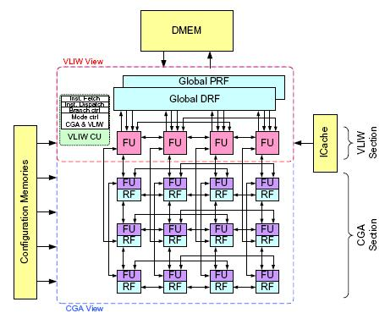
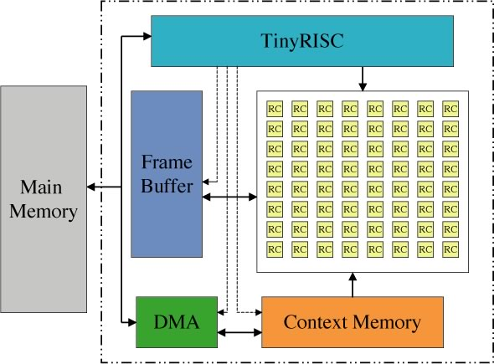
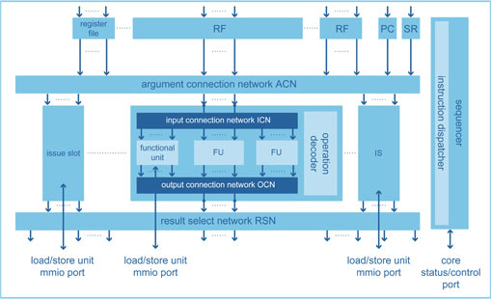
CGRA : Attractive Alternative to ASICs
Source : “Edge-centric Modulo Scheduling for Coarse-Grained Reconfigurable Architectures” Hyunchul Park et al. 2008
Suitable for running multimedia applications for future embedded systems
High throughput, low power consumption, high flexibility
Morphosys SiliconHive ADRES
viterbi at 80Mbps
h.264 at 30fps
50-60 MOps /mW
Morphosys : 8x8 array with RISC processor
SiliconHive : hierarchical systolic array
ADRES : 4x4 array with tightly coupled VLIW

Slide 36
Compiler Is More Important in CGRA
Source : “Edge-centric Modulo Scheduling for Coarse-Grained Reconfigurable Architectures” Hyunchul Park et al. 2008
Compiler is responsible for operand routing
VLIW : routing is guaranteed by central RF
CGRA : Multiple possible route
Routing can easily failed by other operations
An intelligent CGRA compiler is very essential
Many researches are going on
FU
RF
FU
RF
FU
RF
FU
RF
Central RF
FU
RF
FU
RF
FU
RF
FU
RF
FU
FU
FU
FU
FU
RF
FU
RF
FU
RF
FU
RF
FU
RF
FU
RF
FU
RF
FU
RF
Conventional VLIW
CGRA

Slide 37
Acknowledgement
Slides about Scoreboarding, Tomasulo Algorithm, Reorder Buffer, and EPIC architecture closely follows the lecture note given in “Graduate Computer Architecture” course by John Kubiatowicz 2003 and Krste Asanovic 2007
Slides about VLIW closely follows the lecture note given in “Computer Organization and Design” course by Hyuk-Jae Lee 2005

Slide 38
Appendix

Slide 39
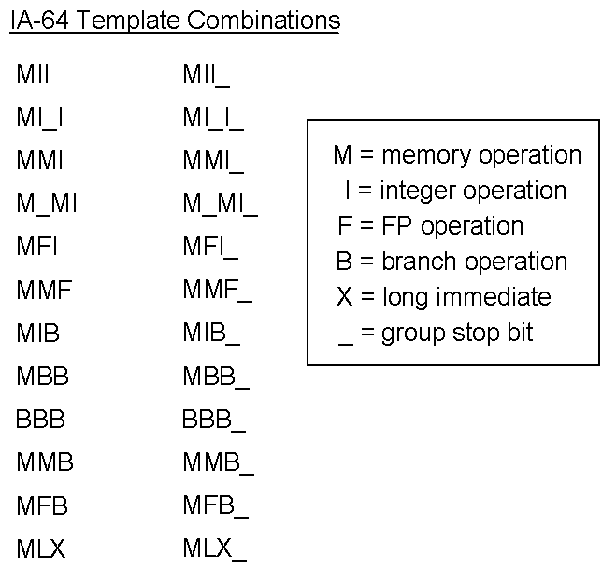
IA-64 Template Combination
Source : http://common.ziffdavisinternet.com/util_get_image/0/0,1425,sz=1&i=9154,00.gif

