Slide 1
HISTORY OF Super computing
Vector processing
Prakash Prabhu

Slide 2
1944 : Colossus 2
Used for breaking encrypted codes
  Not Turing Complete
  Vaccum Tubes to optically read paper tape & apply programmable logic function
Parallel I/O!
  5 processors in parallel, same program, reading different tapes: 25,000 characters/s
Notes:
- WWII by the British to break encrypted German codes (cryptanalysis)
Colossus 2 was the first “parallel” processor in Colossus series, which were the first partially programmable, digital, electronic devices.
Maximum safe speed for reading off tape was 5000 chars/s

Slide 3
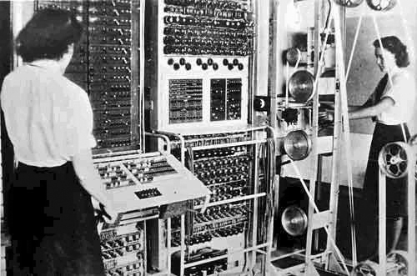
1944 : Colossus 2

Slide 4
1961: IBM 7030 “Stretch”
First Transistorized Supercomputer
  $7.78 million (in 1961!) delivered to LLNL
  3-D fluid dynamics problems
  Gene Amdahl & John Backus amongst the architects
Aggressive Uniproc Parallelism
  “Lookahead”: Prefetch memory instrs, line up for fast arithmetic unit
  Many firsts: Pipelining, Predication, Multipgming
  Parallel Arithmetic Unit
Notes:
http://cyclone.cs.clemson.edu/~mark/stretch.html

Slide 5
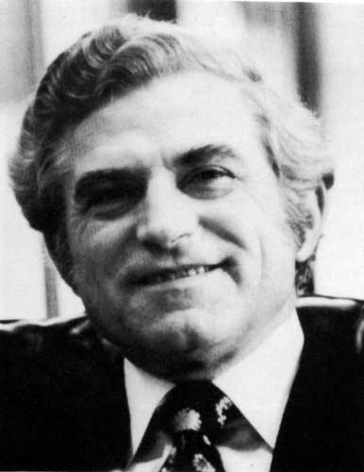
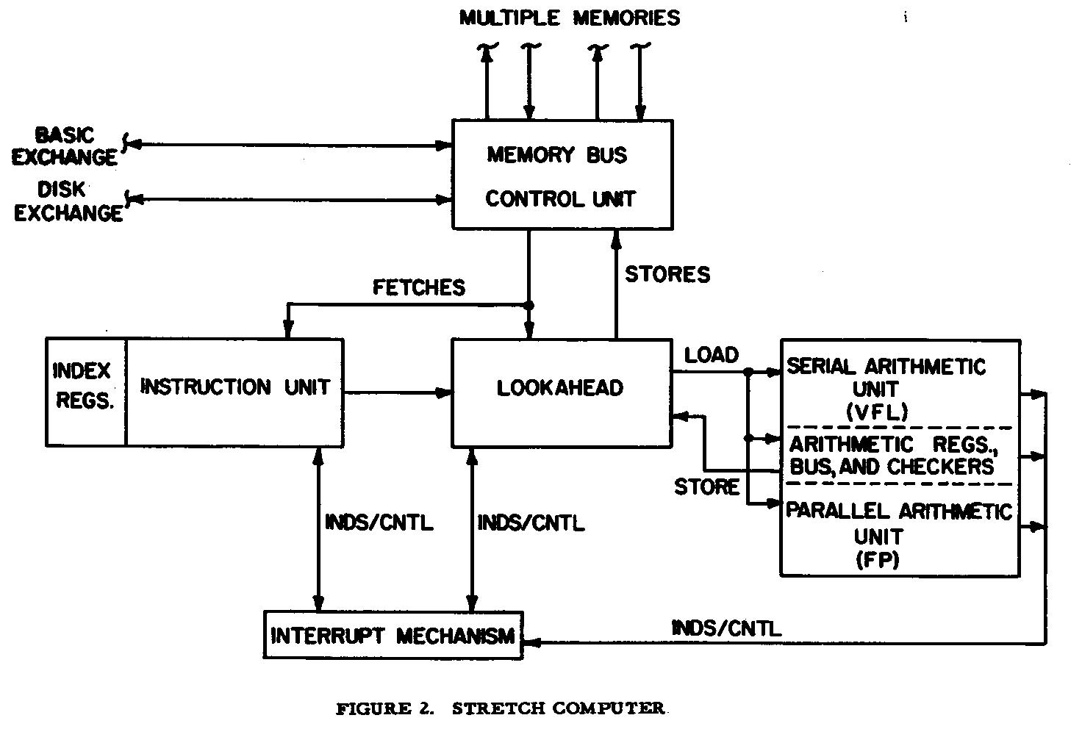
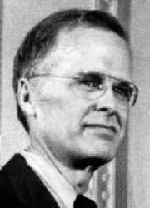
1961: IBM 7030 “Stretch”
Amdahl
Backus
R.T. Blosk, "The Instruction Unit of the Stretch Computer,“ 1960
Notes:
Many firsts
Interrupts
Multiprogramming
Pipelining
Instruction prefetch
Predication/Eager Execution (yes, in 1961!)

Slide 6
1964: CDC 6600
Outperformed ``Stretch’’ by 3 times
Seymour Cray, Father of Supercomputing, main designer
Features
  First RISC processor !
  Overlapped execution of I/O , Peripheral Procs and CPU
    “Anyone can build a fast CPU. The trick is to build a fast system.” – Seymour Cray

Slide 7
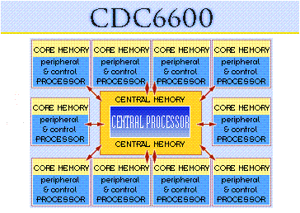
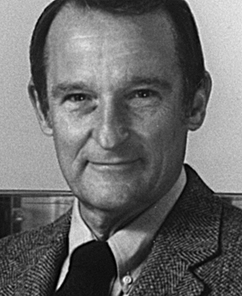
1964: CDC 6600
Seymour Cray

Slide 8
1974: CDC STAR-100
First supercomputer to use vector processing
  STAR: String and Array Operations
  100 million FLOPs
  Vector instructions ~ statements in APL language
    Single instruction to add two vectors of 65535 elements
    High setup cost for vector insts ☹
      Memory to memory vector operations
      Slower Memory killed performance
Notes:
Very few programs can be effectively vectorized into a series of single instructions; nearly all calculations will rely on the results of some earlier instruction, yet the results had to clear the pipelines before they could be fed back in. This forced most programs to hit the high setup cost of the vector units, and generally the ones that did "work" were extreme examples. Making matters worse was that the basic scalar performance was sacrificed in order to improve vector performance. Any time that the program had to run scalar instructions, the overall performance of the machine dropped dramatically.

Slide 9
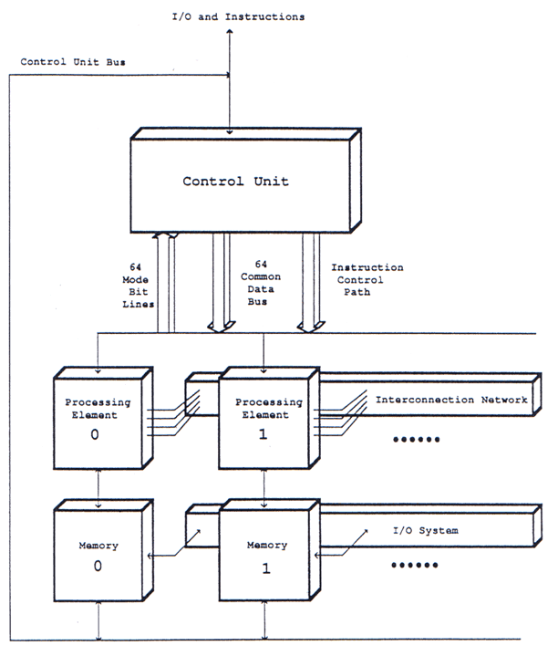
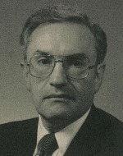
1975: Burroughs ILLIAC IV
“One of most infamous supercomputers”
64 procs in parallel …
  SIMD operations
  Spurred the design of Parallel Fortran
  Used by NASA for CFD
Controversial design at that time (MPP)
Daniel
Slotnick
Notes:
IVTRAN (parallel FORTRAN)

Slide 10
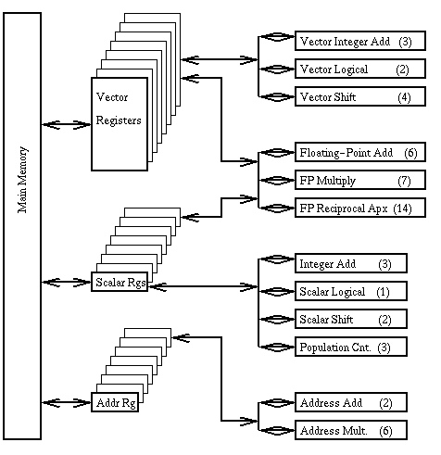
1976: Cray-I
  "If you were plowing a field, which would you rather use? Two strong oxen or 1024 chickens?“
One of best known & successful supercomputer
  Installed at LANL for $8.8 million
Features
  Deep, Multiple Pipelines
  Vector Instructions & Vector registers
  Densely packaged into a microprocessor
Programming Cray-1
  FORTRAN
  Auto vectorizing compiler!

Slide 11
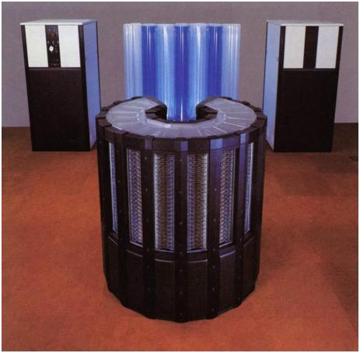
1985: Cray-2
Denser packaging than Cray-I
  3-D stacking & Liquid Cooling
Higher memory capacity
  256 Mword (physical memory)

Slide 12
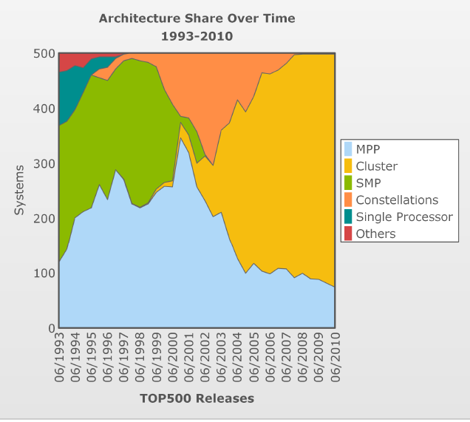
> 1990 : Cluster Computing

Slide 13
2008: IBM Roadrunner
Designed by IBM & DoE
Hybrid Design
  Two different processor arch: AMD dual-core Opteron + IBM Cell processor
  Opteron for CPU computation + communication
  Cell : One GPE and 8 SPE for floating pt computation
  Total of 116,640 cores
  Supercomputer cluster

Slide 14
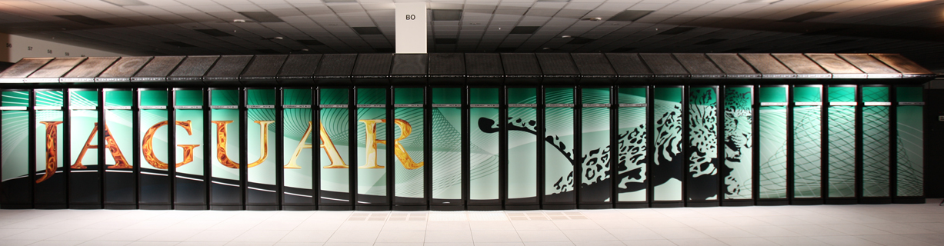
2009: Cray Jaguar
World’s fastest supercomputer at ORNL
  1.75 petaflops
  MPP with 224, 256 AMD opteron processor cores
  Computational Science Applications

Slide 15
Vector Processing*
Vector processors have high-level operations that work on linear arrays of numbers: "vectors"
SCALAR
(1 operation)
VECTOR
(N operations)
r1
r2
v1
v2
+
+
- Slides adapted
from
Prof. Patterson’s
Lecture
r3
v3
vector
length
add r3, r1, r2
add.vv v3, v1, v2

Slide 16
Properties of Vector Processors
Each result independent of previous result
  long pipeline, with no dependencies
  High clock rate
Vector instructions access memory with known pattern
  highly interleaved memory
  amortize memory latency of over ­ 64 elements
  no (data) caches required! (Do use instruction cache)
Reduces branches and branch problems in pipelines
Single vector instruction implies lots of work (­ loop)
  fewer instruction fetches

Slide 17
Styles of Vector Architectures
memory-memory vector processors: all vector operations are memory to memory
vector-register processors: all vector operations between vector registers (except load and store)
  Vector equivalent of load-store architectures
  Includes all vector machines since late 1980s:
  Cray, Convex, Fujitsu, Hitachi, NEC

Slide 18
Components of Vector Processor
Vector Register: fixed length bank holding a single vector
  has at least 2 read and 1 write ports
  typically 8-32 vector registers, each holding 64-128 64-bit elements
Vector Functional Units (FUs): fully pipelined, start new operation every clock
  typically 4 to 8 FUs: FP add, FP mult, FP reciprocal (1/X), integer add, logical, shift; may have multiple of same unit
Vector Load-Store Units (LSUs): fully pipelined unit to load or store a vector; may have multiple LSUs
Scalar registers: single element for FP scalar or address
Cross-bar to connect FUs , LSUs, registers

Slide 19
Vector Instructions
Instr. Operands Operation Comment
ADDV V1,V2,V3 V1=V2+V3 vector + vector
ADDSV V1,F0,V2 V1=F0+V2 scalar + vector
MULTV V1,V2,V3 V1=V2xV3 vector x vector
MULSV V1,F0,V2 V1=F0xV2 scalar x vector
LV V1,R1 V1=M[R1..R1+63] load, stride=1
LVWS V1,R1,R2 V1=M[R1..R1+63*R2] load, stride=R2
LVI V1,R1,V2 V1=M[R1+V2i,i=0..63] indir.("gather")
CeqV VM,V1,V2 VMASKi = (V1i=V2i)? comp. setmask
MOV VLR,R1 Vec. Len. Reg. = R1 set vector length
MOV VM,R1 Vec. Mask = R1 set vector mask

Slide 20
Memory operations
Load/store operations move groups of data between registers and memory
Three types of addressing
  Unit Stride
    Fastest
  Non-unit (constant) stride
  Indexed (gather-scatter)
    Vector equivalent of register indirect
    Good for sparse arrays of data
    Increases number of programs that vectorize

Slide 21
DAXPY (Y = a * X + Y)
LD F0,a ;load scalar a
LV V1,Rx ;load vector X
MULTS V2,F0,V1 ;vector-scalar mult.
LV V3,Ry ;load vector Y
ADDV V4,V2,V3 ;add
SV Ry,V4 ;store the result
Assuming vectors X, Y are length 64
Scalar vs. Vector
LD F0,a
ADDI R4,Rx,#512 ;last address to load
loop: LD F2, 0(Rx) ;load X(i)
MULTD F2,F0,F2 ;a*X(i)
LD F4, 0(Ry) ;load Y(i)
ADDD F4,F2, F4 ;a*X(i) + Y(i)
SD F4 ,0(Ry) ;store into Y(i)
ADDI Rx,Rx,#8 ;increment index to X
ADDI Ry,Ry,#8 ;increment index to Y
SUB R20,R4,Rx ;compute bound
BNZ R20,loop ;check if done
578 (2+9*64) vs.
6 instructions (96X)
64 operation vectors + no loop overhead
also 64X fewer pipeline hazards

Slide 22
Virtual Processor Vector Model
Vector operations are SIMD
(single instruction multiple data)operations
Each element is computed by a virtual processor (VP)
Number of VPs given by vector length
  vector control register

Slide 23
Vector Architectural State
Virtual Processors ($vlr)
VP₀
VP₁
VP_{$vlr-1}
General
Purpose
Registers
vr₀
Control
Registers
vr₁
vr₃₁
vcr₀
$vdw bits
vcr₁
vf₀
Flag
Registers
(32)
vf₁
vcr₃₁
32 bits
vf₃₁
1 bit

Slide 24
Vector Implementation
Vector register file
  Each register is an array of elements
  Size of each register determines maximum
  vector length
  Vector length register determines vector length
  for a particular operation
Multiple parallel execution units = “lanes”
(sometimes called “pipelines” or “pipes”)

Slide 25
Vector Terminology:
4 lanes, 2 vector functional units

Slide 26
Vector Execution Time
Time = f(vector length, data dependencies, struct. hazards)
Initiation rate: rate that FU consumes vector elements
(= number of lanes; usually 1 or 2 on Cray T-90)
Convoy: set of vector instructions that can begin execution in same clock (no struct. or data hazards)
Chime: approx. time for a vector operation
m convoys take m chimes; if each vector length is n, then they take approx. m x n clock cycles (ignores overhead; good approximization for long vectors)
1: LV V1,Rx ;load vector X
2: MULV V2,F0,V1 ;vector-scalar mult.
LV V3,Ry ;load vector Y
3: ADDV V4,V2,V3 ;add
4: SV Ry,V4 ;store the result
4 conveys, 1 lane, VL=64
=> 4 x 64 ­ 256 clocks
(or 4 clocks per result)

Slide 27
Vector Load/Store Units & Memories
Start-up overheads usually longer for LSUs
Memory system must sustain (# lanes x word) /clock cycle
Many Vector Procs. use banks (vs. simple interleaving):
1) support multiple loads/stores per cycle
=> multiple banks & address banks independently
2) support non-sequential accesses
Note: No. memory banks > memory latency to avoid stalls
  m banks => m words per memory lantecy l clocks
  if m < l, then gap in memory pipeline:
  clock: 0 … l l+1 l+2 … l+m- 1 l+m … 2 l
  word: -- … 0 1 2 … m-1 -- … m
  may have 1024 banks in SRAM

Slide 28
Vector Length
What to do when vector length is not exactly 64?
vector-length register (VLR) controls the length of any vector operation, including a vector load or store. (cannot be > the length of vector registers)
do 10 i = 1, n
10 Y(i) = a * X(i) + Y(i)
Don't know n until runtime!
n > Max. Vector Length (MVL)?

Slide 29
Strip Mining
Suppose Vector Length > Max. Vector Length (MVL)?
Strip mining: generation of code such that each vector operation is done for a size Š to the MVL
1st loop do short piece (n mod MVL), rest VL = MVL
low = 1
VL = (n mod MVL) /*find the odd size piece*/
do 1 j = 0,(n / MVL) /*outer loop*/
do 10 i = low,low+VL-1 /*runs for length VL*/
Y(i) = a*X(i) + Y(i) /*main operation*/
10 continue
low = low+VL /*start of next vector*/
VL = MVL /*reset the length to max*/
1 continue

Slide 30
Vector Stride
Suppose adjacent elements not sequential in memory
do 10 i = 1,100
do 10 j = 1,100
A(i,j) = 0.0
do 10 k = 1,100
10 A(i,j) = A(i,j)+B(i,k)*C(k,j)
Either B or C accesses not adjacent (800 bytes between)
stride: distance separating elements that are to be merged into a single vector (caches do unit stride)
=> LVWS (load vector with stride) instruction
Strides => can cause bank conflicts
(e.g., stride = 32 and 16 banks)
Think of address per vector element

Slide 31
Vector Opt #1: Chaining
Suppose:
MULV V1,V2,V3
ADDV V4,V1,V5 ; separate convoy?
chaining: vector register (V1) is not as a single entity but as a group of individual registers, then pipeline forwarding can work on individual elements of a vector
Flexible chaining: allow vector to chain to any other active vector operation => more read/write port
As long as enough HW, increases convoy size

Slide 32
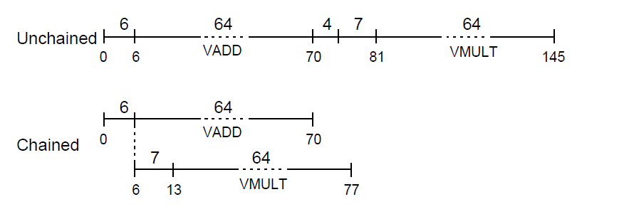
Vector Opt #1: Chaining

Slide 33
Vector Opt #2: Conditional Execution
Suppose:
do 100 i = 1, 64
if (A(i) .ne. 0) then
A(i) = A(i) – B(i)
endif
100 continue
vector-mask control takes a Boolean vector: when vector-mask register is loaded from vector test, vector instructions operate only on vector elements whose corresponding entries in the vector-mask register are 1.

Slide 34
Vector Opt #3: Sparse Matrices
Suppose:
do i = 1,n
A(K(i)) = A(K(i)) + C(M(i))
gather (LVI) operation takes an index vector and fetches the vector whose elements are at the addresses given by adding a base address to the offsets given in the index vector => a nonsparse vector in a vector register
After these elements are operated on in dense form, the sparse vector can be stored in expanded form by a scatter store (SVI), using the same index vector
Can't be done by compiler since can't know Ki elements distinct, no dependencies; by compiler directive
Use CVI to create index 0, 1xm, 2xm, ..., 63xm

Slide 35
Applications
Multimedia Processing (compress., graphics, audio synth, image proc.)
Standard benchmark kernels (Matrix Multiply, FFT, Convolution, Sort)
Lossy Compression (JPEG, MPEG video and audio)
Lossless Compression (Zero removal, RLE, Differencing, LZW)
Cryptography (RSA, DES/IDEA, SHA/MD5)
Speech and handwriting recognition
Operating systems/Networking (memcpy, memset, parity, checksum)
Databases (hash/join, data mining, image/video serving)
Language run-time support (stdlib, garbage collection)
even SPECint95

Slide 36
Intel x86 SIMD Extensions
MMX (Pentium MMX, Pentium II)
  MM0 to MM7 64 bit registers (packed)
  Aliased with x87 FPU stack registers
  Only integer operations
    Saturation Arithmetic great for DSP

Slide 37
Intel x86 SIMD Extensions
SSE (Pentium III)
  128-bit registers (XMM0 to XMM7) with floating point support
  Example
vec_res.x = v1.x + v2.x;
vec_res.y = v1.y + v2.y;
vec_res.z = v1.z + v2.z;
vec_res.w = v1.w + v2.w;
movaps xmm0,address-of-v1
addps xmm0,address-of-v2
movaps address-of-vec_res,xmm0
C code
SSE code

Slide 38
Intel x86 SIMD Extensions
SSE 2 (Pentium 4 – Willamette)
  Extends MMX instructions to operate on XMM registers (twice as wide as MM)
  Cache control registers
    To prevent cache pollution while accessing indefinite stream of instructions

Slide 39
Intel x86 SIMD Extensions
SSE 3 (Pentium 4 – Prescott)
  Capability to work horizontally in the register
    Add/Multiply multiple values stored in a single register
    Simplify the implementation of DSP oprns
  New Instruction to conv. fp to int and vice versa

Slide 40
Intel x86 SIMD Extensions
SSE 4
  50 new instructions, some related to multicore
    Dot product, Maximum, Minimum, Conditional copy, Compare Strings,
  Streaming load
    Improve Memory I/O throughput

Slide 41
Vectorization: Compiler Support
Vectorization of scientific code supported by icc, gcc
Requires code to written with regular memory access
  Using C arrays or FORTRAN code
Example:
Vectorized loop :
for (i=0; i<(N-N%VF); i+=VF){
a[i:i+VF] = a[i:i+VF] + b[i:i+VF];
}
for ( ; i < N; i++) {
a[i] = a[i] + b[i];
}
original serial loop:
for(i=0; i<N; i++){
a[i] = a[i] + b[i];
}

Slide 42
Classic loop vectorizer
data dependence tests
array dependences
dependence graph
int exist_dep(ref1, ref2, Loop)
Separable Subscript tests
  ZeroIndexVar
  SingleIndexVar
  MultipleIndexVar
  (GCD, Banerjee...)
Coupled Subscript tests
(Gamma, Delta, Omega…)
find SCCs
reduce graph
topological sort
for all nodes:
  Cyclic:
  keep sequential loop for this nest.
  non Cyclic:
loop transform to break cycles
for i
for j
for k
A[5] [i+1] [ j] = A[N] [i] [k]
for i
for j
for k
A[5] [i+1] [ i] = A[N] [i] [k]
replace node with vector code
David Naishlos, Autovectorization in GCC , IBM Labs Haifa

Slide 43
Assignment #1
Vectorizing C code using gcc’s vector extensions for Intel SSE instructions

Slide 45
1993: Connection Machine-5
MIMD architecture
  Fat tree network of SPARC RISC Processors
Supported multiple pgmming models, languages
  Shared Memory vs Message passing
  LISP, FORTRAN, C
Applications
  Intended for AI but found greater success in computational science

Slide 46

1993: Connection Machine-5

Slide 47
2005: Blue Gene/L
$100 million research initiative by IBM, LLNL and US DoE
Unique Features
  Low Power
  Upto 65536 nodes, each with SoC design
  3-D Torus Interconnect
Goals
  Advance Scale of Biomolecular simulations
  Explore novel ideas in MPP arch & systems
Notes:
Two goals
Advance Scale of Biomolecular simulations
Explore novel ideas in MPP arch & systems

Slide 48
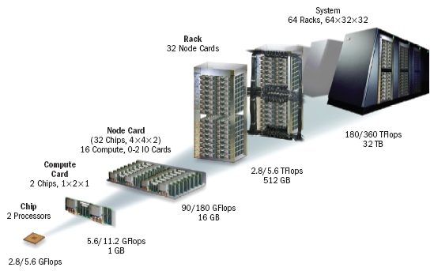
2005: Blue Gene/L
Notes:
Two goals
Advance Scale of Biomolecular simulations
Explore novel ideas in MPP arch & systems

Slide 49
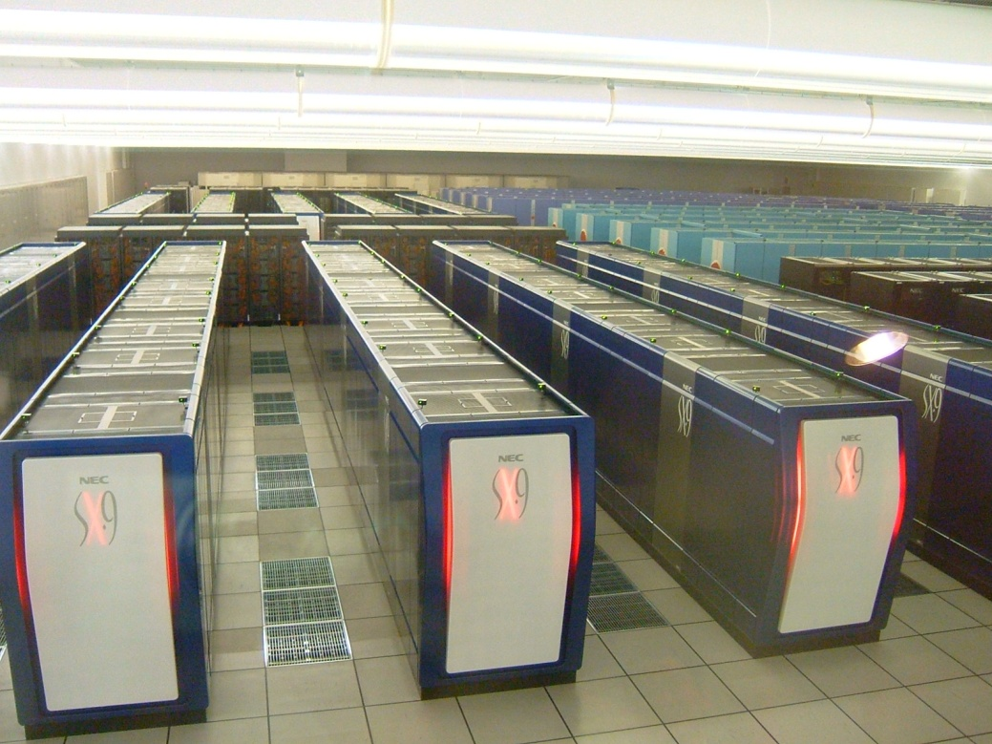
2002: NEC Earth Simulator
Fastest Supercomputer from 2002-2004
640 nodes with 16GB memory at each node
SX-6 node
  8 vector processors + 1 scalar processors on single chip
  Branch Prediction, Speculative Execution
Application
  Modeling Global Climate Changes

