Slide 1
Debugging Techniques
For
Concurrent Programs
Divjyot Sethi with Stephen Beard, Raman Arun, Arnab Sinha, Yun Zhang, Soumyadeep Ghosh

Slide 2
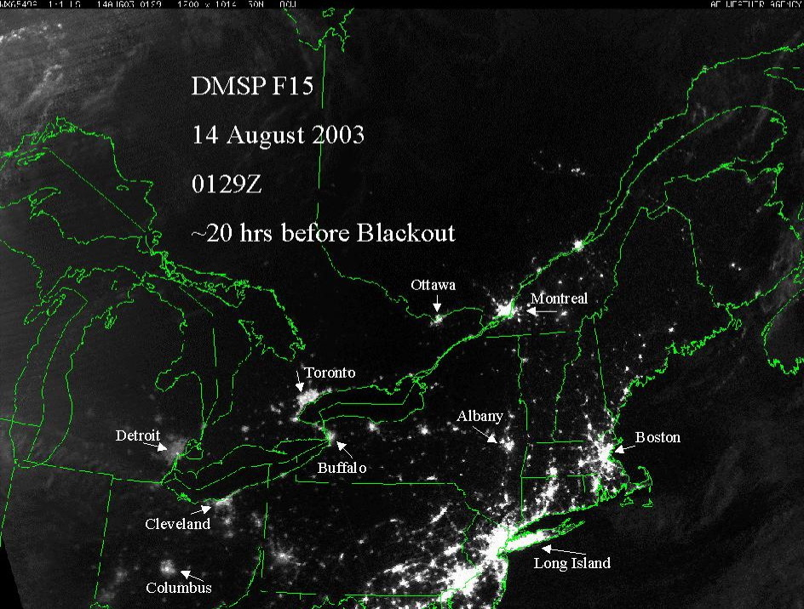
The Northeastern blackout, August 2003
Toronto
Notes:
Some of you may still remember the Norteastern balckout of 2003”. In just hours, big cities had gone dark due to the blackout incident.

Slide 3
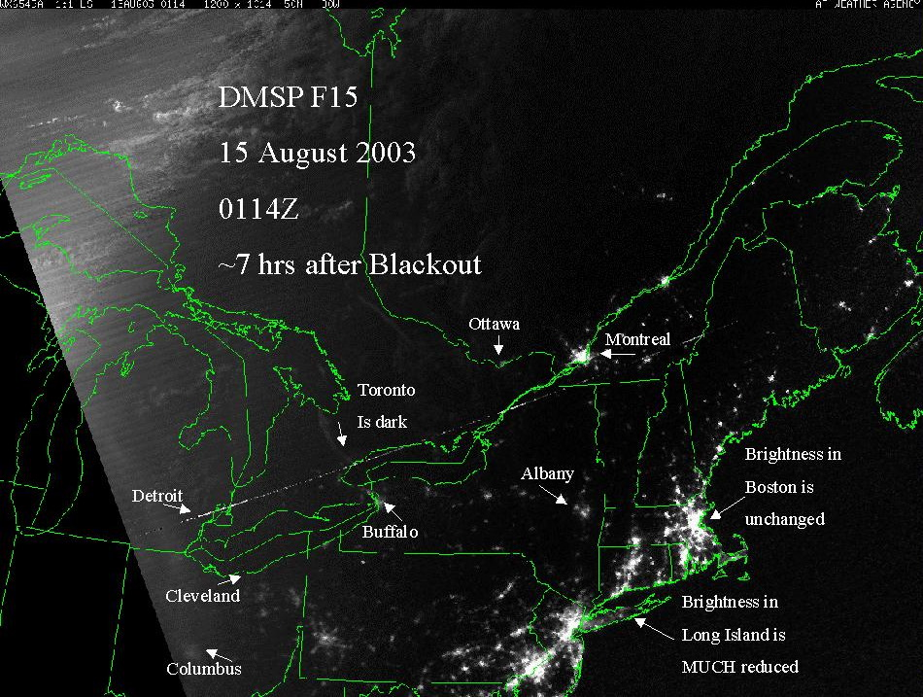
The Northeastern blackout, August 2003
Investigation Revealed
… a race condition, triggered on August 14th by a perfect storm of events …
SecurityFocus, April 7th, 2004
Toronto went dark

Slide 4

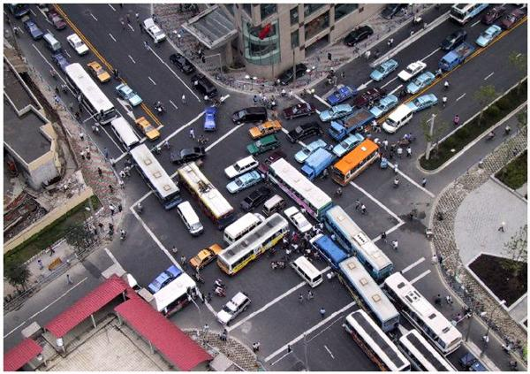
Concurrent Programming is HARD
Easy to write racy code
Deadlocks ☹

Slide 5

Concurrent Programming is HARD
Nontrivial specification
How does one know if the parallel implementation of an algorithm still implements the algorithm?

Slide 6
Overview
Issues in concurrent programs
Simulation based verification
Runtime Verification
Summary and ongoing research

Slide 7
Concurrent Code
Some Important bugs
Deadlock and starvation
Livelock
Race conditions

Slide 8
Deadlock and Starvation
Deadlock – A situation where no further progress can be made by the program (when all processes are blocked).
Let S and Q be two locks
P₀ P₁
S.Lock(); Q.Lock();
Q.Lock(); S.Lock();
 
S.Unlock(); Q.Unlock();
Q.Unlock(); S.Unlock();
Starvation - A process is ready to run or to use a resource, but is never given a chance by the scheduler.

Slide 9
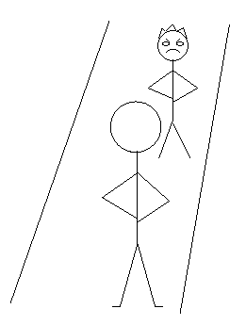
Livelock
Threads are doing something… yet they are not doing anything useful!!
Livelock when two polite people in hallway
Notes:
You first
You first…
Saying something but not doig anything

Slide 10
Where is the Livelock?
// thread 1
getLocks12(lock1, lock2)
{
lock1.lock();
while (lock2.locked())
{
lock1.unlock();
wait();
lock1.lock();
}
lock2.lock();
}
// thread 2
getLocks21(lock1, lock2)
{
lock2.lock();
while (lock1.locked())
{
lock2.unlock();
wait();
lock2.lock();
}
lock1.lock();
}
Notes:
T1-> Lock1
T2->Lock2
T1 hits while
T2 hits while
T1 frees Lock1
T1 waits
T2 frees Lock2
T2 waits
T1 wakes, locks 1
T2 wakes, locks 2
T1 hits while again
T2 hits while again

Slide 11
Data Race
Two concurrent accesses to a memory location where at least one of them is a write.
Example:
  int x = 1;
  Parallel.Invoke(
  () => { x = 2; },
  () => { System.Console.WriteLine(x);}
  );
Possible outcomes?
  1
  2
writes x
reads x

Slide 12
Concurrent Code
What is defined as correct?
Producers
P1
Enq(v1)
Parallel Queue
Consumer
P2
Enq(v2)
Deq
C1
P3
Enq(v3)
Deq -> v2
Deq -> v4
Deq -> v1
Is this correct??
Enq(v4)
P4
Depends on what you define as correct!

Slide 13
Correctness Condition
Data type implementations must appear
sequentially consistent to the client program.
 Observation
 Witness Interleaving
Thread 1
Thread 2
Serialization
enqueue(1)
enqueue(2)
dequeue() -> 1
dequeue() -> 2
enqueue(1)
dequeue() -> 2
enqueue(2)
dequeue() -> 1
The observed argument and return values must be consistent with some global sequence of the operations.
Courtesy: Rajiv Alur
Notes:
- operation-level sequential consistency
- an implementation is CORRECT if illusion is successful.

Slide 14
Serializability
Concurrent execution
[Papadimitriou ‘79]
~
~
~
~
~
~
~
~
~
Equivalent global execution
Notes:
Go back to the previous slide for the example…

Slide 15
Correctness Condition
Data type implementations must appear
sequentially consistent to the client program.
 Observation
 Witness Interleaving
Thread 1
Thread 2
Serialization
enqueue(1)
enqueue(2)
dequeue() -> 1
dequeue() -> 2
enqueue(1)
dequeue() -> 2
enqueue(2)
dequeue() -> 1
~
~
~
Here means values seen by dequeue in the serialization matches original values
Courtesy: Rajiv Alur
Notes:
- operation-level sequential consistency
- an implementation is CORRECT if illusion is successful.

Slide 16
Challenges in Parallel programming: Summary
What could go wrong?
  Deadlocks
  Livelocks
  Data Races
What is defined as correct??
  Correctness notions
    Serializability

Slide 17
Overview
Issues in concurrent programs
Simulation based verification
Runtime Verification
Summary and ongoing research

Slide 18
Simulation based verification: Challenges
Concurrent executions are highly non-determinisitic
Rare thread interleavings result in Heisenbugs
  Difficult to find, reproduce, and debug
Observing the bug can “fix” it
  Likelihood of hitting the same bug can change, say, when you add printfs
A huge productivity problem
  Developers and testers can spend weeks chasing a single Heisenbug
Courtesy Madan Musuvathi

Slide 19
Execution Replay: Bug reproduction
Run the program
On finding bug, have a mechanism to reproduce the bug.
Challenging due to non-determinism at various levels.
  Input
  Timing
  Multiple processors
Notes:
Timing: Due to multi threads
Multiprocessors: Due to multiple processors

Slide 20
Content-based
Record input for every instruction
r1 = 10
r1 = 11
r2 = 401
r1=11
…
add r1,1 → r1
load 8(r1) → r2
store r2 → 12(r1)
…
+ Instruction can be executed in isolation
– Huge trace files
Courtesy Frank Cornelis et al.

Slide 21
Ordering-based
Record ordering of important events in the program from a given initial state, to aid replay.
C1; C2
+ Smaller trace files
– Reexecution required
Courtesy Frank Cornelis et al.

Slide 22
Execution replay systems: Summary
 | DejaVu 1 | DejaVu 2 | IGOR | Instant Replay | Interrupt Replay | JaRec | jRapture | Recap | RecPlay | RSA | Tornado
Input
System Calls |  |  |  |  |  |  | ✓ | ✓ |  |  | ✓
Interrupts |  | ✓ |  |  | ✓ |  |  |  |  | ✓
Shared-Memory (content-based) |  |  | ✓ |  |  |  |  | ✓
Shared-Memory (ordering-based) | ✓ |  |  | ✓ |  | ✓ |  |  | ✓ | ✓
Courtesy Frank Cornelis et al.

Slide 23
CHESS: Smart bug hunting
Probability of finding a bug is low due to interleavings
Thread1
Thread2
x = 1;
y = 1;
x = 2;
y = 2;
0,0
x = 1;
1,0
2,0
y = 1;
1,1
2,0
1,0
2,2
x = 2;
2,1
2,1
2,2
1,1
1,2
1,2
y = 2;
2,2
2,2
2,1
1,2
1,1
1,1
Probability of hitting a buggy branch is low!
Courtesy Madan Musuvathi et al.
Notes:
Explain: probability of hitting a bug is low
Repeated simulation: you might end up simulating the same path again and again… Addressed by chess

Slide 24
CHESS
CHESS is a user-mode scheduler
  Controls all scheduling non-determinism
Guarantees:
  Every program run takes a different thread interleaving
  Reproduce the interleaving for every run
Courtesy Madan Musuvathi et al.
Notes:
q) Does it control ALL non-determinism?

Slide 25
CHESS Basic Idea
  Synchronization Wrappers: All important calls like enter_critical, create_thread etc. are wrapped using CHESS defined functions.
    Programs call these CHESS defined functions.
  These CHESS defined functions inform the CHESS scheduler about process status, and also make actual system calls

Slide 26
CHESS Synchronization Wrappers
Expose nondeterministic choices
Provide enabled information
Chess scheduler finds disabled threads this way.
CHESS_EnterCS{
while(true) {
canBlock = TryEnterCS (&cs);
if(canBlock)
Sched.Disable(currThread);
}
}

Slide 27
CHESS Scheduler
Introduce an event per thread
Every thread blocks on its event
The scheduler wakes one thread at a time by enabling the corresponding event
The scheduler does not wake up a disabled thread
  Need to know when a thread can make progress
    Wrappers for synchronization provide this information
The scheduler has to pick one of the enabled threads
  The exploration engine decides for the scheduler
Courtesy Madan Musuvathi et al.

Slide 28
CHESS: State space explosion
Thread 1
Thread n
Number of executions
= O( n^{nk} )
Exponential in both n and k
  Typically: n < 10 k > 100
Limits scalability to large programs
x = 1;
…
…
…
…
…
y = k;
x = 1;
…
…
…
…
…
y = k;
…
k steps
each
n threads
Huge State Space!

Slide 29
CHESS: State space explosion
Thread 1
Thread 2
Choose c preemption points
x = 1;
…
…
…
…
…
y = k;
x = 1;
…
…
…
…
x = 1;
…
…
…
…
…
y = k;
x = 1;
…
…
…
Permute n+c atomic blocks
…
…
…
y = k;
y = k;
Terminating program with fixed inputs and deterministic threads
  n threads, k steps each, c preemptions
Number of executions <= _{nk}C_{c} . (n+c)!
= O( (n²k)^{c}. n! )
  Exponential in n and c, but not in k

Slide 30
Chess: Summary
CHESS is a tool for
Systematically enumerating thread interleavings
  Algorithms for systematic scheduling
Reliably reproducing concurrent executions
Limits state space by limiting preemption points.

Slide 31
Overview
Issues in concurrent programs
Simulation based verification
Runtime Verification
Summary and ongoing research

Slide 32
Challenges in Simulation
Too many traces
Poor absolute coverage
Difficult to derive useful traces
Difficult to characterize true coverage
Courtesy Valeria Bertacco

Slide 33
Runtime Verification
On-the-fly checking
Focus on current trace
Complete coverage
Courtesy Valeria Bertacco

Slide 34
Runtime Verification Case Study: Transactional Memory
Notes:
Explain motivation for picking up this case study
Ask people if they are familiar with transactional memory basics?

Slide 35
What is Transactional Memory?
System state S1
begin_transaction
read a;
write b;
end_transaction
Transaction Boundaries
System state S2
Modified system state (S2) is visible only if transaction completes execution (commit), otherwise (abort) earlier state (S1) is preserved.
Courtesy Arnab Sinha et al.

Slide 36
Serializability in Transactional Memory
Serializability: Global order of operations (transaction execution) exists.
init: a = b = 0;
// Transaction T1
begin_transaction
read a;
read b;
end_transaction
// Transaction T2
begin_transaction
write b:=1;
end_transaction
Transaction T1 reads (a, b) = (0, 1).
Transaction T2 writes (a, b) = (0, 1).
Hence, in effect, trans. T1 follows trans. T2. Therefore, this execution trace is serializable!
time
We assume that this trace is serializable.
Transaction T1 reads (a, b) = (0, 1).
Transaction T2 writes (a, b) = (1, 1).
Case 1: T1 < T2
T1 should have read (0, 0).
Case 2: T2 < T1
T1 should have read (1, 1).
Contradiction!
Therefore, this execution trace is not serializable!
init: a = b = 0;
// Transaction T1
begin_transaction
read a;
read b;
end_transaction
// Transaction T2
begin_transaction
write a:=1;
write b:=1;
end_transaction
time
Courtesy Arnab Sinha et al.
Notes:
Explain: We are checking an implementation of transactional memory here…

Slide 37
Serializability Checking through Graph Checking
Vertices are the transactions.
Edges represent the conflicting shared data accesses (e.g. RAW, WAR and WAW).
Edge A → B, if trans. A accesses before trans B.
init: a = b = 0;
// Transaction T1
begin_transaction
read a;
read b;
end_transaction
// Transaction T2
begin_transaction
write b:=1;
end_transaction
time
T1
T2
RAW
No cycle → Serializable execution
WAR
init: a = b = 0;
// Transaction T1
begin_transaction
read a;
read b;
end_transaction
// Transaction T2
begin_transaction
write a:=1;
write b:=1;
end_transaction
T1
T2
time
RAW
Cycle exists → Therefore, this execution
trace is not serializable!
Courtesy Arnab Sinha et al.

Slide 38

Top-Level Algorithm
Challenge 2: Efficient graph construction
Graph construction
DSR
graph
DSR
graph
Transaction threads
Logging the “interesting” events
Challenge 1: Minimize logging overhead on transactions
Graph compaction
Challenge 3: Efficient graph compaction
Courtesy Arnab Sinha et al.

Slide 39
Runtime Verification Case Study: ERASER

Slide 40
ERASER
Eraser checks that all shared memory accesses follow a consistent locking discipline.
  a locking discipline is a programming policy that ensures the absence of data races.
  E.g. every variable shared between threads is protected by a mutual exclusion lock.
Courtesy: Stefan Savage et al.

Slide 41
Lockset Algorithm
The basic lockset algorithm enforces the locking discipline that every shared variable is protected by some lock.
Eraser checks whether the program respects this discipline by monitoring all reads and writes as the program executes.
Eraser infers the protection relation from the execution history.
Courtesy: Stefan Savage et al.

Slide 42
Lockset Algorithm
Locks: mu1, mu2
Shared Variable: v
Programs
locks_held
C(v): Candidate Locks for variable v
{ }
{mu1}
{mu1,mu2}
{mu1}
{ }
{mu2}
{mu1, mu2}
{mu1,mu2}
{mu1}
{ }
issues an alarm!!
1
2
3
4
5
6
7
8
9
10
lock(mu1) ;
lock(mu2) ;
v := v+1 ;
unlock(mu2) ;
v := v+2 ;
unlock(mu1) ;
lock(mu2) ;
v := v+1 ;
Courtesy: Stefan Savage et al.

Slide 43
Lockset Algorithm
If some lock l consistently protects v, it will remain in C(v) as C(v) is refined. If C(v) becomes empty, this indicates that there is no lock that consistently protects v.
In summary, the first lockset algorithm is
  Let locks_held(t) be the set of locks held by thread t
  For each v, initialize C(v) to the set of all locks.
  On each access to v by thread t,
  set C(v) := C(v) Å locks_held(t) ;
  if C(v) = { }, then issue a warning.
Courtesy: Stefan Savage et al.

Slide 44
Overview
Issues in concurrent programs
Simulation based verification
Runtime Verification
Summary and ongoing research

Slide 45
Summary
Challenges in parallel programming
Simulation based verification
  Execution Replay
  Systematic bug hunting: CHESS
Runtime Validation
  Transaction Memories
  Eraser (Lockset Algorithm)

Slide 46
Acknowledgements
Yun Zhang
Arnab Sinha
Arun Raman
Stephen Beard
Soumyadeep Ghosh
Daniel Schwartz-Narbonne
Prof. David Walker
Prof. Sharad Malik
Prof. David August

Slide 47
THANK
YOU

