Slide 1
Transactional Memory
Lecture II
Daniel Schwartz-Narbonne
COS597C
Notes:
list of citasions
examples

Slide 2
Hardware Transactional Memories
Hybrid Transactional Memories
Case Study: Sun Rock
Clever ways to use TM

Slide 3
Recap: Parallel Programming
Find independent tasks in the algorithm
Map tasks to execution units (e.g. threads)
Define and implement synchronization among tasks
  Avoid races and deadlocks, address memory
  model issues, …
Compose parallel tasks
Recover from errors
Ensure scalability
Manage locality
…
Transactional Memory
Notes:
Transactional memory offers a higher-level abstraction for writing parallel programs.
Let’s see how transactions …

Slide 4
Recap: TM Implementation
Data Versioning
Eager Versioning
Lazy Versioning
Conflict Detection and Resolution
Pessimistic Concurrency Control
Optimistic Concurrency Control
Conflict Detection Granularity
Object Granularity
Word Granularity
Cache line Granularity

Slide 5
Hardware vs. Software TM
Hardware Approach
Low overhead
  Buffers transactional state in Cache
More concurrency
  Cache-line granularity
Bounded resource
Software Approach
High overhead
  Uses Object copying to keep transactional state
Less Concurrency
  Object granularity
No resource limits
Useful BUT Limited
Useful BUT Limited
Notes:
green and red

Slide 6
Hardware Transactional Memory
Transactional memory implementations require tracking read / write sets
Need to know whether other cores have accessed data we are using
Expensive in software
  Have to maintain logs / version ID in memory
  Every read / write turns into several instructions
  These instructions are inherently concurrent with the actual accesses, but STM does them in series
Notes:
how does this differ from isa extention
graph – software tm
hardware accelerated
hybrid
htm

Slide 7
Hardware Transactional Memory
Idea: Track read / write sets in Hardware
  Unlike Hardware Accelerated TM, handle commit / rollback in hardware as well
Cache coherent hardware already manages much of this
Basic idea: map storage to cache
HTM is basically a smarter cache
  Plus potentially some other storage buffers etc
Can support many different TM paradigms
  Eager, lazy
  optimistic, pessimistic
Default seems to be Lazy, pessimistic

Slide 8
HTM – The good
Most hardware already exists
Only small modification to cache needed
Core
Regular
Accesses
L1 $
L1 $
Tag
Data
Kumar et al. (Intel)

Slide 9
HTM – The good
Most hardware already exists
Only small modification to cache needed
Core
Regular
Accesses
Transactional
Accesses
L1 $
L1 $
Transactional $
Addl. Tag
Old Data
New Data
Tag
Data
Tag
Kumar et al. (Intel)

Slide 10
HTM Example
Tag | data | Trans? | State | Tag | data | Trans? | state
atomic {
read B
Write A = 2
}
Bus Messages:
atomic {
read A
write B =1
}

Slide 11
HTM Example
Tag | data | Trans? | State | Tag | data | Trans? | state
 |  |  |  | B | 0 | Y | S
atomic {
read B
Write A = 2
}
Bus Messages: 2 read B
atomic {
read A
write B =1
}

Slide 12
HTM Example
Tag | data | Trans? | State | Tag | data | Trans? | state
A | 0 | Y | S
 |  |  |  | B | 0 | Y | S
atomic {
read B
Write A = 2
}
Bus Messages: 1 read A
atomic {
read A
write B =1
}

Slide 13
HTM Example
Tag | data | Trans? | State | Tag | data | Trans? | state
A | 0 | Y | S
B | 1 | Y | M | B | 0 | Y | S
atomic {
read B
Write A = 2
}
Bus Messages: NONE
atomic {
read A
write B =1
}

Slide 14
Conflict, visibility on commit
Tag | data | Trans? | State | Tag | data | Trans? | state
A | 0 | N | S
B | 1 | N | M | B | 0 | Y | S
atomic {
read B
ABORT
Write A = 2
}
Bus Messages: 1 B modified
atomic {
read A
write B =1
}

Slide 15
Conflict, notify on write
Tag | data | Trans? | State | Tag | data | Trans? | state
A | 0 | Y | S
B | 1 | Y | M | B | 0 | Y | S
atomic {
read B
ABORT?
Write A = 2
}
Bus Messages: 1 speculative write to B
2: 1 conflicts with me
atomic {
read A
write B =1 ABORT?
}

Slide 16

HTM – The good
Strong isolation

Slide 17
HTM – The good
ISA Extensions
Allows ISA extentions (new atomic operations)
Double compare and swap
Necessary for some non-blocking algorithms
Similar performance to handtuned java.util.concurrent implementation (Dice et al, ASPLOS ’09)
int DCAS(int *addr1, int *addr2, int old1, int old2, int new1, int new2)
atomic {
if ((*addr1 == old1) && (*addr2 == old2)) {
*addr1 = new1;
*addr2 = new2;
return(TRUE);
} else return(FALSE);
}
Notes:
show examples of how these are used

Slide 18
HTM – The good
ISA Extensions
int DCAS(int *addr1, int *addr2, int old1, int old2, int new1, int new2)
atomic {
if ((*addr1 == old1) && (*addr2 == old2)) {
*addr1 = new1;
*addr2 = new2;
return(TRUE);
} else return(FALSE);
}
Ref count = 1
ref count = 2
ref count =1
Ref count = 1
ref count = 1
ref count =1
Notes:
show examples of how these are used

Slide 19
HTM – The good
ISA Extensions
Allows ISA extentions (new atomic operations)
Atomic pointer swap
Elem 1
Loc 1
Elem 2
Loc 2
Notes:
show examples of how these are used

Slide 20
HTM – The good
ISA Extensions
Allows ISA extentions (new atomic operations)
Atomic pointer swap
  21-25% speedup on canneal benchmark (Dice et al, SPAA’10)
Elem 1
Loc 1
Elem 2
Loc 2
Notes:
show examples of how these are used

Slide 21
HTM – The bad
False Sharing
Tag | data | Trans? | State | Tag | data | Trans? | state
 |  |  |  | C/D | 0/0 | Y | S
atomic {
read C
Write B = 2
}
Bus Messages: Read C/D
atomic {
read A
write D = 1
}

Slide 22
HTM – The bad
False Sharing
Tag | data | Trans? | State | Tag | data | Trans? | state
 |  |  |  | C/D | 0/0 | Y | S
A/B | 0/0 | Y | S
atomic {
read C
Write B = 2
}
Bus Messages: Read A/B
atomic {
read A
write D = 1
}

Slide 23
HTM – The bad
False sharing
Tag | data | Trans? | State | Tag | data | Trans? | state
C/D | 0/1 | Y | M | C/D | 0/0 | Y | S
A/B | 0/0 | Y | S
atomic {
read C
Write B = 2
}
Bus Messages: Write C/D
atomic {
read A
write D = 1
}
UH OH

Slide 24
HTM – The bad
Context switching
Cache is unaware of context switching, paging, etc
OS switching typically aborts transactions

Slide 25
HTM – The bad
Inflexible
Poor support for advanced TM constructs
Nested Transactions
Open variables
etc

Slide 26
HTM – The bad
Limited Size
Tag | data | Trans? | State | Tag | data | Trans? | state
A | 0 | Y | M
Bus Messages: Read A
atomic {
read A
read B
read C
read D
}
Write C/

Slide 27
HTM – The bad
Limited Size
Tag | data | Trans? | State | Tag | data | Trans? | state
A | 0 | Y | M
B | 0 | Y | M
Bus Messages: Read B
atomic {
read A
read B
read C
read D
}

Slide 28
HTM – The bad
Limited Size
Tag | data | Trans? | State | Tag | data | Trans? | state
A | 0 | Y | M
B | 0 | Y | M
C | 0 | Y | M
Bus Messages: Read C
atomic {
read A
read B
read C
read D
}

Slide 29
HTM – The bad
Limited Size
Tag | data | Trans? | State | Tag | data | Trans? | state
A | 0 | Y | M
B | 0 | Y | M
C | 0 | Y | M
Bus Messages: …
atomic {
read A
read B
read C
read D
}
UH OH

Slide 30
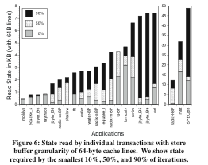
Transactional memory coherence and consistency (Hammond et al, ISCA ‘04)

Slide 31
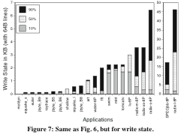
Transactional memory coherence and consistency (Hammond et al, ISCA ‘04)

Slide 32
Hardware vs. Software TM
Hardware Approach
Low overhead
  Buffers transactional state in Cache
More concurrency
  Cache-line granularity
Bounded resource
Software Approach
High overhead
  Uses Object copying to keep transactional state
Less Concurrency
  Object granularity
No resource limits
Useful BUT Limited
Useful BUT Limited
What if we could have both worlds simultaneously?
Notes:
green and red

Slide 33
Hybrid TM
Damron et al. ASPLOS ’06
Pair software transactions with best-effort hardware transactions
High level idea: software transactions maintain read/write state of variables, which hardware transactions can check
  Similar to the cached bits in HTM
Hashed table of per-object orecs
Each record can be unowned, owned by 1 or more readers, or owned exclusive for writing

Slide 34
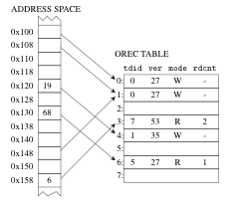
Hybrid TM
Notes:
work example

Slide 35
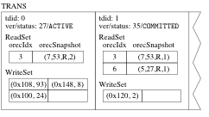
Hybrid TM

Slide 36


Hybrid TM

Slide 37
Hybrid TM
Example on board

Slide 38
Hybrid TM
Few problems:
Change from unowned to read will spuriously fail transaction
orec reading overhead unnecessary when only hardware transactions are running
  Can maintain num_software_transactions variable, and avoid orec accesses when == 0

Slide 39
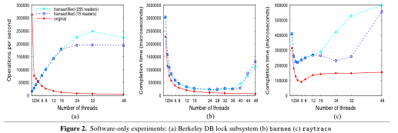
Hybrid TM

Slide 40
Case Study: SUN Rock
Commercial processor with HTM support
Sun actually built it, and was going to sell it
Canceled by Oracle ☹
Fascinating look into the real world challenges of HTM
Dice, Lev, Moir and Nussbaum ASPLOS’09
Notes:
floorplan pictures

Slide 41
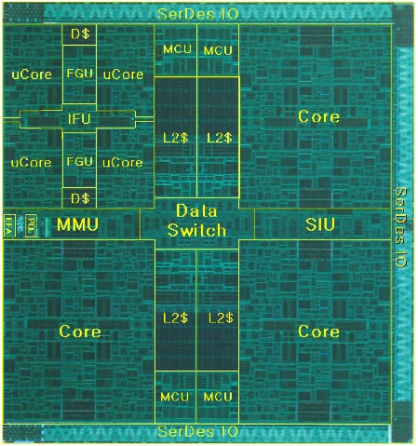
Case Study: Sun Rock

Slide 42
Case Study: SUN Rock
Major challenge: Diagnosing the cause of Transaction aborts
  Necessary for intelligent scheduling of transactions
  Also for debugging code
  And equally importantly, debugging the processor architecture / µarchitecture
Many unexpected causes of aborts
And Rock v1 diagnostics were unable to distinguish many distinct failure modes

Slide 43
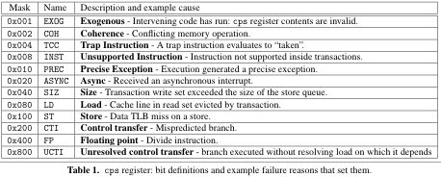
Case Study: SUN Rock

Slide 44
Case Study: SUN Rock
Several unexpected sources of aborts
Branch mispredictions
  Rock supports speculative branch execution. Mispredicted branches might invalidly cause the transaction to abort
TLB misses
  Context switches abort transactions. To get good performance, they found they had to warm the data structures using dummy CAS instructions
Excessive cache misses
  Rock hides cache miss latency using speculative buffers
  If these buffers overflow, transaction must abort
Core multithreading configuration
  Each core can execute 2 threads in parallel, or one thread with twice the resources.

Slide 45
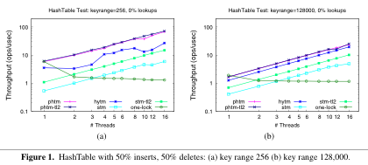
Case Study: SUN Rock

Slide 46
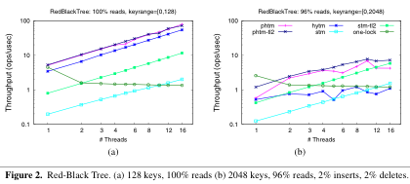
Case Study: SUN Rock

Slide 47
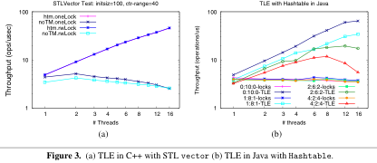
Case Study: SUN Rock

Slide 48
Clever Ways to use TM
Lock Elision
  In many data structures, accesses are contention free in the common case
  But need locks for the uncommon case where contention does occur
  For example, double ended queue
  Can replace lock with atomic section, default to lock when needed
  Allows extra parallelism in the average case

Slide 49
Lock Elision
hashTable.lock()
var = hashTable.lookup(X);
if (!var) hashTable.insert(X);
hashTable.unlock();
hashTable.lock()
var = hashTable.lookup(Y);
if (!var) hashTable.insert(Y);
hashTable.unlock();
Parallel Execution
atomic {
if (!hashTable.isUnlocked()) abort;
var = hashTable.lookup(X);
if (!var) hashTable.insert(X);
} orElse …
atomic {
if (!hashTable.isUnlocked()) abort;
var = hashTable.lookup(X);
if (!var) hashTable.insert(X);
} orElse …

Slide 50
Privatization
atomic {
var = getWorkUnit();
do_long_compution(var);
}
VS
atomic {
var = getWorkUnit();
}
do_long_compution(var);
Note that this may only work correctly in STMs that support strong
isolation

Slide 51
Work Deferral
atomic {
do_lots_of_work();
update_global_statistics();
}

Slide 52
Work Deferral
atomic {
do_lots_of_work();
update_global_statistics();
}
atomic {
do_lots_of_work();
atomic open {
update_global_statistics();
}
}

Slide 53
Work Deferral
atomic {
do_lots_of_work();
update_global_statistics();
}
atomic {
do_lots_of_work();
atomic open {
update_global_statistics();
}
}
atomic {
do_lots_of_work();
queue_up
update_local_statistics(); //effectively serializes transactions
}
atomic{
update_global_statististics_using_local_statistics()
}

Slide 54
} commit transaction(talk)
Any questions?

Slide 55
Bibliography
Chi Cao Minh, Martin Trautmann, JaeWoong Chung, Austen McDonald, Nathan Bronson, Jared Casper, Christos Kozyrakis, and Kunle Olukotun. 2007. An effective hybrid transactional memory system with strong isolation guarantees. SIGARCH Comput. Archit. News 35, 2 (June 2007), 69-80. DOI=10.1145/1273440.1250673 http://doi.acm.org/10.1145/1273440.1250673
Bratin Saha, Ali-Reza Adl-Tabatabai, and Quinn Jacobson. 2006. Architectural Support for Software Transactional Memory. In Proceedings of the 39th Annual IEEE/ACM International Symposium on Microarchitecture (MICRO 39). IEEE Computer Society, Washington, DC, USA, 185-196. DOI=10.1109/MICRO.2006.9 http://dx.doi.org/10.1109/MICRO.2006.9
Dave Dice, Yossi Lev, Mark Moir, and Daniel Nussbaum. 2009. Early experience with a commercial hardware transactional memory implementation. In Proceeding of the 14th international conference on Architectural support for programming languages and operating systems (ASPLOS '09). ACM, New York, NY, USA, 157-168. DOI=10.1145/1508244.1508263 http://doi.acm.org/10.1145/1508244.1508263
Dan Grossman. 2007. The transactional memory / garbage collection analogy. SIGPLAN Not. 42, 10 (October 2007), 695-706. DOI=10.1145/1297105.1297080 http://doi.acm.org/10.1145/1297105.1297080

Slide 56
Bibliography
Milo Martin, Colin Blundell, and E. Lewis. 2006. Subtleties of Transactional Memory Atomicity Semantics. IEEE Comput. Archit. Lett. 5, 2 (July 2006), 17-. DOI=10.1109/L-CA.2006.18 http://dx.doi.org/10.1109/L-CA.2006.18
Dave Dice , Ori Shalev , Nir Shavit Transactional Locking II (2006) In Proc. of the 20th Intl. Symp. on Distributed Computing
Lance Hammond, Vicky Wong, Mike Chen, Brian D. Carlstrom, John D. Davis, Ben Hertzberg, Manohar K. Prabhu, Honggo Wijaya, Christos Kozyrakis, and Kunle Olukotun. 2004. Transactional Memory Coherence and Consistency. In Proceedings of the 31st annual international symposium on Computer architecture (ISCA '04). IEEE Computer Society, Washington, DC, USA, 102-.
Rock: A SPARC CMT Processor www.hotchips.org/archives/hc20/3_Tues/HC20.26.931.pdf
Peter Damron, Alexandra Fedorova, Yossi Lev, Victor Luchangco, Mark Moir, and Daniel Nussbaum. 2006. Hybrid transactional memory. SIGOPS Oper. Syst. Rev. 40, 5 (October 2006), 336-346. DOI=10.1145/1168917.1168900 http://doi.acm.org/10.1145/1168917.1168900
Tatiana Shpeisman, Vijay Menon, Ali-Reza Adl-Tabatabai, Steven Balensiefer, Dan Grossman, Richard L. Hudson, Katherine F. Moore, and Bratin Saha. 2007. Enforcing isolation and ordering in STM. SIGPLAN Not. 42, 6 (June 2007), 78-88. DOI=10.1145/1273442.1250744 http://doi.acm.org/10.1145/1273442.1250744

