Slide 1
Transactional Memory – Implementation
Lecture 1
COS597C, Fall 2010
Princeton University
Arun Raman

Slide 2
Module Outline
Lecture 1 (THIS LECTURE)
Transactional Memory System Taxonomy
Software Transactional Memory
Hardware Accelerated STMs
Lecture 2 (Thursday)
Hardware based TMs
Hybrid TMs
When are transactions a good (bad) idea
Assignment
Compare lock-based and transaction-based
implementations of a concurrent data structure

Slide 3
Resources
[0] TL2 and STAMP Benchmark Suite --- For ASSIGNMENT
http://stamp.stanford.edu/
[1] Transactional Memory, Concepts, Implementations, and Opportunities -
Christos Kozyrakis
http://csl.stanford.edu/~christos/publications/2008.tm_tutorial.acaces.pdf
[2] Transactional Memory - Larus and Rajwar
Chapter 4: Hardware Transactional Memory
[3] McRT-STM: A High Performance Software Transactional Memory System for a Multi-core Runtime
http://portal.acm.org/ft_gateway.cfm?id=1123001&type=pdf&CFID=109418483&CFTOKEN=70706278
[4] Architectural Support for Software Transactional Memory (Hardware Accelerated STM) - Saha et al.
http://www.computer.org/portal/web/csdl/doi/10.1109/MICRO.2006.9
[5] Signature-Accelerated STM (SigTM)
http://portal.acm.org/citation.cfm?id=1250673
[6] Case Study: Early Experience with a Commercial Hardware
Transactional Memory Implementation [ASPLOS '09]
http://delivery.acm.org/10.1145/1510000/1508263/p157-dice.pdf?key1=1508263&key2=2655478821&coll=GUIDE&dl=GUIDE&CFID=111387689&CFTOKEN=28498606
[7] The Transactional Memory / Garbage Collection Analogy - Dan Grossman
http://portal.acm.org/ft_gateway.cfm?id=1297080&type=pdf&coll=GUIDE&dl=GUIDE&CFID=111387606&CFTOKEN=67012128
[8] Subtleties of Transactional Memory Atomicity Semantics - Blundell et al.
http://www.cis.upenn.edu/acg/papers/cal06_atomic_semantics.pdf
Lot of the material in this
lecture is sourced from here

Slide 4
Lecture Outline
Recap of Transactions
Transactional Memory System Taxonomy
Software Transactional Memory
Hardware Accelerated STM

Slide 5
Lecture Outline
Recap of Transactions
Transactional Memory System Taxonomy
Software Transactional Memory
Hardware Accelerated STMs

Slide 6
Parallel Programming
Find independent tasks in the algorithm
Map tasks to execution units (e.g. threads)
Define and implement synchronization among tasks
  Avoid races and deadlocks, address memory
  model issues, …
Compose parallel tasks
Recover from errors
Ensure scalability
Manage locality
…
Notes:
Parallel programming encompasses all the difficulties of sequential programming, but also introduces the hard problem of coordinating interactions among concurrently executing tasks. Today, most parallel programs employ low-level programming constructs that consist of threads, locks, and semaphores. Considerable experience has shown that parallel programs written with these constructs are difficult to design, program, debug, and often do not perform well.
Transactional memory offers a higher-level abstraction for writing parallel programs.
TODO: Turn into imperatives – Find …

Slide 7
Parallel Programming
Find independent tasks in the algorithm
Map tasks to execution units (e.g. threads)
Define and implement synchronization among tasks
  Avoid races and deadlocks, address memory
  model issues, …
Compose parallel tasks
Recover from errors
Ensure scalability
Manage locality
…
Transactional Memory
Notes:
Transactional memory offers a higher-level abstraction for writing parallel programs.
Let’s see how transactions …

Slide 8
Transactional Programming
void deposit(account, amount) {
lock(account);
int t = bank.get(account);
t = t + amount;
bank.put(account, t);
unlock(account);
}
void deposit(account, amount) {
atomic {
int t = bank.get(account);
t = t + amount;
bank.put(account, t);
}
}
Declarative Synchronization – What, not How
System implements Synchronization transparently
Notes:
No management of locks
Implementation typically with optimistic concurrency

Slide 9
Transactional Memory
Memory Transaction - An atomic and isolated sequence of memory accesses
Transactional Memory – Provides transactions for threads running in a shared address space
Notes:
Atomicity – What this means is that although the code in a transaction may modify individual variables through a series of assignments, another computation can only observe the program state immediately before or immediately after the transaction executes.
The bottomline is that a program’s author only needs to identify a sequence of operations on shared data that should appear to execute atomically to other, concurrent threads. It is the task of the TM system to ensure this outcome.

Slide 10
Transactional Memory - Atomicity
Atomicity – On transaction commit, all memory updates appear to take effect at once; on transaction abort, none of the memory updates appear to take effect
Thread 1
Thread 2
void deposit(account, amount) {
atomic {
int t = bank.get(account);
t = t + amount;
bank.put(account, t);
}
}
CONFLICT
RD
RD A : 0
RD A : 0
WR
WR A : 5
COMMIT
WR A : 10
ABORT
Notes:
Atomicity – What this means is that although the code in a transaction may modify individual variables through a series of assignments, another computation can only observe the program state immediately before or immediately after the transaction executes.
The bottomline is that a program’s author only needs to identify a sequence of operations on shared data that should appear to execute atomically to other, concurrent threads. It is the task of the TM system to ensure this outcome.

Slide 11
Transactional Memory - Isolation
Isolation – No other code can observe updates before commit
Programmer only needs to identify operation sequence that should appear to execute atomically to other, concurrent threads
Notes:
The bottomline is that a program’s author only needs to identify a sequence of operations on shared data that should appear to execute atomically to other, concurrent threads. It is the task of the TM system to ensure this outcome.

Slide 12
Transactional Memory - Serializability
Serializability – Result of executing concurrent transactions on a data structure must be identical to a result in which these transactions executed serially.
Notes:
This is the basic correctness condition for transactions. We have already looked at this in Assignment 2.

Slide 13
Some advantages of TM
Ease of use (declarative)
Composability
Expected performance of fine-grained locking
Notes:
Other advantage
Failure atomicity and recovery
No lost locks when a thread fails
Transaction abort and restart

Slide 14
Composability : Locks
void transfer(A, B, amount) {
synchronized(A) {
synchronized(B) {
withdraw(A, amount);
deposit(B, amount);
}
}
}
void transfer(B, A, amount) {
synchronized(B) {
synchronized(A) {
withdraw(B, amount);
deposit(A, amount);
}
}
}
Fine grained locking → Can lead to deadlock
Need some global locking discipline now
Notes:
TODO Alternatives to locks and transactions while parallelizing code

Slide 15
Composability : Locks
void transfer(A, B, amount) {
synchronized(bank) {
withdraw(A, amount);
deposit(B, amount);
}
}
void transfer(B, A, amount) {
synchronized(bank) {
withdraw(B, amount);
deposit(A, amount);
}
}
Fine grained locking → Can lead to deadlock
Coarse grained locking → No concurrency

Slide 16
Composability : Transactions
void transfer(A, B, amount) {
atomic {
withdraw(A, amount);
deposit(B, amount);
}
}
void transfer(B, A, amount) {
atomic {
withdraw(B, amount);
deposit(A, amount);
}
}
Serialization for transfer(A,B,100) and transfer(B,A,100)
Concurrency for transfer(A,B,100) and transfer(C,D,100)
Notes:
Transactions compose gracefully
Programmer declares global intention (atomic transfer)
No need to know of a global implementation strategy
Transaction in transfer subsumes those in withdraw and deposit
Outermost transaction defines atomicity boundary

Slide 17
Some issues with TM
I/O and unrecoverable actions
Atomicity violations are still possible
Interaction with non-transactional code
Notes:
Of course, transactional memory is not a panacea for parallel programming
Difficult to undo output and redo input
Possible solutions:
Buffer output and log input
Finalize output and clear log on commit
Does not work if atomic does input after output

Slide 18
Atomicity Violation
Thread 1
Thread 2
atomic {
…
ptr = A;
…
}
atomic {
…
ptr = NULL;
}
atomic {
B = ptr->field;
}
Notes:
The transaction boundaries for Thread 1 code must be redefined to prevent unexpected things from happening

Slide 19
Interaction with non-transactional code
Thread 1
Thread 2
lock_acquire(lock);
obj.x = 1;
if (obj.x != 1)
fireMissiles();
lock_release(lock);
obj.x = 2;
Notes:
Thread 1 operates on obj.x inside a critical section protected by lock. Thread 2’s unprotected updates to obj.x compete with thread 1’s access, resulting in a data race on obj.x. The result of the execution is not deterministic as Thread 2’s execution may change the value of obj.x at any time. Preventing the data race requires Thread 2 to acquire lock before modifying obj.x or Thread 2 not to execute concurrently with Thread 1.

Slide 20
Interaction with non-transactional code
Thread 1
Thread 2
atomic {
obj.x = 1;
if (obj.x != 1)
fireMissiles();
}
obj.x = 2;

Slide 21
Interaction with non-transactional code
Thread 1
Thread 2
atomic {
obj.x = 1;
if (obj.x != 1)
fireMissiles();
}
obj.x = 2;
Weak Isolation – Transactions are serializable only against other transactions
Strong Isolation – Transactions are serializable against all memory accesses (Non-transactional LD/ST are 1-instruction TXs)
Notes:
Strong atomicity, while desirable, has high overheads for software transactional memory

Slide 22
Nested Transactions
void transfer(A, B, amount) {
atomic {
withdraw(A, amount);
deposit(B, amount);
}
}
void deposit(account, amount) {
atomic {
int t = bank.get(account);
t = t + amount;
bank.put(account, t);
}
}
Semantics of Nested Transactions
Flattened
Closed Nested
Open Nested
Notes:
A nested transaction is a transaction whose execution is properly contained in the dynamic extent of another transaction. For now, we assume that there is only one thread of control for the transactions, so the outer one passes control to the inner one. The inner transaction sees modifications to program state made by the outer transaction. The behavior of the two transactions can be linked in several ways.

Slide 23
Nested Transactions - Flattened
int x = 1;
atomic {
x = 2;
atomic flatten {
x = 3;
abort;
}
}
Notes:
If the transactions are flattened, aborting the inner transaction causes the outer transaction to abort, but committing the inner transaction has no effect until the outer transaction commits, at which point the inner transaction’s changes become visible to other threads. The outer transaction sees modifications to program state made by the inner transaction. If the inner transaction is flattened in the following example, when the outer transaction terminates, the variable x has value 1. Flattened transactions are easy to implement, since there is only a single transaction in execution. However, they are a poor programming abstraction that subverts program composition, since an abort in a library routine terminates all surrounding transactions.
When the system aborts a transaction, it reexecutes the transaction to give it another opportunity to complete. When the program aborts a transaction, control passes to the statement after the atomic block or to an exception handler.

Slide 24
Nested Transactions - Closed
int x = 1;
atomic {
x = 2;
atomic closed {
x = 3;
abort;
}
}
Notes:
A closed transaction aborts without terminating its parent transaction. When a closed inner transaction commits or aborts, control passes to its surrounding transaction. If the inner transaction commits, its modifications become visible to the surrounding transaction. However, nonsurrounding transactions see these changes only when the outermost surrounding transaction commits. In the example, variable x is left with the value 2 because the inner transaction’s assignment is undone by the abort. Closed nesting can have higher overheads than flattened transactions. For executions that commit successfully, the behavior of flattening and closed nesting is equivalent. If commits are common, a TM system can take advantage of flattening transactions as a performance optimization and switch to closed nesting if aborts occur

Slide 25
Nested Transactions - Open
int x = 1;
atomic {
x = 2;
atomic open {
x = 3;
}
abort;
}
Notes:
By contrast, when an open transaction commits, its changes become visible to all other transactions in the system, even if the surrounding transaction is still executing. Moreover, even if the parent transaction aborts, the results of the nested, open transactions will remain committed. In the following example, even after the outer transaction aborts, variable x is left with the value 3.

Slide 26
Nested Transactions – Open – Use Case
int counter = 1;
atomic {
…
atomic open {
counter++;
}
}
Notes:
A common programming paradigm is to use a counter to generate unique tokens. If this counter is incremented in a closed transaction, then every transaction that uses the counter conflicts, and the counter effectively serializes their execution. If the transaction that obtains value N from the counter aborts, then every transaction that obtains a later value must also abort. Open transactions provide a mechanism to increment the counter atomically without serializing execution.
On the other hand, open transactions can subvert the ACI properties of transactions. The correctness of an optimization may depend on a subtle understanding of the semantics of a program. Consider the example above. In general, tokens only have to be unique (not contiguous), so it does not matter if an aborted transaction generated a value that was discarded. However, if this counter were recording the number of operations successfully completed, an aborted transaction must decrement the counter when it fails, an action known as compensation.

Slide 27
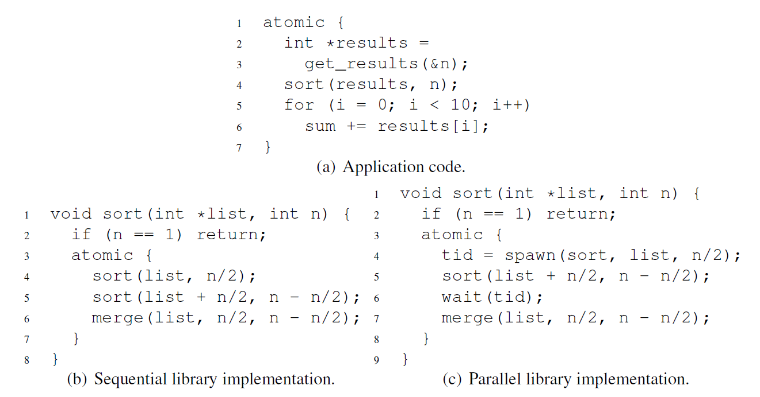
Nested Transactions ≠ Nested Parallelism!
Intelligent Speculation for Pipelined Multithreading
– Neil Vachharajani, PhD Thesis, Princeton University
Notes:
This code gathers a set of results, sorts the results, and then accumulates the first ten values in the sorted set. The code is executing within an atomic bloc k, so the underlying runtime system will initiate a transaction at the beginning of the block and attempt to commit it at the end of the block. Both sorts partition the list into two pieces and recursively sort each piece. The two sorted pieces are then merged to produce a fully sorted list. The first sort implementation is sequential and is compatible with the code executing in the atomic block. The atomic block contained inside the sort function creates a nested transaction, but not nested parallelism. The second sort implementation is parallel and delegates one of the two recursive sorts to another thread. Since nested parallelism is unsupported by proposed transactional memory (TM) systems, the parallel sort will not run correctly.
Problems first arise at the call to spawn. Since current TM proposals only provide single-threaded atomicity, the spawned thread necessarily does not run in the same transaction as the spawning thread. Consequently, the newly spawned thread cannot read the list it is supposed to sort since the data is still being buffered in the uncommitted spawning thread. Even if the data were available, the problem resurfaces in the call to merge.
The merge function must be able to read the results of stores executed in the spawned thread. Unfortunately, those stores are not executed in the transaction containing the call to merge. Transaction isolation ensures that these stores are not visible.
Avoiding these problems means that the spawning thread has to commit its transaction before spawning the recursive call to sort and before the call to merge. Similarly, the spawned thread must commit its transaction before returning. However, if a transaction in another part of the system conflicts with the code executing in the atomic block in (a), the modifications made within the block must be able to roll back. Unfortunately, if any of the commits just described occur, such a roll back is impossible. Consequently, current TM systems cannot support this nested parallelism.
Forbidding nested parallelism both limits parallelism and breaks modularity by exposing an interface’s implementation.

Slide 28
Transactional Programming - Summary
Transactions do not generate parallelism
Transactions target performance of fine-grained locking
@ effort of coarse-grained locking
Various constructs studied previously (atomic, retry,
orelse,…)
4. Different semantics (Weak/Strong Isolation, Nesting)

Slide 29
Lecture Outline
Recap of Transactions
Transactional Memory System Taxonomy
Software Transactional Memory
Hardware Accelerated STMs

Slide 30
TM Implementation
Data Versioning
Eager Versioning
Lazy Versioning
Conflict Detection and Resolution
Pessimistic Concurrency Control
Optimistic Concurrency Control
Conflict Detection Granularity
Object Granularity
Word Granularity
Cache line Granularity

Slide 31
TM Implementation
Data Versioning
Eager Versioning
Lazy Versioning
Conflict Detection and Resolution
Pessimistic Concurrency Control
Optimistic Concurrency Control
Conflict Detection Granularity
Object Granularity
Word Granularity
Cache line Granularity

Slide 32
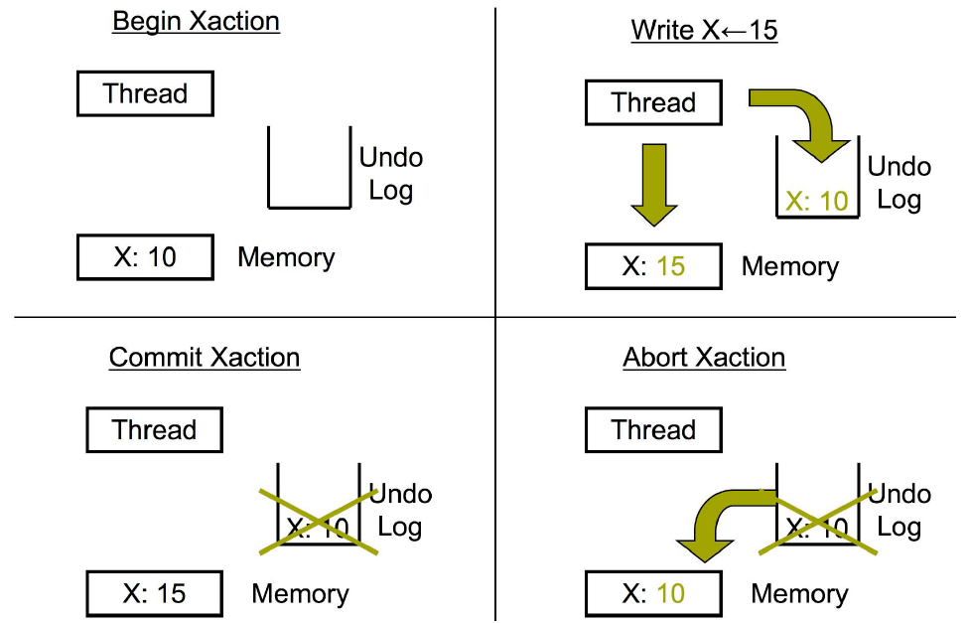
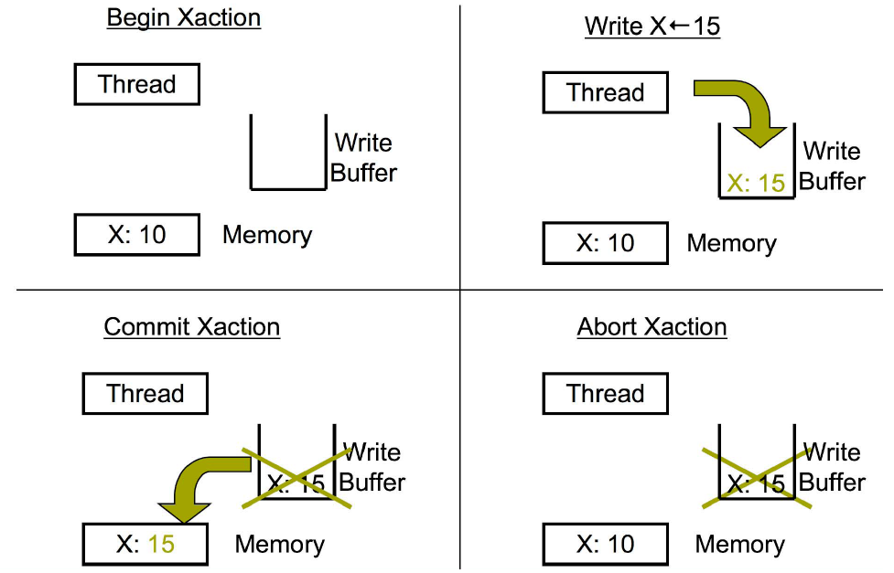
Data Versioning
Eager Versioning (Direct Update)
Lazy Versioning (Deferred Update)
Notes:
Eager versioning
Update memory location directly
Maintain undo info in a log
Faster commit, direct reads (SW)
Slower aborts, fault tolerant issues
Lazy versioning
Buffer data until commit in a write-buffer
Update actual memory location on commit
Faster abort, no fault tolerance issues
Slower commits, indirect reads (SW)

Slide 33
TM Implementation
Data Versioning
Eager Versioning
Lazy Versioning
Conflict Detection and Resolution
Pessimistic Concurrency Control
Optimistic Concurrency Control
Conflict Detection Granularity
Object Granularity
Word Granularity
Cache line Granularity

Slide 34
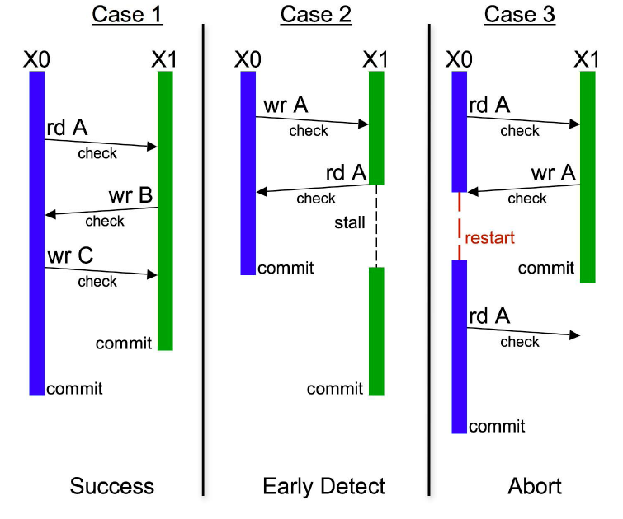
Conflict Detection and Resolution - Pessimistic
No Conflict
Conflict with Stall
Conflict with Abort
Time
Notes:
Check for conflicts during loads or stores
Acquire ownership
+ Detect conflicts early and potentially undo less work (turn some aborts into stalls)
- Locking issues (SW), fine-grained communication (HW)
SW: SW barriers using locks and/or version numbers
HW: Check through coherence actions
Mention eager or lazy

Slide 35
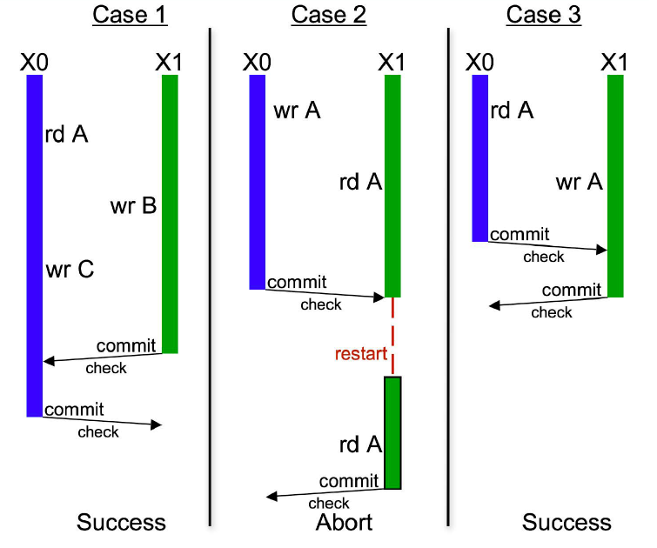
Conflict Detection and Resolution - Optimistic
No Conflict
Conflict with Abort
Conflict with Commit
Time
Notes:
Detect conflicts when a transaction attempts to commit
+ Potentially less conflicts, shorter locking (SW), bulk communication (HW)
- Detects conflicts late
SW: Validate read/write sets using locks or version numbers
HW: validate write-set using coherence actions- get exclusive access for cache lines in write set
On conflict, give priority to committing transaction
NOTE: SEVERAL STM SYSTEMS USE OPTIMISTIC FOR READS AND PESSIMISTIC FOR WRITES

Slide 36
TM Implementation
Data Versioning
Eager Versioning
Lazy Versioning
Conflict Detection and Resolution
Pessimistic Concurrency Control
Optimistic Concurrency Control
Conflict Detection Granularity
Object Granularity
Word Granularity
Cache line Granularity
Notes:
Object Granularity
+ Reduced overhead (time/space)
+ Close to programmer’s reasoning
- False sharing on large objects (e.g. arrays)
Word Granularity
+ Minimize false sharing
Increased overhead (time/space)
Cache line Granularity
+ Compromise between object and word
+ Works for both HW/SW
NOTE: COMBINED – WORD LEVEL FOR ARRAYS AND OBJECT LEVEL FOR OTHER DATA
TODO: Block granularity, combined

Slide 37
Examples
Hardware TM
Stanford TCC: Lazy + Optimistic
Intel VTM: Lazy + Pessimistic
Wisconsin LogTM: Eager + Pessimistic
UHTM
SpHT
Software TM
Sun TL2: Lazy + Optimistic (R/W)
Intel STM: Eager + Optimistic (R)/Pessimistic (W)
MS OSTM: Lazy + Optimistic (R)/Pessimistic (W)
Draco STM
STMLite
DSTM
Can find many more at http://www.dolcera.com/wiki/index.php?title=Transactional_memory
Notes:
SpHT uses minimal software support to combine multiple segments of an atomic block, each executed using a separate hardware transaction, into one atomic operation. The idea of segmenting transactions can be used for many purposes, including nesting, local retry, or Else, and user-level thread scheduling.

Slide 38
Lecture Outline
Recap of Transactions
Transactional Memory System Taxonomy
Software Transactional Memory (Intel McRT-STM)
Hardware Accelerated STMs

Slide 39
Software Transactional Memory (STM)
atomic {
a.x = t1
a.y = t2
if (a.z == 0) {
a.x = 0
a.z = t3
}
}
tmTXBegin()
tmWr(&a.x, t1)
tmWr(&a.y, t2)
if (tmRd(&a.z) != 0) {
tmWr(&a.x, 0)
tmWr(&a.z, t3)
}
tmTXCommit()

Slide 40
Intel McRT-STM
Strong or Weak Isolation | Weak
Transaction Granularity | Word or Object
Lazy or Eager Versioning | Eager
Concurrency Control | Optimistic read, Pessimistic Write
Nested Transaction | Closed

Slide 41
McRT-STM Runtime Data Structures
Transaction Descriptor (per thread)
Used for conflict detection, commit, abort, …
Includes read set, write set, undo log or write buffer
Transaction Record (per datum)
Pointer-sized record guarding shared datum
Tracks transactional state of datum
  Shared: Read-only access by multiple readers
    Value is odd (low bit is 1)
  Exclusive: Write-only access by single owner
    Value is aligned pointer to owning transaction’s descriptor
Notes:
Transaction record
LS bit: 0 if writer-locked, 1 if not locked
MS bits: Timestamp of last commit if not locked, pointer to owner TX if locked
For C/C++, hash address to record within table of records
mov rec, addr
and rec, 0x3ffc0
add rec, TxRecTableBase

Slide 42
McRT-STM: Example
Class Foo {
int x;
int y;
};
Foo bar, foo;
T1
T2
atomic {
t = foo.x;
bar.x = t;
t = foo.y;
bar.y = t;
}
atomic {
t1 = bar.x;
t2 = bar.y;
}
T1 copies foo into bar
T2 reads bar, but should not see intermediate values

Slide 43
McRT-STM: Example
T1
T2
stmStart();
t = stmRd(foo.x);
stmWr(bar.x,t);
t = stmRd(foo.y);
stmWr(bar.y,t);
stmCommit();
stmStart();
t1 = stmRd(bar.x);
t2 = stmRd(bar.y);
stmCommit();
T1 copies foo into bar
T2 reads bar, but should not see intermediate values

Slide 44
McRT-STM Operations
STM read (Optimistic)
Direct read of memory location (eager versioning)
Validate read data
  Check if unlocked and data version <= local timestamp
  If not, validate all data in read set for consistency
validate() {for <txnrec,ver> in transaction’s read set, if (*txnrec != ver) abort();}
Insert in read set
Return value
STM write (Pessimistic)
Validate data
  Check if unlocked and data version <= local timestamp
Acquire lock
Insert in write set
Create undo log entry
Write data in place (eager versioning)
Notes:
Optimistic read (Use versioning on TxR)
+ Caching effects
+ Avoids lock operations
Pessimistic read (Read lock on TxR)
Caching effects
Lock operations
Pessimistic write (Write lock on TxR)
+ In place updates
+ Fast commits
+ Fast reads
Optimistic write (Buffer writes & acquire locks at commit)
Slow commits
Reads have to search for latest value

Slide 45
McRT-STM: Example
7
foo
T1
3
5
bar
Commit
hdr
hdr
Abort
x = 9
x = 9
x = 0
y = 7
T1
y = 7
y = 0
T2
stmStart();
t = stmRd(foo.x);
stmWr(bar.x,t);
t = stmRd(foo.y);
stmWr(bar.y,t);
stmCommit;
stmStart();
t1 = stmRd(bar.x);
t2 = stmRd(bar.y);
stmCommit();
T2 waits
Reads
Reads
<bar, 5>
<bar, 7>
<foo, 3>
<foo, 3>
Writes
<bar, 5>
T2 should read [0, 0] or should read [9,7]
Undo
<bar.x, 0>
<bar.y, 0>
Notes:
McRT-STM uses two-phase locking to control access to an object. This protocol allows
multiple transactions to read an object, but only a single transaction to modify the object. After
acquiring a read lock, a transaction records the object’s version number in its read set, to permit
subsequent validation. After acquiring a write lock, the transaction records the location’s value
and object’s version number in a log, to allow rollback if the transaction aborts. Conflicting
writes from other transactions are detected by verifying that the version numbers of all locations
read by a transaction remain unchanged when the transaction commits. Deadlock is detected
by timeouts on lock acquires. Aborting a transaction and rolling back its side effects resolves
conflicts or deadlocks.
Each object contains a transaction lock, which can be in one of two states. If the object
is unlocked or only being read, its lock contains the object’s current version number. In this
state, another transaction can open the object for reading by simply recording, in its read set,
the object and its current version.
The other state indicates that the object is open for writing. In this case, the lock points
to the transaction descriptor of the transaction modifying the object.When a transaction opens
the object for writing, it records the object and its version number (from the lock) and replaces
the version number in the lock with a pointer to its transaction descriptor. When the transaction
commits and releases its lock, it increments the object’s version number and replaces the
transaction descriptor in the lock with the new version number. Upgrades—from reading to
writing an object—require that the reader acquire a write lock and, at commit time, verify that
the object’s read version number matches the initial write version number. Active readers do
not prevent a writer from acquiring a lock and modifying an object; the conflict is detected and
resolved when a reader transaction attempts to commit.
When an object is open for writing, other transactions that attempt to open the object for
reading or writing will block on its write lock. McRT-STMimplements a policy of suspending
these contending transactions if the thread holding the lock is active and aborting the transaction
holding a write lock if its thread is suspended. This policy approximates the obstruction-free
behavior of other STM systems, by ensuring that a suspended transaction does not prevent
active transactions from making forward progress.
When a transaction opens an object for writing and modifies its value, it does not abort
transactions that previously read the object. Each of these transactions will detect the conflict
when it checks the version numbers of the objects in its read set, as part of the commit process.
Since transactions directly modify locations, any of these transactions may read values modified
by another transaction and so observe inconsistent program state. This can cause abnormal
executions, for example, unexpected exceptions or improper loop termination. The former
problem can be handled by catching these exceptions, aborting the transaction, and subsequently
retrying it. The latter problem requires the consistency of a transaction’s read set to be validated
on the backedge of every loop whose termination may be dependent on state potentially modified
by another transaction.

Slide 46
Lecture Outline
Recap of Transactions
Transactional Memory System Taxonomy
Software Transactional Memory (Intel McRT-STM)
Hardware Accelerated STMs (HASTM)

Slide 47
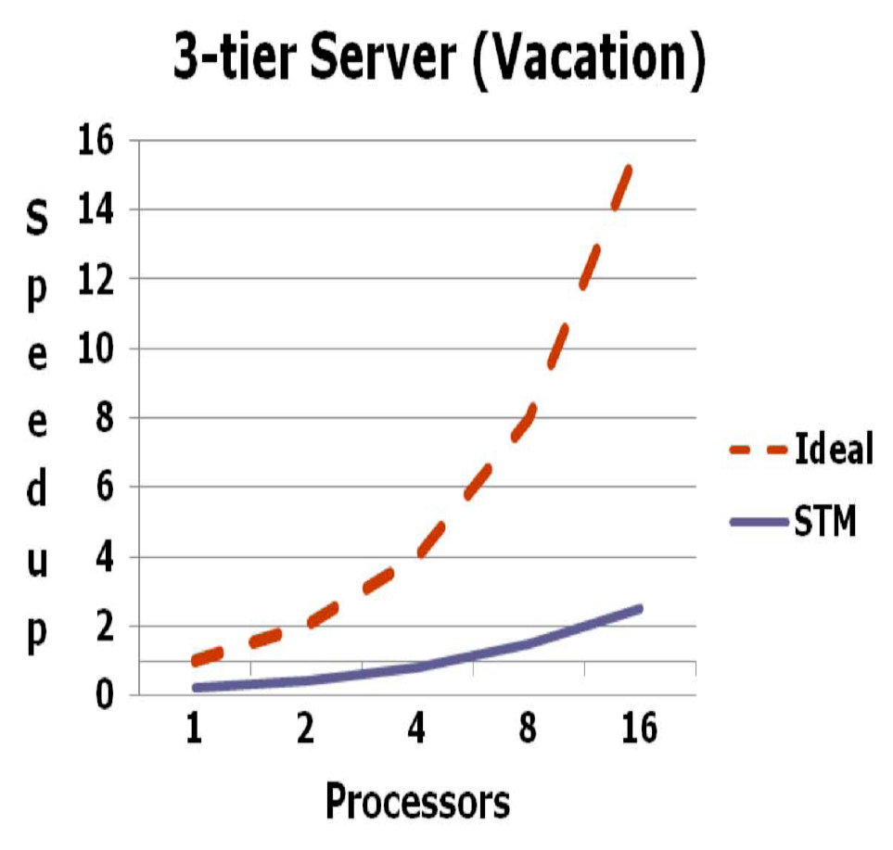
Hardware Support?
Notes:
STM Slowdown: 2-8x per thread due to barriers
Lack of strong atomicity – Costly to provide purely in software

Slide 48
Types of Hardware Support
Hardware-accelerated STM systems (HASTM, SigTM, …)
Hardware-based TM systems (TCC, LTM, VTM, LogTM, …)
Hybrid TM systems (Sun Rock)
Notes:
Hardware-accelerated STM
Start with an STM system and identify key bottlenecks
Provide (simple) HW primitives for acceleration
Hardware-based TM systems
Versioning and conflict detection directly in HW
Hybrid TM systems
Combine an HTM and an STM by switching modes when needed based on TX characteristics, available resources, …

Slide 49
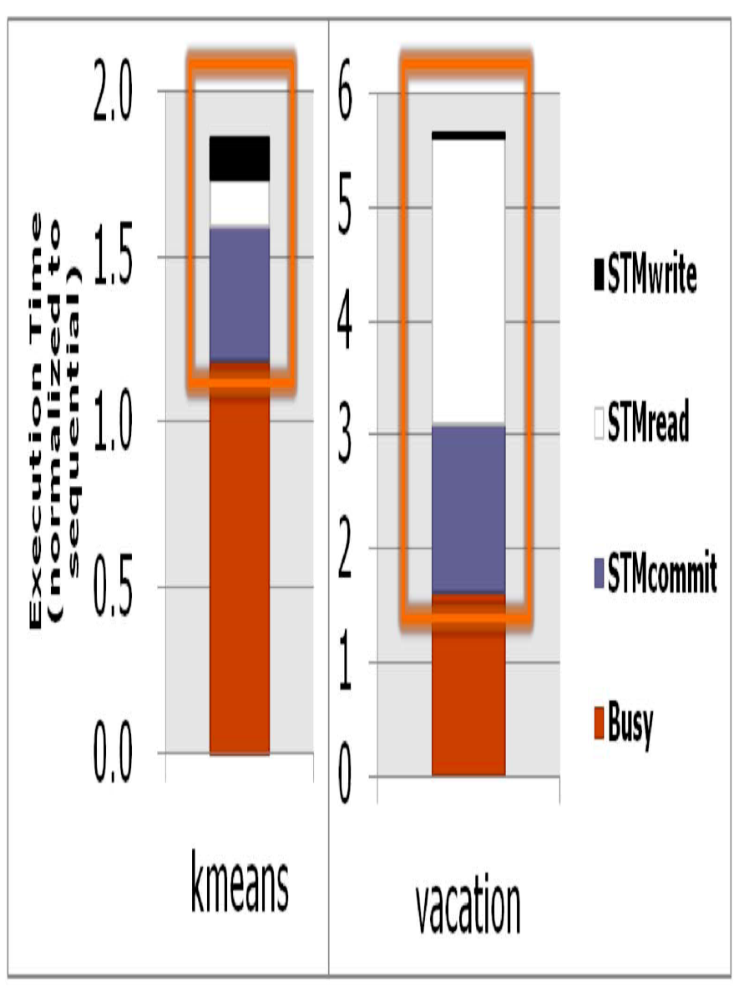
Hardware Support?
1.8x – 5.6x slowdown over sequential
Most time goes in read barriers and validation
Notes:
Most apps read more data than they write

Slide 50
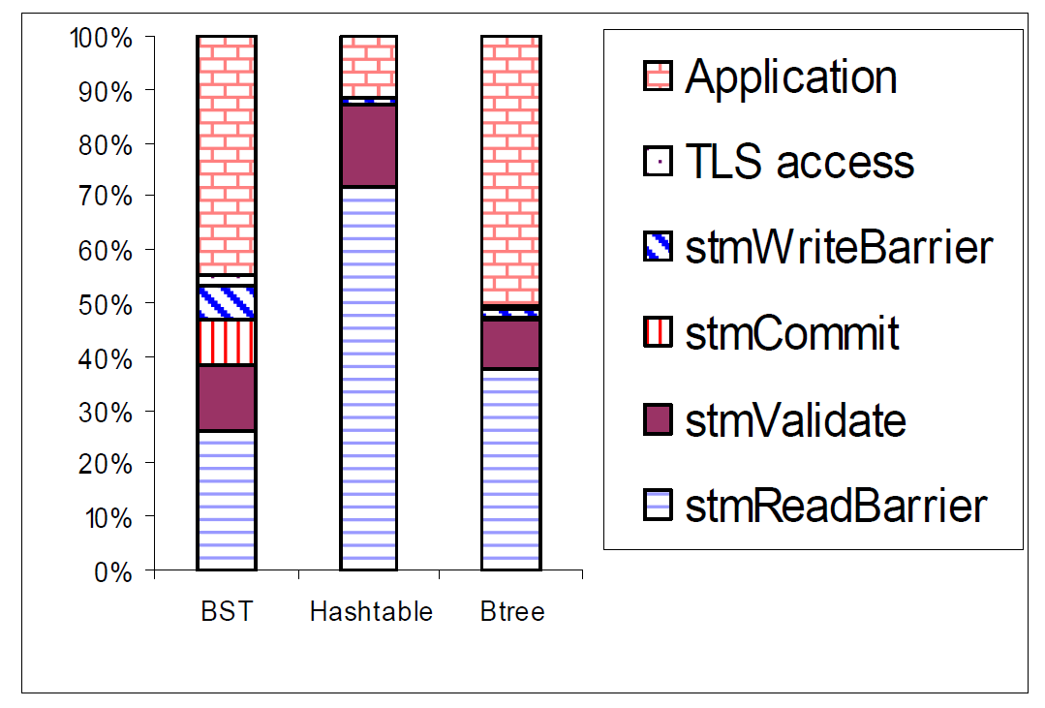
Hardware Support?
Architectural Support for Software Transactional Memory – Saha et al.
Notes:
Most apps read more data than they write

Slide 51
Hardware-accelerated STM (HASTM)
Hardware Support
Per-thread mark bits at granularity of cache lines
New register (mark counter)
Used to build fast filters to speed up read barriers
ISA Extensions
loadSetMark(addr) – Loads value at addr and sets mark bit associated with addr
loadResetMark(addr) – Loads value at addr and clears mark bit associated with addr
loadTestMark(addr) – Loads the value at addr and sets carry flag to value of mark bit
resetMarkAll() – Clears all mark bits in cache and increments mark counter
resetMarkCounter() – Resets mark counter
readMarkCounter() – Reads mark counter value
Notes:
There are two key capabilities enabled with the mechanism. First, software can query if the mark bit has been previously set for a single given block of memory
and that there has been no writes to the memory by other threads since the block was marked. Second, software can query if there has potentially been any writes by other threads to any of the set of memory blocks the software has marked.
Software sets and queries the mark bits with new instructions discussed below. Hardware may discard a mark bit as long as it records that it has done so. Hardware records that a mark bit has been discarded by incrementing
a saturating mark counter (new register) that is part of the architected state of a thread. Software may query whether any of the bits have been discarded by reading the mark counter. Mark bits are discarded when a coherency event occurs
such that another thread may modify the memory block the mark bit is associated with. Mark bits can also be discarded because of hardware capacity limits. In our implementation we also discard all mark bits on priority transitions (ring transitions in IA32 terminology). The mark counter does not have to be saved on context switches as it can be restored to a default value of all ones
by either hardware or software.
If address spans across multiple blocks (or cache lines), then all the mark bits are set (cleared).
loadTestMark – If address spans … then the logical AND of all the mark bits are put into the carry flag

Slide 52
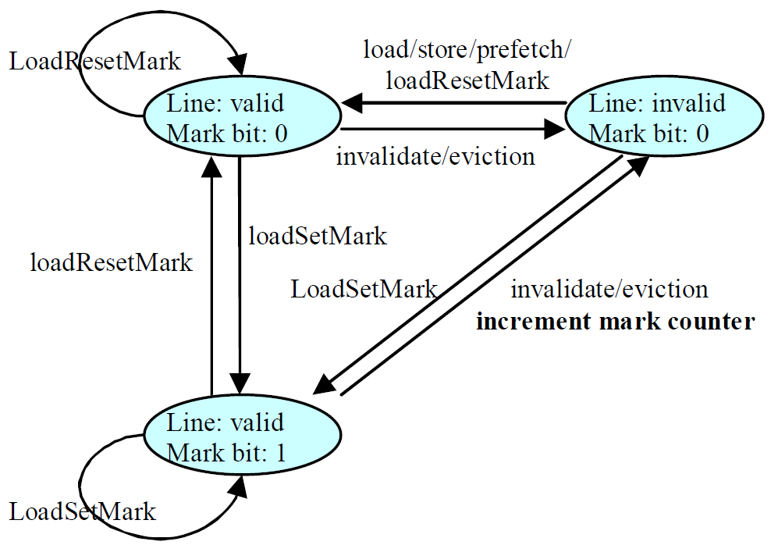
HASTM – Cache line transitions
Notes:
The processor increments the mark counter whenever a marked cache line gets evicted or snooped; that is, when a marked cache line transitions to the invalid state.
The mark bits allow software to track cache residency of data and thus whether other processors could have potentially written to a datum between two accesses. By loading a value using loadTestMark, software can simultaneously load a value from memory and test the mark bit of the memory address. If the mark bit is set, software knows not only that it has accessed the address
before by using a loadSetMark instruction, but also that the cache line has not been invalidated since that last access, implying that no other thread has written to that cache line in the interim. We’ll see how to use this filtering capability to avoid STM read barriers for memory locations that the STM has already logged.
The mark counter allows software to monitor whether any of the data it has accessed could have been written by another processor. If the mark counter value is zero, software knows that none of the lines it has accessed using
loadSetMark has been invalidated, implying that no other processor has written to any of those lines since the last time software reset the mark counter. We’ll see how to use this monitoring mechanism to avoid STM conflict checking (i.e., validation) overheads.

Slide 53
McRT-STM Operations
stmRd = stmRdBar + Rd
stmRdBar(TxnRec* rec) {
void* recval = *rec;
void* txndesc = getTxnDesc();
if (recval == txndesc) return;
if (isVersion(recVal) == false)
recval = handleContention(rec);
logRead(rec,recval);
}

Slide 54
McRT-STM Operations
stmWr = stmWrBar + LogOldValue + Wr
stmWrBar(TxnRec* rec) {
void* recval = *rec;
void* txndesc = getTxnDesc();
i f (recval == txndesc) return;
if (isVersion(recVal) == false)
recval = handleContention(rec);
while (CAS(rec,recval,txndesc) == false)
recval = handleContention(rec);
logWrite(rec,recval);
}

Slide 55
McRT-STM Operations
stmRd = stmRdBar + Rd
mov eax, [rec] /* load TxRec */
cmp eax, txndesc /* do I own exclusive */
jeq done
test eax, #versionmask /* is a version no. */
jz contention
Manage Contention
mov ecx, [txndesc + rdsetlog] /*get log ptr*/
test ecx, #overflowmask
jz overflow
Manage Overflow
add ecx, 8 /*inc log ptr*/
mov [txndesc + rdsetlog], ecx
mov [ecx – 8], rec /* logging */
mov [ecx – 4], eax /* logging */
Fast Path
Slow Path
done:
…

Slide 56
HASTM Operations
stmRd = stmRdBar + Rd
loadTestMark eax, [rec] /* check 1st access */
jnae done
loadSetMark eax, [rec]
test eax, #versionmask /* is a version no. */
jz contention
Manage Contention
mov ecx, [txndesc + rdsetlog] /*get log ptr*/
test ecx, #overflowmask
jz overflow
Manage Overflow
add ecx, 8 /*inc log ptr*/
mov [txndesc + rdsetlog], ecx
mov [ecx – 8], rec /* logging */
mov [ecx – 4], eax /* logging */
Fast Path
Slow Path
done:
…
Notes:
When a transaction executes a read barrier on a transaction record T for the first time, the loadSetMark (line 3) sets the mark bit, and the normal read barrier sequence checks T and appends it to the read set. On subsequent executions of a read barrier on T the conditional branch (line 2) succeeds
and the read barrier completes if the line holding T has not been invalidated in the interim. Thus, the fast path reduces from 12 instructions in the STM to 2 instructions. The HASTM write barrier also sets the mark bit on the transaction record so that subsequent read barriers take the fast path.
JNAE - Neither above nor equal – Carry Flag
loadTestMark(addr) – Loads the value at addr and sets carry flag to value of mark bit
HASTM uses the ISA from Section 3 to eliminate redundant logging and to eliminate validation overhead altogether for transactions whose transaction records fit in the cache.

Slide 57
HASTM Operations
validate
validate() {
markCount = readMarkCounter();
resetMarkAll();
if (markCount == 0) /*no snoop or eviction*/
return;
/* perform full read set validation */
for <txnrec,ver> in transaction’s read set
if (*txnrec != ver)
abort();
}
Notes:
Validation first checks the mark counter to detect whether marked lines were invalidated. If none of the marked lines were invalidated, then it avoids validation overhead; otherwise, it checks the version numbers in the read set. Note that invalidation of a marked cache line does not by itself abort a transaction; it simply forces a full software validation of the read set.

Slide 58
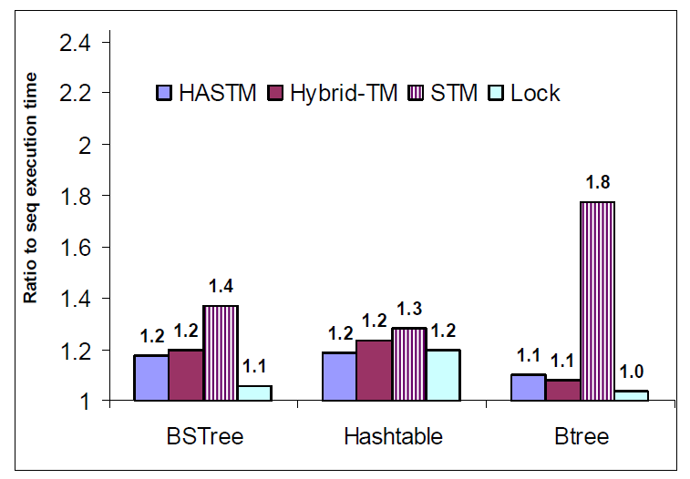
HASTM Performance Improvement
Notes:
Figure shows the single thread performance of HASTM on the concurrent data structures. The baseline is sequential execution time (i.e., the fastest single thread execution time). Note that an ideal unbounded HW TM implementation would execute no faster than the sequential execution time. HASTM performs as well as HyTM on all the benchmarks. Moreover, it has a small overhead when
compared to the sequential execution time, and significantly cuts down the STM overhead. The improvement is the smallest in the hashtable because of its
small cache reuse (< 3%). The hashing function spreads nodes across buckets, so traversing a single bucket leads to poor cache behavior. The improvement is the largest in the Btree because of its high cache reuse (68%). The high cache reuse arises in part due to the good spatial locality of the Btree keys. The BST has a cache reuse of 38%.
Degree of cache reuse for the loads inside critical sections; that is, the fraction of loads inside critical sections that access a cache line that has already been accessed by a prior load inside the same critical section.
HyTM first tries to execute a transaction using HTM, failing which it executes the transaction using STM. When executing using HTM, the hardware detects conflicts and buffers speculative updates.

Slide 59
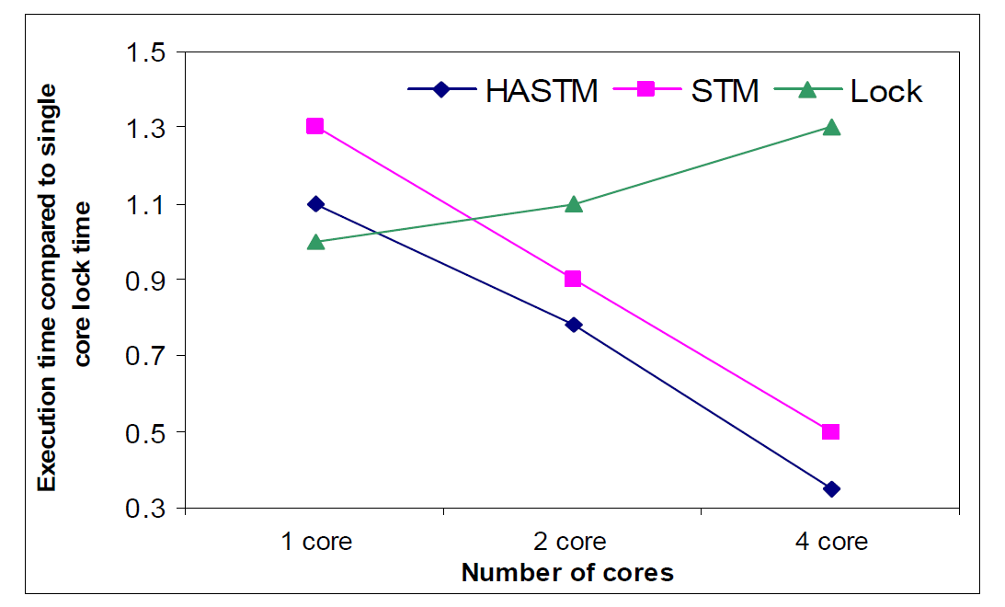
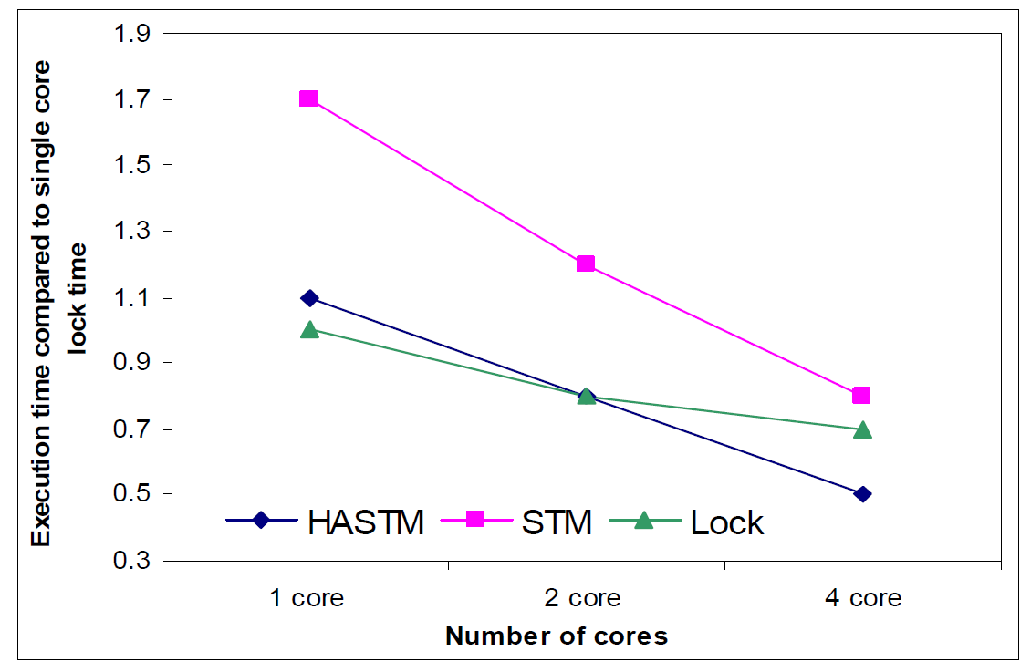
HASTM Performance Improvement – Multicore
Binary Search Tree
B-Tree
Notes:
For each experiment, 20% of the operations were updates.
The locking algorithm for the BST locks the root to handle tree rotations; thus the locking approach does not scale at all (Figure 18). Both the HASTM and STM configurations simply replace the lock acquire and release
by transaction begin and end; thus the BST results show the advantages of transactions over locks.
For the btree, the STM scales somewhat better than the HASTM as we increase the number of cores, but the HASTM implementation still performs the best. In the btree, multiple cores interfere destructively – prefetches
and speculative accesses from one core kick out marked cache lines from another core, and the inclusive nature of the cache hierarchy also results in one core accidentally kicking out marked cache lines of another core. With multiple cores, HASTM encounters more situations where it is unable to leverage the HW (mark counter) for validation, and falls back on the software validation. As a result, the relative performance improvement from
HASTM drops as we increase the number of cores since the performance improvement increasingly relies solely on the filtering benefit.
TODO: Pros and Cons of HASTM
Overflow
They can substitute with NOPs because it is only a performance enhancement.

Slide 60
HASTM - Issues
Insufficient Cache Capacity
Mark bits are only an acceleration mechanism
Cache evictions, cause mark bits to be lost – revert to slow software validation
Weak Isolation

Slide 61
Other Slides

Slide 62
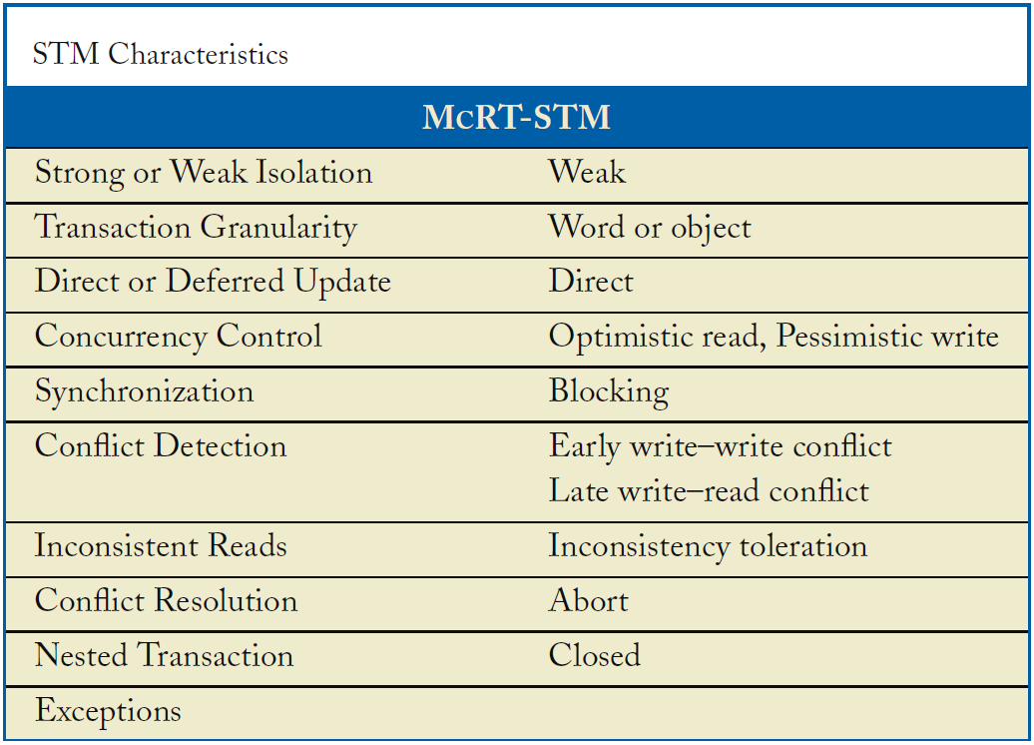
Intel McRT-STM
Lazy/Eager
Eager

Slide 63
Other Transactional Programming Primitives
User-triggered abort: abort
  void transfer(A,B,amount)
  atomic{
  try{
  work();
  }
  catch(error1) {fix_code();}
  catch(error2) {abort;}
  }
Conditional synchronization: retry
  Object blockingDequeue(q)
  atomic{
  if(q.isEmpty()) retry;
  return dequeue();
  }
Composing code sequences: orelse
  atomic{q1.blockingDequeue();
  }orelse{q2.blockingDequeue();
  }
Notes:
Abort
Undo current transaction (no visible writes)
Jump to a specified code location
OrElse
Allows composition of alternative code statements
If one clause fails due to retry, try next alternative
Sequential order of clauses

