Slide 1
Functional Message Passing: Getting started with Erlang
Arnab Sinha
COS 597C, Oct 21
materials drawn from:
http://www.erlang.org/download/getting_started-5.4.pdf

Slide 2
Overview
Background and Motivation
Sequential Erlang
Concurrent Erlang
Some Applications

Slide 3
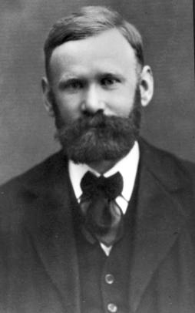
History of Erlang
Erlang either refer to Danish mathematician and engineer Agner Krarup Erlang, or alternatively, as an abbrev. of "Ericsson Language“.
Experiments with Erlang started in Ellemtel Computer Science Laboratory in 1987.
First version was developed by Joe Armstrong.
Agner Krarup Erlang (1878-1929)
Inventor of the fields: traffic engineering and queueing theory (foundation of telecom network studies).

Slide 4
Cool Features of Erlang
Started out as a concurrent Prolog.
High reliability. (e.g. Ericsson Switch)
“You need mechanisms and primitives provided to the general programmer or the developer in order for the systems to have these properties, otherwise they tend to get lost in the way.“ – Lennart Ohman, Developer of Open Telecom Platform (OTP), MD of Sjoland & Thyselius Telecom AB in Sweden.
Seamless scaling to large number of processes (literally 100,000 processes) through message passing communication.
Functional programming (Seq.) + OO (Conc.).
Concurrency for the sake of modularity, reliability etc.
Library support (web-server, databases etc.)

Slide 5
Projects using Erlang
Ericsson AXD301 switch (1998).
reported to achieve a reliability of nine “9”s (i.e. 1 sec of downtime in 1 billion seconds, roughly 30 years.)
CouchDB, a document based database that uses MapReduce.
ejabberd, instant messaging server
Facebook chat system based on ejabberd.
Twitterfall, a service to view trends and patterns from Twitter
…

Slide 6
Future of Erlang: What experts believe.
Scalability: "Virtually all language use shared state concurrency. This is very difficult and leads to terrible problems when you handle failure and scale up the system...Some pretty fast-moving startups in the financial world have latched onto Erlang; for example, the Swedish www.kreditor.se.“ – Joe Armstrong, “Programming Erlang”.
Promise for multi-core apps: "I do not believe that other languages can catch up with Erlang anytime soon. It will be easy for them to add language features to be like Erlang. It will take a long time for them to build such a high-quality VM and the mature libraries for concurrency and reliability. So, Erlang is poised for success. If you want to build a multicore application in the next few years, you should look at Erlang.“ – Ralph Johnson (UIUC), “Erlang, the next Java”.
Joe Armstrong, author of Erlang
Ralph Johnson, co-author of the now-legendary book, "Design Patterns"

Slide 7
Sequential Programming: The Erlang Shell
Full-stop and carriage return
On Ctrl-C
Numbers
Another way to shutdown system: halt().

Slide 8
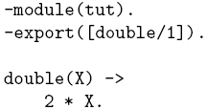
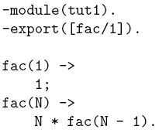
Sequential Programming: Modules and Functions
In Erlang the file name should be the module name: tut.erl
Function prototype declaration
“;” denotes “else” where as “.” denotes “end”
Let’s compile the file.
Variables must start with capital letters, e.g. Number, ShoeSize, Age
Let’s run the program.

Slide 9
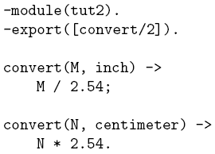
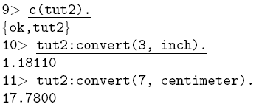
Sequential Programming: Atoms
Let’s compile and test
Atoms must start with small letters, e.g. centimeter, inch, charles
Atoms are analogous to elements of enumerated type or data-types in ML.
Let’s try something which is not matching.
However:
An atom consumes memory (4 bytes/atom in a 32-bit system, 8 bytes/atom in a 64-bit system).
The atom table is not garbage collected, and so atoms will accumulate until the system tips over, either from memory usage or because 1048577 atoms were declared.
Notes:
Elements of enumerated type, dataytype in ML

Slide 10
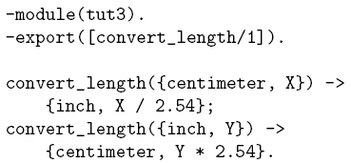
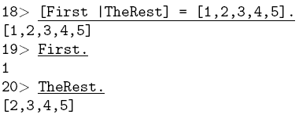
Sequential Programming: Tuples and Lists
Although, tuple has a fixed number of parts, but it can contain any valid Erlang term.
Confusing!! Does this mean that 3 is in inches?
Or 3 cm needs to converted to inches?
This is better!
Convert “X cm”
While tuples are enclosed within “{ }“, lists are enclosed by “[ ]”.
A very useful way of looking at parts of list is by using “|” (like Prolog).

Slide 11
Sequential Programming: Record
Records are similar to structs.
-module(my_server). -record(server_opts, {port, ip="127.0.0.1", max_connections=10}).
1st parameter: Name of the record.
2nd parameter: Tuple that contains the fields of the record and their default values.
Creating records.
Opts1 = #server_opts{port=80}.
Opts2 = #server_opts{port=80, ip="192.168.0.1"}.
Rest will take default values.
Accessing records.
Opts = #server_opts{port=80, ip="192.168.0.1"}, Opts#server_opts.port
Any time you want to access a record you have to include the record’s name. Why? Because records aren’t really internal data types, they’re a compiler trick. Internal representation (map):
{server_opts, 80, "127.0.0.1", 10}
Source: http://20bits.com/articles/erlang-an-introduction-to-records/

Slide 12
Sequential Programming: Record
Updating records.
Opts = #server_opts{port=80, ip="192.168.0.1"}, NewOpts = Opts#server_opts{port=7000}.
Matching records.
handle(Opts=#server_opts{port=8080}) -> % do special port 8080 stuff handle(Opts=#server_opts{}) -> % default stuff
Guard statement.
handle(Opts) when Opts#server_opts.port <= 1024 -> % requires root access handle(Opts=#server_opts{}) -> % Doesn’t require root access
Binding to ports below 1024 requires root access.
Source: http://20bits.com/articles/erlang-an-introduction-to-records/

Slide 13
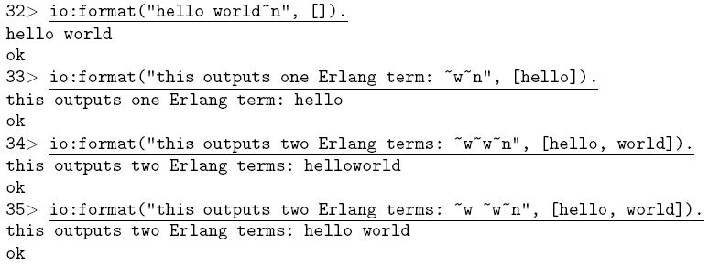
Sequential Programming: Writing Outputs to the Terminal
Function format/2
takes 2 lists.
Each ~w is replaced by a term taken in order from the second list
io:format returns ok if there is no error.

Slide 14
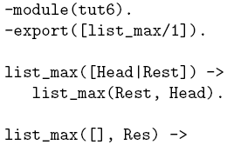
Sequential Programming: Arity
Let’s consider the following program for finding maximum number in a given list.
We have two functions with same name: [list_max/1] and [list_max/2].
However, in Erlang they are regarded as entirely different functions. (name/arity).

Slide 15
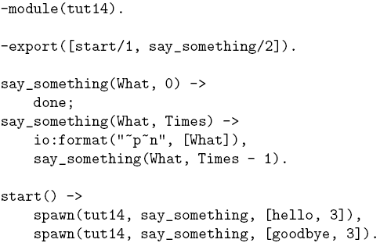
Concurrent Programming: Processes
Ease of creation and communication among parallel threads make Erlang more appealing.
Threads of Erlang share no data – hence they are processes.
spawn(Module, Exported_Func., List of args)
Notes:
“~p Writes the data with standard syntax in the same way as ~w, but breaks terms whose printed representation is longer than one line into many lines and indents each line sensibly. It also tries to detect lists of printable characters and to output these as strings.”

Slide 16
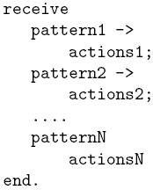
Concurrent Programming: Message Passing (Ping-Pong)
pong spawned with Pong_PID.
ping spawned with ‘Pong_PID’ as argument.
ping (master)
pong (slave)
{ping, Ping_PID}
{pong, Pong_PID}
“pong recvd ping”
“ping recvd pong”
{ping, Ping_PID}
“pong recvd ping”
N times
N times
{pong, Pong_PID}
“ping recvd pong”
{finished, Ping_PID}
“ping finished”
“pong finished”
Send message construct:
Receiver_PID ! {message}
e.g. Ping_PID ! Hello % Sent by Pong.
Moreover, my_pid = self() % returns self-PID
Receive message construct:
Notes:
Message passing constructs

Slide 17
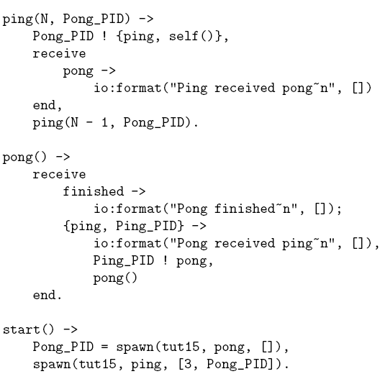
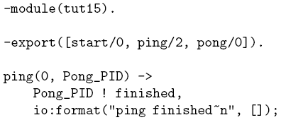
Concurrent Programming: Message Passing (Ping-Pong)
2. {ping, pid} sent to pong. “!” is the operator for send.
6. Ping prints if ping recvs ‘pong’
7. Ping is the master and decides when to terminate
3. {ping, pid} recvd.
4. Send ‘pong’ to ping.
5. Goes back and waits for messages
1. Ping has the PID of pong

Slide 18
Concurrent Programming: register
What is ping and pong were created independently?
Process pong registered as “pong”.
Before:
Sent to PID
After:
Sent to reg. name

Slide 19
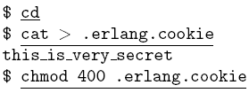
Concurrent Programming: Distributed Programming
How about ping and pong were written on different computers?
Security Issue:
Magic cookie.
Having a file .erlang.cookie in the home directory of all the communicating machines.
On Windows, directory pointed to by $HOME (env. variable) – might need to set it.
Only owner can access it. This is a requirement.
Any Erlang system which needs to communicate should have a name.
A node called “my_name” is created.
Erlang System:
There can be multiple Erlang systems on the same computer but with different names.
Each Erlang system running on a computer is called an Erlang node.

Slide 20
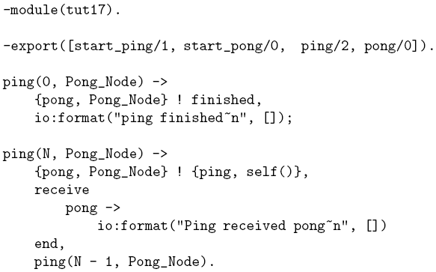
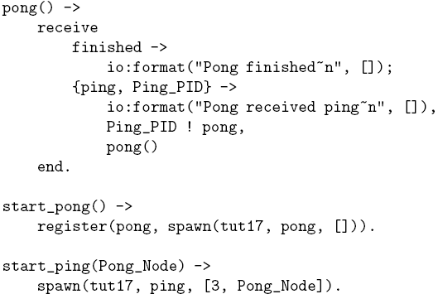
Concurrent Programming: Distributed Ping-Pong
Let’s assume two computers foo and bar.

Slide 21
Concurrent Programming: Distributed Ping-Pong
PID vs registered name
Erlang PIDs contain information about where the process executes , i.e. matter if the node is same or different.
However, for registered process (in a different node) we need {registered_name, node_name}.

Slide 22
Some More Message Passing Examples
Server
Traditional shared
memory programming
add No./retrieve
add No./retrieve
ack/list
ack/list
Producer
Consumer
However, no locking is necessary in Erlang,
as nothing is shared!
Client1
Client2

Slide 23
Hot Code Swapping
Acc. to page 355 in Joe Armstrong’s book, there have been Erlang systems running out there for years with 99.9999999% reliability.
How to a fix a bug (traditional approach):
1. You find a bug in the system,
2. you fix it locally,
3. you take down the system,
4. upload the new code,
5. restart the system
How to a fix a bug (Erlang approach):
1. You find a bug in the system,
2. you fix it locally,
3. upload the new code. System is fixed.
Notes:
Constructs and architecture, producer/consumer example in shared memory and erlang and comparison.

Slide 24
Hot Code Swapping
loop()
recv
recv
loop()
hcs:loop()
hcs:loop()
hcs:loop()
loop()
loop()
loop()
loop()
pattern2
patternN
switch
pattern2
patternN
pattern1
pattern1
switch
Action1
Action2
ActionN
NOP
Action1
Action2
ActionN
NOP
hcs:loop() or ?MODULE:loop() always points to the latest version.
Notes:
Constructs and architecture, producer/consumer example in shared memory and erlang and comparison.

Slide 25
Thank You!

Slide 26
Backup

Slide 27
Installation FAQ
In Windows:
Download the distribution from here.
Download MS Visual C++ 2005 Redistributable Package (x86) from here.
Using winzip or winrar, extract the contents of the “vcredist_x86.exe” file to a folder, (which for me was vcredi~3.exe), then extract the contents of vcredi~3.exe file, and within that are vcredis1.cab and vcredist.msi.
While installation of the exe downloaded in step 1, point to the .msi file extracted in step 3.

Slide 28
Sys module
We use the sys module to suspend the registered process for our gen_server.
When a process is suspended, it will only respond to system messages.
Next the change_code/4 method is called:
5> sys:suspend(t).
ok
6> c(t).
{ok,t}
7> l(t).
{module,t}
8> sys:change_code(t,t,[],[]).
ok
9> sys:resume(t).
ok
10> t:print_state().
state: 3.0
ok
11> t:print_state().
state: 4.0
ok
change_code(Name, Module, OldVsn, Extra) ->
ok | {error, Reason}
Types:
Name = pid() | atom() | {global, atom()}
Module = atom()
OldVsn = undefined | term()
Extra = term()

