Slide 1
Profiling Network Performance in Multi-tier Datacenter Applications
Minlan Yu
minlanyu@cs.princeton.edu
Princeton University
Joint work with Albert Greenberg, Dave Maltz, Jennifer Rexford, Lihua Yuan, Srikanth Kandula, Changhoon Kim

Slide 2
Applications inside Data Centers
Data Center Architecture
Multi-tier Applications
Front end Server
Aggregator
… …
Aggregator
Aggregator
Aggregator
…
…
Worker
Worker
Worker
Worker
Worker
Notes:
_{Examples,} delay sensitive, large amount of traffic
Maybe stress out loud that much of the traffic in the DC is between machines in the DC. E.g., to answer one search query involves a rather small amount of data to/from the Internet, but a lot inside to assemble the results. And these apps are delay sensitive, etc. In fact, I wonder if you want a slide between slides 2 and 3 to set the stage for these apps and their requirements and complexity, rather than jumping (kind of abruptly) into diagnosis in slide 3.

Slide 3
Challenges of Datacenter Diagnosis
Multi-tier applications
  Tens of hundreds of application components
  Tens of thousands of servers
Evolving applications
  Add new features, fix bugs
  Change components while app is still in operation
Human factors
  Developers may not understand network well
  Nagle’s algorithm, delayed ACK, etc.
Notes:
in practice, I think Microsoft doesn't
really "hot swap" in the new code, but rather brings up new images for a
service and gradually phase out the old ones your point is more that change
in constant.
Just stress the point about constant influx of new developers out loud.
silly window syndrome

Slide 4


Where are the Performance Problems?
Network or application?
  App team:
  Why low throughput, high delay?
  Net team:
  No equipment failure or congestion
Network and application! -- their interactions
  Network stack is not configured correctly
  Small application writes delayed by TCP
  TCP incast: synchronized writes cause packet loss
A diagnosis tool to understand
network-application interactions

Slide 5
Today’s Diagnosis Methods
Ad-hoc, application specific
  Dig out throughput/delay problems from app logs
Significant overhead and coarse grained
  Capture packet trace for manual inspection
  Use switch counters to check link utilization
A diagnosis tool that
runs everywhere, all the time
Notes:
Everywhere: generic across applications/devices
All the time: low CPU, memory, bandwidth overhead

Slide 6
Full Knowledge of Data Centers
Direct access to network stack
  Directly measure rather than relying on inference
  E.g., # of fast retransmission packets
Application-server mapping
  Know which application runs on which servers
  E.g., which app to blame for sending a lot of traffic
Network topology and routing
  Know which application uses which resource
  E.g., which app is affected if a link is congested

Slide 7
SNAP: Scalable Net-App Profiler

Slide 8
Outline
SNAP architecture
  Passively measure real-time network stack info
  Systematically identify performance problems
  Correlate across connections to pinpoint problems
SNAP deployment
  Operators: Characterize performance problems
  Developers: Identify problems for applications
SNAP validation and overhead

Slide 9
SNAP Architecture
Step 1: Network-stack measurements

Slide 10
What Data to Collect?
Goals:
  Fine-grained: in milliseconds or seconds
  Low overhead: low CPU overhead and data volume
  Generic across applications
Two types of data:
  Poll TCP statistics → Network performance
  Event-driven socket logging → App expectation
  Both exist in today’s linux and windows systems
Notes:
SNMP data, packet trace, application logs
Standardized data that can be get directly…..Can use directly
100K$ a few monitoring machines montor two racks of servers…

Slide 11
TCP statistics
Instantaneous snapshots
  #Bytes in the send buffer
  Congestion window size, receiver window size
  Snapshots based on Poisson sampling
Cumulative counters
  #FastRetrans, #Timeout
  RTT estimation: #SampleRTT, #SumRTT
  RwinLimitTime
  Calculate difference between two polls
Notes:
Data are used for classify and to show details for people to …
Why Poisson sampling? – to get meaningful values…

Slide 12
SNAP Architecture
Step 2: Performance problem classification

Slide 13
Life of Data Transfer
Sender App
Application generates the data
Copy data to send buffer
TCP sends data to the network
Receiver receives the data and ACK
Send Buffer
Network
Receiver
Notes:
Nagle and delayed ack… : small data which trigger Nagle’s algo.

Slide 14
Classifying Socket Performance
  Bottlenecked by CPU, disk, etc.
  Slow due to app design (small writes)
  Send buffer not large enough
  Fast retransmission
  Timeout
  Not reading fast enough (CPU, disk, etc.)
  Not ACKing fast enough (Delayed ACK)
Sender App
Send Buffer
Network
Receiver
Notes:
Nagle and delayed ack… : small data which trigger Nagle’s algo.

Slide 15
Identifying Performance Problems
Sender App
  Not any other problems
  Send buffer is almost full
  #Fast retransmission
  #Timeout
  RwinLimitTime
  Delayed ACK
  diff(SumRTT) > diff(SampleRTT)*MaxQueuingDelay
Send Buffer
Sampling
Network
Direct
measure
Receiver
Inference
Notes:
Nagle and delayed ack… : small data which trigger Nagle’s algo.
What is the assumptions about why send buffer is full? Maybe recv window/congestion is the cause…

Slide 16
SNAP Architecture
Step 3: Correlation across connections

Slide 17
Pinpoint Problems via Correlation
Correlation over shared switch/link/host
  Packet loss for all the connections going through one switch/host
  Pinpoint the problematic switch

Slide 18
Pinpoint Problems via Correlation
Correlation over application
  Same application has problem on all machines
  Report aggregated application behavior

Slide 19
Correlation Algorithm
Input:
  A set of connections (shared resource or app)
  Correlation interval M, Aggregation interval t
Solution:
Correlation interval M
Aggregation interval t
… …
… …
time(t1,c1..c6)
time(t2,c1..c6)
time(t3,c1..c6)
Linear correlation across connections
… …
… …
time(t1,c1..c6)
time(t2,c1..c6)
time(t3,c1..c6)

Slide 20
SNAP Architecture
Notes:
C++
Map-reduce

Slide 21
SNAP Deployment

Slide 22
SNAP Deployment
Production data center
  8K machines, 700 applications
  Ran SNAP for a week, collected petabytes of data
Operators: Profiling the whole data center
  Characterize the sources of performance problems
  Key problems in the data center
Developers: Profiling individual applications
  Pinpoint problems in app software, network stack, and their interactions
Notes:
700 always running, persistent connection

Slide 23
Performance Problem Overview
A small number of apps suffer from significant performance problems
Problems | >5% of the time | > 50% of the time
Sender app | 567 apps | 551
Send buffer | 1 | 1
Network | 30 | 6
Recv win limit | 22 | 8
Delayed ACK | 154 | 144
Notes:
1M connections…
30 apps have congestion > 5% of the time
8 apps are recv-window limited for > 50% of the time
0.06% of the connections are send-buffer limited
for > 25% of the time

Slide 24
Performance Problem Overview
Delayed ACK should be disabled
  ~2% of conns have delayed ACK > 99% of the time
  129 delay-sensitive apps have delayed ACK > 50% of the time
A
B
Data
B has data to send
Data+ACK
A has data to send
Data+ACK
B doesn’t have data to send
ACK
Notes:
1M connections…

Slide 25
Classifying Socket Performance
  Bottlenecked by CPU, disk, etc.
  Slow due to app design (small writes)
  Send buffer not large enough
  Fast retransmission
  Timeout
  Not reading fast enough (CPU, disk, etc.)
  Not ACKing fast enough (Delayed ACK)
Sender App
Send Buffer
Network
Receiver
Notes:
Nagle and delayed ack… : small data which trigger Nagle’s algo.

Slide 26
Send Buffer and Recv Window
Problems on a single connection
App process
App process
Write
Bytes
Read
Bytes
…
…
Some apps use default 8KB
TCP
TCP
Fixed max size 64KB not enough for some apps
Send Buffer
Recv Buffer

Slide 27
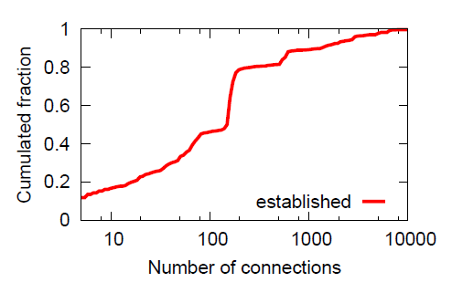
Need Buffer Autotuning
Problems of sharing buffer at a single host
  More send buffer problems on machines with more connections
  How to set buffer size cooperatively?
Auto-tuning send buffer and recv window
  Dynamically allocate buffer across applications
  Based on congestion window of each app
  Tune send buffer and recv window together

Slide 28
Classifying Socket Performance
  Bottlenecked by CPU, disk, etc.
  Slow due to app design (small writes)
  Send buffer not large enough
  Fast retransmission
  Timeout
  Not reading fast enough (CPU, disk, etc.)
  Not ACKing fast enough (Delayed ACK)
Sender App
Send Buffer
Network
Receiver
Notes:
Nagle and delayed ack… : small data which trigger Nagle’s algo.

Slide 29
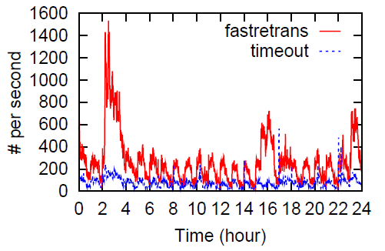
Packet Loss in a Day in the Datacenter
Packet loss burst every hour
2-4 am is the backup time
Notes:
Due to periodical traffic pattern…Operators

Slide 30
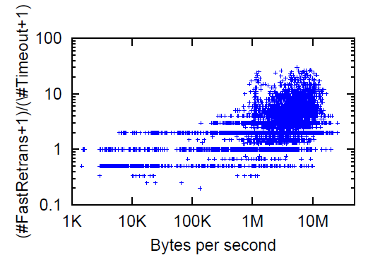
Types of Packet Loss vs. Throughput
More FastRetrans
Operators should reduce the number and effect of packet loss (especially timeouts) for small flows
One point for each connection at each interval
Why peak at 1M/sec?
Small traffic, not enough packets to trigger FastRetrans
Mostly FastRetrans
Why still timeouts?
More Timeouts
Notes:
More timeouts-→

Slide 31
Recall: SNAP diagnosis
Sender App
SNAP diagnosis steps:
  Correlate connection performance to pinpoint applications with problems
  Expose socket and TCP stats
  Find out root cause with operators and developers
  Propose potential solutions
Send Buffer
Network
Receiver
Notes:
Nagle and delayed ack… : small data which trigger Nagle’s algo.

Slide 32
Spread Writes over Multiple Connections
SNAP diagnosis:
  More timeouts than fast retransmission
  Small packet sending rate
Root cause:
  Two connections to avoid head-of-line blocking
  Low-rate small requests gets more timeouts
Req
Req
Req
Response
Notes:
Make clear that we are now talking about developers

Slide 33
Spread Writes over Multiple Connections
SNAP diagnosis:
  More timeouts than fast retransmission
  Small packet sending rate
Root cause:
  Two connections to avoid head-of-line blocking
  Low-rate small requests gets more timeouts
Solution:
  Use one connection; Assign ID to each request
  Combine data to reduce timeouts
Response 2
Req 3
Req 2
Req 1
Notes:
if a big request is put prior to a small one, then the small one has to wait a long time for the big one to finish.

Slide 34
Congestion Window Allows Sudden Bursts
SNAP diagnosis:
  Significant packet loss
  Congestion window is too large after an idle period
Root cause:
  Slow start restart is disabled

Slide 35
Slow Start Restart
Slow start restart
  Reduce congestion window size if the connection is idle to prevent sudden burst
Window
Drops after an idle time
t
35

Slide 36
Slow Start Restart
However, developers disabled it because:
  Intentionally increase congestion window
  over a persistent connection
  to reduce delay
  E.g., if congestion window is large, it just takes 1 RTT to send 64 KB data
Potential solution:
  New congestion control for delay sensitive traffic

Slide 37
Classifying Socket Performance
  Bottlenecked by CPU, disk, etc.
  Slow due to app design (small writes)
  Send buffer not large enough
  Fast retransmission
  Timeout
  Not reading fast enough (CPU, disk, etc.)
  Not ACKing fast enough (Delayed ACK)
Sender App
Send Buffer
Network
Receiver
Notes:
Nagle and delayed ack… : small data which trigger Nagle’s algo.

Slide 38
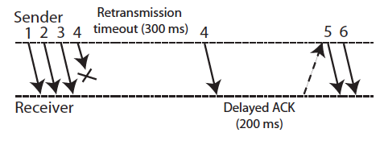
Timeout and Delayed ACK
SNAP diagnosis
  Congestion window drops to one after a timeout
  Followed by a delayed ACK
Solution:
  Congestion window drops to two

Slide 39
Nagle and Delayed ACK
SNAP diagnosis
  Delayed ACK and small writes
App
TCP/IP
Network
TCP/IP
App
W1: write() less than MSS
TCP segment with W1
W2: write() less than MSS
read() W1
200ms ACK Delay
ACK for W1
TCP segment with W2
read() W2

Slide 40
Send Buffer and Delayed ACK
SNAP diagnosis: Delayed ACK and send buffer = 0
Application buffer
Application
With Send Buffer
1. Send complete
Socket send buffer
Receiver
Network
Stack
2. ACK
Application buffer
Application
Set Send Buffer to zero
2. Send complete
Receiver
Network
Stack
1. ACK

Slide 41
SNAP Validation and Overhead

Slide 42
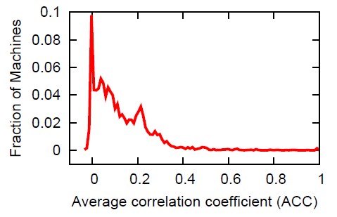
Correlation Accuracy
  Inject two real problems
  Mix labeled data with real production data
  Correlation over shared machine
  Successfully identified those labled machines
2.7% of machines
have ACC > 0.4

Slide 43
SNAP Overhead
Data volume
  Socket logs: 20 Bytes per socket
  TCP statistics: 120 Bytes per connection per poll
CPU overhead
  Log socket calls: event-driven, < 5%
  Read TCP table
  Poll TCP statistics

Slide 44
Reducing CPU Overhead
CPU overhead
  Polling TCP statistics and reading TCP table
  Increase with number of connections and polling freq.
  E.g., 35% for polling 5K connections with 50 ms interval
  5% for polling 1K connections with 500 ms interval
Adaptive tuning of polling frequency
  Reduce polling frequency to stay within a target CPU
  Devote more polling to more problematic connections

Slide 45
Conclusion
A simple, efficient way to profile data centers
  Passively measure real-time network stack information
  Systematically identify components with problems
  Correlate problems across connections
Deploying SNAP in production data center
  Characterize data center performance problems
    Help operators improve platform and tune network
  Discover app-net interactions
    Help developers to pinpoint app problems
Notes:
SNAP demonstrates that

Slide 46
Class Discussion
Does TCP fit for data centers?
  How to optimize TCP for data centers?
  What should new transport protocol be?
How to diagnose data center performance problems?
  What kind of network/application data do we need?
  How to diagnose virtualized environment?
  How to perform active measurement?
Notes:
Low delay, high throughput
Fully controlled environment
High performance requirements
Send buffer and receiver window
Packet retransmission and delayed ACK

Slide 47
Backup

Slide 48
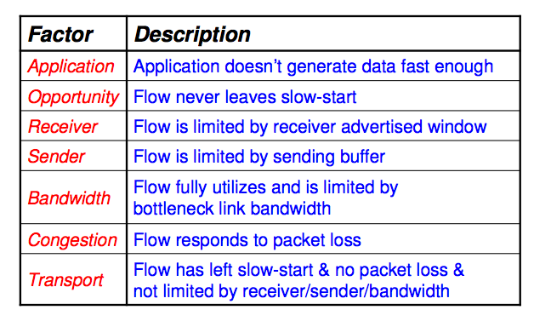
T-RAT: TCP Rate Analysis Tool
Goal
  Analyze TCP packet traces
  determine rate-limiting factors for different connections
Seven classes of rate-limiting factors

