Slide 1
Grafting Routers to Accommodate Change
Eric Keller
Princeton University
Oct12, 2010
Jennifer Rexford, Jacobus van der Merwe, Michael Schapira

Slide 2
Dealing with Change
Networks need to be highly reliable
  To avoid service disruptions
Operators need to deal with change
  Install, maintain, upgrade, or decommission equipment
  Deploy new services
  Manage resource usage (CPU, bandwidth)
But… change causes disruption
  Forcing a tradeoff

Slide 3
Why is Change so Hard?
Root cause is the monolithic view of a router
(Hardware, software, and links as one entity)

Slide 4
Why is Change so Hard?
Root cause is the monolithic view of a router
(Hardware, software, and links as one entity)
Revisit the design to make
dealing with change easier

Slide 5



Our Approach: Grafting
In nature: take from one, merge into another
  Plants, skin, tissue
Router Grafting
  To break the monolithic view
  Focus on moving link (and corresponding BGP session)

Slide 6

Why Move Links?

Slide 7
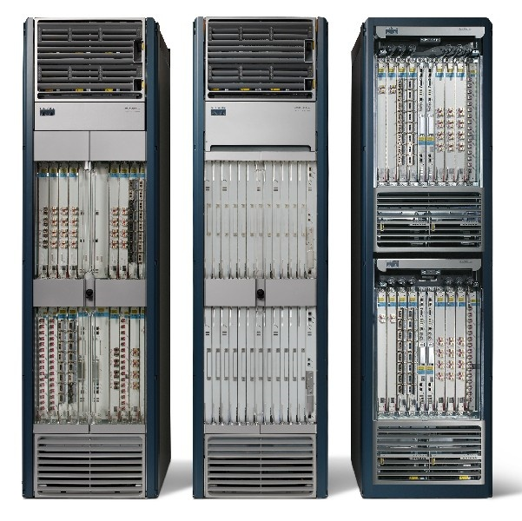
Planned Maintenance
Shut down router to…
  Replace power supply
  Upgrade to new model
  Contract network
Add router to…
  Expand network

Slide 8
Planned Maintenance
Could migrate links to other routers
  Away from router being shutdown, or
  To router being added (or brought back up)

Slide 9
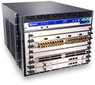

Customer Requests a Feature
Network has mixture of routers from different vendors
* Rehome customer to router with needed feature

Slide 10
Traffic Management
Typical traffic engineering:
* adjust routing protocol parameters based on traffic
Congested link

Slide 11
Traffic Management
Instead…
* Rehome customer to change traffic matrix

Slide 12
Shutting Down a Router (today)
How a route is propagated
128.0.0.0/8
(A, C, D, E)
B
A
128.0.0.0/8
(C, D, E)
128.0.0.0/8 (E)
128.0.0.0/8 (D, E)
128.0.0.0/8
(F, G, D, E)
E
C
D
F
G

Slide 13
Shutting Down a Router (today)
Neighbors detect router down
Choose new best route (if available)
Send out updates
Downtime best case – settle on new path (seconds)
Downtime worst case – wait for router to be up (minutes)
Both cases: lots of updates propagated
128.0.0.0/8
(A, F, G, D, E)
B
A
E
C
D
F
G

Slide 14
Moving a Link (today)
Reconfigure D, E
Remove Link
B
A
E
C
D
F
G

Slide 15
Moving a Link (today)
No route to E
B
A
withdraw
E
C
D
F
G

Slide 16
Moving a Link (today)
Downtime best case – settle on new path (seconds)
Downtime worst case – wait for link to be up (minutes)
Both cases: lots of updates propagated
B
A
128.0.0.0/8 (E)
E
C
D
128.0.0.0/8 (G, E)
F
G
Add Link
Configure E, G

Slide 17
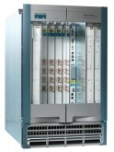
Router Grafting: Breaking up the router
Send state
Move link

Slide 18
Router Grafting: Breaking up the router
Router Grafting enables this breaking apart a router (splitting/merging).

Slide 19
Not Just State Transfer
Migrate session
AS300
AS100
AS200
AS400

Slide 20
Not Just State Transfer
Migrate session
AS300
AS100
The topology changes
(Need to re-run decision processes)
AS200
AS400

Slide 21
Goals
Routing and forwarding should not be disrupted
  Data packets are not dropped
  Routing protocol adjacencies do not go down
  All route announcements are received
Change should be transparent
  Neighboring routers/operators should not be involved
  Redesign the routers not the protocols

Slide 22
Challenge: Protocol Layers
A
B
BGP
Exchange routes
BGP
TCP
Deliver reliable stream
TCP
IP
Send packets
IP
Physical Link
Migrate
State
C
Migrate
Link

Slide 23
Physical Link
A
B
BGP
Exchange routes
BGP
TCP
Deliver reliable stream
TCP
IP
Send packets
IP
Physical Link
Migrate
State
C
Migrate
Link

Slide 24
Physical Link
Unplugging cable would be disruptive
Migrate-from
Remote
end-point
Migrate-to

Slide 25
Physical Link
Unplugging cable would be disruptive
Links are not physical wires
  Switchover in nanoseconds
mi
Migrate-from
Remote
end-point
Migrate-to

Slide 26
IP
A
B
BGP
Exchange routes
BGP
TCP
Deliver reliable stream
TCP
IP
Send packets
IP
Physical Link
Migrate
State
C
Migrate
Link

Slide 27
Changing IP Address
IP address is an identifier in BGP
Changing it would require neighbor to reconfigure
  Not transparent
  Also has impact on TCP (later)
mi
1.1.1.2
Migrate-from
Remote
end-point
1.1.1.1
Migrate-to

Slide 28
Re-assign IP Address
IP address not used for global reachability
  Can move with BGP session
  Neighbor doesn’t have to reconfigure
mi
Migrate-from
Remote
end-point
1.1.1.1
1.1.1.2
Migrate-to

Slide 29
TCP
A
B
BGP
Exchange routes
BGP
TCP
Deliver reliable stream
TCP
IP
Send packets
IP
Physical Link
Migrate
State
C
Migrate
Link

Slide 30
Dealing with TCP
TCP sessions are long running in BGP
  Killing it implicitly signals the router is down
BGP and TCP extensions as a workaround
(not supported on all routers)

Slide 31
Migrating TCP Transparently
Capitalize on IP address not changing
  To keep it completely transparent
Transfer the TCP session state
  Sequence numbers
  Packet input/output queue (packets not read/ack’d)
app
recv()
send()
TCP(data, seq, …)
ack
OS
TCP(data’, seq’)

Slide 32
BGP
A
B
BGP
Exchange routes
BGP
TCP
Deliver reliable stream
TCP
IP
Send packets
IP
Physical Link
Migrate
State
C
Migrate
Link

Slide 33
BGP: What (not) to Migrate
Requirements
  Want data packets to be delivered
  Want routing adjacencies to remain up
Need
  Configuration
  Routing information
Do not need (but can have)
  State machine
  Statistics
  Timers
Keeps code modifications to a minimum

Slide 34
Routing Information
Could involve remote end-point
  Similar exchange as with a new BGP session
  Migrate-to router sends entire state to remote end-point
  Ask remote-end point to re-send all routes it advertised
Disruptive
  Makes remote end-point do significant work
mi
Migrate-from
Remote
end-point
Exchange Routes
Migrate-to

Slide 35
Routing Information (optimization)
Migrate-from router send the migrate-to router:
The routes it learned
  Instead of making remote end-point re-announce
The routes it advertised
  So able to send just an incremental update
mi
Migrate-from
Remote
end-point
Send routes
advertised/learned
Incremental
Update
Migrate-to

Slide 36
Migration in The Background
Migration takes a while
  A lot of routing state to transfer
  A lot of processing is needed
Routing changes can happen at any time
Disruptive if not done in the background
Migrate-from
Remote
End-point
Migrate-to

Slide 37
While exporting routing state
BGP is incremental, append update
In-memory:
p1, p2, p3, p4
Dump:
p1, p2
Migrate-from
Remote
End-point
Migrate-to

Slide 38
While moving TCP session and link
TCP will retransmit
Migrate-from
Remote
End-point
Migrate-to

Slide 39
While importing routing state
BGP is incremental, ignore dump file
In-memory:
p1, p2
Dump:
p1, p2, p3, p4
Migrate-from
Remote
End-point
Migrate-to

Slide 40
Special Case: Cluster Router
Don’t need to re-run decision processes
Links ‘migrated’ internally
Blade
Blade
A
B
C
D
Line card
Switching
Fabric
Line card
Line card
Line card
A
C
B
D

Slide 41
Prototype
Added grafting into Quagga
  Import/export routes, new ‘inactive’ state
  Routing data and decision process well separated
Graft daemon to control process
SockMi for TCP migration
Graftable Router
Emulated
link migration
Unmod.
Router
Modified
Quagga
graft
daemon
Handler
Comm
Quagga
SockMi.ko
click.ko
Linux kernel 2.6.19.7
Linux kernel 2.6.19.7-click
Linux kernel 2.6.19.7

Slide 42
Evaluation
Impact on migrating routers
Disruption to network operation
Overhead on rest of the network

Slide 43
Evaluation
Impact on migrating routers
Disruption to network operation
Overhead on rest of the network

Slide 44
Impact on Migrating Routers
How long migration takes
  Includes export, transmit, import, lookup, decision
  CPU Utilization roughly 25%
Between Routers
0.9s (20k)
6.9s (200k)
Between Blades
0.3s (20k)
3.1s (200k)

Slide 45
Disruption to Network Operation
Data traffic affected by not having a link
  nanoseconds
Routing protocols affected by unresponsiveness
  Set old router to “inactive”, migrate link, migrate TCP, set new router to “active”
  milliseconds

Slide 46
Conclusion
Enables moving a single link/session with…
  Minimal code change
  No impact on data traffic
  No visible impact on routing protocol adjacencies
  Minimal overhead on rest of network
Future work
  Explore applications
  Generalize grafting
  (multiple sessions, different protocols, other resources)

Slide 47
Traffic Engineering with Router Grafting
(or migration in general)

Slide 48
Recall: Traffic Management
Typical traffic engineering:
* adjust routing protocol parameters based on traffic
Congested link

Slide 49
Recall: Traffic Management
Instead…
* Rehome customer to change traffic matrix

Slide 50
Recall: Traffic Management
Instead…
* Rehome customer to change traffic matrix
Is it that simple?
What to graft, and where to graft it?

Slide 51
Traffic Engineering Today
Traffic (Demand) Matrix
  A->B, A->C, A->D, A->E, B->A, B->C…
B
C
A
D
E

Slide 52
Multi-commodity Flow
Traffic between routers (e.g., A and B) are Flows
  MCF assigns flows to paths
Capacity constraint
  Links are limited by their bandwidth
Flow conservation
  Traffic that enters a router, must exit the router
Demand Satisfaction
  Traffic reaches destination
Minimize network utilization
  There are different variants

Slide 53
Traffic Engineering Today
Traffic (Demand) Matrix
  A->B, A->C, A->D, A->E, B->A, B->C…
B
C
A
D
E
Notes:
Constraints
What if customer connected to B moves to A… MCF results don’t hold

Slide 54
Traffic Engineering w/ Grafting
Traffic (Demand) Matrix:
  Customer to Customer
  Set of potential links
C
D
E
B
A
F
G
H
Notes:
MCF still not sufficient, we developed algorithms based on it.

Slide 55
Heuristic 1: Virtual Node Heuristic
  Include potential links in graph
  Run MCF
  Choose a link (most utilized)
C
D
E
B
A
F
H
G

Slide 56
Heuristic 2: Cluster Heuristic
  Group customers
  Run MCF
  Assign customers to routers
  Mimics fractional result of MCF
Cluster_(C,D)
E
B
A
F
H
G

Slide 57
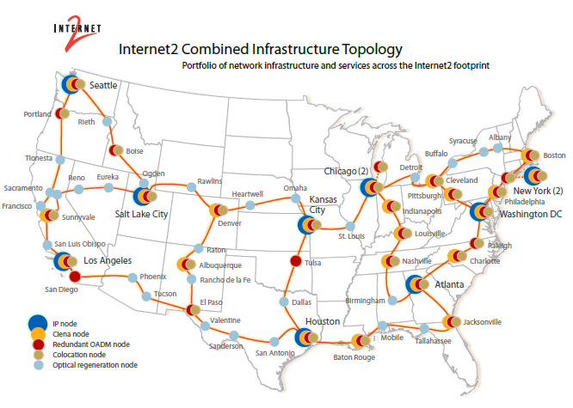
Evaluation
Setup
  Internet2 topology
  Traffic data (via netflow)

Slide 58
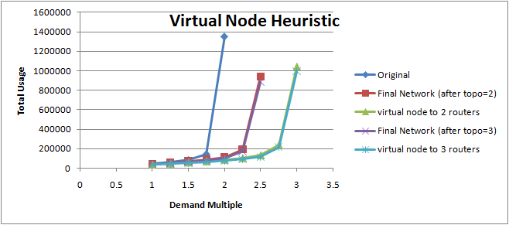
Virtual Node Heuristic

Slide 59
Misc. Discussion
Omitted
  Theoretical Framework
  Evaluation from Cluster Heuristic
    Takes some explanation
Migration in Datacenters

Slide 60
Class discussion
VROOM
ShadowNet

Slide 62
Backup

Slide 63

VROOM: Virtual Routers on the Move
[SIGCOMM 2008]

Slide 64
The Two Notions of “Router”
The IP-layer logical functionality, and the physical equipment
Logical
(IP layer)
Physical

Slide 65
The Tight Coupling of Physical & Logical
Root of many network-management challenges
(and “point solutions”)
Logical
(IP layer)
Physical

Slide 66
VROOM: Breaking the Coupling
Re-mapping the logical node to another physical node
VROOM enables this re-mapping of logical to physical through virtual router migration.
Logical
(IP layer)
Physical

Slide 67
Enabling Technology: Virtualization
Routers becoming virtual
data plane
control plane
Switching
Fabric

Slide 68
Case 1: Planned Maintenance
NO reconfiguration of VRs, NO reconvergence
VR-1
A
B

Slide 69
Case 1: Planned Maintenance
NO reconfiguration of VRs, NO reconvergence
A
VR-1
B

Slide 70
Case 1: Planned Maintenance
NO reconfiguration of VRs, NO reconvergence
A
VR-1
B

Slide 71
Case 2: Power Savings
$ Hundreds of millions/year of electricity bills

Slide 72
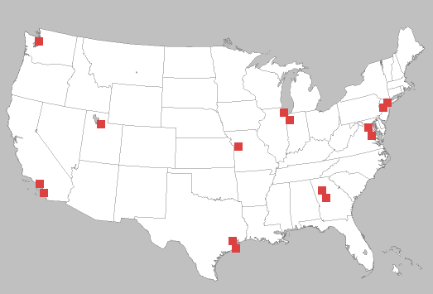


Case 2: Power Savings
Contract and expand the physical network according to the traffic volume

Slide 73
Case 2: Power Savings
Contract and expand the physical network according to the traffic volume

Slide 74
Case 2: Power Savings
Contract and expand the physical network according to the traffic volume

Slide 75
Virtual Router Migration: the Challenges
Migrate an entire virtual router instance
  All control plane & data plane processes / states
data plane
control plane
Switching
Fabric

Slide 76
Virtual Router Migration: the Challenges
Migrate an entire virtual router instance
Minimize disruption
  Data plane: millions of packets/second on a 10Gbps link
  Control plane: less strict (with routing message retransmission)

Slide 77
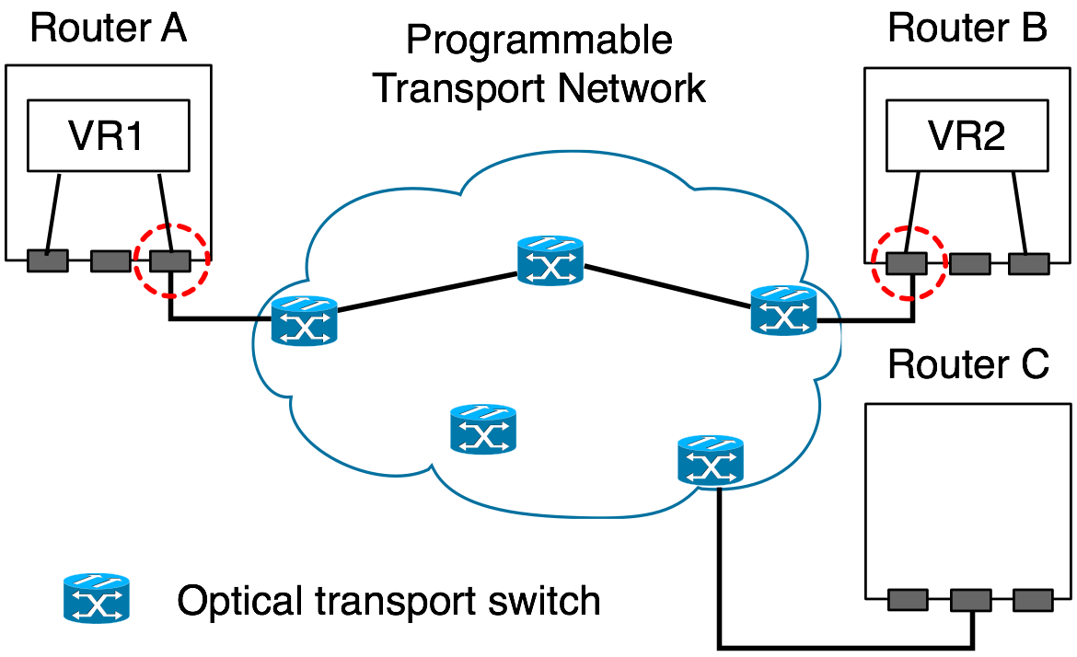
Virtual Router Migration: the Challenges
Migrate an entire virtual router instance
Minimize disruption
Link migration

Slide 78
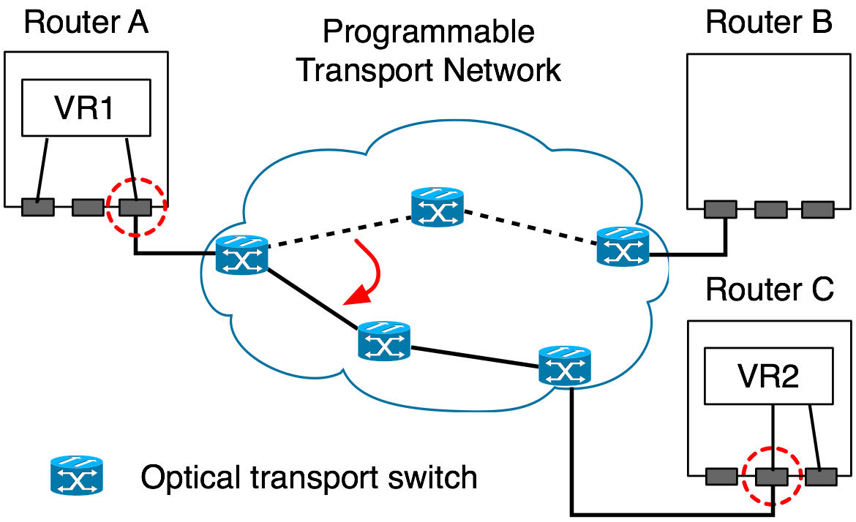
Virtual Router Migration: the Challenges
Migrate an entire virtual router instance
Minimize disruption
Link migration

Slide 79
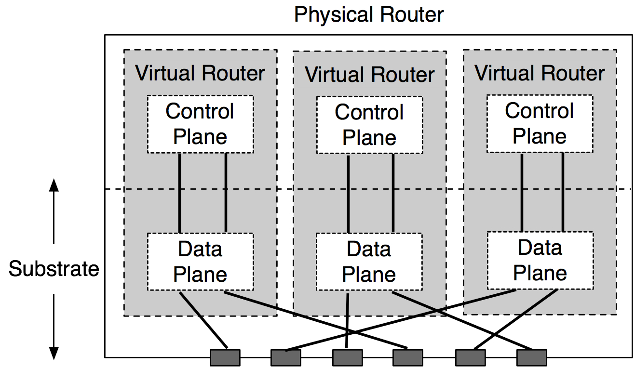
VROOM Architecture
Data-Plane Hypervisor
Dynamic Interface Binding

Slide 80
VROOM’s Migration Process
Key idea: separate the migration of control and data planes
Migrate the control plane
Clone the data plane
Migrate the links

Slide 81
Control-Plane Migration
Leverage virtual server migration techniques
Router image
  Binaries, configuration files, running processes, etc.

Slide 82
Control-Plane Migration
Leverage virtual server migration techniques
Router image
  Binaries, configuration files, running processes, etc.
CP
Physical router A
DP
Physical router B

Slide 83
Data-Plane Cloning
Clone the data plane by repopulation
  Enables traffic to be forwarded during migration
  Enables migration across different data planes
Physical router A
DP-old
CP
Physical router B
DP-new
DP-new

Slide 84
Remote Control Plane
Data-plane cloning takes time
  Installing 250k routes takes over 20 seconds*
The control & old data planes need to be kept “online”
Solution: redirect routing messages through tunnels
Physical router A
DP-old
CP
Physical router B
DP-new
*: P. Francios, et. al., Achieving sub-second IGP convergence in large IP networks,
ACM SIGCOMM CCR, no. 3, 2005.

Slide 85
Remote Control Plane
Data-plane cloning takes time
  Installing 250k routes takes over 20 seconds*
The control & old data planes need to be kept “online”
Solution: redirect routing messages through tunnels
Physical router A
DP-old
CP
Physical router B
DP-new
*: P. Francios, et. al., Achieving sub-second IGP convergence in large IP networks,
ACM SIGCOMM CCR, no. 3, 2005.

Slide 86
Double Data Planes
At the end of data-plane cloning, both data planes are ready to forward traffic
DP-old
CP
DP-new

Slide 87
Asynchronous Link Migration
With the double data planes, links can be migrated independently
A
DP-old
B
CP
DP-new

Slide 88
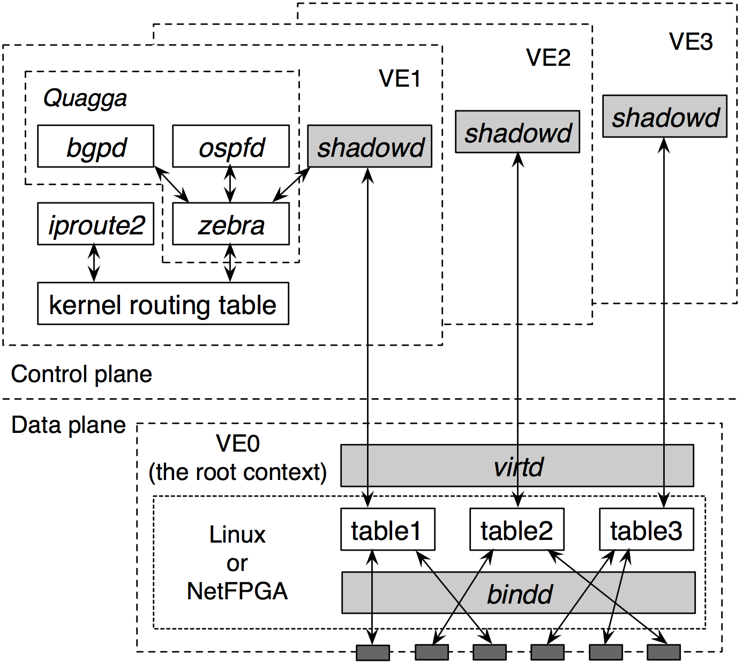
Prototype: Quagga + OpenVZ
Old router
New router
88
Notes:
88

Slide 89
Evaluation
Performance of individual migration steps
Impact on data traffic
Impact on routing protocols
Experiments on Emulab

Slide 90
Evaluation
Performance of individual migration steps
Impact on data traffic
Impact on routing protocols
Experiments on Emulab

Slide 91
Impact on Data Traffic
The diamond testbed
n1
VR
n0
n3
n2
No delay increase or packet loss

Slide 92
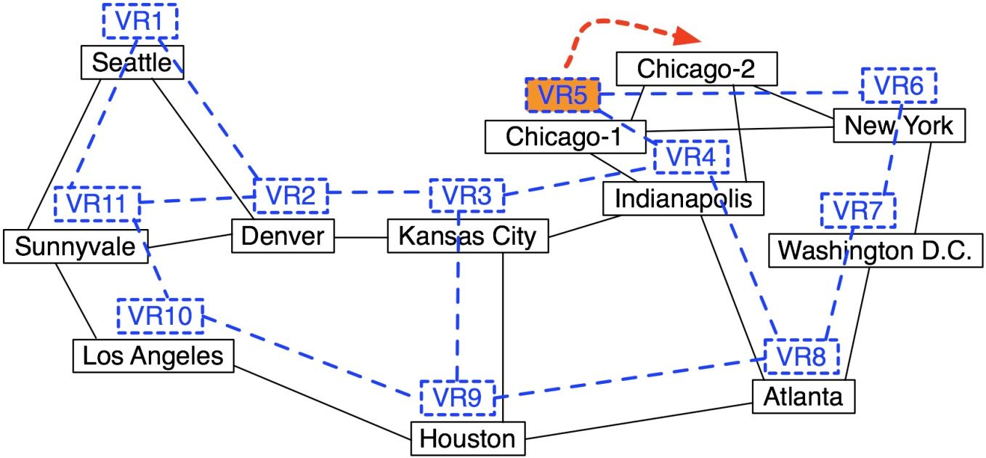
Impact on Routing Protocols
The Abilene-topology testbed

Slide 93
Edge Router Migration: OSPF + BGP
Average control-plane downtime: 3.56 seconds
OSPF and BGP adjacencies stay up
At most 1 missed advertisement retransmitted
Default timer values
  OSPF hello interval: 10 seconds
  OSPF RouterDeadInterval: 4x hello interval
  OSPF retransmission interval: 5 seconds
  BGP keep-alive interval: 60 seconds
  BGP hold time interval: 3x keep-alive interval

Slide 94
VROOM Summary
Simple abstraction
No modifications to router software
(other than virtualization)
No impact on data traffic
No visible impact on routing protocols

Slide 95
Migrating and Grafting Together
Router Grafting can do everything VROOM can
  By migrating each link individually
But VROOM is more efficient when…
  Want to move all sessions
  Moving between compatible routers
  (same virtualization technology)
  Want to preserve “router” semantics
VROOM requires no code changes
  Can run a grafting router inside of virtual machine
  (e.g., VROOM + Grafting)
  Each useful for different tasks

