Slide 1
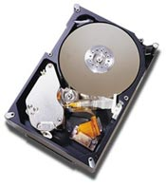
COS 318: Operating Systems
Storage Devices

Slide 2
Today’s Topics
Magnetic disks
Magnetic disk performance
Disk arrays (RAID)
Flash memory

Slide 3
A Typical Magnetic Disk Controller
External connection
  IDE/ATA, SATA
  SCSI, SCSI-2, Ultra SCSI, Ultra-160 SCSI, Ultra-320 SCSI
  Fibre channel
Cache
  Buffer data between disk and interface
Controller
  Read/write operation
  Cache replacement
  Failure detection and recovery
External connection
Interface
DRAM
cache
Controller
Disk

Slide 4
Disk Caching
Method
  Use DRAM to cache recently accessed blocks
    Most disk has 16MB
    Some of the RAM space stores “firmware” (an embedded OS)
  Blocks are replaced usually in an LRU order
Pros of disk caching
  Good for reads if accesses have locality
Cons
  Cost
  Need to deal with reliable writes

Slide 5
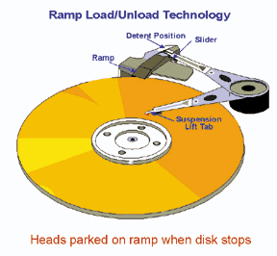
Disk Arm and Head
Disk arm
  A disk arm carries disk heads
Disk head
  Mounted on an actuator
  Read and write on disk surface
Read/write operation
  Disk controller receives a command with <track#, sector#>
  Seek the right cylinder (tracks)
  Wait until the right sector comes
  Perform read/write

Slide 6
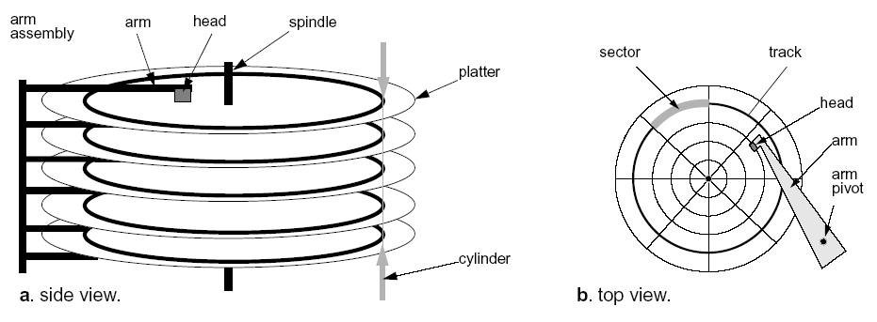
Mechanical Component of A Disk Drive
Tracks
  Concentric rings around disk surface, bits laid out serially along each track
Cylinder
  A track of the platter, 1000-5000 cylinders per zone, 1 spare per zone
Sectors
  Each track is split into arc of track (min unit of transfer)

Slide 7
Disk Sectors
Where do they come from?
  Formatting process
  Logical maps to physical
What is a sector?
  Header (ID, defect flag, …)
  Real space (e.g. 512 bytes)
  Trailer (ECC code)
What about errors?
  Detect errors in a sector
  Correct them with ECC
  If not recoverable, replace it with a spare
  Skip bad sectors in the future
Hdr
512 bytes
ECC
…
Sector
i
defect
i+1
defect
i+2

Slide 8
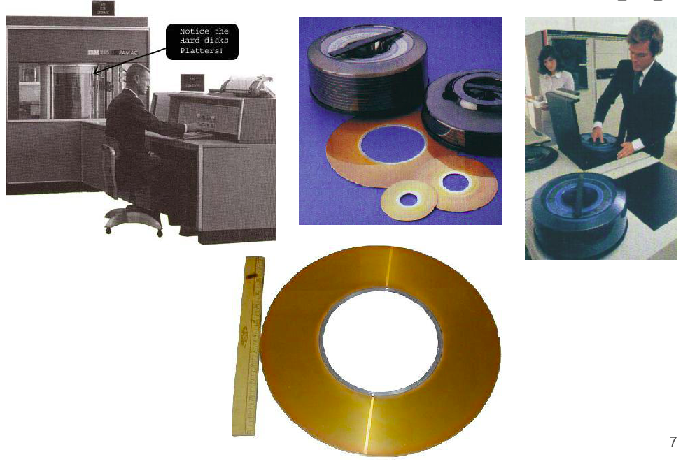
Disks Were Large
First Disk:
IBM 305 RAMAC (1956)
5MB capacity
50 disks, each 24”

Slide 9
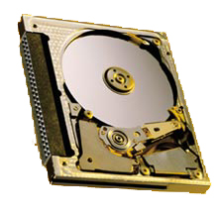
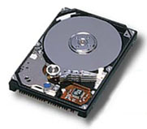

They Are Now Much Smaller
Form factor:
.5-1”× 4”× 5.7”
Storage:
120-750GB
Form factor:
.4-.7” × 2.7” × 3.9”
Storage:
60-200GB
Form factor:
.2-.4” × 2.1” × 3.4”
Storage:
1GB-8GB

Slide 10
Areal Density vs. Moore’s Law
(Mark Kryder at SNW 2006)

Slide 11
50 Years Later (Mark Kryder at SNW 2006)
 | IBM RAMAC (1956) | Seagate Momentus (2006) | Difference
Capacity | 5MB | 160GB | 32,000
Areal Density | 2K bits/in² | 130 Gbits/in² | 65,000,000
Disks | 50 @ 24” diameter | 2 @ 2.5” diameter | 1 / 2,300
Price/MB | $1,000 | $0.01 | 1 / 3,200,000
Spindle Speed | 1,200 RPM | 5,400 RPM | 5
Seek Time | 600 ms | 10 ms | 1 / 60
Data Rate | 10 KB/s | 44 MB/s | 4,400
Power | 5000 W | 2 W | 1 / 2,500
Weight | ~ 1 ton | 4 oz | 1 / 9,000

Slide 12
Sample Disk Specs (from Seagate)
 | Cheetah 15k.5 | Barracuda ES.2
Capacity
Formatted capacity (GB) | 300 | 1000
Discs | 4 | 4
Heads | 8 | 8
Sector size (bytes) | 512 | 512
Performance
External interface | Ultra320 SCSI, FC, S. SCSI | SATA
Spindle speed (RPM) | 15,000 | 7,200
Average latency (msec) | 2.0 | 4.16
Seek time, read/write (ms) | 3.5/4.0 | 8.5/9.5
Track-to-track read/write (ms) | 0.2-0.4 | 0.8/1.0
External transfer (MB/sec) | 300-400 | 350
Internal transfer rate (MB/sec) | 89-150 | 105 (sustained)
Cache size (MB) | 16 | 32
Reliability
Recoverable read errors | 1 per 10¹² bits read | 1 per 10¹⁰ bits read
Non-recoverable read errors | 1 per 10¹⁶ bits read | 1 per 10¹⁵ bits read

Slide 13
Disk Performance
Seek
  Position heads over cylinder, typically 3.5-9.5 ms
Rotational delay
  Wait for a sector to rotate underneath the heads
  Typically 8 − 4 ms (7,200 – 15,000RPM)
  or ½ rotation takes 4 - 2ms
Transfer bytes
  Transfer bandwidth is typically 40-125 Mbytes/sec
Performance of transfer 1 Kbytes
  Seek (4 ms) + half rotational delay (2ms) + transfer (0.013 ms)
  Total time is 6.01 ms or 167 Kbytes/sec (1/360 of 60MB/sec)!
Notes:
8.3*25*10=1660KB

Slide 14
More on Performance
What transfer size can get 90% of the disk bandwidth?
  Assume Disk BW = 60MB/sec, ½ rotation = 2ms, ½ seek = 4ms
  BW * 90% = size / (size/BW + rotation + seek)
  size = BW * (rotation + seek) * 0.9 / 0.1
  = 60MB * 0.006 * 0.9 / 0.1 = 3.24MB
Seek and rotational times dominate the cost of small accesses
  Disk transfer bandwidth are wasted
  Need algorithms to reduce seek time
Speed depends on which sectors to access
Block Size (Kbytes) | % of Disk Transfer Bandwidth
1Kbytes | 0.28%
1Mbytes | 73.99%
3.24Mbytes | 90%

Slide 15
FIFO (FCFS) order
Method
  First come first serve
Pros
  Fairness among requests
  In the order applications expect
Cons
  Arrival may be on random spots on the disk (long seeks)
  Wild swings can happen
0
53
199
98, 183, 37, 122, 14, 124, 65, 67

Slide 16
SSTF (Shortest Seek Time First)
Method
  Pick the one closest on disk
  Rotational delay is in calculation
Pros
  Try to minimize seek time
Cons
  Starvation
Question
  Can we avoid the starvation?
0
53
199
98, 183, 37, 122, 14, 124, 65, 67
(65, 67, 37, 14, 98, 122, 124, 183)

Slide 17
Elevator (SCAN)
Method
  Take the closest request in the direction of travel
  Real implementations do not go to the end (called LOOK)
Pros
  Bounded time for each request
Cons
  Request at the other end will take a while
0
53
199
98, 183, 37, 122, 14, 124, 65, 67
(37, 14, 65, 67, 98, 122, 124, 183)

Slide 18
C-SCAN (Circular SCAN)
Method
  Like SCAN
  But, wrap around
  Real implementation doesn’t go to the end (C-LOOK)
Pros
  Uniform service time
Cons
  Do nothing on the return
0
53
199
98, 183, 37, 122, 14, 124, 65, 67
(65, 67, 98, 122, 124, 183, 14, 37)

Slide 19
Discussions
Which is your favorite?
  FIFO
  SSTF
  SCAN
  C-SCAN
Disk I/O request buffering
  Where would you buffer requests?
  How long would you buffer requests?

Slide 20
RAID (Redundant Array of Independent Disks)
Main idea
  Store the error correcting codes on other disks
  General error correcting codes are too powerful
  Use XORs or single parity
  Upon any failure, one can recover the entire block from the spare disk (or any disk) using XORs
Pros
  Reliability
  High bandwidth
Cons
  The controller is complex
RAID controller
D1
D2
D3
D4
P
⊕
P = D1 ⊕ D2 ⊕ D3 ⊕ D4
D3 = D1 ⊕ D2 ⊕ P ⊕ D4

Slide 21
Synopsis of RAID Levels
RAID Level 0: Non redundant
RAID Level 1:
Mirroring
RAID Level 2:
Byte-interleaved, ECC
RAID Level 3:
Byte-interleaved, parity
RAID Level 4:
Block-interleaved, parity
RAID Level 5:
Block-interleaved, distributed parity

Slide 22
RAID Level 6 and Beyond
Goals
  Less computation and fewer updates per random writes
  Small amount of extra disk space
Extended Hamming code
  Remember Hamming code?
Specialized Eraser Codes
  IBM Even-Odd, NetApp RAID-DP, …
Beyond RAID-6
  Reed-Solomon codes, using MOD 4 equations
  Can be generalized to deal with k (>2) disk failures
0
1
2
3
A
4
5
6
7
B
8
9
10
11
C
12
13
14
15
D
E
F
G
H

Slide 23
Dealing with Disk Failures
What failures
  Power failures
  Disk failures
  Human failures
What mechanisms required
  NVRAM for power failures
  Hot swappable capability
  Monitoring hardware
RAID reconstruction

Slide 24
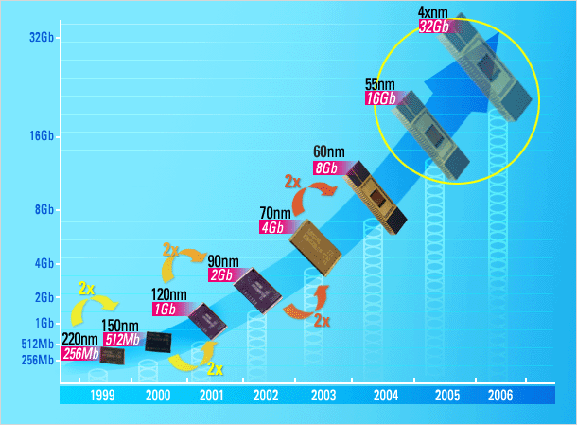

Next Generation: FLASH
1995 16 Mb NAND flash chips
2005 16 Gb NAND flash
Doubled each year since 1995
Market driven by Phones, Cameras, iPod,…
Low entry-cost,
~$30/chip → ~$3/chip
2012 1 Tb NAND flash
== 128 GB chip
== 1TB or 2TB “disk”
for ~$400
or 128GB disk for $40
or 32GB disk for $5
Samsung prediction

Slide 25
Some Current FLASH Parameters
5,000 IOs / second
Chip read ~ 20 MB/s
write ~ 10 MB/s
N chips have N x bandwidth
Latency ~ 25 μs to start read,
~ 100 μs to read a “2K page”
~ 2,000 μs to erase
~ 200 μs to write a “2K page”
Power ~ 1W for 8 chips and controller

Slide 26
What’s Wrong With FLASH?
Expensive: $/GB
  2x less than cheap DRAM
  50x more than disk today, may drop to 10x in 2012
Limited lifetime
  ~100k to 1M writes / page
  requires “wear leveling”
  but, if you have 1B pages,
  then 15,000 years to “use” ½ the pages.
Current performance limitations
  Slow to write
  can only write 0’s, so erase (set all 1) then write
  Large (e.g. 128K) segments to erase
  need to manage data layout

Slide 27
Where Is Flash Going
Consumer products
  Camera, cell phone, USB stick, …
High reliability
  Airplane, high vibration environment, dusty, …
High performance
  Emerging products to replace high-end storage system with huge cache and 15,000RPM FC drives
New flash technologies
  No erase cycle

Slide 28
Summary
Disk is complex
Disk real density is on Moore’s law curve
Need large disk blocks to achieve good throughput
OS needs to perform disk scheduling
RAID improves reliability and high throughput at a cost
Careful designs to deal with disk failures
Flash memory has emerged at both low end and high end and may simplify systems software

